Slide 1
TestNG
Simplilearn
Date -07/04/2023

Slide 2
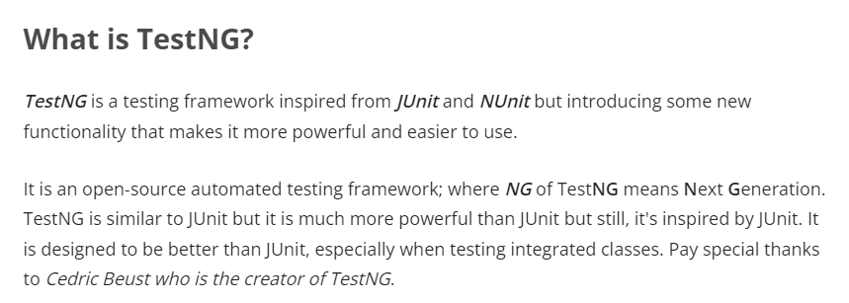
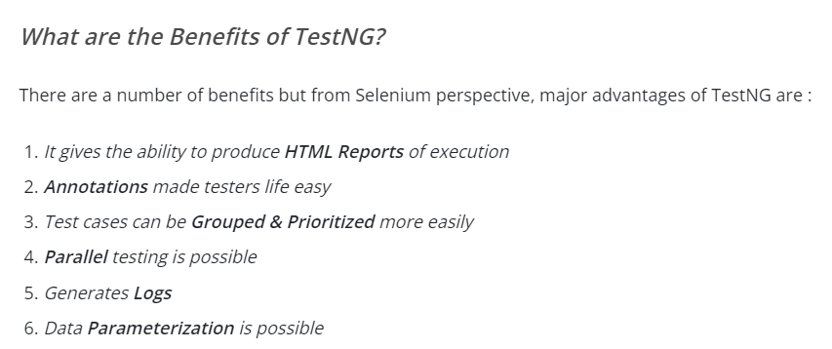
TestNg:Defination and Overview

Slide 3
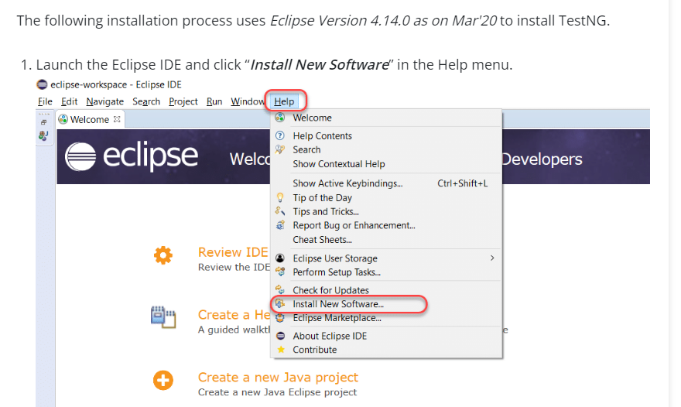
Installation of TestNg

Slide 4
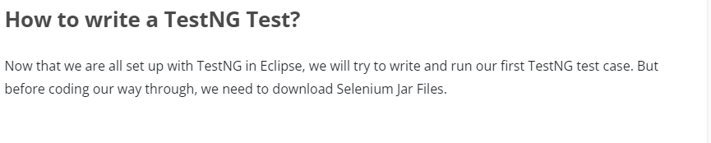
Writing TestNg Test

Slide 5
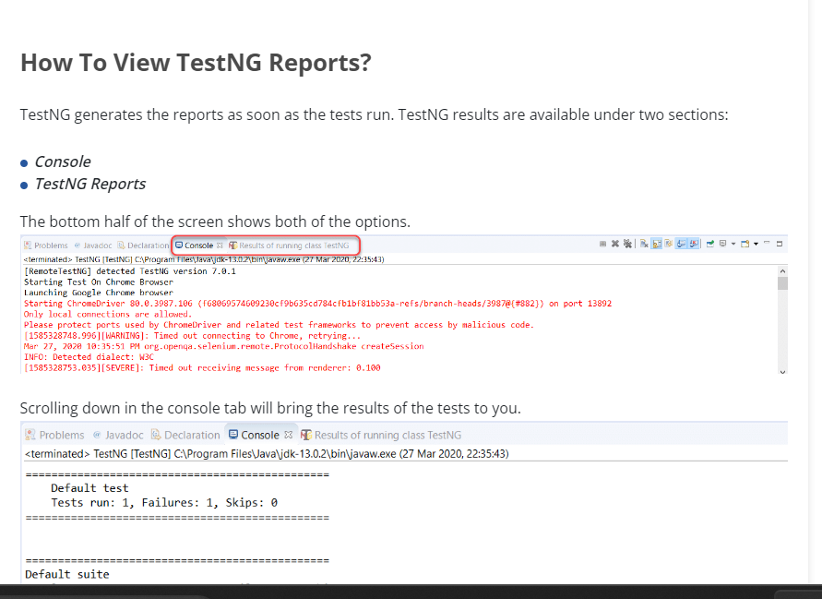
TestNg Reports

Slide 6
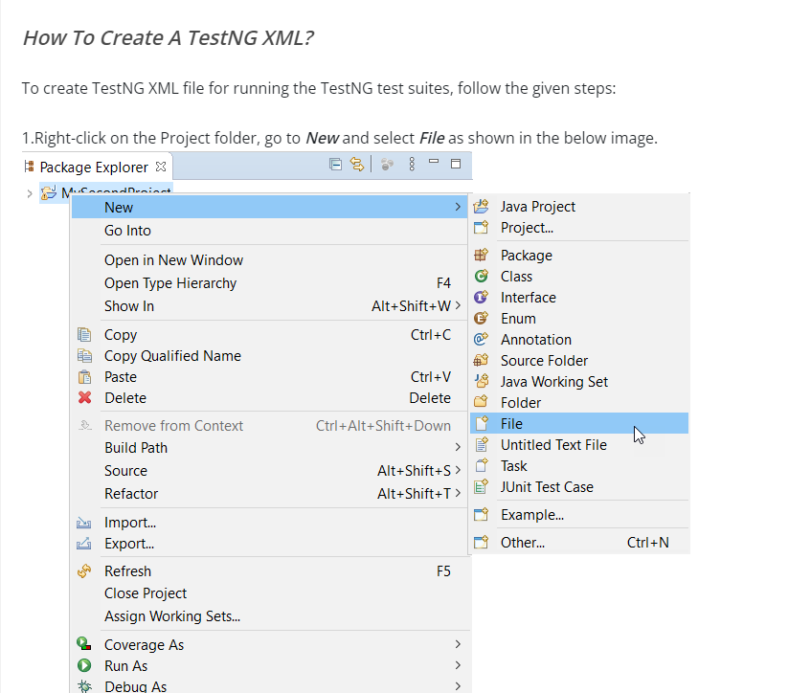
TestNg XML file Creation

Slide 7
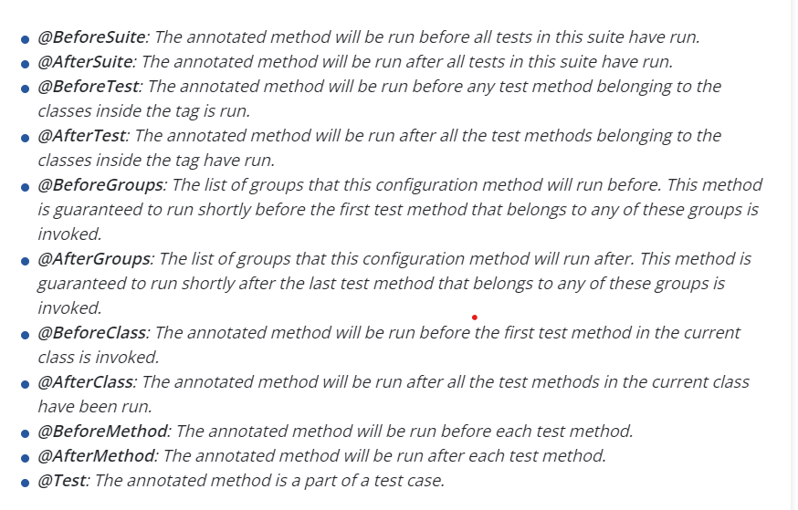
TestNg Annotations

Slide 8
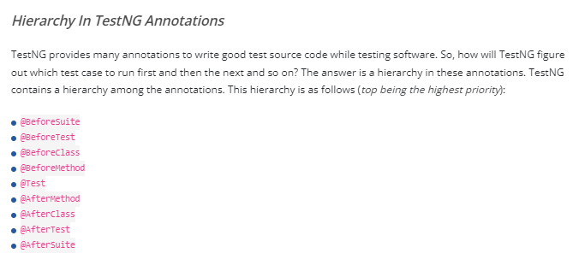
Hierarchy in TestNg Annotations

Slide 9
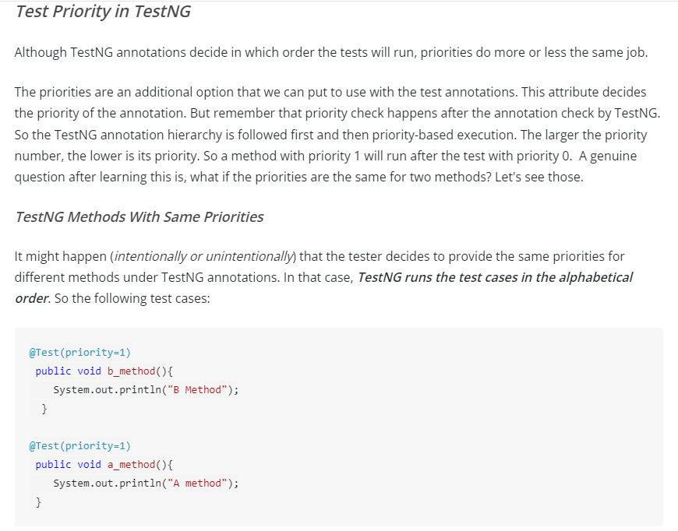
TestNG Priority

Slide 10
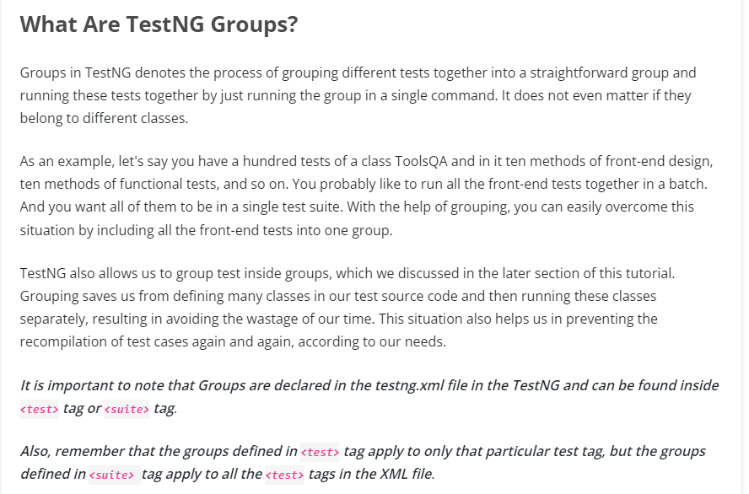
TestNG Groups

Slide 11
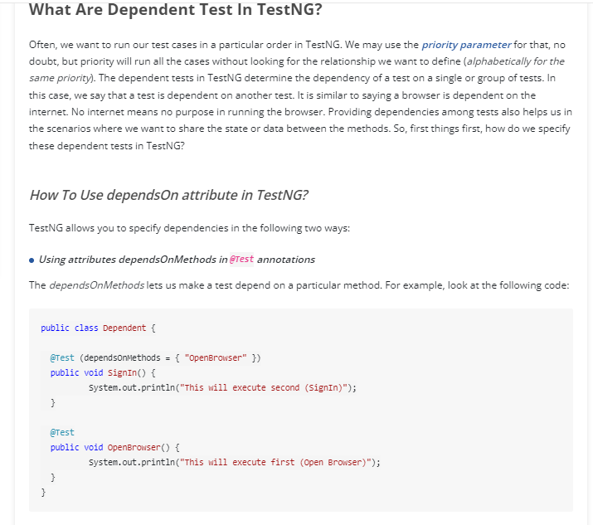
Dependent Test in TestNG

Slide 12
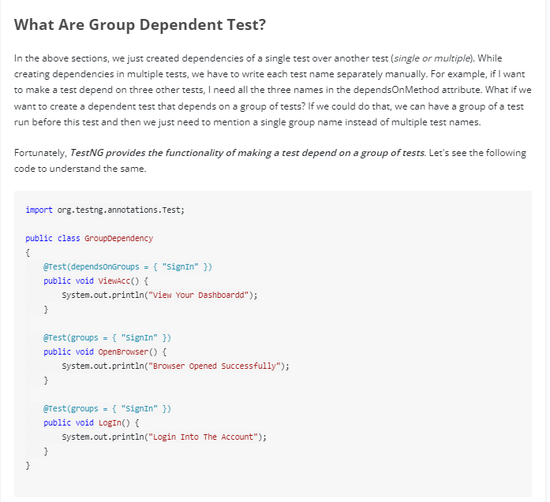
Group Dependent Test

Slide 13
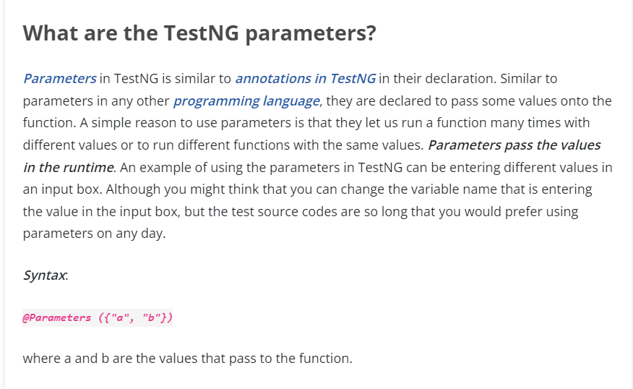
TestNG Parameters

Slide 14
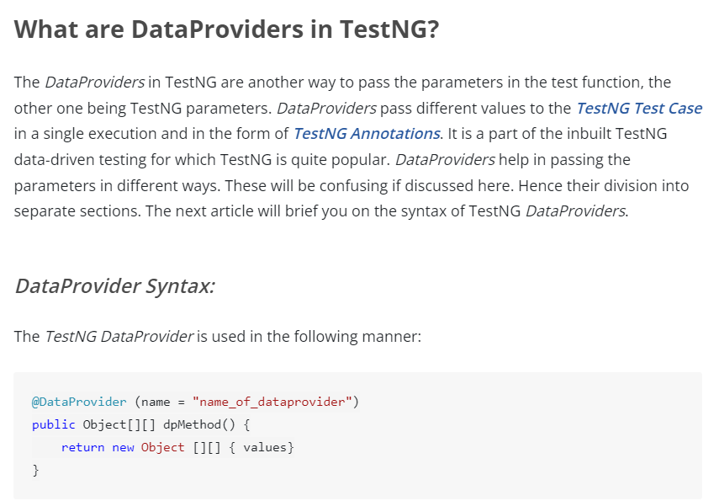
TestNG Data Providers

Slide 15
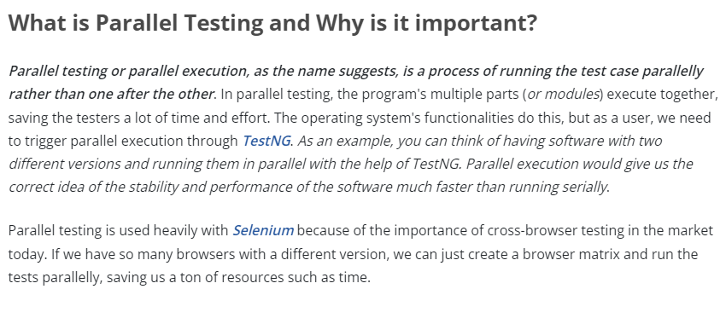
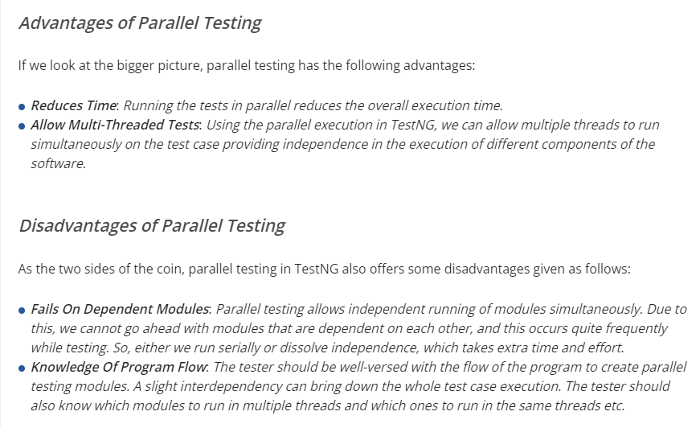
Parallel Testing in TestNG

Slide 16
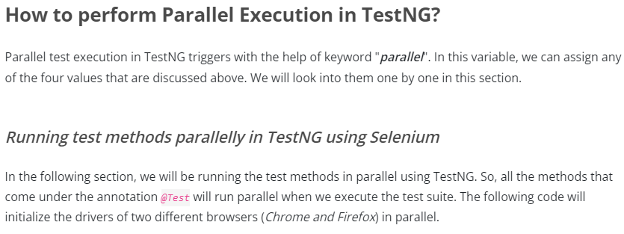
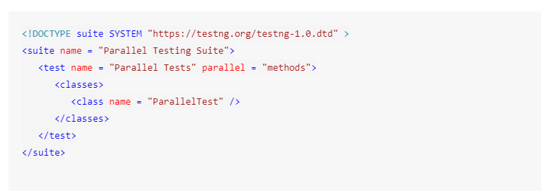
Parallel Testing in TestNg

Slide 17
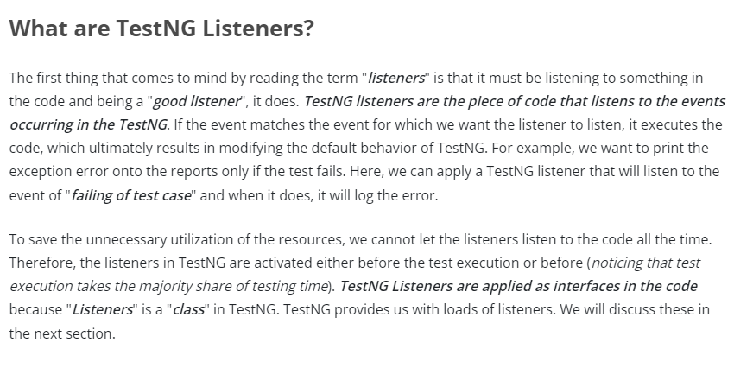
TestNG Listeners

Slide 18
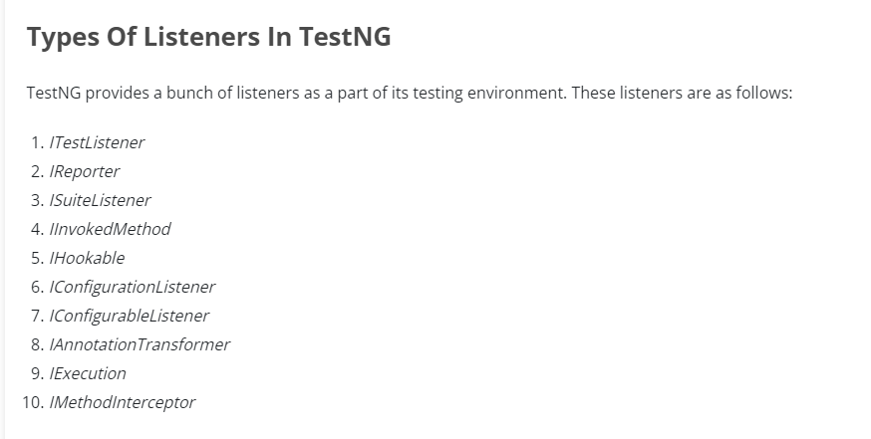
Types of Listener in TestNG

