Slide 1
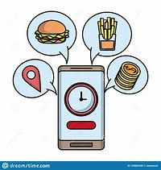

Voice controlled Food Ordering System
“A new advancement in the area of voice controlled systems.”

Slide 2
Introduction
As We all know nowadays all the things are working through online mode, people like to order things of their use through online mode, So we selected this topic to make a mini project. By creating this we are also using and improving our knowledge to do some real-world application. As we know to achieve something big we always start from small that’s why we selected this topic for mini project to improve our knowledge and use in any real-world application in future.

Slide 3
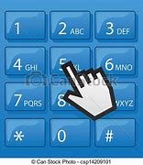
Ancestor
A Dial on System:
You may have seen or probably used an on-call system while contacting with several Companies and MNCs. It is a computerized system which helps us to get what we need by typing on keypad certain number of option which corresponds to the help we may seek.
It has been of a great help to a number of people who now don’t have wait for there calls to get redirected to the respected departments and have also helped companies to manage and satisfy their customers appropriately.
Our program is just another step forward in this system.

Slide 4
Abstract
This project was built keeping in mind about latest advancements in technology i.e voice controlled programs and it would also help blind people, who cannot order something to eat through online mode, so this project will provide them a system which will respond to voice instruction and provide them an easy way to order something to eat.

Slide 5
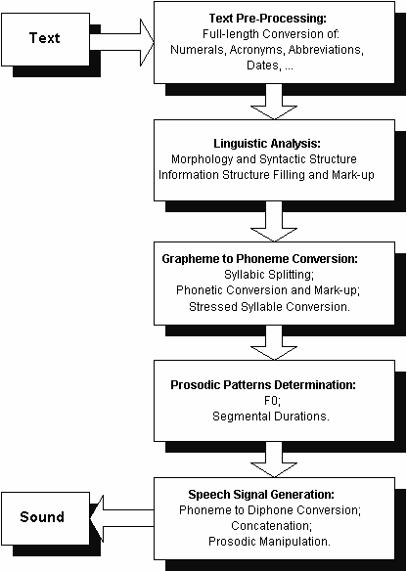
Modules Used
Google_Text_to_Speech (gTTS):
(We needed a feature that could speak/vocalize the menu as intended.
gTTS is a very easy to use tool which converts the text entered, into audio which can be saved as a mp3 file.)

Slide 6
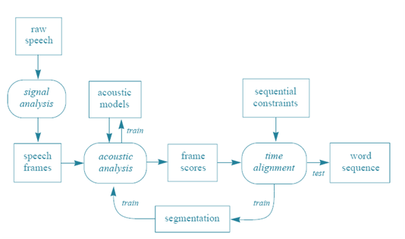
Speech_Recognition
(Now we needed a feature that could take voice as input and return it as text for further processing.
Speech_Recognition package/service provided by Google that does the exact same thing. This goes hand in hand with gTTS module.)

Slide 7

Working:
It is a choice based system which reads the instructions and menu options and then takes voice input. After an order is placed it stores order details in a file on your system for future reference.

Slide 8
Requirements:
RAM /memory required: 512 mb.
Hard disk capacity: 200mb.
Operating System: Windows XP or above version.
Processor: 32 bit or more.
Microphone and Speakers.
Good Internet connection.

Slide 9
Future Scope
This type of system can be developed for any type of websites for example you want to invade this type of system on any college website, then it will be helpful for students to look for any information from the website through this invaded system just by giving voice instructions.

Slide 10
Limitations
• Good internet connection is required.
• Surrounding sound may effect the input process.

Slide 11
Made By:
Thank you All……
Shubham Bhardwaj(1902900100159)
Tushar Chauhan(1902900100172)
Skand Sisodia(1902900100165)

