Slide 1


ALLWEB Human Resource Management
Released version 1.02
ALLWEB Company
Notes:
ALLWEB Human Resource Management

Slide 2
ALLWEB Human Resource Management
The new functionalities in this version are :
    Internationalization
    Facility Department Management
    New user level
ALLWEB Company
Notes:
ALLWEB Human Resource Management

Slide 3
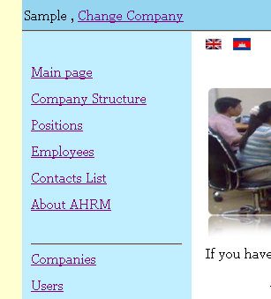
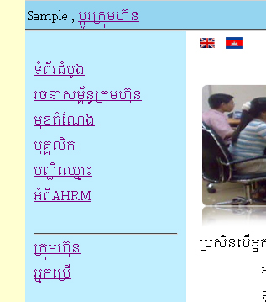
ALLWEB Human Resource Management
    1. Internationalization:
    In this new version our application is really more easy for every user because we add more functionalities on language that make our application support multi languages.
ALLWEB Company
Notes:
ALLWEB Human Resource Management

Slide 4
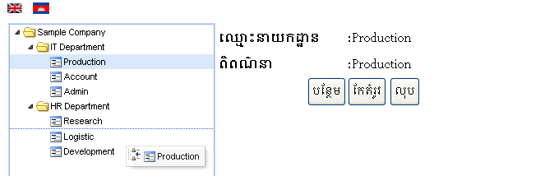
ALLWEB Human Resource Management
    2. Facility Department Management:
    In this part the user can easily move the department by drag and drop on it.
ALLWEB Company
Notes:
ALLWEB Human Resource Management

Slide 5
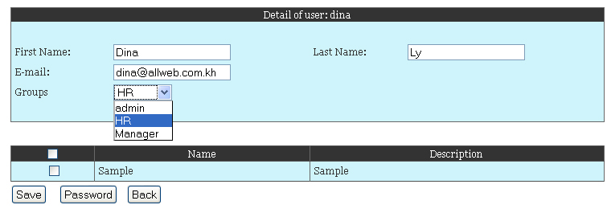
ALLWEB Human Resource Management
    3. New User Level:
    For security our application have created the level access for every user. We have defined the levels :
        Admin
        Super user that can control every company
        HR
        Is the type of HR Manager in one company
        Manager
        Is the new type of administrator in companies.
        This type of user can only manage his own companies.
ALLWEB Company
Notes:
ALLWEB Human Resource Management

Slide 6
ALLWEB Human Resource Management
    Thank You !
    http://www.allweb.com.kh
    exalog@allweb.com.kh
ALLWEB Company
Notes:
ALLWEB Human Resource Management

