Slide 1







CALL NOW: +1 415-233-4737
info@optisolbusiess.com
www.optisolbusiness.com
Micro Services Architecture: Spring Boot and Netflix Infrastructure
Page | 1

Slide 2


















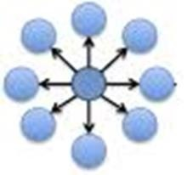


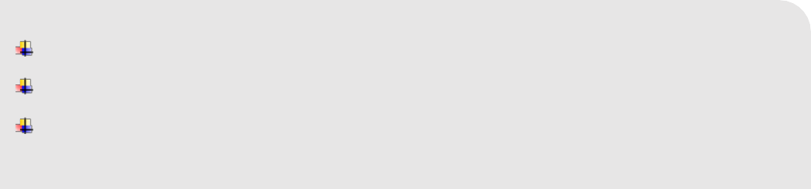



Micro services - Overview
What is Micro Service?
The main objective of the micro-services implementation is to split up the application as separate service for each core and API service functionality and it should be deployed independently on cloud. We have chosen the reactive programming language from spring.io family project with a set of components that can be used to implement our operations model. Spring Cloud integrates the Netflix components in the spring environment in a very nice way using auto configuration and convention over configuration similar to how Spring Boot works.
Why Micro Services Architecture?
We chose micro services architecture to write each functionality as a separate service for core and API functionality and it helps us to achieve the continuous delivery and integration.
Patterns in Micro Services Architecture
API Gateway Service registry Service discovery
Page | 3

Slide 3


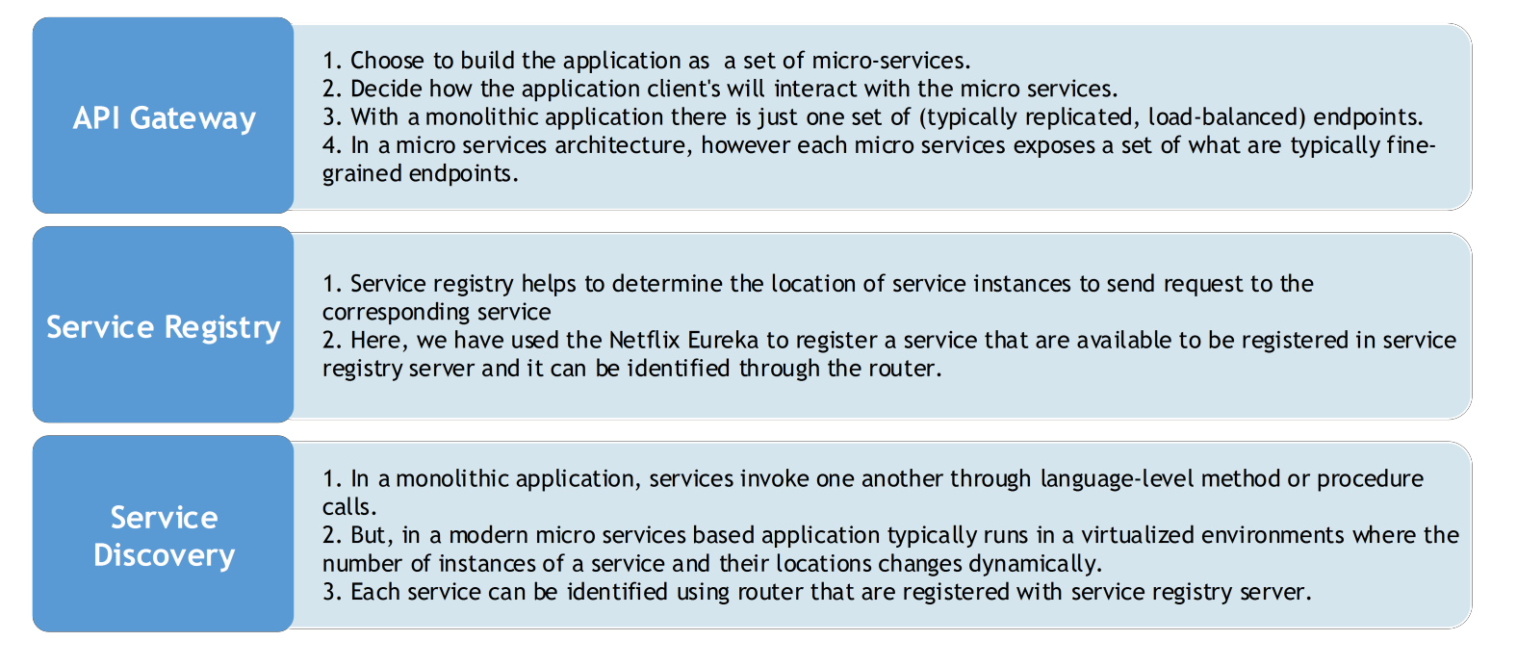

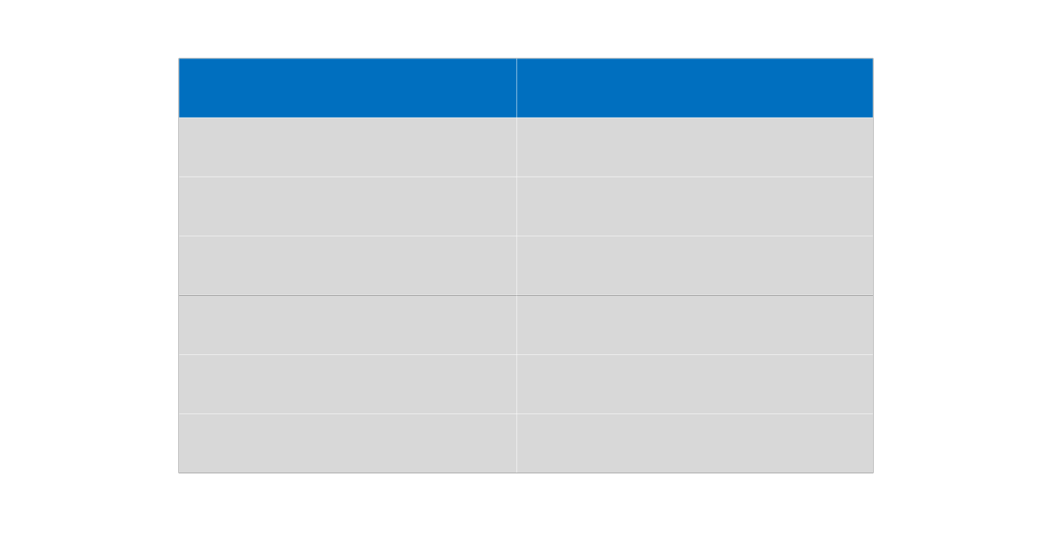
Patterns in Micro services Architecture
Micro services Architecture via Netflix Components
We have used the Netflix components to accomplish the above micro services architecture patterns.
Operations Component | Spring, Netflix OSS
Service Discovery server | Netflix Eureka
Edge Server | Netflix Zuul
Central configuration server | Spring Cloud Config Server
Dynamic Routing and Load Balancer | Netflix Ribbon
OAuth 2.0 protected API's | Spring Cloud + Spring Security OAuth2
Monitoring | Netflix Hystrix dashboard and turbine
Page | 4

Slide 4






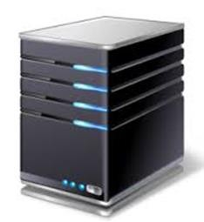


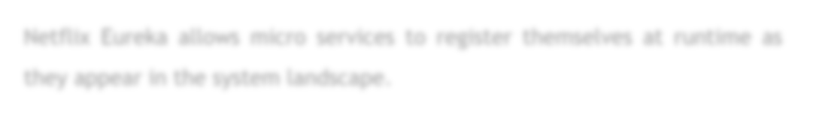



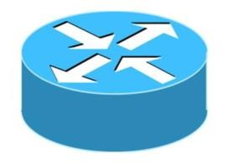







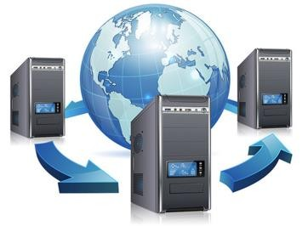



Major Components of Netflix
Netflix Eureka - Service Discovery Server
Netflix Eureka allows micro services to register themselves at runtime as they appear in the system landscape.
Netflix Ribbon - Dynamic Routing & Load Balancer
Netflix Ribbon can be used by service consumers to look up services at runtime. Ribbon uses the information available in Eureka to locate appropriate service instances. If more than one instance is found, Ribbon will apply load balancing to spread the requests over the available instances. Ribbon does not run as a separate service but instead as an embedded component in each service consumer.
Netflix Zuul - Edge Server
Zuul is (of course) our gatekeeper to the outside world, not allowing any unauthorized external requests pass through. Zulu also provides a well- known entry point to the micro services in the system landscape. Using dynamically allocated ports is convenient to avoid port conflicts and to minimize administration but it makes it of course harder for any given service consumer. Zuul uses Ribbon to look up available services and routes the external request to an appropriate service instance.
Page | 5

Slide 5

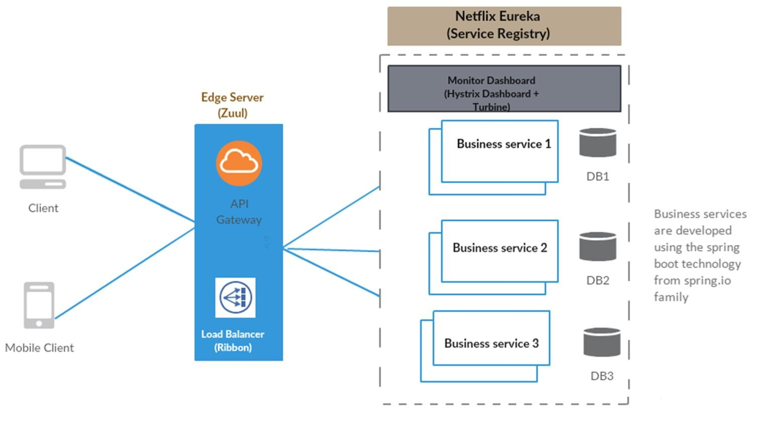

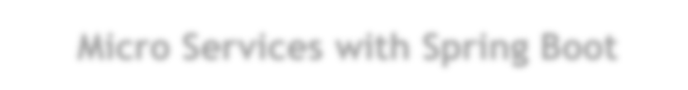


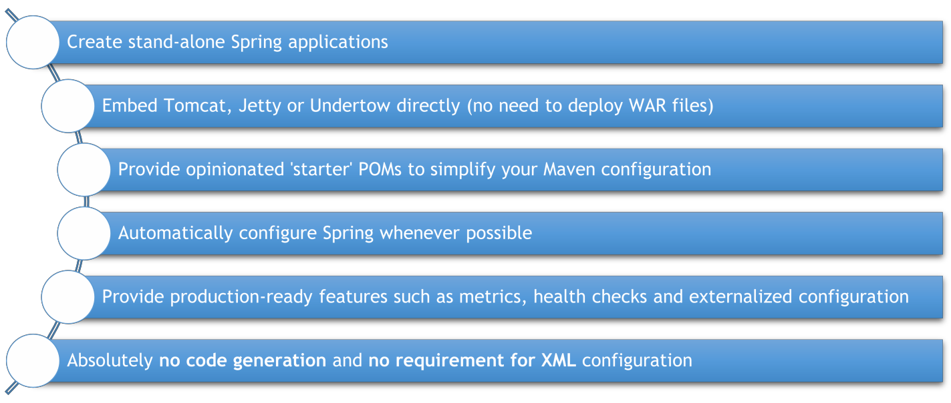
Spring Boot & Spring Cloud Netflix OSS – Micro Service Architecture
Micro Services with Spring Boot
Spring Boot is a brand new framework from the team at Pivotal, designed to simplify the bootstrapping and development of a new spring application. The framework takes an opinionated approach to configuration, freeing developers from the need to define boilerplate configuration.
Page | 6

Slide 6


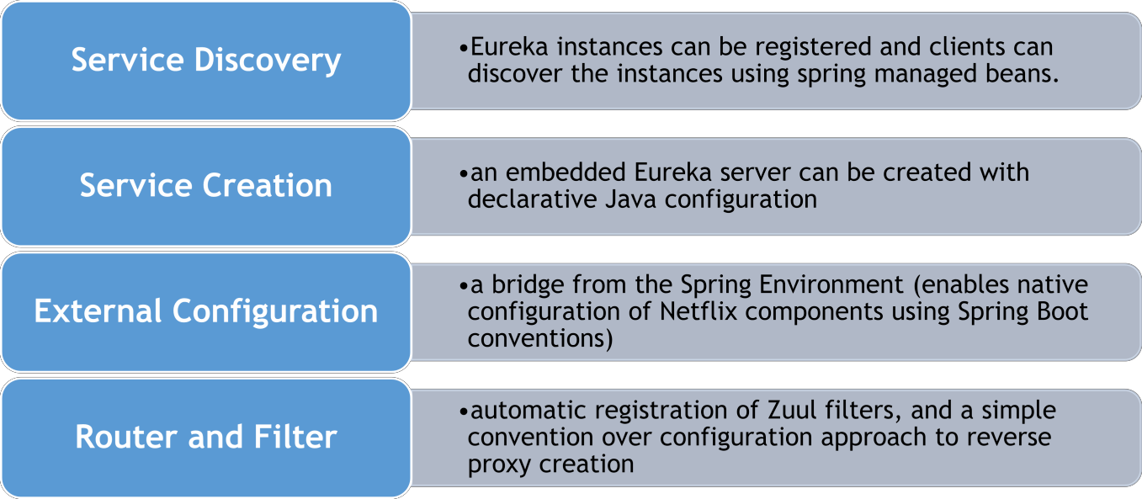



Spring Cloud Netflix
Spring cloud Netflix provides Netflix OSS integrations for spring boot apps through auto configuration and binding to the spring environment and other spring programming models. With a few simple annotations we can quickly enable and configure common patterns inside application and to build large distributed systems with Netflix components. There are lot of features available with spring cloud Netflix. Here, we have listed some of the common features we have implemented with micro services with spring boot and Netflix,
CALL NOW: +1 415-233-4737
www.optisolbusiness.com

