Slide 1
Continue Integration & Continue Delivery
CD
CI
Email: kanel.soeng@amkcambodia.com

Slide 2
We Will Talk about
Explore our scenario
What was the problems?
What we can improve?
How Do We Get There?
Tools and why?
Demo

Slide 3
Objective
Helps software teams of all sizes automate their development process
- quickly, safely, and at scale.

Slide 4
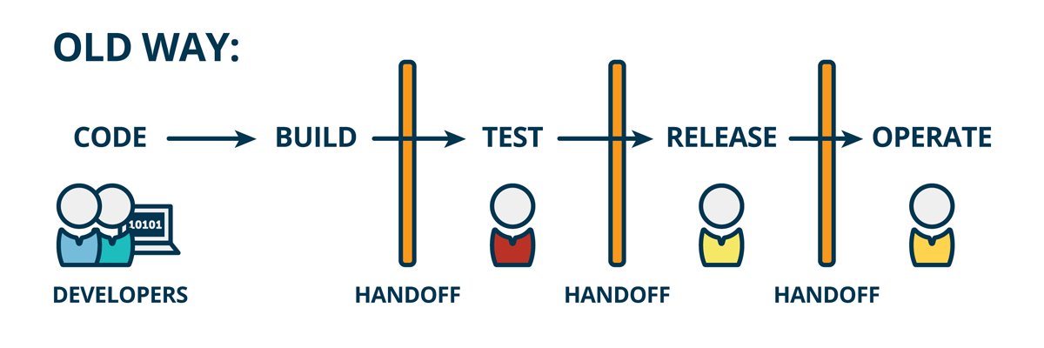

Slide 5
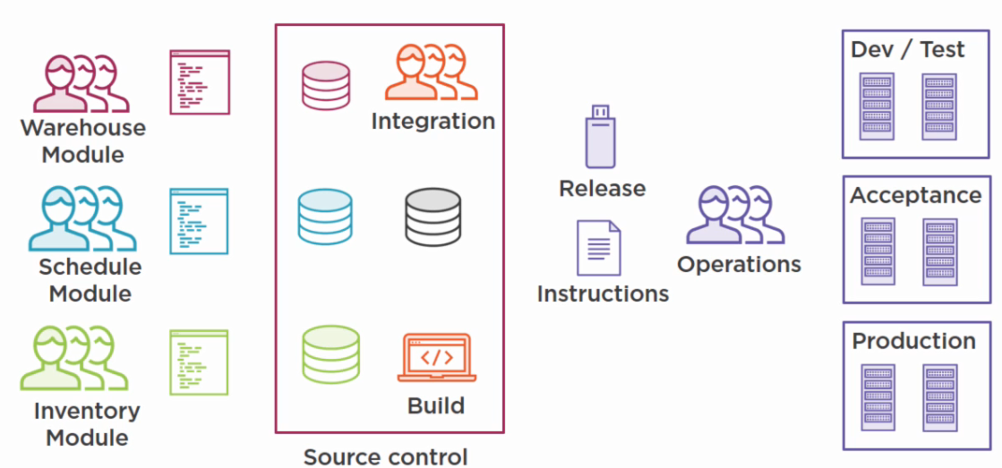
Explore our scenario
MIS team
Business team
At the end of each iteration
Merge the module branches into the main source code
Build the integration locally then release with instructions
At the end of each iteration
Test the module or feature
Report bugs
Notes:
Operations here is development team also

Slide 6
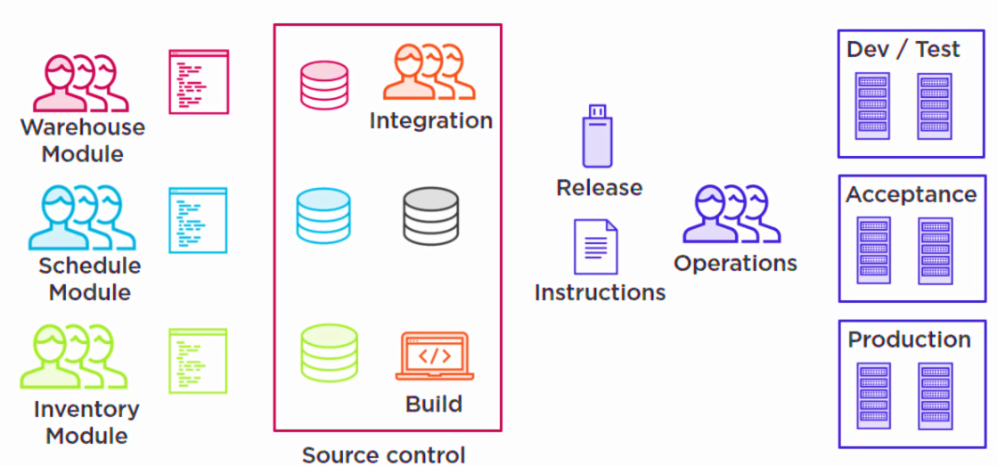
What was the problem?
High chance of bugs and rework
Defects are found late
Causing of extra work
Lots of effort in integration
Difficult to reproduce the release
Can only release once per iteration
High chance of errors
Lots of effort in deployment
Difficult to reproduce deployment
Inconsistency in environments
Deployment are scary (Friday afternoon)
Slow delivery of functionality

Slide 7
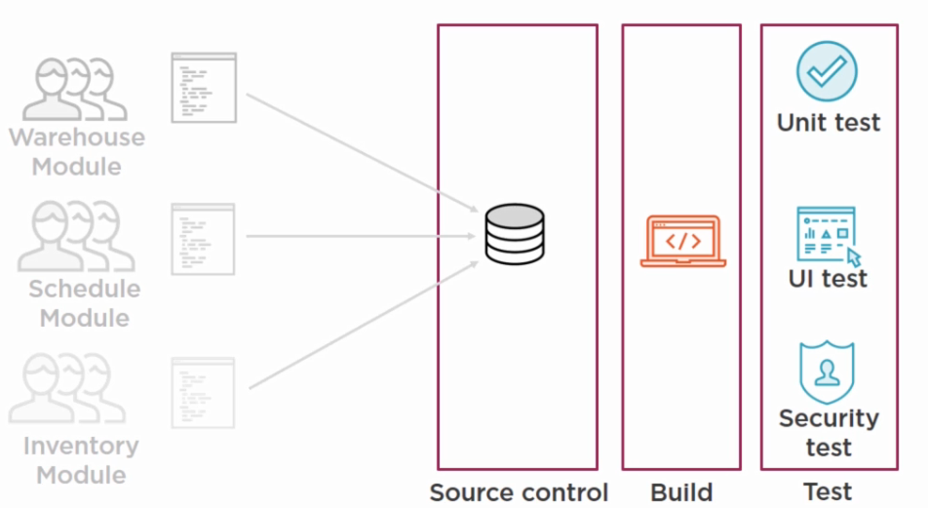
WHAT WE CAN IMPROVE?
CI
Automated
CI

Slide 8
CI Principles
Have a single place where all the code lives (repository or mainline)
Everyone commits to the mainline every day (at lease once a day)
Automate the build process
Fix broken build immediately
Make and keep the build fast
Every commit triggers a build
Automate the testing process (as much as possible)
Everyone has access to the latest result (if build succeed/wrong?)
Everyone can see everything( all of source code, build & test result)

Slide 9
CI Benefits
Integration takes less effort
Issues will come up more early
Automation means less issues
The process is more visible
Improve team communication
Short integration iterations means more flexibility
The code is ready to be delivered more often.

Slide 10
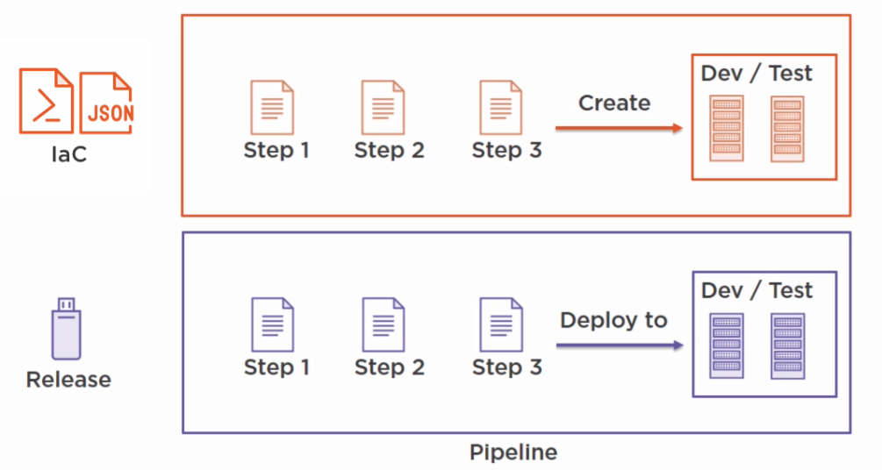
WHAT WE CAN IMPROVE?
CD
Notes:
Continue Delivery (CD) is a software development discipline where software CAN be released to production at ANYTIME.
Delivery (OPTIONAL) != Deployment (AUTATICALLY)

Slide 11
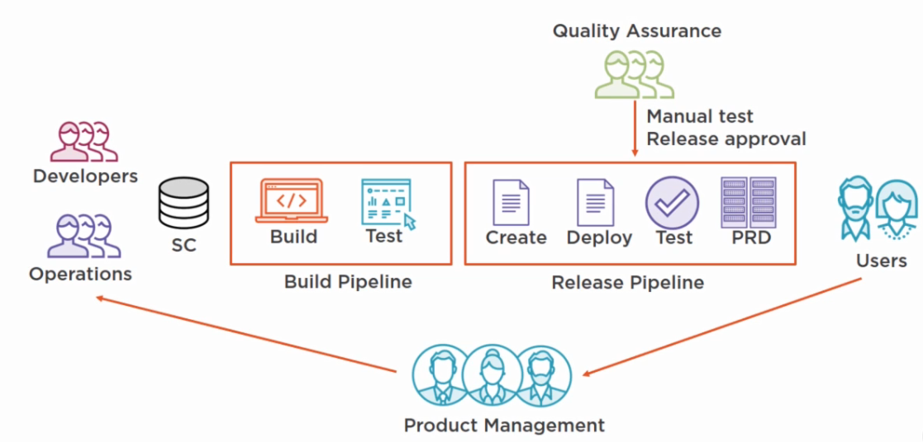
Automated
On demand

Slide 12
CD Principles
Have a continue integration in place
Development and Operation should work well together
Treat infrastructure as a code artifact
Automate the environment creation process
Automate the release process
Automate acceptance tests
Include release to definition of done
Releasing should be on demand
Everyone has access to the latest result
Everyone can see everything (succeed or failed)

Slide 13
CD Benefits
Releasing takes less effort
Releasing is more
Reliable
Repeatable
Put control of release in the hands of business
Release more often
Get feedback earlier

Slide 14
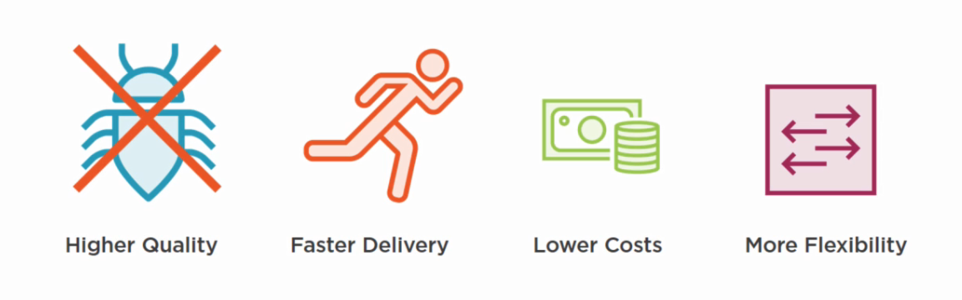
What are we trying to accomplish?

Slide 15
How to implement
Get to a single source control repository (Branching Strategy)
Branching strategy
|> Merge to a single repository
|> Collaboration
Create a build pipeline
a) Create an automated build process
Setup a dedicated serer
|> Install a build engine
|> Create build definitions
b) Create an automated test process
Run static tests with the build
|> Deploy the build result to a (temp) environment
|> Run(UI) test
CI

Slide 16
How to implement
CD
Have Continue integration in place
Unite developers and operations
Developers <SC> Operations
Create a release pipeline
Deploy and test the release
Configuration a deployment server
|> Create release definitions
|> Run tests
b) (optional) create an IaC process
Script your environment
|> Create release definitions
|> Run test

Slide 17
TOOL OF CHOICE & WHY
WINDOW OS | ORACLE SOLARIS OS
Dockers | N/A
Jenkins 2 | Jenkins 2
TFS/VSTS | N/A
Oracle DB | Oracle DB
MSSQL SERVER | N/A
C#, JAVA, OTHERS | JAVA, OTHERS
IIS, Tomcat, Jboss (Widlfly), WebLogic,.. | Tomcat, Jboss (Widlfly), WebLogic,..

Slide 18
WHY
The right automation tools can deliver the best of both worlds – software innovation and compliance – working together to meet business objectives.
2. Dockers support only Linux and windows (optional for CI&CD because we do with the physical server or any virtual machines. )
3. Oracle STACK is easy to integration with other future apps.
4. Jenkins is shipped by Solaris OS in the oracle repository, (Linux/window as well)
5.Jenkins is adopted by many industry included Microsoft and oracle
6.Jenkins provides many plugins for automation such as code quality, code review…
7. Jenkins is easy to backup and restore by just copy and past.
Jenkins support for other technologies such as MS Build , Android..
DevOps or MIS and security teams don’t have to be at war with each other. DevOps can, in fact, be an enabler as opposed to a risk. Likewise, security doesn’t have to slow down innovation.

Slide 19
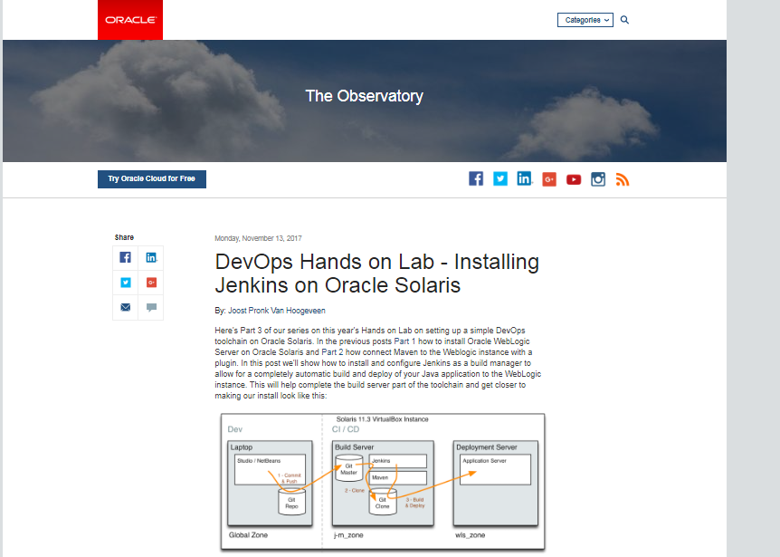
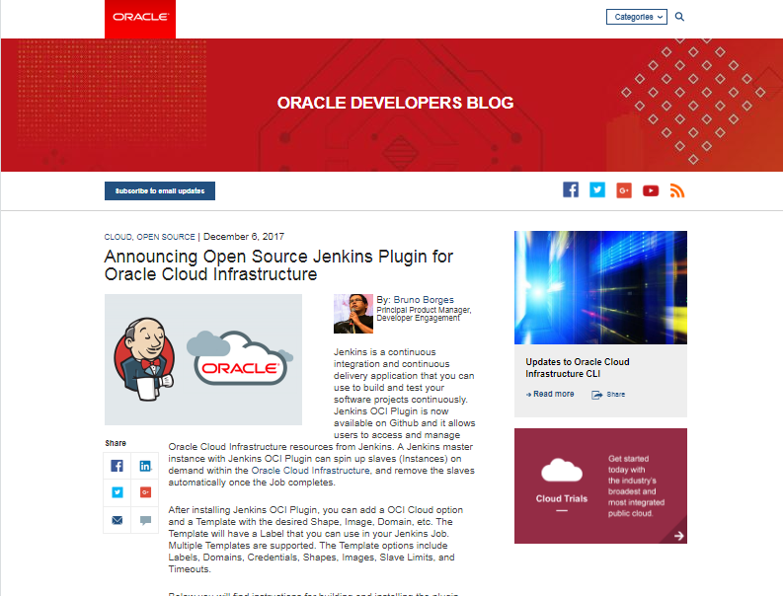
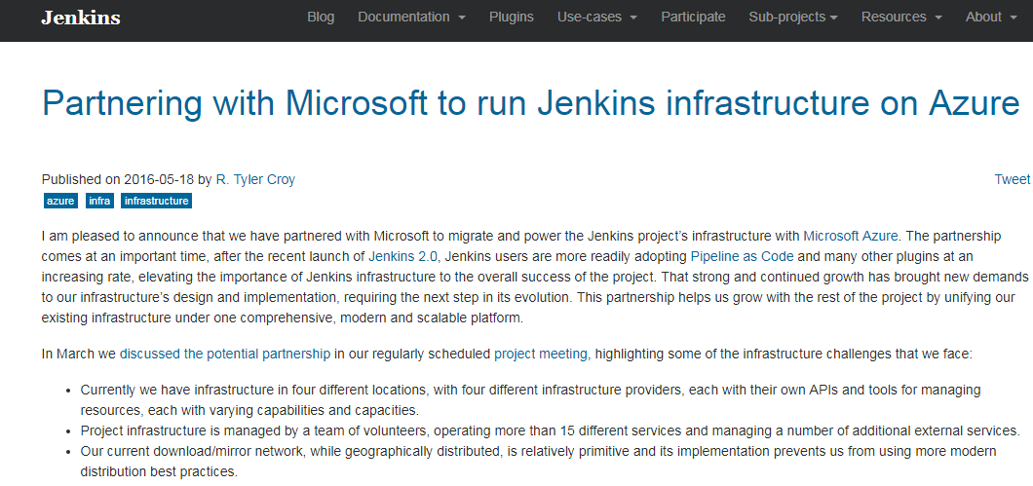
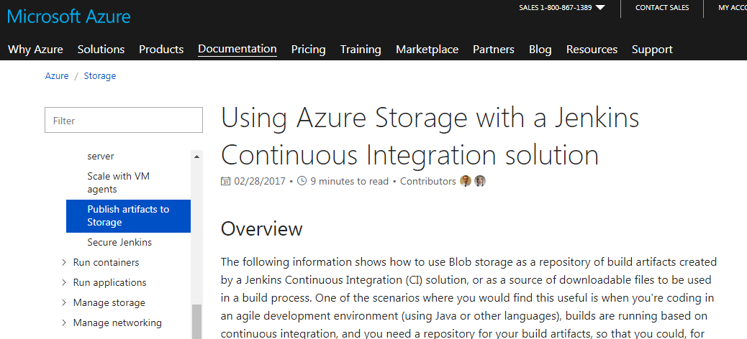
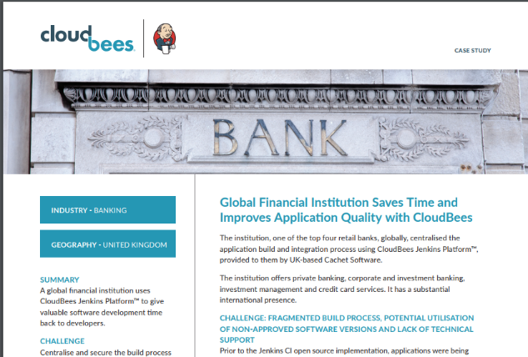
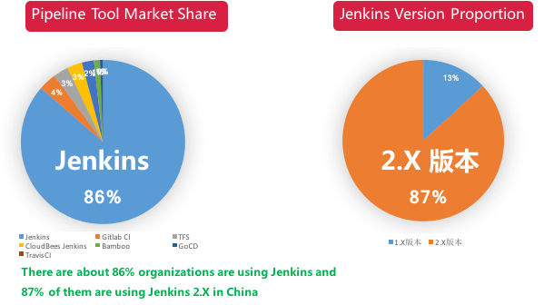
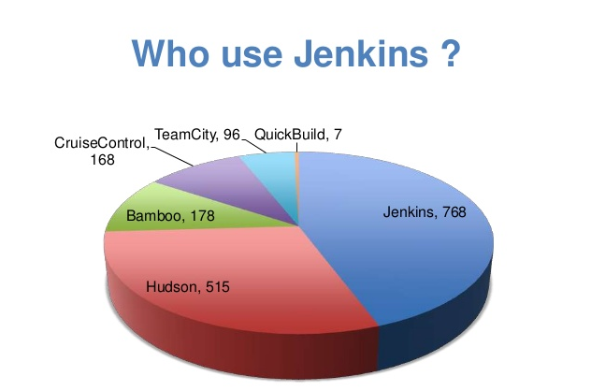

Slide 20
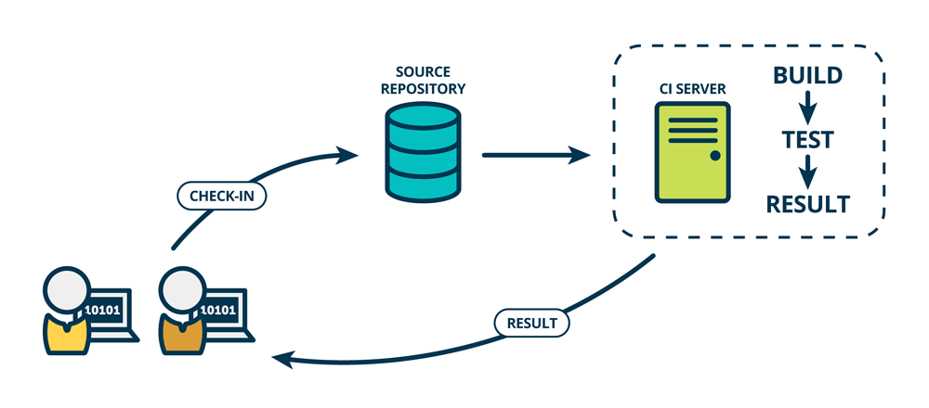
WRAP UP

Slide 21
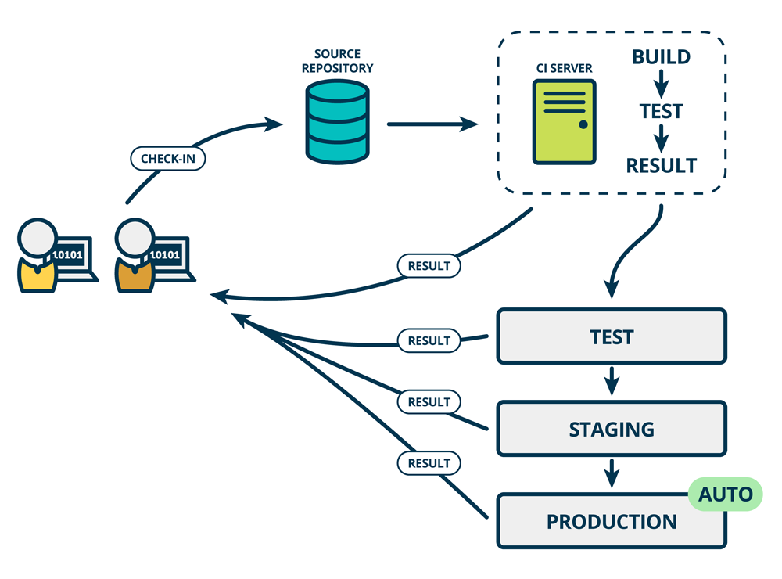
Manual

Slide 22
LET’S SEE THE DEMO

Slide 23
សូម​អរគុណ

