Slide 1
Predicting Respiratory Condition Flare Up
Team Enigma 3
September 2018

Slide 2
Predicting Respiratory Condition Flare Up
Machine Learning Approach
Methodology :
We have written the code in Python3 and used sklearn.
Model Assumption:
We have chosen Gaussian Naïve Bayes classifier for the COPD flare up prediction among all the classifier we tried.
Naive Bayes classifier assumes that all the features are unrelated to each other. Presence or absence of a feature does not influence the presence or absence of any other feature.
When attribute values are continuous, an assumption is made that the values associated with each class are distributed according to Gaussian i.e., Normal Distribution.
Explanation and Validation of Engineered Variables:
We tried few options but couldn’t get better results.
Variable importance of Top Predictors:
Next Slide shows the list of 40 variables that we selected for creating model with development data.
Any insights and recommendations
The correlation of variables and their contexts (Demo1 = Age etc.) are missing, it would have helped us better in selecting the Feature Set, if the contexts of each variables were defined.

Slide 3
40 variables chosen to compute the model
Demo1 | DisHis5 | LungFun10 | Dis5Treat
Demo5 | DisHis6 | LungFun19 | Dis6
Demo6 | DisHis7 | LungFun20 | Dis6Treat
DisHis1 | DisStage1 | Dis1Treat | Dis7
DisHis1Times | DisStage2 | Dis2Times | RespQues1
DisHis2 | LungFun1 | Dis3 | ResQues1a
DisHis2Times | LungFun4 | Dis3Times | ResQues1b
DisHis3 | LungFun5 | Dis4 | ResQues1c
DisHis3Times | LungFun6 | Dis4Treat | ResQues2a
DisHis4 | LungFun9 | Dis5 | SmokHis4

Slide 4
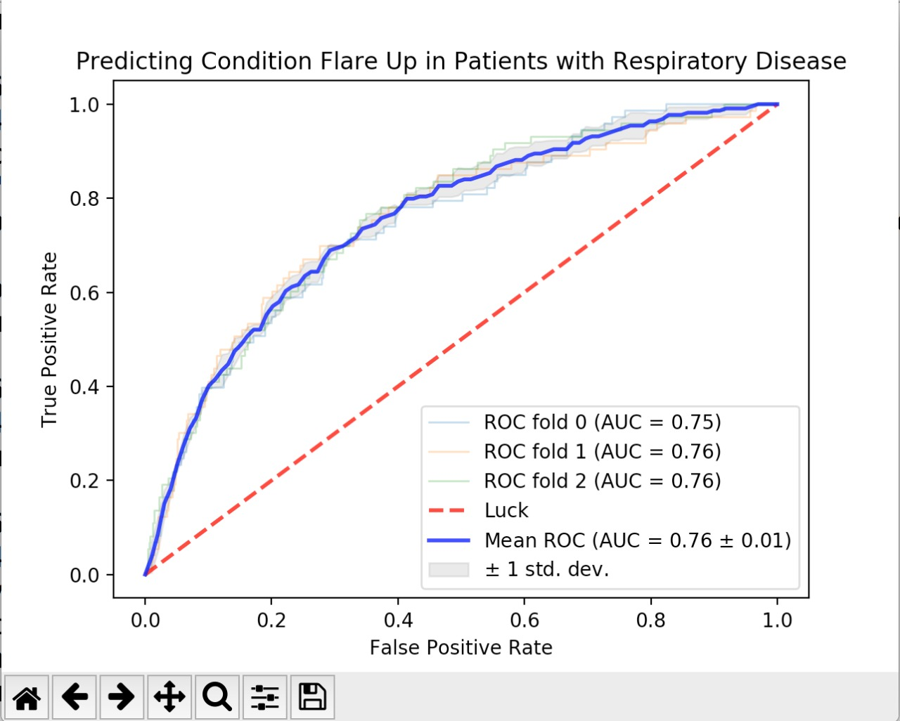
Area under the ROC Curve for Development Data

Slide 5
Thank You
Please email any questions to PowerPoint@vmware.com

