Slide 1
REPORTING
GROUP A3

Slide 2
Library used for reporting
Crystal reports module
A product of SAP
Reporting tool for .NET framework

Slide 3
Reports library code snippet
library : using CrystalDecisions.CrystalReports.Engine;
code:
CrystalReport1 objRpt = new CrystalReport1();
objRpt.SetDataSource(ds.Tables[1]);
crystalReportViewer1.ReportSource = objRpt;
crystalReportViewer1.Refresh();

Slide 4
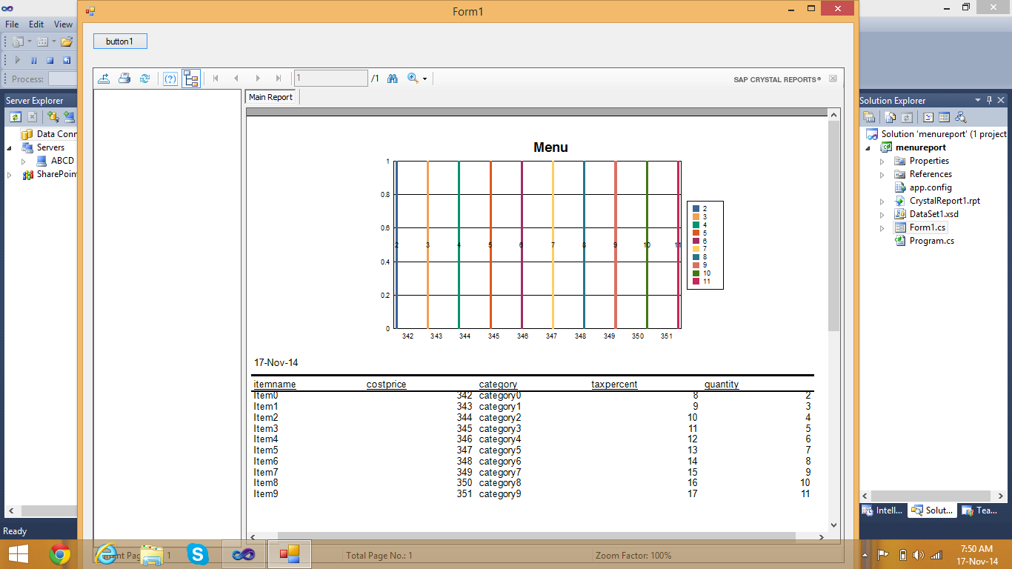
Food Menu

Slide 5
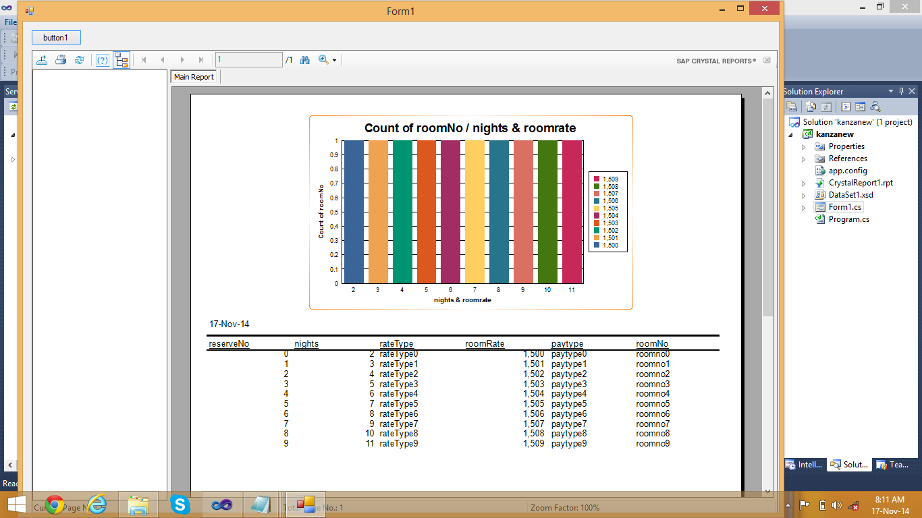
RESERVATION

Slide 6
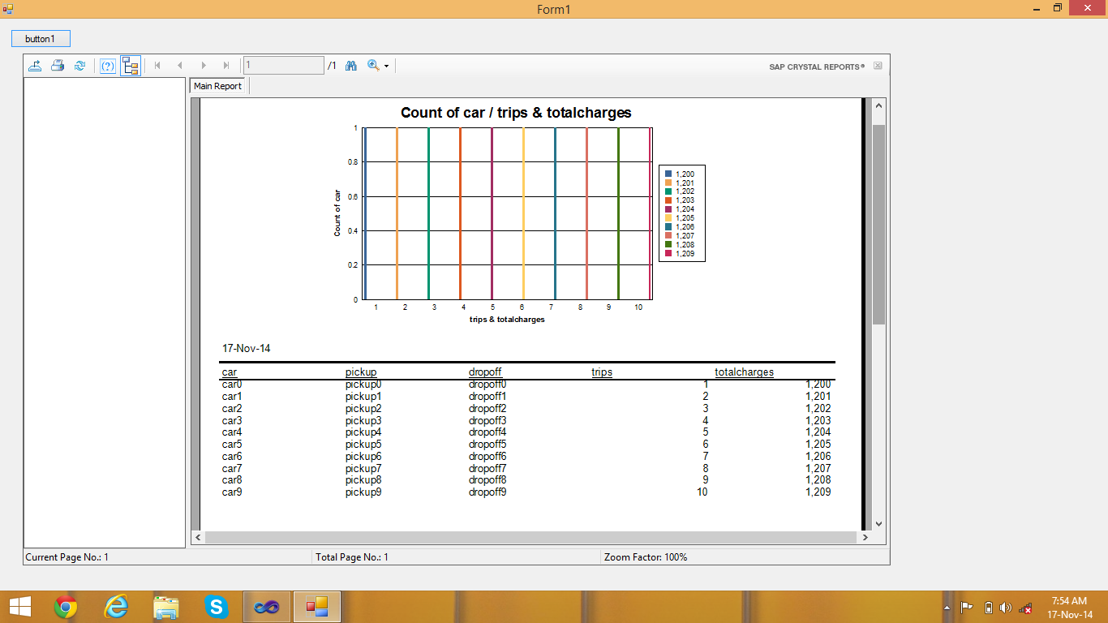
Car Rental

Slide 7
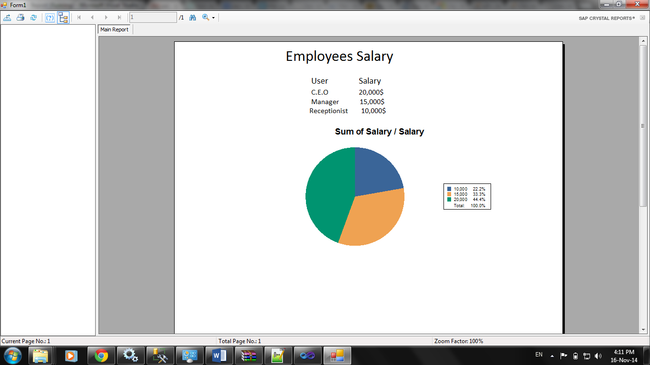
Employee’s Salary

Slide 8
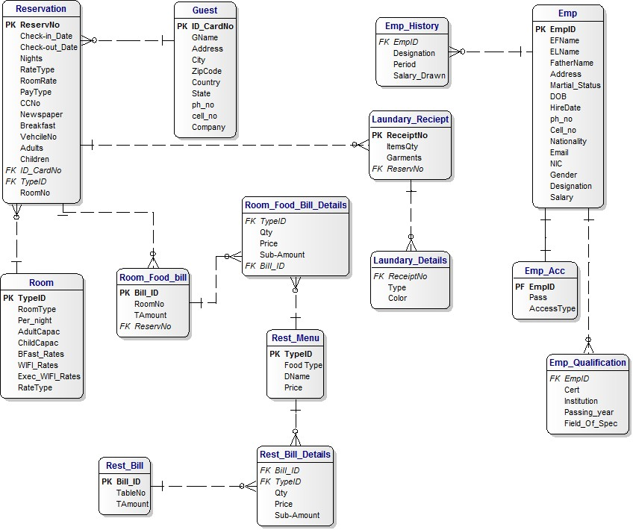
Project ERD

