Slide 1
QUESTIONS
Task 4.2: Aggregation Pipeline
Create aggregation pipelines using PyMongo for:
Course Enrollment Statistics:
Count total enrollments per course
Calculate average course rating
Group by course category
Student Performance Analysis:
Average grade per student
Completion rate by course
Top-performing students
Instructor Analytics:
Total students taught by each instructor
Average course rating per instructor
Revenue generated per instructor

Slide 2
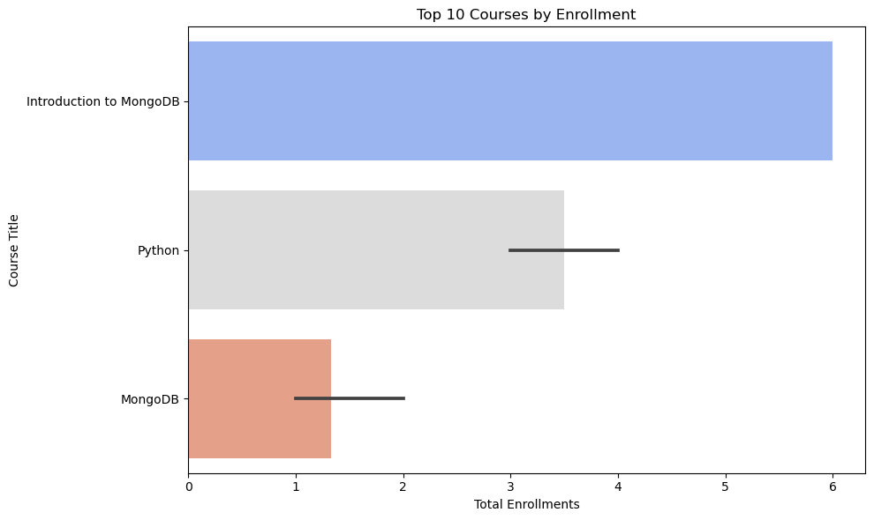
Task 4.2.1: Course Enrollment Statistics
count total enrollments per course
Calculate average course rating
Group by course category

Slide 3
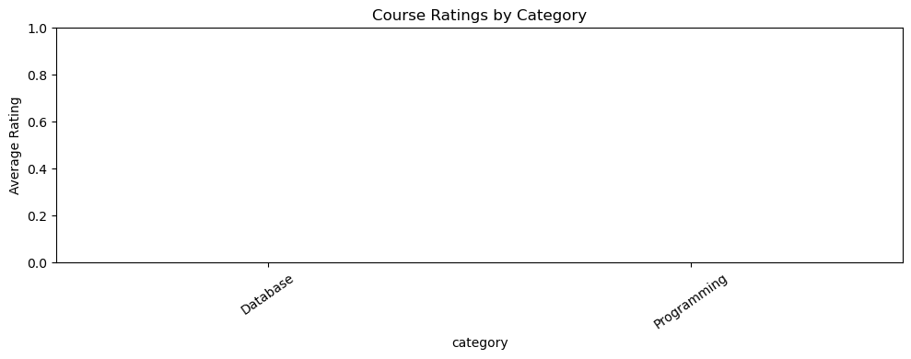
Task 4.2.1: Course Enrollment Statistics
count total enrollments per course
Calculate average course rating
Group by course category

Slide 4
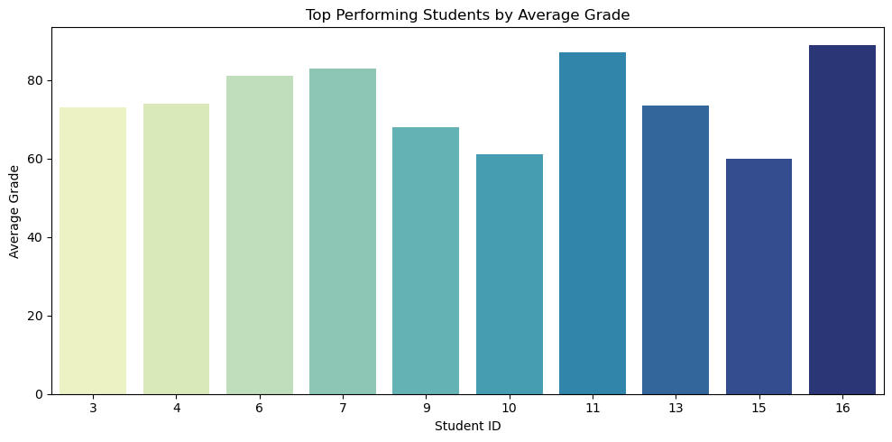
Task 4.2.2: Course Enrollment Statistics
Student Performance Analysis:
Average grade per student
Completion rate by course
Top-performing students

Slide 5
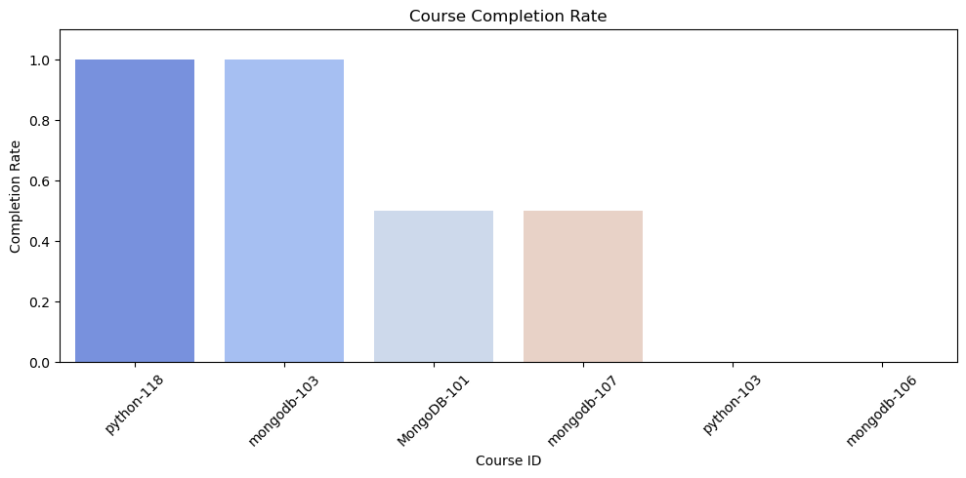
Task 4.2.2: Course Enrollment Statistics
Student Performance Analysis:
Average grade per student
Completion rate by course
Top-performing students

Slide 6
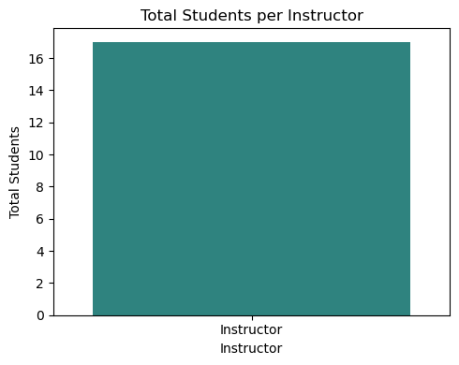
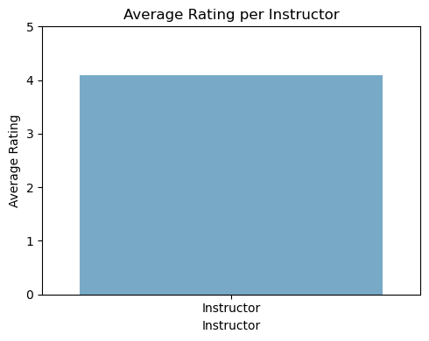
Task 4.2.3: Instructor Analytics:
Total students taught by each instructor
Average course rating per instructor
Revenue generated per instructor

Slide 7
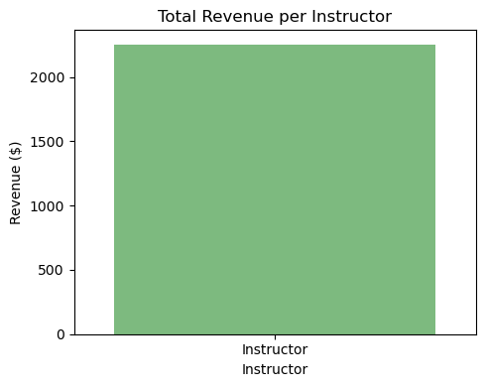
Task 4.2.3: Instructor Analytics:
Total students taught by each instructor
Average course rating per instructor
Revenue generated per instructor

