Slide 1

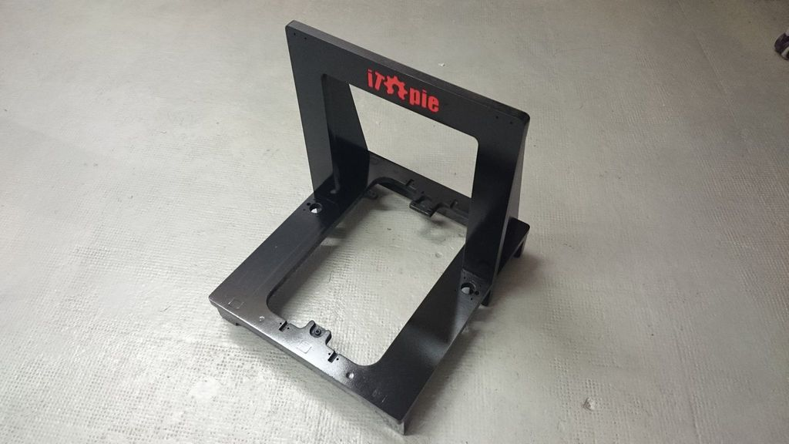
iTopie RepRap
Build Manual

Slide 2
CHAPTERS
The Frame
The X Axis
The Y Axis
The Z Axis
The Belts
The Heated Bed

Slide 3
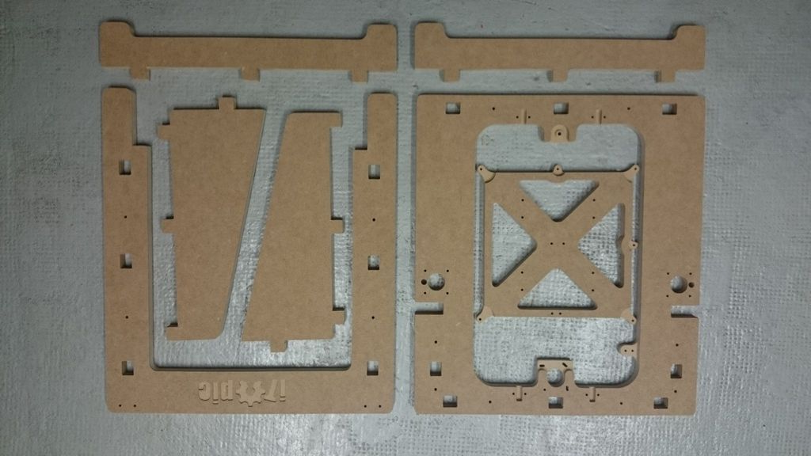
CHAPTER 1
The Frame

Slide 4
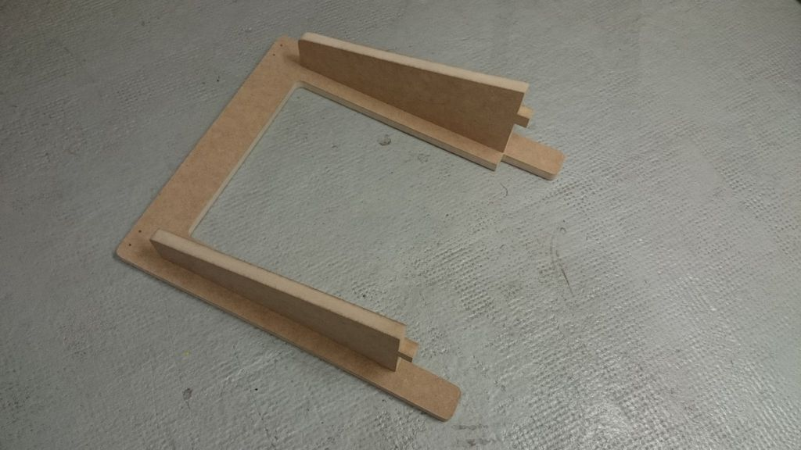
Fit the rear triangle on the U part.

Slide 5
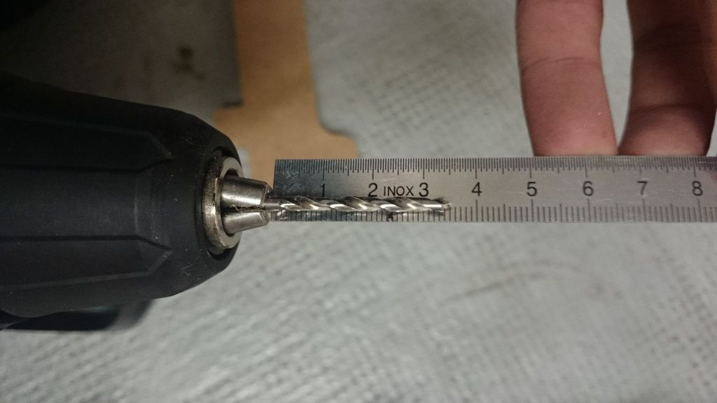
Take a 3mm drillbit and adjuste to 3.5mm from the mandrel.

Slide 6
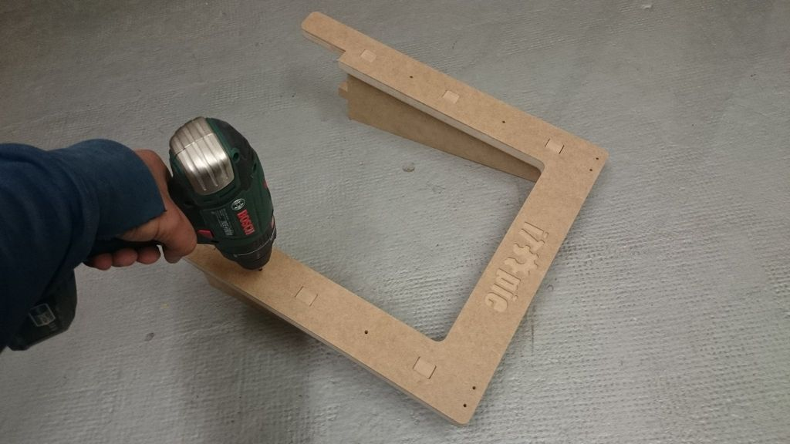
Make some holes.
(4x)

Slide 7
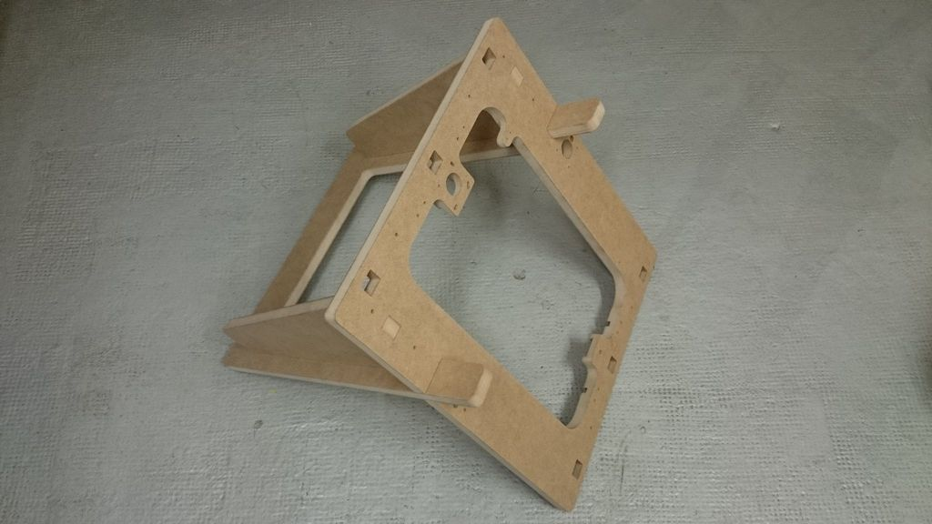
Fit the assembly on the O part.

Slide 8
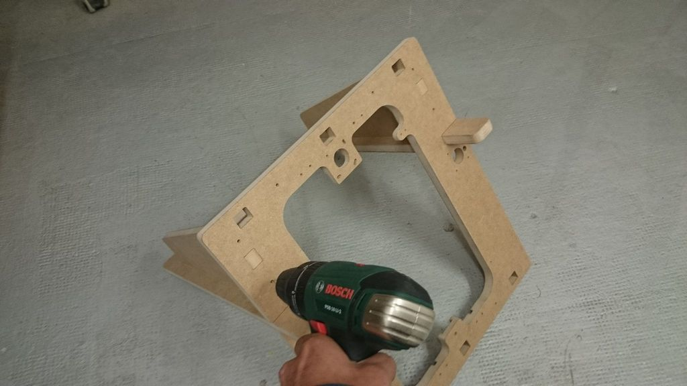
Make more holes.
(4x)

Slide 9
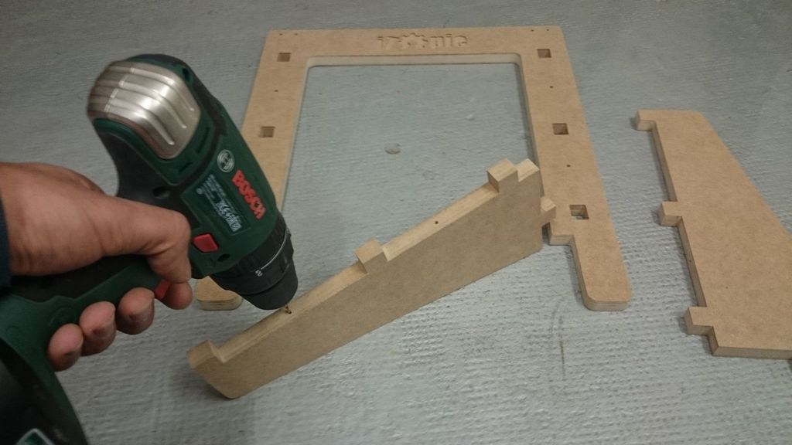
Remove all parts and remake again the holes in depth. (8x)

Slide 10
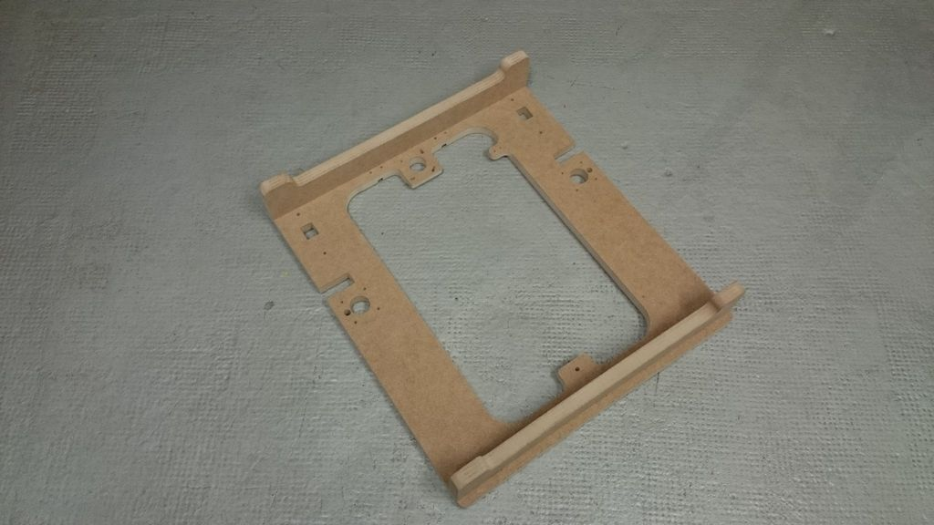
Ok !, Fit the feet on the O part.

Slide 11
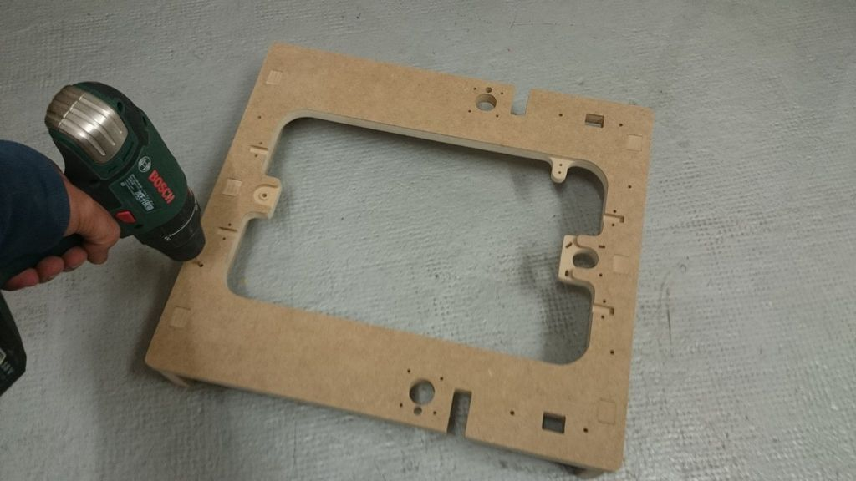
Turn back and... yes ! more and more holes. (4x)

Slide 12
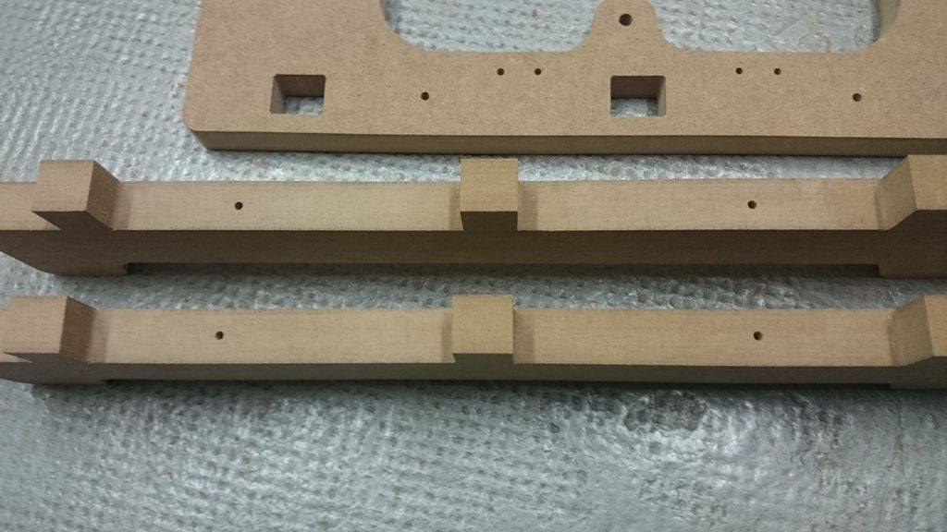
Same as above, unplug the parts and remake the holes. (4x)

Slide 13
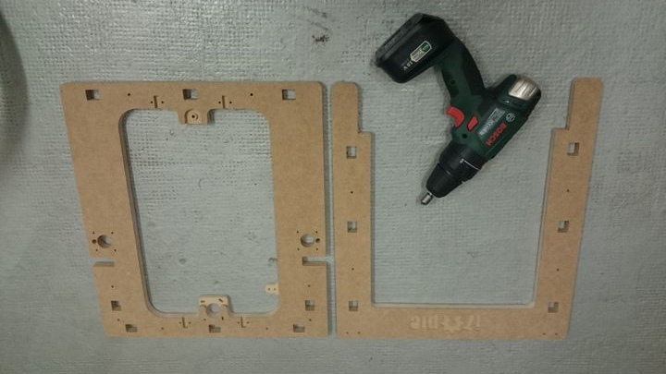
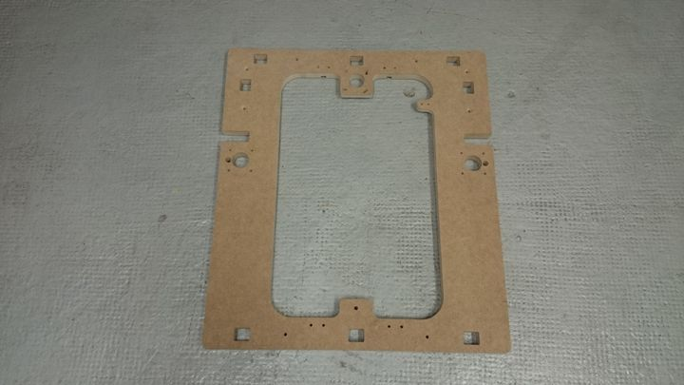
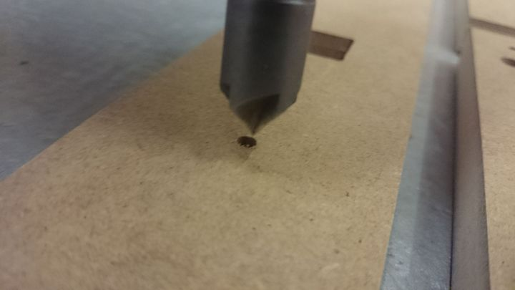
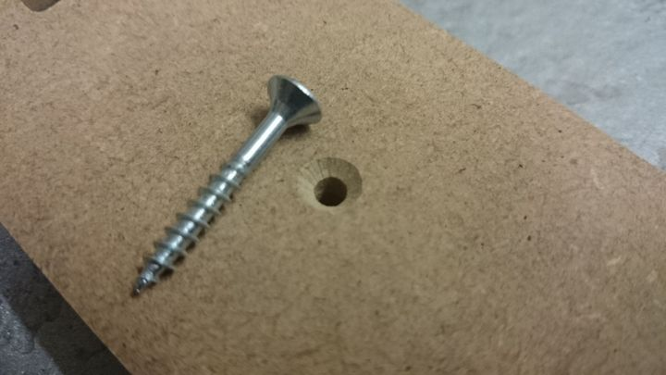
The chamfers, optional but recommended.
This is the back side

Slide 14
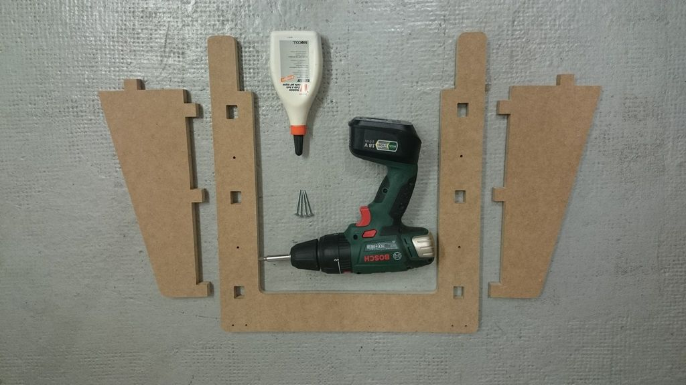
Glue and screws party.

Slide 15
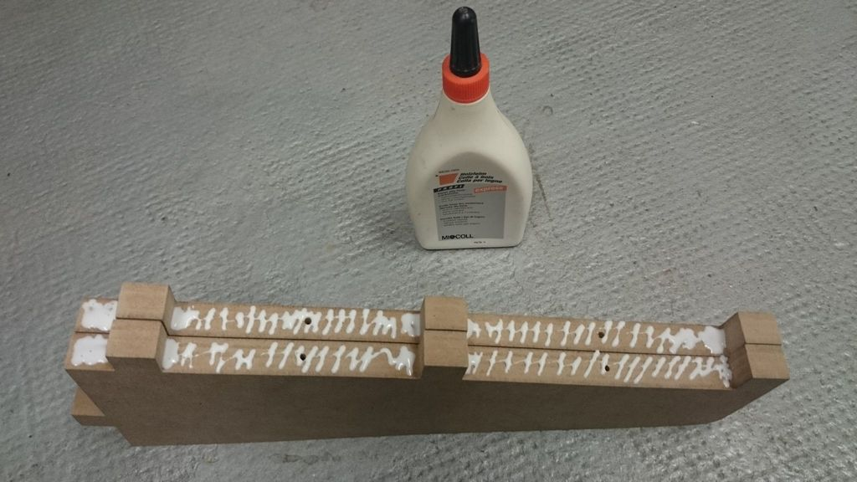
Apply some glue on the two triangle.

Slide 16
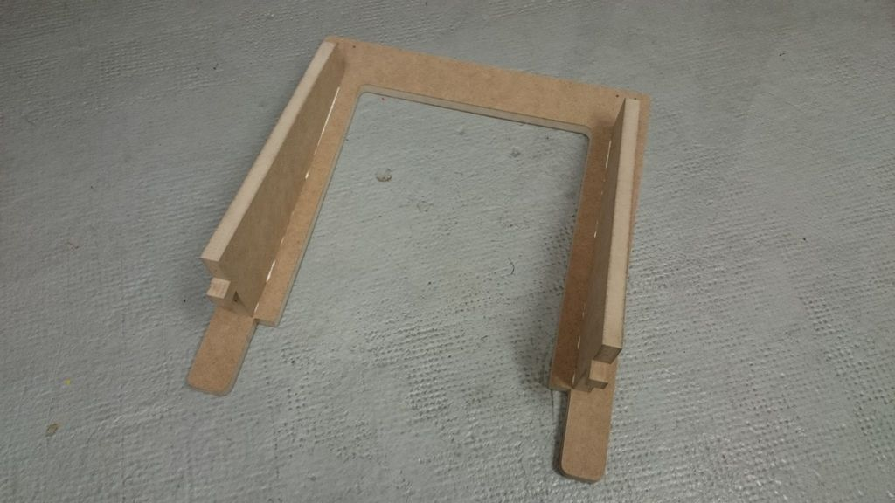
Re-Fit the rear triangle on the U part and press hard.

Slide 17
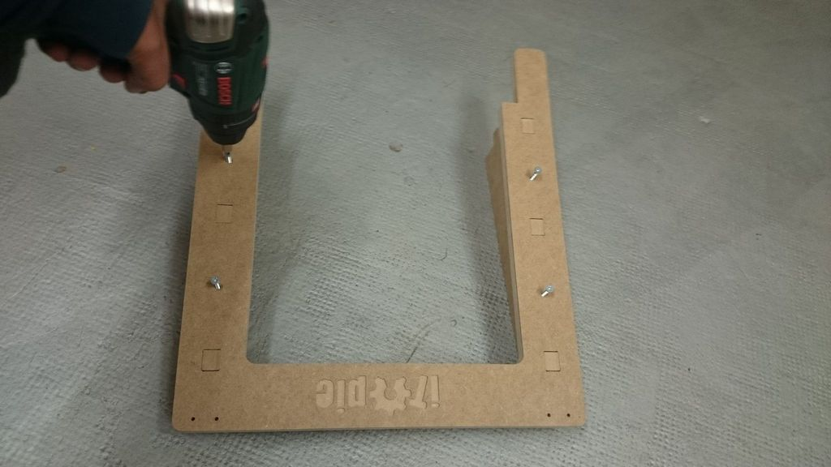
Turn back and screw all together
3.5x40mm (4x)

Slide 18
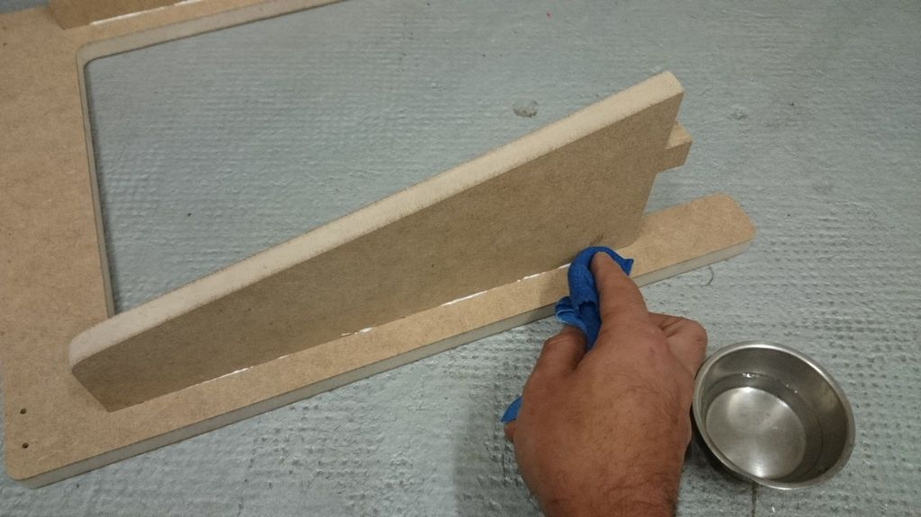
With a wet cloth, wipe the superfluous glue.

Slide 19
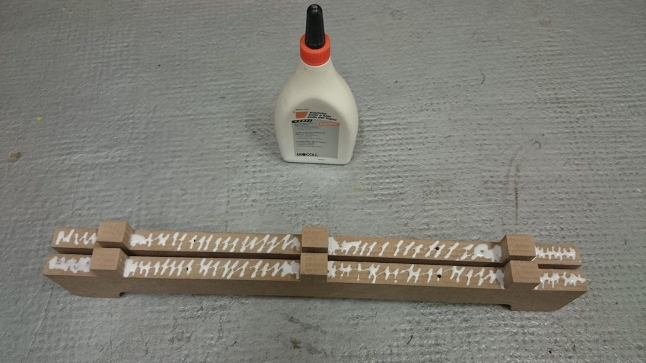
Take the feet and apply some glue.

Slide 20
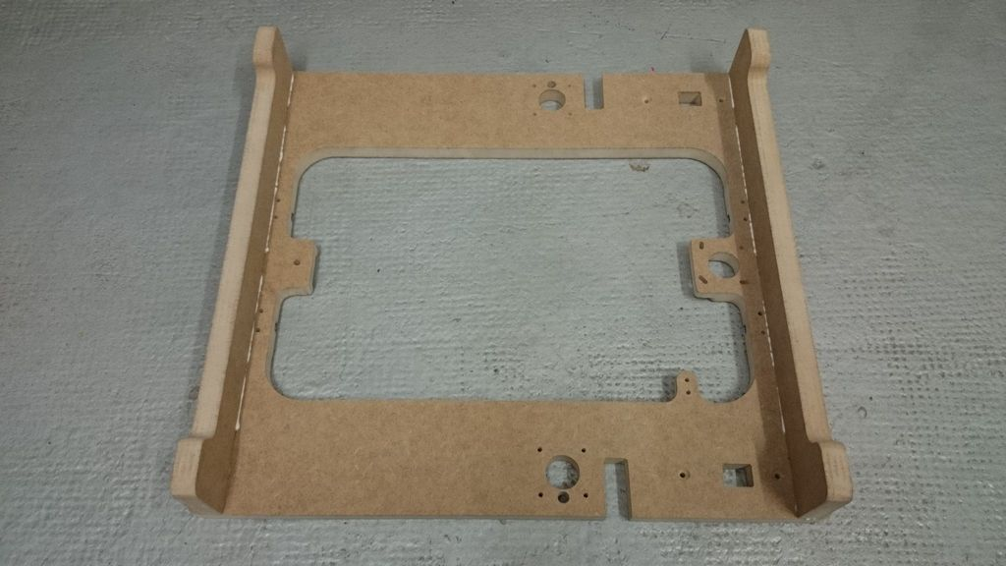
Plug the feet and press hard.

Slide 21
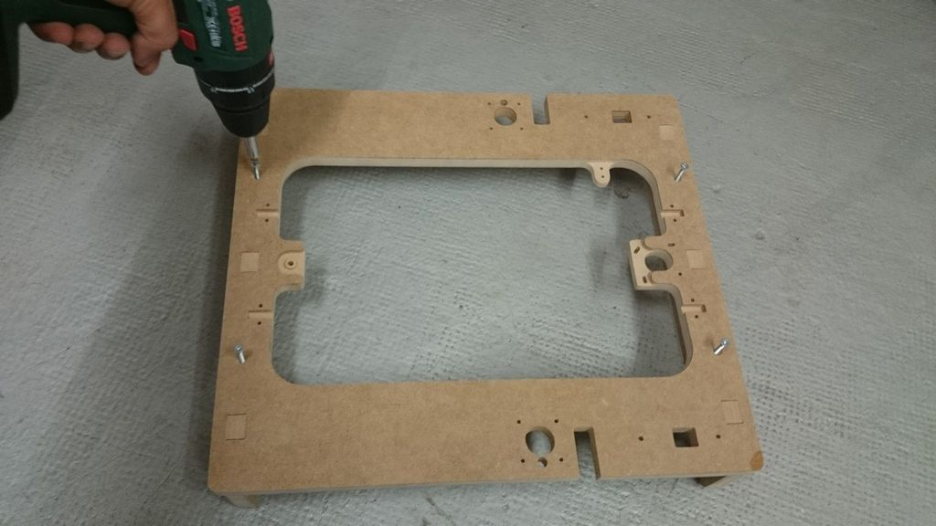
Turn back and screw all together
3.5x40mm (4x).

Slide 22
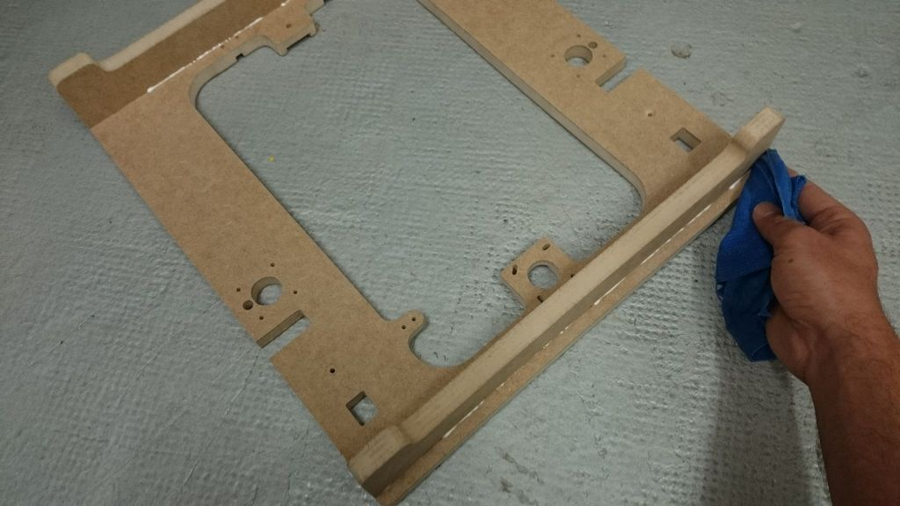
As before, clean the glue.

Slide 23
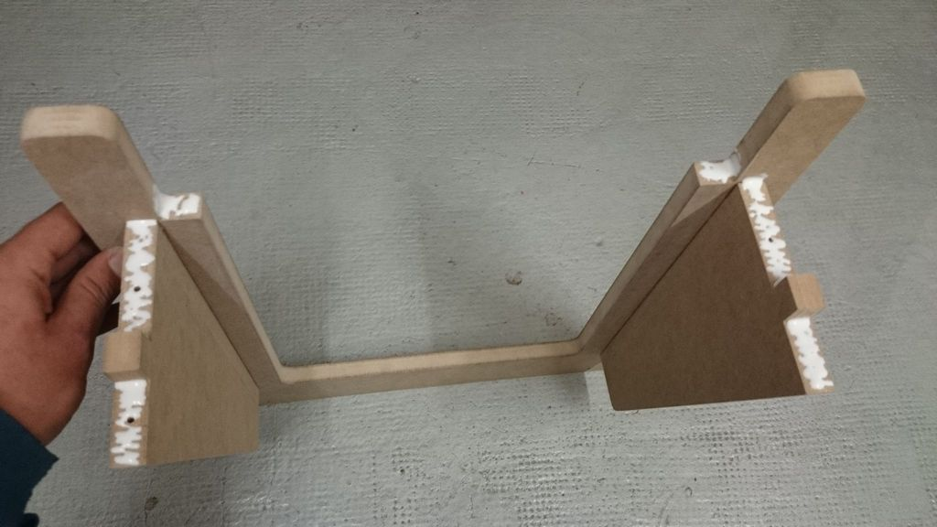
Apply some glue as pictured.

Slide 24
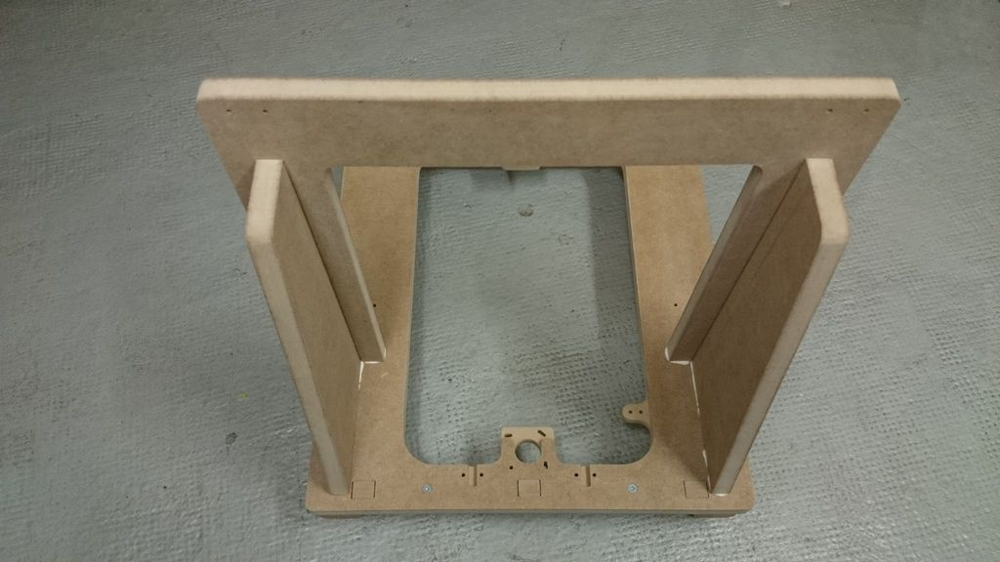
Fit all together and press hard.

Slide 25
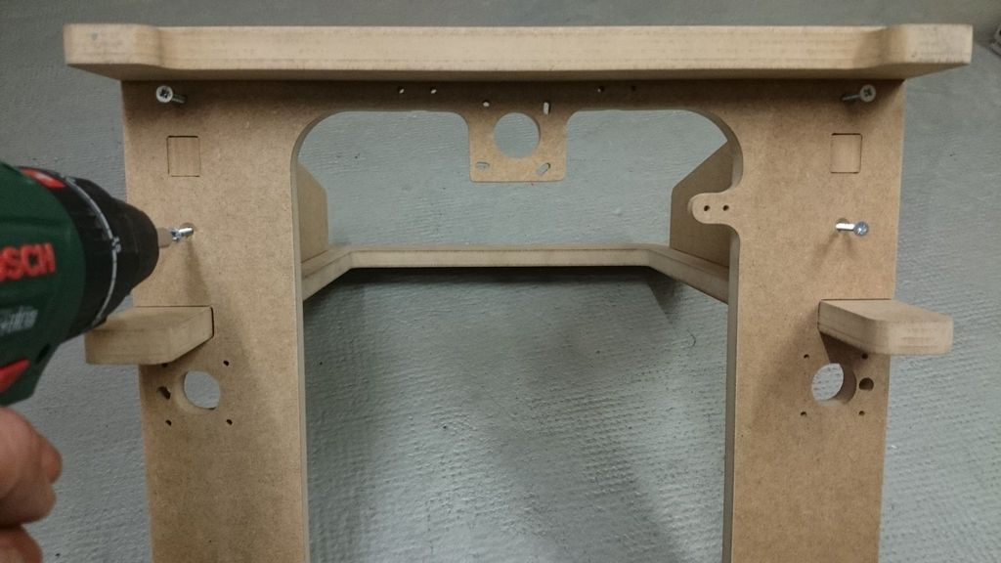
Turn back and screw all together
3.5x40mm (4x).

Slide 26
Do not forget to clean the glue.

Slide 27
CHAPTER 1
The end...
At this point your frame is finished and functional. The following statement is optional but highly recommended.

Slide 28
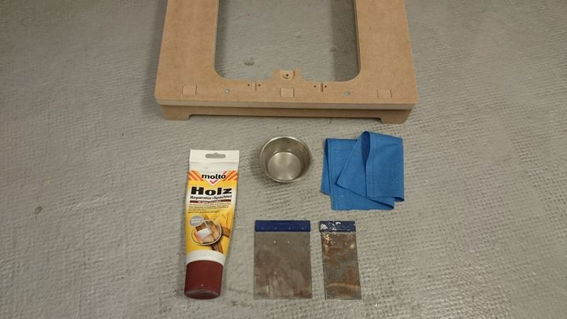
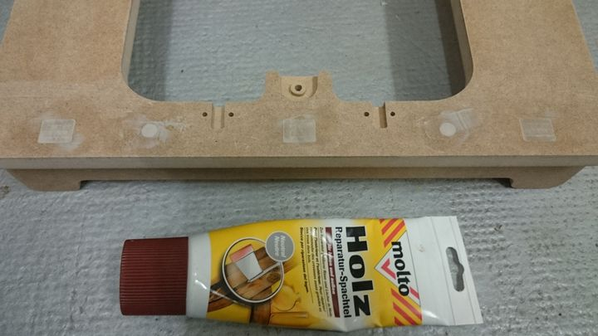
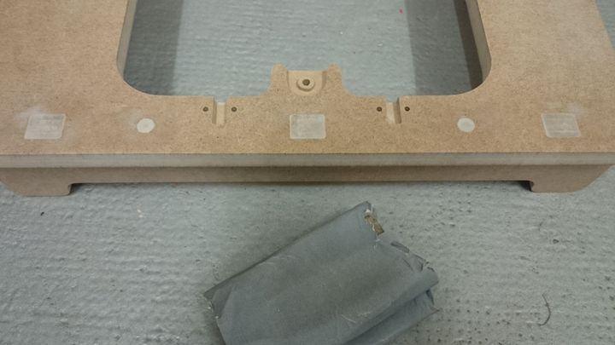
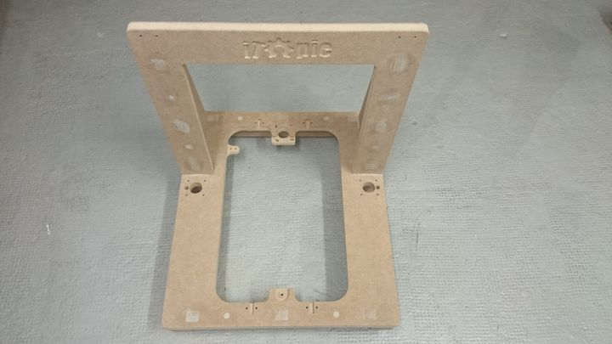
1Cleaning, 2Apply some wood putty, 3Sanding,
4Final cleaning with a damp cloth.

Slide 29
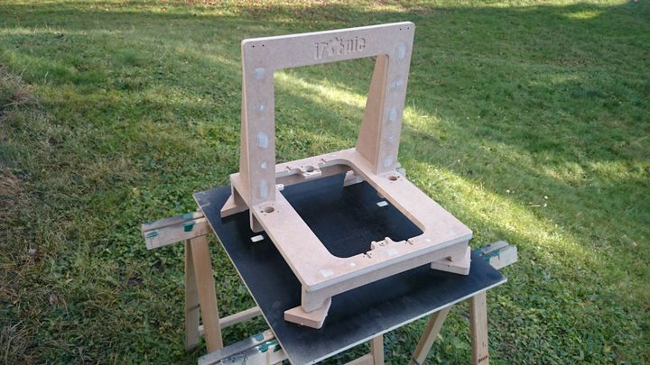
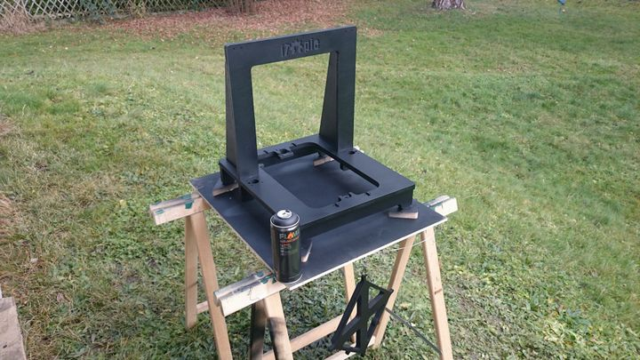
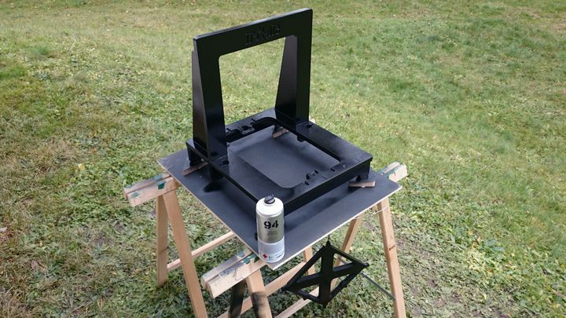
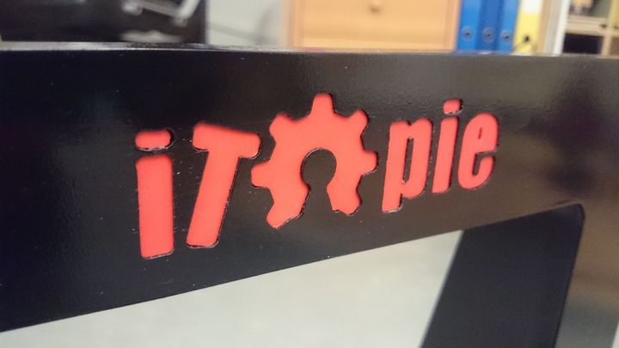
5Color (two coats), 6Laquer (two coats), 7Logo.

Slide 30
CHAPTER 1
Alternative ending.

