Slide 1
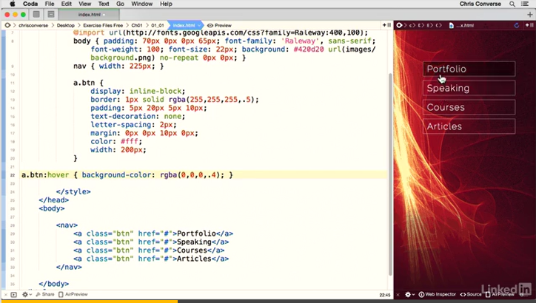
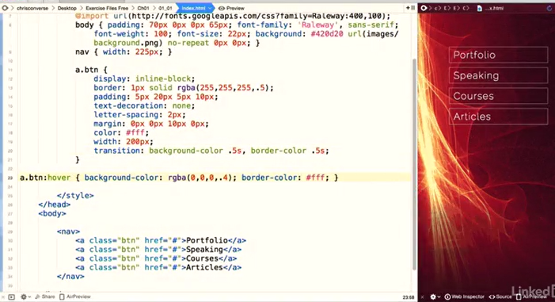
Background-colour
Change to 40% black transparent when ‘hovered’

