Slide 1
Coupled Oscillator Model parameter optimization with UKF on fMRI data
H. Khalegpoor
S.Karaoglu

Slide 2
Goals of the Project
This project aims to leverage nonlinear system identification techniques, focusing on the Unscented Kalman Filter (UKF), to enhance modeling and understanding of neural dynamics from fMRI data, addressing the direct challenges of noise and indirect measurement.​
UKF on different fMRI signals (different regions, different subjects)​
Coupled oscillator model modification​ - New model
Parameter estimation methods comparison - Optimization methods
Measuring coupling on more than 2 regions simultaneously - Possible

Slide 3
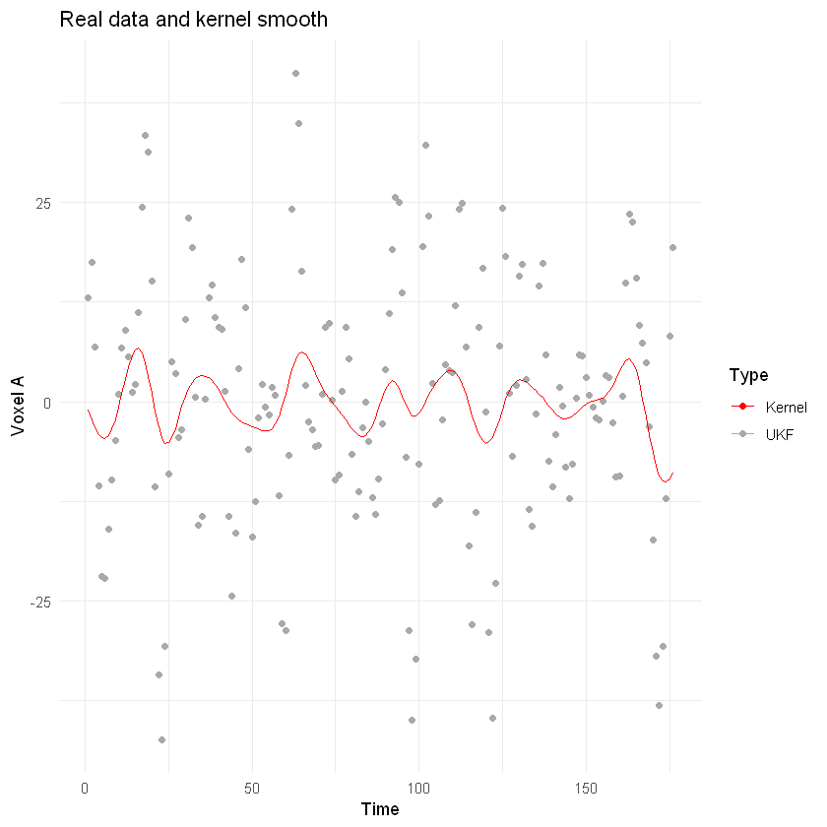
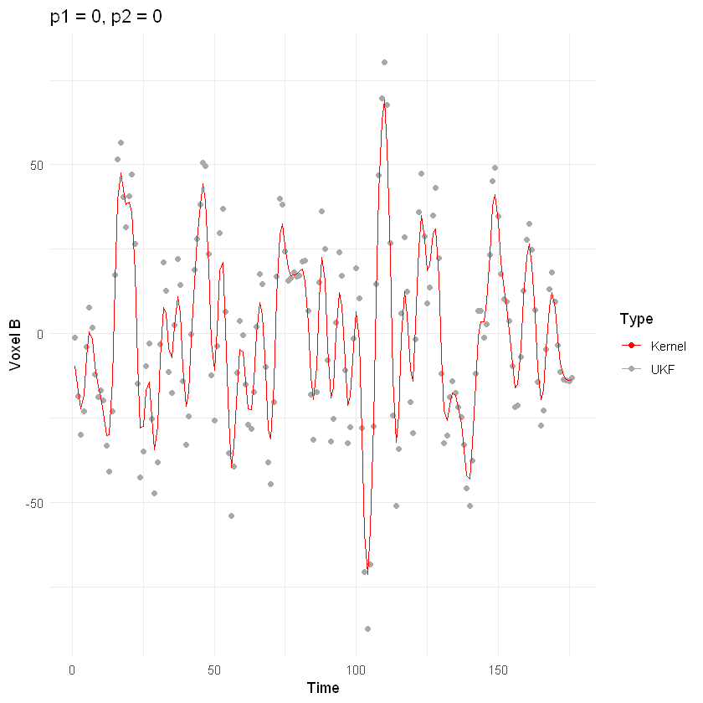
Datasets
Voxel A & B data (accessible through Harvey)
Harvard - Oxford atlas dataset
2 subjects
1 ASD and 1 Normal condition
voxel A: 18th voxel (Left Amygdala)
voxel B: 26th voxel (Left Accumbens)
https://scalablebrainatlas.incf.org/human/HOA06
https://www.kaggle.com/datasets/mhkoosheshi/asdfmri?resource=download&select=Harvard-Oxford+Atlas+%28Label+of+Brain+Regions%29.csv
Normal Subject 01 voxels #18 and #26

Slide 4
Coupled Oscillator Model
Coupled pendulum approximation. “p” are unknown parameters to estimate (other parameters could also be optimized or determined).
w1 + a1 sinθ1 + p1 sinθ2,
w2 + p2 sinθ1 + a4 sinθ2.
* In the experiment, w1 & w2 = 0, a1 & a4 = 1.

Slide 5

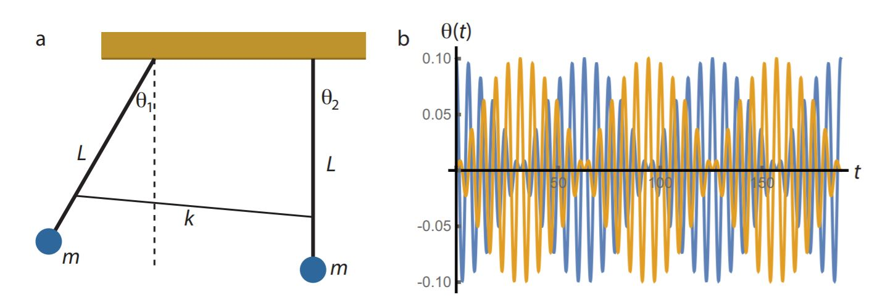
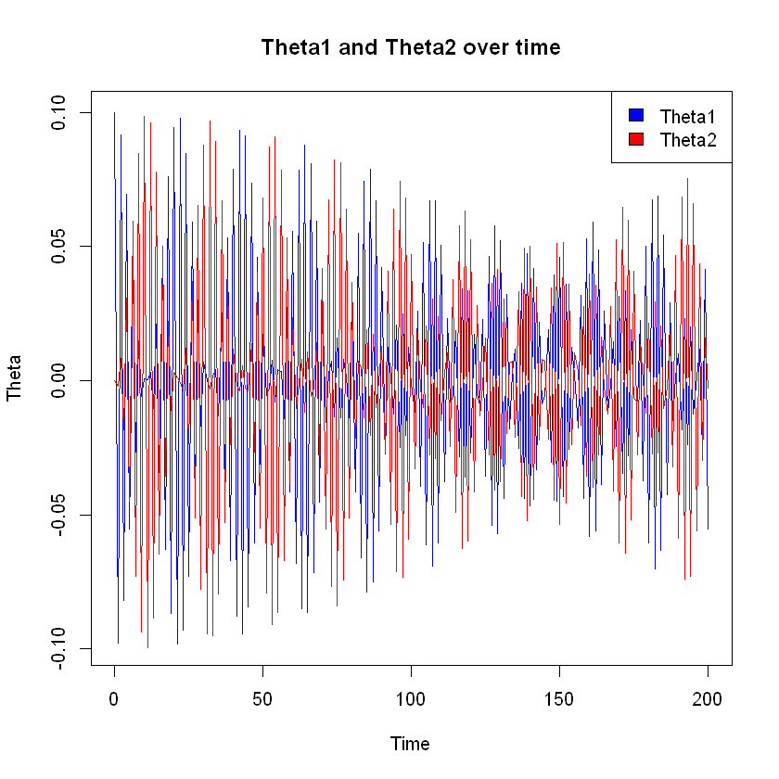
Coupled Oscillator Model
Two identical pendulums of length L and mass m, which are connected by a weak spring with spring constant k.
L ̈ θ1 = −g sinθ1 − k L (sinθ1−sinθ2),
L ̈ θ2 = −g sinθ2 + k L (sinθ1−sinθ2)

Slide 6
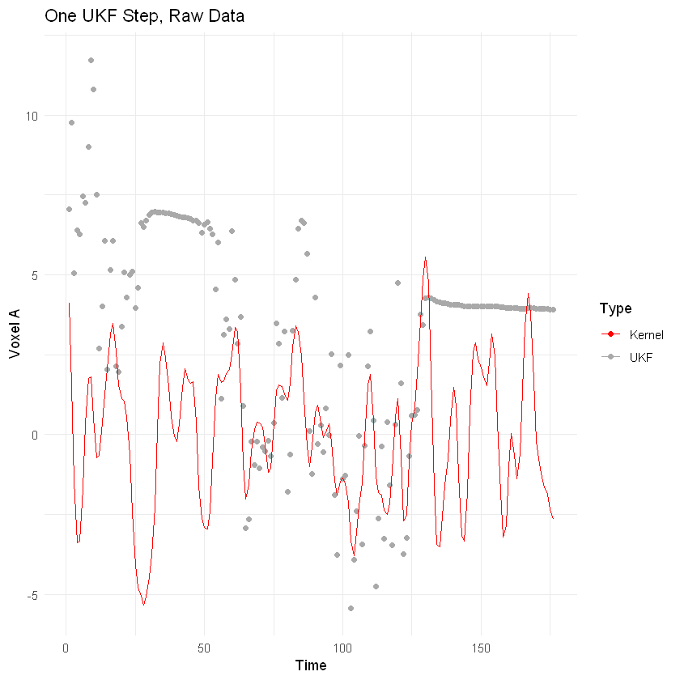
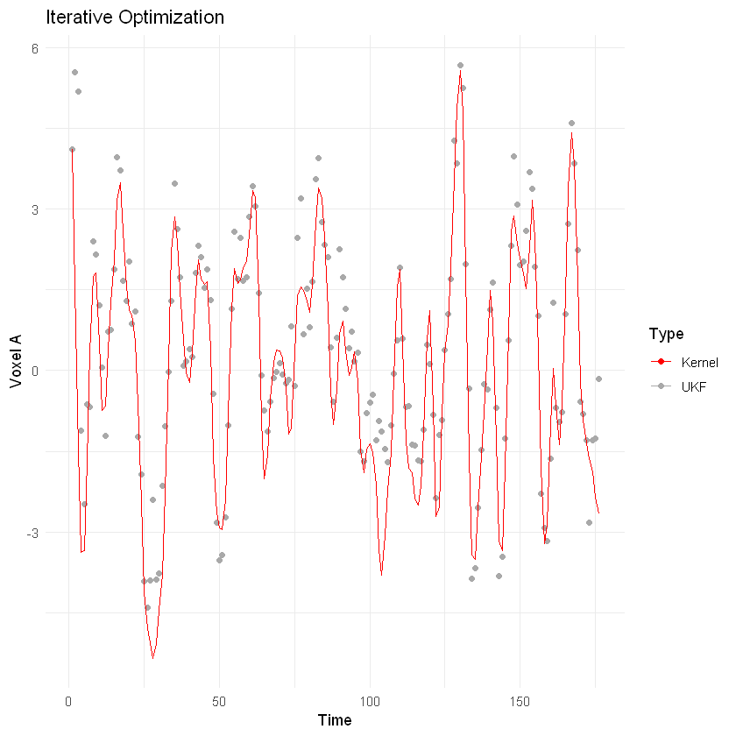
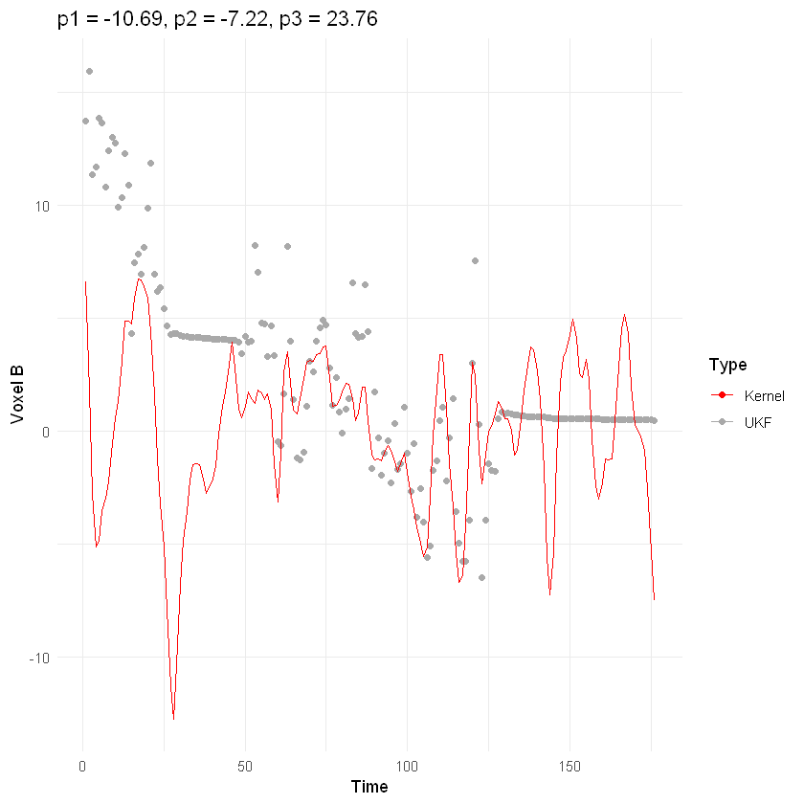
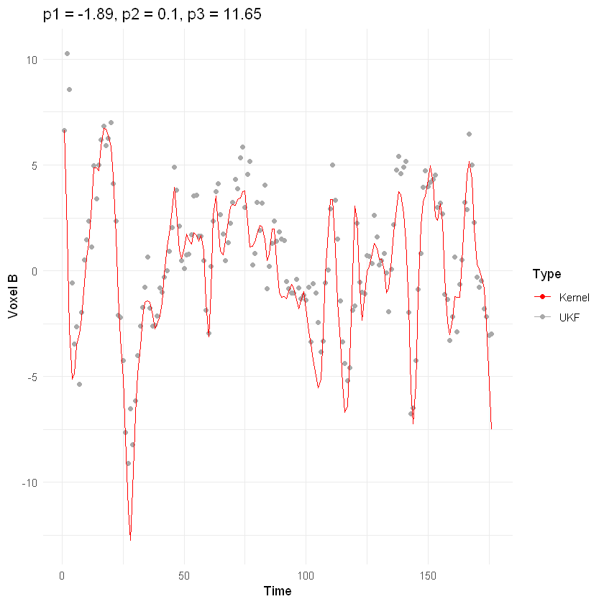
UKF & New Coupled Oscillator Model
One Pass, g = -10.69, L = -7.22, k = 23.76, chi2 = 62.6
Iterative Opt., g = -1.89, L = 0.1, k = 11.64, chi2 = 4.33

Slide 7
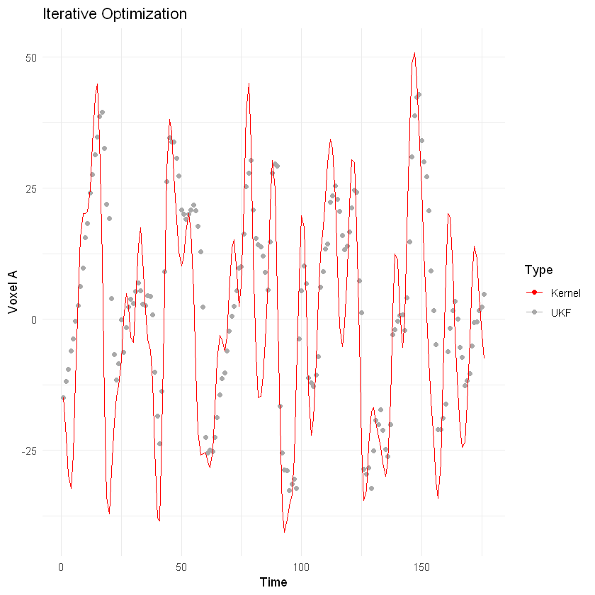
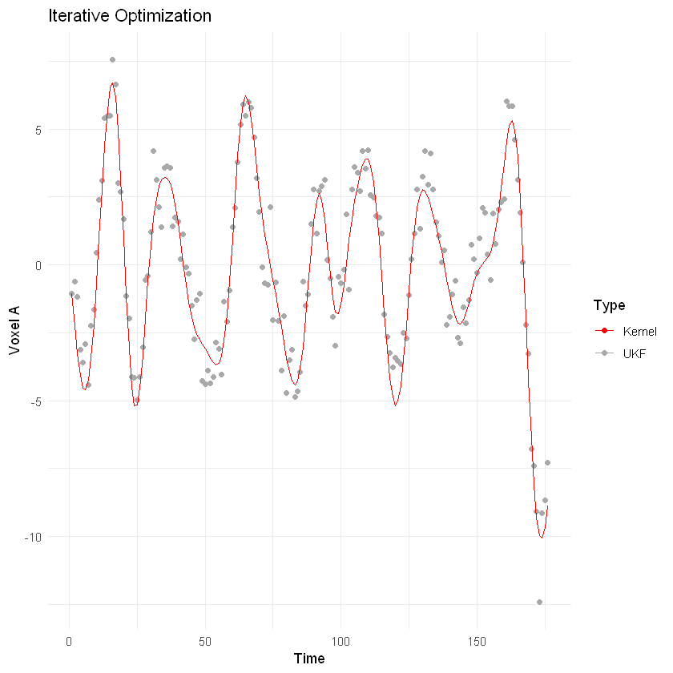
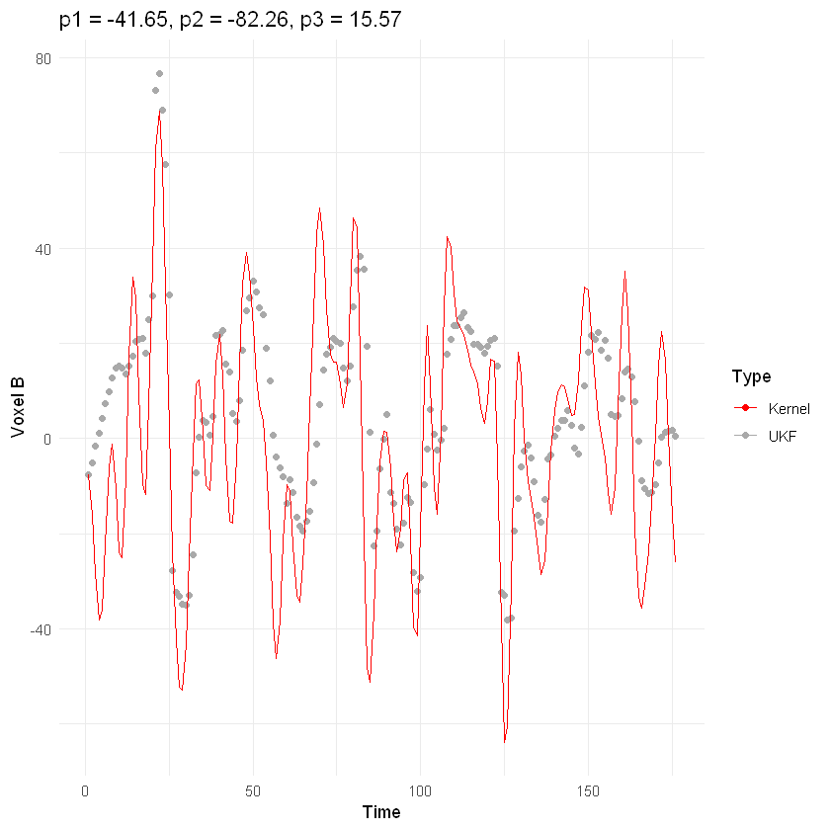
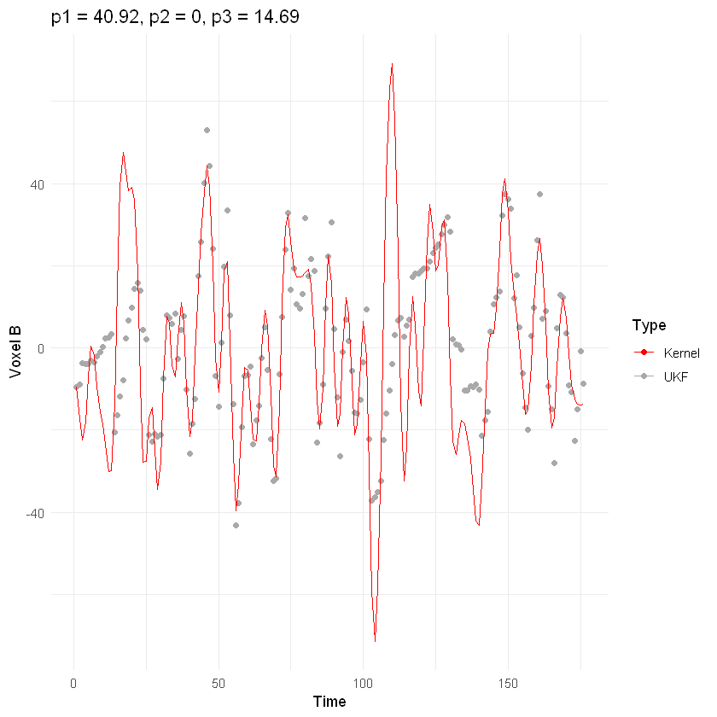
Iterative Opt. smoothed data, g = -1.89, L = 0.1, k = 11.64, chi2 = 4.33
Iterative Opt. smoothed subj1 (ADS Subject 01), g = -41.65, L = -82.26, k = 15.57, chi2 = 592.5
Iterative Opt. smoothed subj2 (Normal Subject 01), g = 40.92, L = -0.01, k = 14.69, chi2 = 315.4

Slide 8
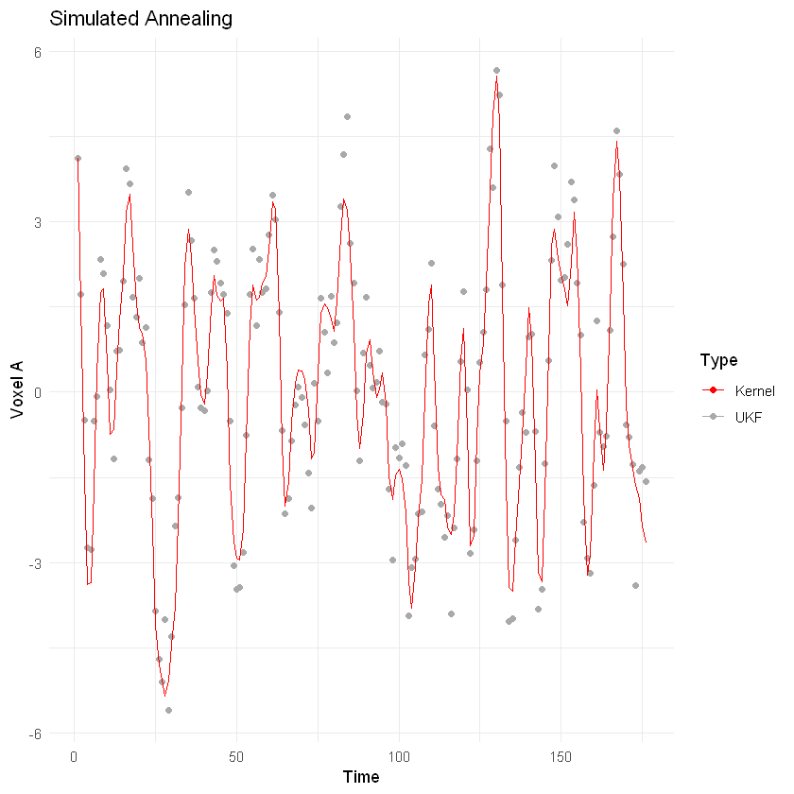
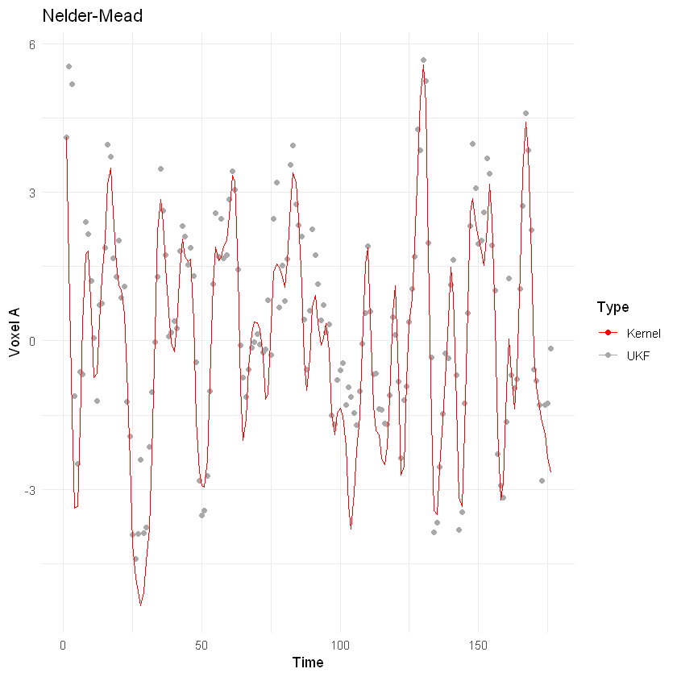
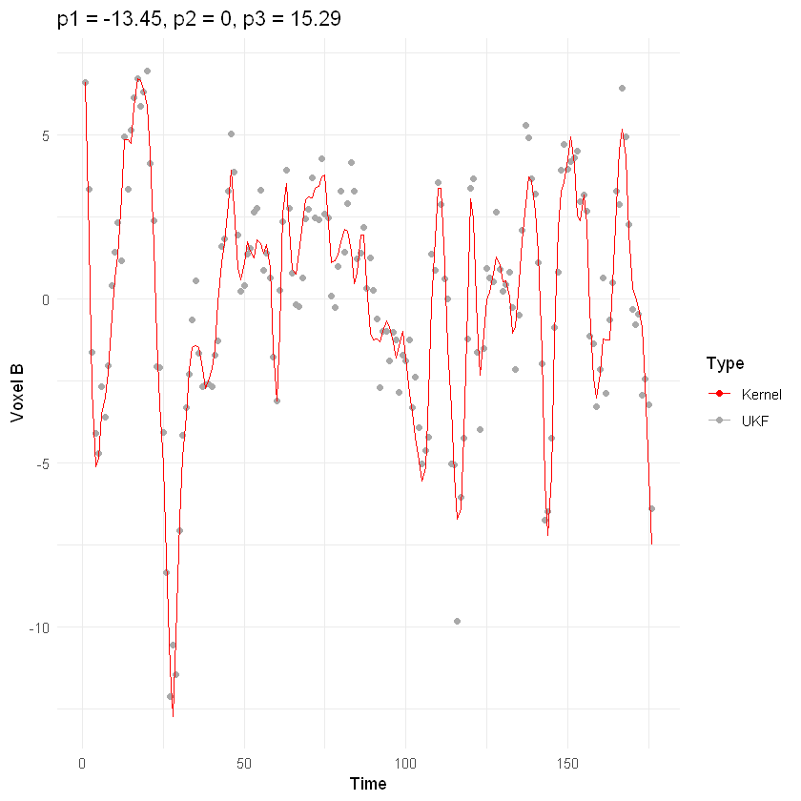
Iterative Opt. smoothed data, g = -1.89, L = 0.1, k = 11.64, chi2 = 4.33
Simulated Annealing smoothed data + UKF, g = -15.4, L = 1.35, k = 15.53, chi2 = 1.4
Nelder-Mead smoothed data + UKF, g = -1.89, L = 0.1, k = 11.64, chi2 = 4.33

Slide 9
Conclusion
Future Work
New Coupled Oscillator model is efficient on fMRI data analysis
As the number of parameters increase, the runtime and the search space increases.
More datasets and correlated voxels can be examined
New model can be modified to have more parameters
Parallelization for larger search spaces
UKF function modifications

Slide 10
References
https://phys.libretexts.org/Bookshelves/University_Physics/Mechanics_and_Relativity_(Idema)/08%3A_Oscillations/8.04%3A_Coupled_Oscillators
https://scalablebrainatlas.incf.org/human/HOA06
https://www.kaggle.com/datasets/mhkoosheshi/asdfmri?resource=download&select=Harvard-Oxford+Atlas+%28Label+of+Brain+Regions%29.csv
https://groups.seas.harvard.edu/courses/cs281/papers/unscented.pdf

