Slide 1
Cloud Computing

Slide 2
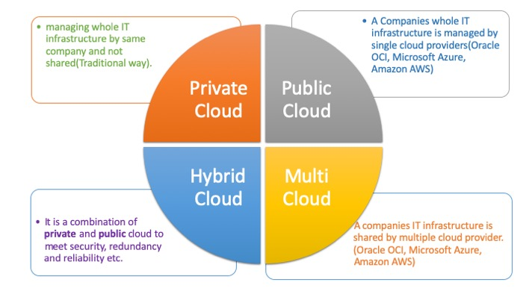
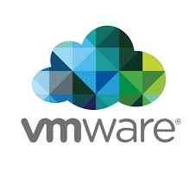

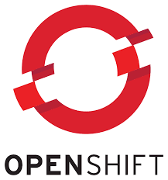
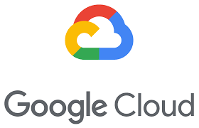
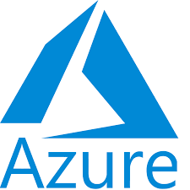
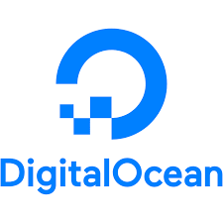
Cloud Computing
What is Cloud? And What is Cloud Computing?
Definition: Cloud computing is the on-demand delivery of IT resources over the internet with pay-as-you-go pricing. It allows users to rent computing services instead of buying and maintaining physical hardware.
Notes:
“Let’s now shift gears and talk about something you’ve probably heard a lot — Cloud Computing. But what is it really?
Cloud computing, in the simplest terms, is like renting computing power instead of buying it.
Let me give you a quick analogy: Think about electricity. You don’t have a power plant in your backyard, right? You consume electricity on demand, pay only for what you use, and the electric company takes care of maintenance and uptime.
Cloud computing works the same way — instead of owning physical servers and data centers, you use the internet to access computing services on demand — servers, databases, storage, networking, AI tools, and more.
🧩 So why use the cloud? Because it’s:
✅ On-demand – You only pay when you need it. ✅ Scalable – You can go from one user to one million overnight. ✅ Reliable – Providers guarantee uptime and take care of backups. ✅ Cost-efficient – No capital expenses on hardware or IT staff to maintain it.
📦 Now, there are three things you can ‘rent’ from the cloud:
Infrastructure — like servers and networks
Platforms — like tools to deploy your code
Software — fully functional apps you just log into
We'll break these down in the upcoming slides as IaaS, PaaS, and SaaS — but remember, at its heart, cloud computing is just outsourcing your IT needs to the internet.
💡 Real-world example: Imagine a startup wants to launch a mobile app. Instead of buying servers, setting up databases, hiring admins… they use AWS to launch a server in minutes, Firebase to store user data, and SendGrid to send emails — all cloud-based services.
They’re live in a day — that’s the power of the cloud.
So whenever you hear 'cloud', think of it as: ➡️ Pay-as-you-go computing over the internet, without the hassle of owning anything.
Cool? Let’s now explore the different ways you can use the cloud — starting with deployment models.”

Slide 3
Cloud Computing
Deployment Models
Model | Description | Example Use Case
Public | Services delivered over internet and shared infrastructure | Startups, Scalable apps (e.g., Azure)
Private | Dedicated infrastructure for one organization | Banks, Government
Hybrid | Mix of public + private; integrated management | Disaster recovery, burst scaling
Multi-cloud | Use of multiple public cloud providers | Avoid vendor lock-in, optimize pricing

Slide 4
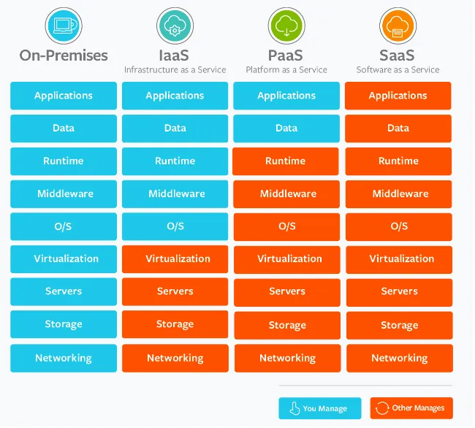


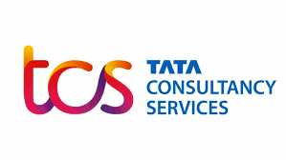
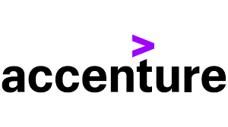
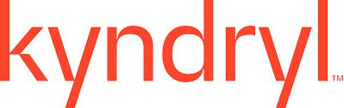
Cloud Computing
Cloud Service Models
IaaS (Infrastructure as a Service)
Provides virtualized computing resources: VMs, storage, networks
Example: AWS EC2, Azure Virtual Machines
You manage: OS, apps, runtime
PaaS (Platform as a Service)
Provides a platform to develop, run, and manage applications without managing infrastructure
Example: Azure App Services, Google App Engine
You manage: Apps and data
SaaS (Software as a Service)
Delivers software applications over the internet
Example: Gmail, Microsoft 365, Salesforce
You use the software; provider manages everything else

Slide 5
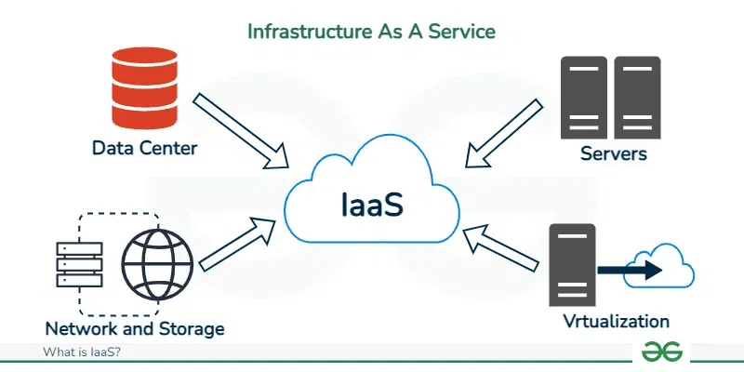
Cloud Computing
Infrastructure As Service (IAAS)
🔹 What It Means:
You rent infrastructure — virtual machines, storage, networking, etc.
You manage the OS, runtime, and applications.
The cloud provider manages the physical servers, virtualization, and networking.
🧰 Example:
You get a virtual server from Azure, install your operating system, your database, and then deploy your web app on it.
💡 Real-World Analogy:
Imagine renting an empty house. You bring in your own furniture, appliances, do your own cooking and maintenance — but you don’t own the building.
✅ Use Case:
Developers who want full control over the server
Hosting custom applications or legacy software
🛠 Examples of IaaS:
Microsoft Azure Virtual Machines
AWS EC2 (Elastic Compute Cloud)
Google Compute Engine

Slide 6
Cloud Computing
Platform As Service (PAAS)
🔹 What It Means:
You rent not just infrastructure, but also a platform that includes the OS, runtime, and development tools.
You only manage your code and data
The provider manages the OS, infrastructure, runtime, and tools
🧰 Example:
You use Azure App Service to deploy a web app. You just upload your code — Azure takes care of the rest (hosting, scaling, patches).
💡 Real-World Analogy:
Renting a fully furnished apartment where you just bring your suitcase. You can live there and cook meals, but don’t worry about repairs or appliances — it’s all maintained for you.
✅ Use Case:
Quick web app deployments without worrying about servers
Focus on coding, not setup
🛠 Examples of PaaS:
Azure App Service
Google App Engine
Heroku
AWS Elastic Beanstalk

Slide 7
Cloud Computing
Software As Service (SAAS)
🔹 What It Means:
You use a complete software product hosted and managed by someone else.
You don’t worry about the infrastructure or the platform — you just use the application via browser or app.
🧰 Example:
You log into Outlook, Gmail, or Microsoft Teams — you’re using a SaaS product. No setup, no installations.
💡 Real-World Analogy:
Like eating at a restaurant — everything is prepared and served to you. You just enjoy the food (features), no cooking or cleaning.
✅ Use Case:
Email, file storage, CRM, team collaboration
End users and businesses who need ready-to-use tools
🛠 Examples of SaaS:
Microsoft 365
Google Workspace
Dropbox
Salesforce
Zoom

Slide 8
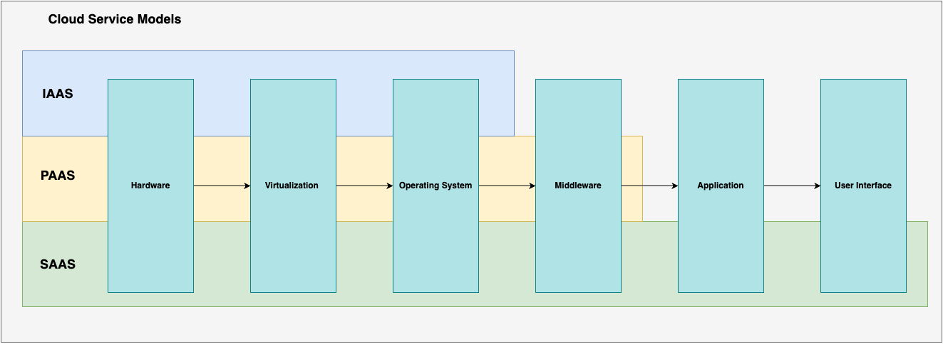
Cloud Computing
Cloud Service Models
Feature | IaaS | PaaS | SaaS
Managed By You | App, data, runtime, OS | App & data | Just using the software
Control Level | Highest | Medium | Lowest
Setup Time | Long | Medium | Almost none
Flexibility | Maximum | Moderate | Minimal
Example | Azure VM | Azure App Service | Microsoft 365

Slide 9
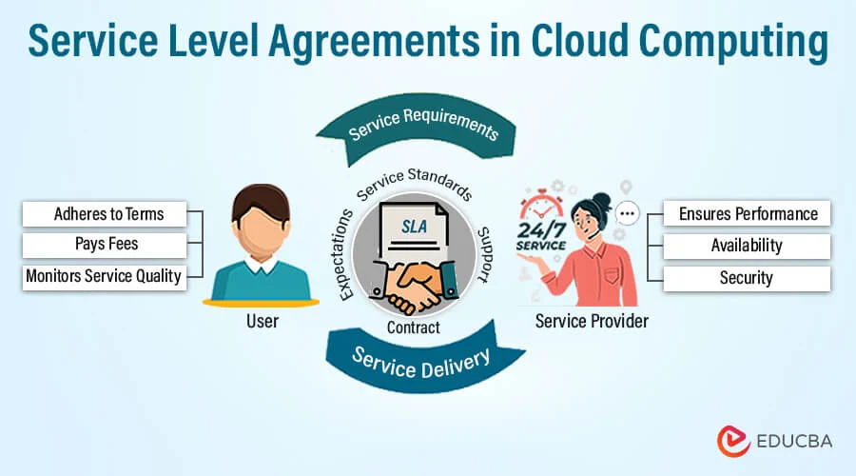
Cloud Computing
Cloud Security – Service Level Agreements (SLA)
What is it? An SLA is a formal agreement between the cloud provider and the customer that defines:
Uptime (availability) expectations
Response time for issues or outages
Support commitments and escalation paths
Example: Azure offers a 99.9% uptime SLA for Virtual Machines. That means the VM is guaranteed to be available at least 99.9% of the time in a given month (less than ~45 minutes of downtime).
Why SLAs matter:
Helps businesses plan for redundancy (e.g., use multiple Availability Zones)
Defines accountability and compensation if guarantees are not met

Slide 10
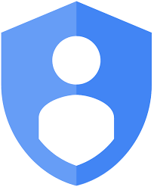
Cloud Computing
Cloud Security – Identify & Access Management (IAM)
👤 Identity & Access Management (IAM)
What is IAM?
IAM helps organizations securely manage who has access to what resources in the cloud. It's the gatekeeper of your cloud environment.
🔐 Key IAM Concepts:
✅ Role-Based Access Control (RBAC)
Assigns permissions to users based on their role (e.g., Admin, Developer, Reader)
You don’t give access directly to users — you give it through roles
Example: A "Reader" can view a VM but can’t stop or delete it
✅ Principle of Least Privilege
Users should have only the minimum access needed to do their job — nothing more
Helps reduce the risk of mistakes or breaches
✅ Multi-Factor Authentication (MFA)
Adds an extra layer of security beyond just username & password
User must also verify via:
SMS code
Mobile app (e.g., Microsoft Authenticator)
Biometric login (e.g., fingerprint)
🔐 Why IAM is Critical
Prevents unauthorized access
Supports compliance (e.g., ISO, GDPR)
Essential for secure collaboration in DevOps teams

Slide 11
Cloud Computing
Identity & Access Management
🔐 What is IAM (Identity and Access Management)?
Framework to manage who can access what in the cloud.
Ensures secure, controlled, and auditable access to resources.
Manages:
Identities (users, apps, services)
Authentication (verify identity)
Authorization (grant/deny access)
🌐 Why IAM is Critical in Cloud:
Cloud is accessible from anywhere → strong access control is a must.
Prevents unauthorized access, accidental deletions, security breaches.
Helps with compliance, accountability, and operational security.
🧱 Core Components of IAM:
Component | Purpose
User | Individual identity (e.g., developer)
Group | Collection of users with similar permissions
Role | Defined set of permissions for tasks
Policy | Rules that allow/deny actions
Permissions | Fine-grained controls (e.g., read/write/delete access)
👩‍💻 Example:
Rahul, a developer:
Identity created
Added to “Dev Team” group
Assigned a role that allows code push but blocks production deletes
Notes:
IAM is your gatekeeper in the cloud. It ensures that only the right people or systems access specific resources, at the right time, and for the right reasons. Think of it as giving out customized keycards in a high-security building — you decide who gets into which rooms.
IAM uses a combination of users, groups, roles, and policies. You can think of it like building a permissions system with Lego blocks — flexible, modular, and powerful. One role can be reused by many users, and one policy can control access across multiple services.

Slide 12
Cloud Computing
Identity & Access Management
🔐 What is IAM (Identity and Access Management)?
🧱 Summary:
Azure: Uses Azure AD + RBAC (roles like Reader, Contributor)
AWS: JSON-based policies for users, groups, and roles
GCP: Project-level roles (basic, predefined, custom)
IAM Concept | Purpose
Authentication | Who you are
Authorization | What you’re allowed to do
RBAC | Role-based access
MFA, Logs | Boost security and visibility
🔐 IAM Best Practices:
✅ Grant least privilege access
✅ Use roles over individual permissions
✅ Enable Multi-Factor Authentication
✅ Review access regularly
✅ Use managed identities/service accounts for apps
✅ Monitor access logs for suspicious activity
Notes:
Every cloud platform has its own way of doing IAM, but the principles are the same. If you follow the best practices, especially "least privilege" and MFA, you’re already ahead of 90% of security issues. IAM is the foundation of secure cloud usage — get this right and everything else becomes easier.

Slide 13
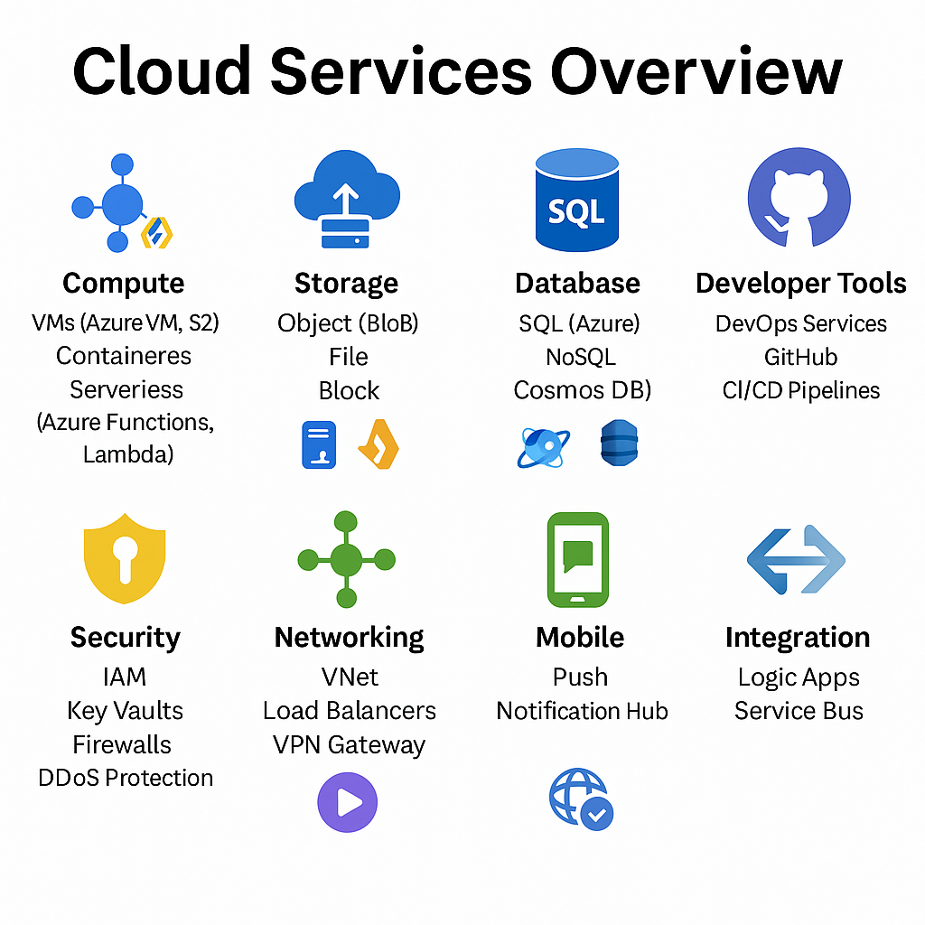
Cloud Computing
Cloud Offerings
Category | Services / Examples | Platform(s)
Compute | Azure VM, AWS EC2, AKS, EKS, Azure Functions, Lambda | Azure, AWS
Storage | Azure Blob, S3, Azure Files, EBS (block storage) | Azure, AWS
Database | Azure SQL, Cosmos DB, RDS, DynamoDB | Azure, AWS
Developer Tools | Azure DevOps, GitHub, Jenkins, CI/CD Pipelines | Azure, GitHub, Jenkins
Security | IAM, Azure Key Vault, AWS KMS, NSGs, DDoS Protection | Azure, AWS
Networking | Azure VNet, Load Balancers, VPN Gateway, AWS VPC | Azure, AWS
Media | Azure CDN, AWS CloudFront, Encoding Services | Azure, AWS
Mobile | Azure Notification Hub, Firebase Cloud Messaging (FCM) | Azure, Firebase
Integration | Azure Logic Apps, Service Bus, AWS Step Functions, EventBridge | Azure, AWS

