Slide 1
01
Virtualization

Slide 2
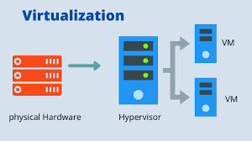
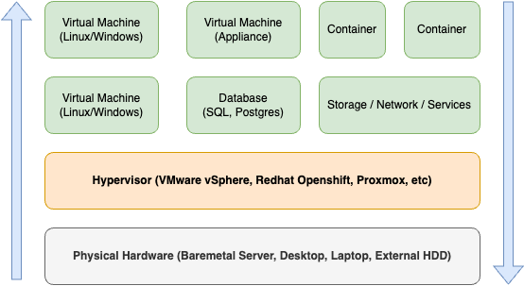
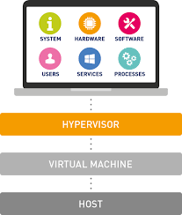
Virtualization
What is Virtualization?
Core of Virtualization
Why It Matters?
Virtualization abstracts physical resources, allowing multiple operating systems to run concurrently on a single hardware platform.
Improves hardware utilization
Reduces operational cost
Enables scalability and flexibility
Provides isolation between workloads
What is it?
Virtualization is the process of creating a virtual version of physical components such as servers, storage devices, and network resources. It allows multiple operating systems and applications to run on a single physical machine by abstracting the hardware.
Notes:
Let’s start with virtualization, which is how we simulate multiple computers on a single physical machine.
Imagine one computer acting like five—it’s possible through a hypervisor, which creates and manages virtual machines.
These VMs can each run different OSes and apps. Think of it like having five apartments in one building, each self-contained.
Now, OS-level virtualization uses containers. It doesn’t replicate the entire OS—just the application layer, which is lighter and faster.
Docker is a perfect example. And we’ll use Docker later in our labs to understand containers in action.

Slide 3
Hardware Level Virtualization
OS Level Virtualization
Traditional Virtual Machines (VMs)
Containers, Desktop Virtualization
✅ What it is: You simulate entire hardware — CPU, memory, storage — so that each Virtual Machine (VM) behaves like a separate computer.
✅ How it works: A software layer called a hypervisor sits directly on the physical machine (or on an OS) and allows you to run multiple full operating systems (e.g., Windows, Linux) on one physical server.
✅ Characteristics:
Each VM has its own kernel (the core part of an OS)
VMs are heavier, take more time to boot, and use more memory
Ideal for running multiple full systems like test environments or legacy apps
✅ Examples: VMware ESXi, Microsoft Hyper-V, KVM
✅ What it is: Instead of virtualizing hardware, you virtualize the operating system itself. Multiple containers share the same OS kernel but run in isolated spaces.
✅ How it works: The host OS runs many lightweight, standalone applications (containers), each in its own space, without needing a full OS per app.
✅ Characteristics:
Containers are faster and lighter than VMs
They start instantly and use fewer resources
Great for microservices, DevOps pipelines, and scalable cloud apps
✅ Examples: Docker, LXC, Podman
Notes:
“Alright, let’s break down one of the most fundamental concepts in cloud computing: the two major types of virtualization—Hardware-Level and OS-Level.
🔹 First up: Hardware-Level Virtualization.
Imagine you’re setting up an entire apartment building. Each flat has its own kitchen, bathroom, electricity meter, and is completely isolated. That’s what hardware-level virtualization does. You create Virtual Machines—each with its own operating system, kernel, memory, and even virtualized CPU and storage.
It’s made possible by something called a hypervisor—software like VMware ESXi, Microsoft Hyper-V, or KVM. The hypervisor sits directly on the physical hardware and lets you install full-blown OSes like Windows or Linux on top.
This is super useful when you want strong isolation between systems. For example, an organization might run Windows Server for Active Directory on one VM, and Ubuntu for hosting a web app on another—all on the same physical box.
✅ Pros? High isolation, great for legacy apps, secure. ❌ Cons? Heavier, slower to boot, and resource-hungry.
🔹 Now let’s talk about OS-Level Virtualization, or what we commonly know today as containers.
This one’s more like a co-living space. You share the same infrastructure—kitchen, Wi-Fi—but each person has their own room and rules. Containers share the host OS kernel, but they’re isolated at the process level.
Tools like Docker, Podman, or LXC allow you to spin up containers in seconds. They don’t carry the full OS baggage—just the code, dependencies, and runtime needed for that one app.
Let me give you a real-world example. You’re building a Python Flask app. With Docker, you can package your app, Python runtime, and all libraries into one container. Your teammate on Windows can run the same container—and it just works, without any “but it’s working on my machine” issues.
✅ Pros? Lightweight, fast, perfect for microservices and DevOps. ❌ Cons? Less isolation than full VMs, all containers share the same kernel.

Slide 4
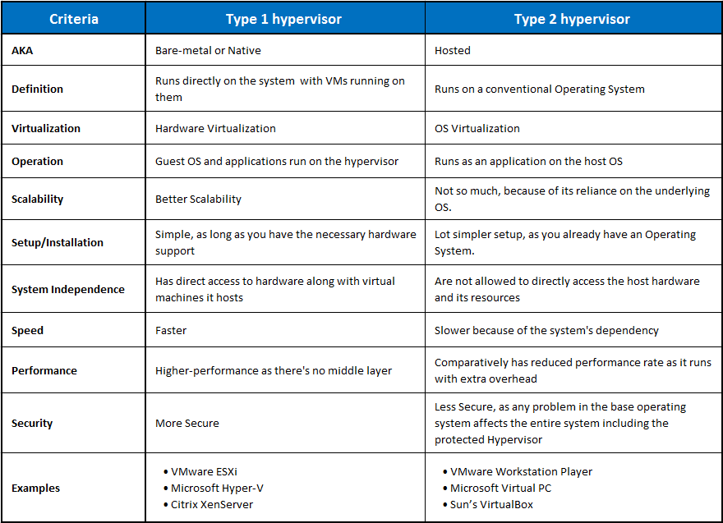
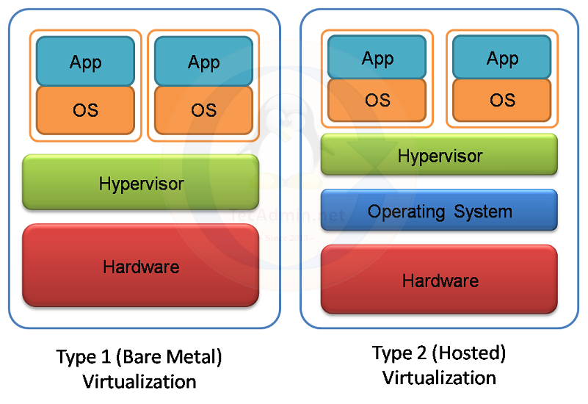
Types of Virtualizations
Type 1 & Type 2

Slide 5
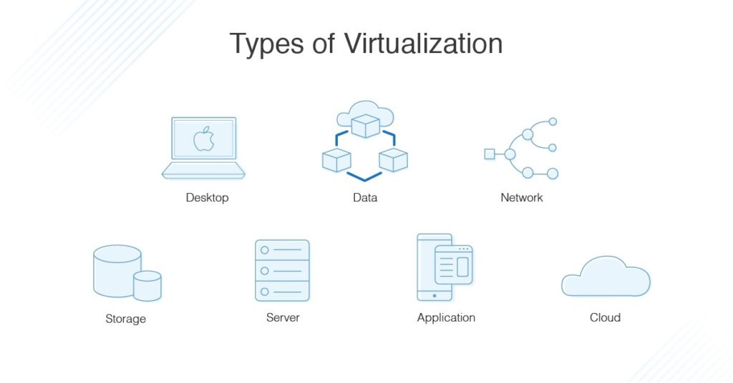
Virtualization
Context of Cloud
How Virtualization Powers Cloud?
Why it’s important for cloud?
Virtualization is the foundation of cloud computing — it enables cloud providers to offer multiple isolated virtual machines on shared physical infrastructure.
It allows elastic resource allocation, multi-tenancy, and dynamic provisioning.
Enables Infrastructure as a Service (IaaS)
Supports scalability and high availability
Reduces cost and increases efficiency for providers and users

