Slide 1
Transforming Bank Marketing: Classification, Clustering, and Pattern Mining

Slide 2

Project Overview & Problem Statement
Direct marketing campaigns suffer from operational inefficiency.
High costs result from low conversion rates in telemarketing.
Goal is to predict customer term deposit subscriptions accurately.
Transitioning from generalized marketing to data-driven targeting strategies.
Improving resource allocation by identifying high-probability customer leads.

Slide 3
Data Preparation & Feature Engineering
Treated "unknown" categorical values as distinct informative categories.
Handled "999" in pdays as a binary missingness indicator.
Removed duration variable to prevent unrealistic predictive data leakage.
Applied One-Hot Encoding to transform categorical variables for modeling.
Binned Age and Campaign features to capture broad behavioral trends.

Slide 4
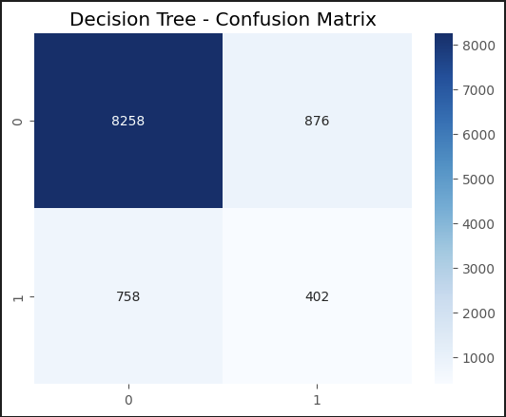
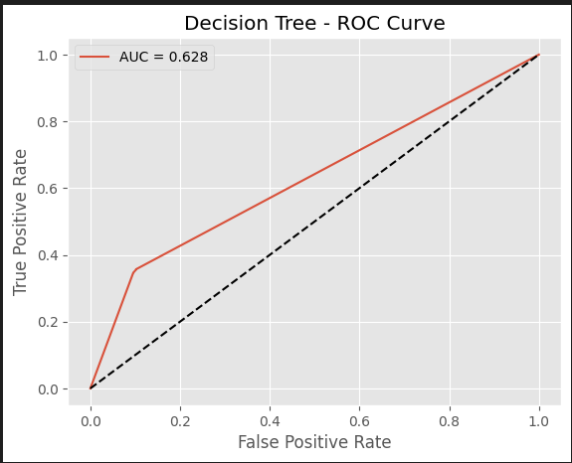
Supervised Learning: Model Selection
Transitioned from Regression to Classification for binary outcome prediction.
Implemented Decision Tree Classifier to establish a baseline for interpretability.
Utilized Random Forest Ensemble to reduce variance and prevent overfitting.
Applied class weighting to handle significant dataset class imbalance.
Used standardized preprocessing pipeline to ensure fair model comparison.

Slide 5

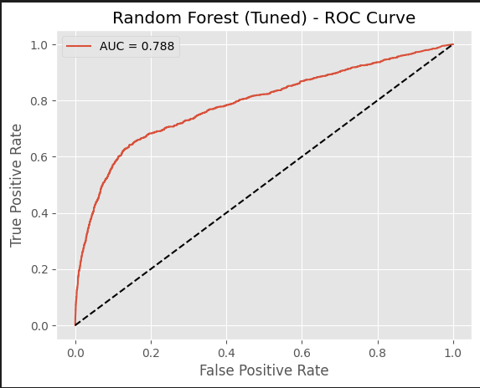
Hyperparameter Tuning & Evaluation
Tuned hyperparameters using GridSearchCV to optimize model predictive performance.
Random Forest achieved a strong ROC-AUC score of 0.79.
Precision improved significantly compared to the baseline Decision Tree model.
Euribor interest rates identified as the dominant predictor of subscriptions.
Confusion matrix analysis demonstrates a reduction in false positive predictions.

Slide 6
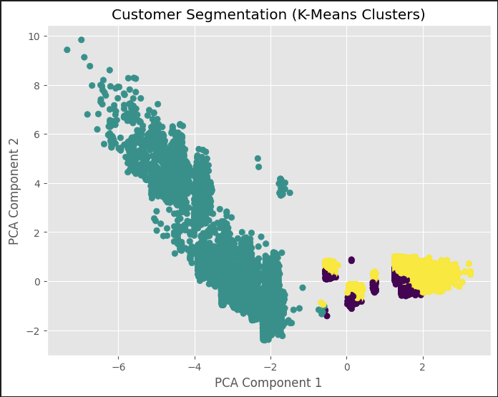
Unsupervised Learning: Customer Segmentation
Applied K-Means clustering to identify distinct customer personas within data.
Used Principal Component Analysis to visualize separation between clusters.
Identified "Cold Leads" characterized by no prior engagement history.
Characterized "Standard Clients" as the stable mass market demographic segment.
Discovered "High-Propensity" group highly sensitive to Euribor rate changes.

Slide 7
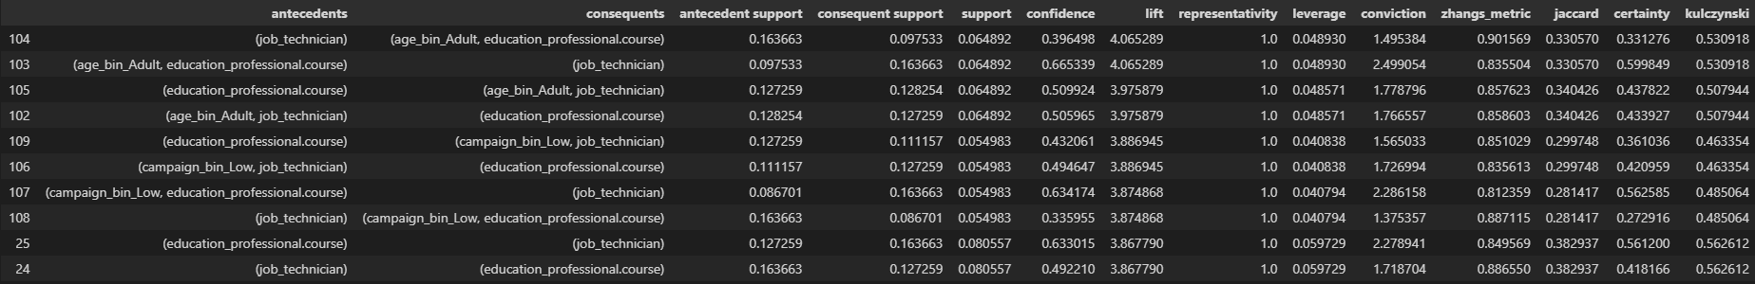
Association Rule Mining (Pattern Discovery)
Deployed Apriori algorithm to uncover hidden categorical data relationships.
Found strong association between Technicians and Professional Course education levels.
Successful subscriptions are linked to low campaign contact frequency.
High call volume did not correlate with subscription success.
Retired status shows strong association with term deposit interest.

Slide 8
Strategic Recommendations
Prioritize re-engaging customers with successful previous campaign outcomes.
Adjust marketing spend dynamically based on Euribor interest rate fluctuations.
Implement a strict three-call cap to prevent customer fatigue.
Tailor specific messaging for the Technician and Professional demographic segments.
Focus aggressive acquisition strategies on Senior and Young demographics.

Slide 9
Ethical Considerations & Conclusion
Ensure data privacy by encrypting sensitive customer information securely.
Monitor predictive models for algorithmic bias against specific demographics.
Provide explainability for decisions to comply with banking regulations.
Successful transformation from raw data to robust predictive framework achieved.
Project enables precise targeting to maximize marketing Return on Investment.

