Slide 1
Ansible
By
Raj Kiran

Slide 2
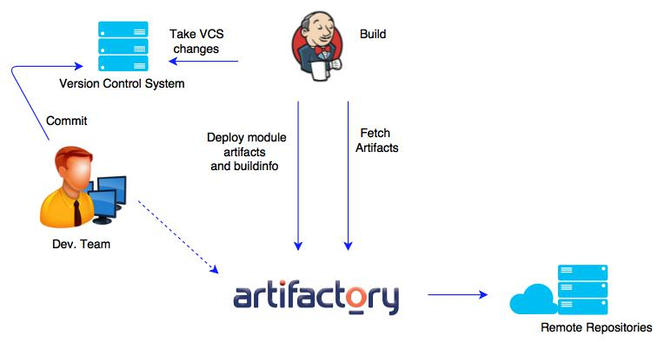

Slide 3
Idempotence
for an operation (or service call) to be idempotent, clients can make that same call repeatedly while producing the same result.(Caw)
HTTP Calls
PUT, GET (Idempo…)
DELETE, POST (No Idempo..)

Slide 4
Key concepts behind ansible
Change management (System State)
Provisioning ( transition of system state to another. Includes installation, configuration of software)
Automation (tasks, ordered operations, and describes what Ansible does)
Orchestration (Coordinate automation between systems)

Slide 5
Agent less
Every things in YAML formate (Structured, Easy to read and write)
Secure (users ssh, Vault, no PKI)
Open source
Extendable (API Call, shell commands, scripts, Ansible galaxy)
No complex upgrades

Slide 6
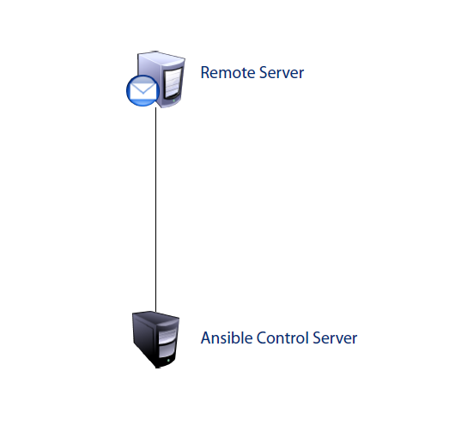

Slide 7
Ansible requirements
Python 2.6+
Password less ssh connection between remote server and ansible controller

Slide 8
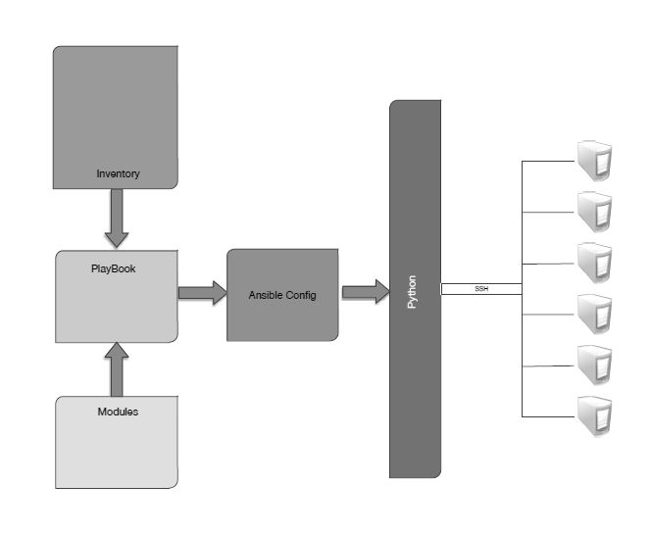

Slide 9
Key Terms
Module: A programmed unit of work to be done.
Play: A single task from a module, executed on a host or set of hosts
Playbook: A set of plays built in specific order sequence to produce an expected outcome or outcomes.

Slide 10
Variables
Host Variables
Facts
Dynamic variables

Slide 11
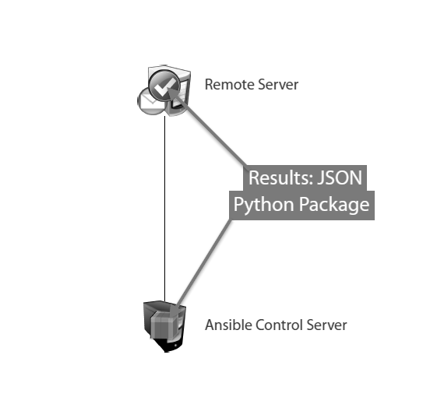
Execution Types:
Remote
Local

Slide 12
Modules
Core
Extras
Deprecated
462 Modules
Access modules
ansible-doc –l
Ansible-doc modulename
Ansible-doc –s modulename

Slide 13
Modules used for?
Manage servers
Deploy configurations
Configure network equipments
Maintain virtual servers
Manage databases and tables
Deploy load balancing configurations

Slide 14
Copy module
Copies a file from local to remote machine
It has backup capability
We can use this module to validate remotely
---
- name: “Copy file to target”
copy: src={{slocation}} dest={{dlocation}}

Slide 15
Fetch Module
Pulls a file from remote host to local
Can use md5 checksums to valudate
name: “Lets fetch a file”
fetch:
src:{{slocation}}
dest: {{dlocation}}
fail_on_missing: yes
validate_checksum: yes

Slide 16
Apt Module
To install packages in debian based systems.
We can install, update or delete packages.
We can even update entire system.
name: Install latest version of "openjdk-6-jdk" ignoring "install-recommends"
apt: name: openjdk-6-jdk
state: latest
name: Update all packages to the latest version
apt:
upgrade: package

Slide 17
Yum module
To install packages in debian based systems.
We can install, update or delete packages.
We can even update entire system.
name: install the latest version of Apache
yum:
name: httpd
state: latest
name: remove the Apache package
yum:
name: httpd
state: absent

Slide 18
Service Module
We can start, stop or restart services.
Can enable service to start on reboot.
# Example action to start service httpd, if not running
- service:
name: httpd
state: started
# Example action to stop service httpd, if running
- service:
name: httpd
state: stopped
# Example action to restart service httpd, in all cases
- service:
name: httpd
state: restarted

Slide 19
Examples
ansible webserver –i inventory –m yum –a “name=httpd state=present” –sudo
ansible webserver –i inventory –m service –a “name=httpd enabled=yes state=started” –sudo
ansible webserver:dbserver –i inventory –m service –a “name=iptables state=stopped” –sudo
Host group patterns
webservs:dbservers
webservs:&dbservers
!webservs
web*.mycomp.com
~web[0-9]*.mycomp.com

Slide 20
Setup module
gathering facts from remote systems.
ansible webser –i inventory –m setup
Use those facts as variables.
Lets say i want to look only network devices.
ansible webser –i inventory –m setup –a “filter=ansible_eth*”
I want to look for ansible mount.
ansible webser –i inventory –m setup –a “filter=ansible_mounts”
Dump all facts into files.
ansible all –i inventory –m setup –tree ./setup

Slide 21
Playbook
Plays maps hosts to tasks.
A play can have multiple tasks.
A playbook can have multiple tasks.
Tasks are executed in an order from top down
Tasks users modules

Slide 22
Play Example
- name: "Install and staring apache in webservers – play1"
remote_user: user
hosts: webservers
tasks:
- name: "Install apache server"
yum: name=httpd state=present
- name: "Stop Iptables service"
service: name=iptables state=stopped
- name: "Start apache service"
service: name=httpd state=started
- name: "Install and staring mysql in dbservers – play2"
remote_user: user
hosts: dbservers
tasks:
- name: "Install mysql server"
yum: name=mysql-server state=present
- name: "Start mysql service"
service: name=mysqld state=started

Slide 23
Play declarations
- hosts: servers
vars:
http_port: 3333
urls: http://test.com
db_user: username
sudo: yes
sudo_user: username
gather_facts: no
Execute a playbook
ansible-playbook playbookname.yml

Slide 24
ansible.cfg
[defaults]
hostfiles = inventory

Slide 25
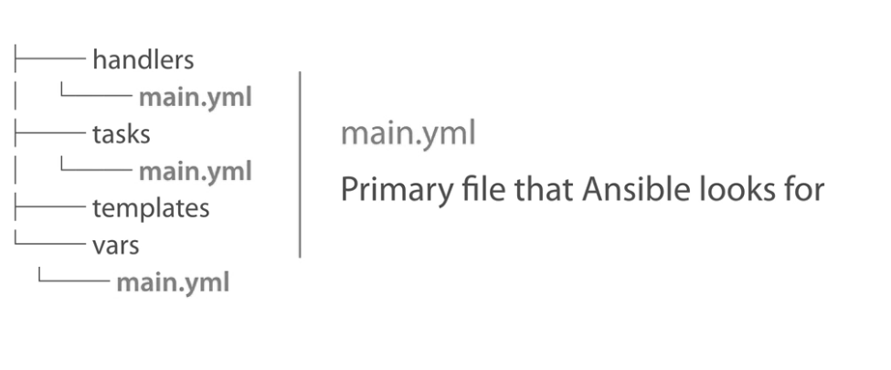
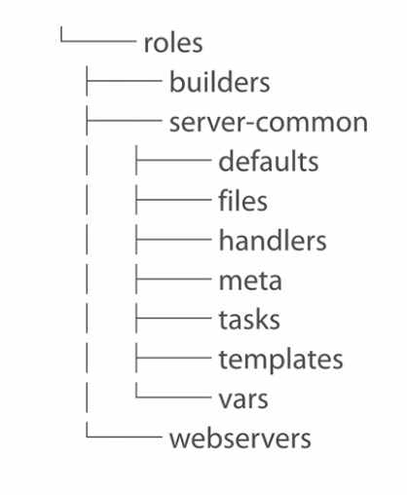
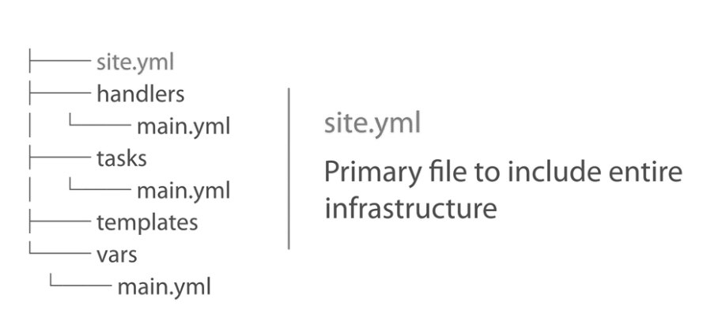
Roles

