Slide 1
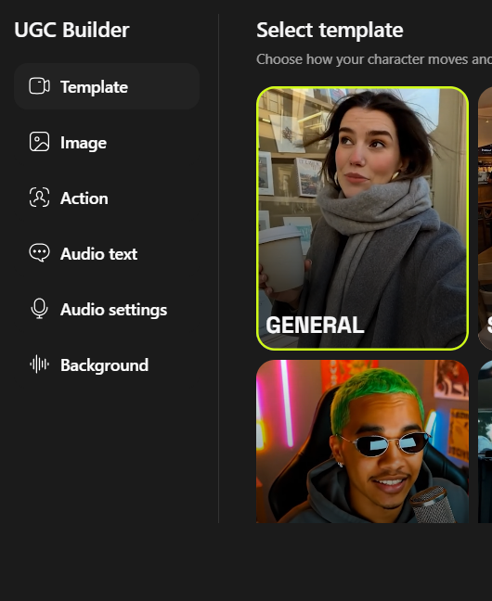
Higgsfield
A UGC Video Creation Tool and Its Current Limitations
Also With Add new features

Slide 2
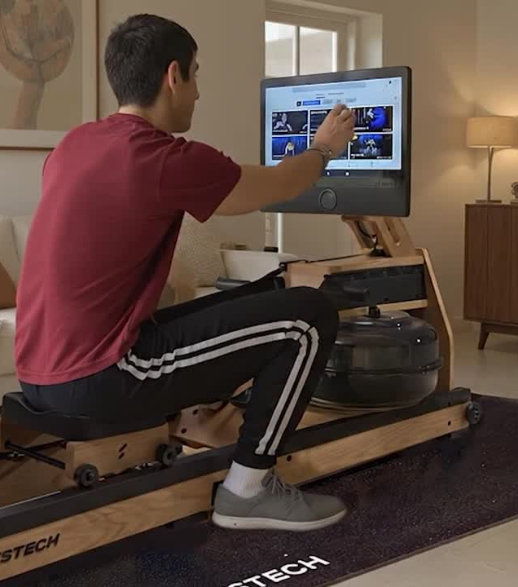

Higgsfield video
creation & duration
Higgsfield, when used with VEO3, currently generates videos limited to 7–8 seconds in duration. Attempts to extend the output by looping or holding the final frame did not deliver satisfactory results.

Slide 3
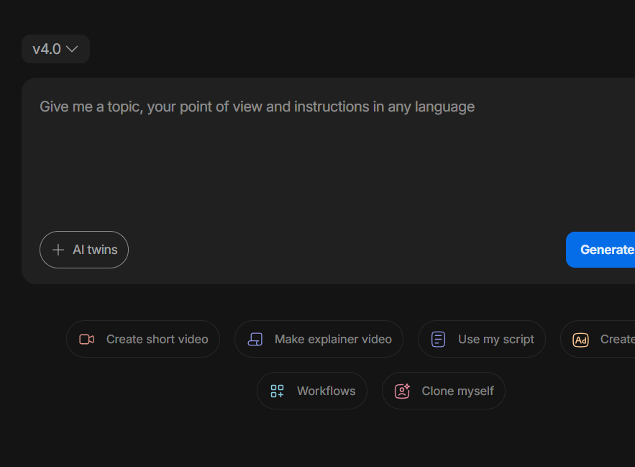
Extend the video
using Invideo ai
We attempted to extend the video using Invideo, but the platform does not currently offer a direct video extension feature.

Slide 4
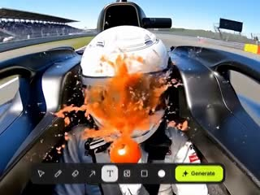
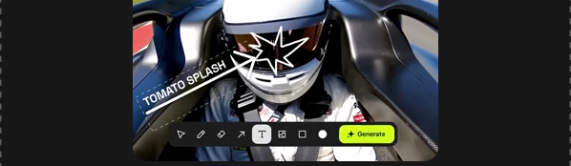
Higgsfield new feature
Draw to Video
This feature helps reduce the need for excessive prompting while delivering more accurate and natural-looking results with smooth video flow. It primarily runs on Veo3, Minimax, and Seedance Pro. The current process is similar to Veo3’s draw-to-video approach, where we first prepare the input in Photoshop, draw moving objects or animated elements, and then use that image as the first frame in Veo3. However, with Higgsfield, the workflow is significantly faster. Its built-in drawing feature allows us to directly create and animate elements without relying on external tools like Photoshop, reducing preparation time and improving video quality.

Slide 5
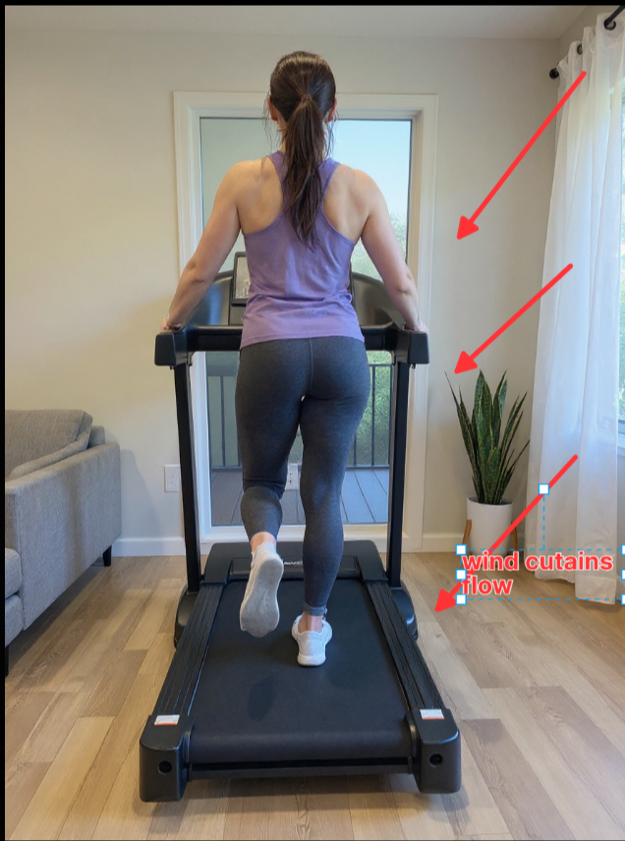
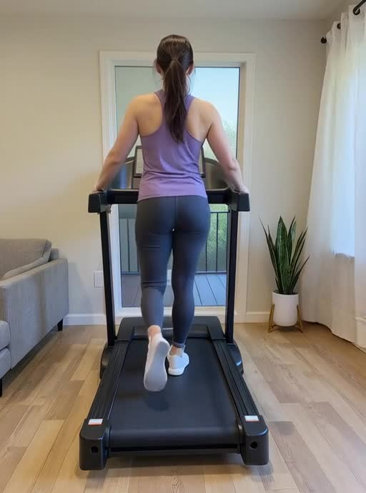
Higgsfield new feature
Input
Output

Slide 6
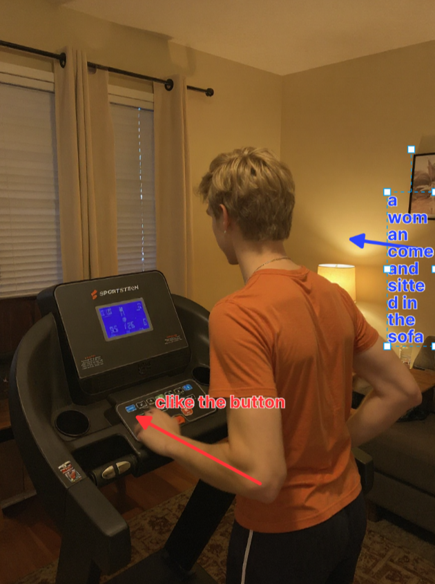
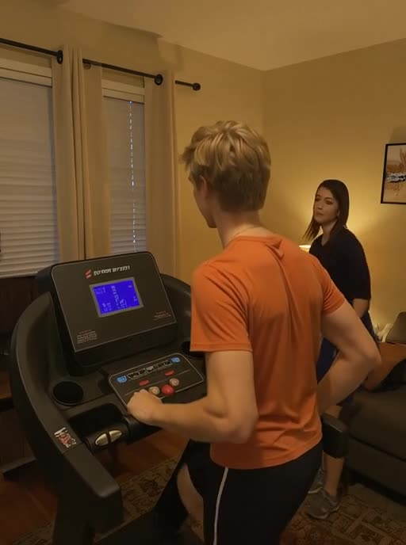
Input
Output

Slide 7
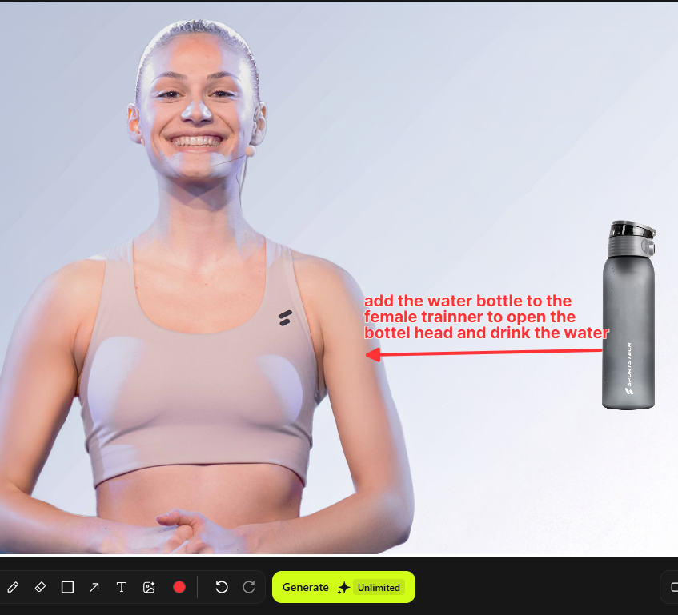
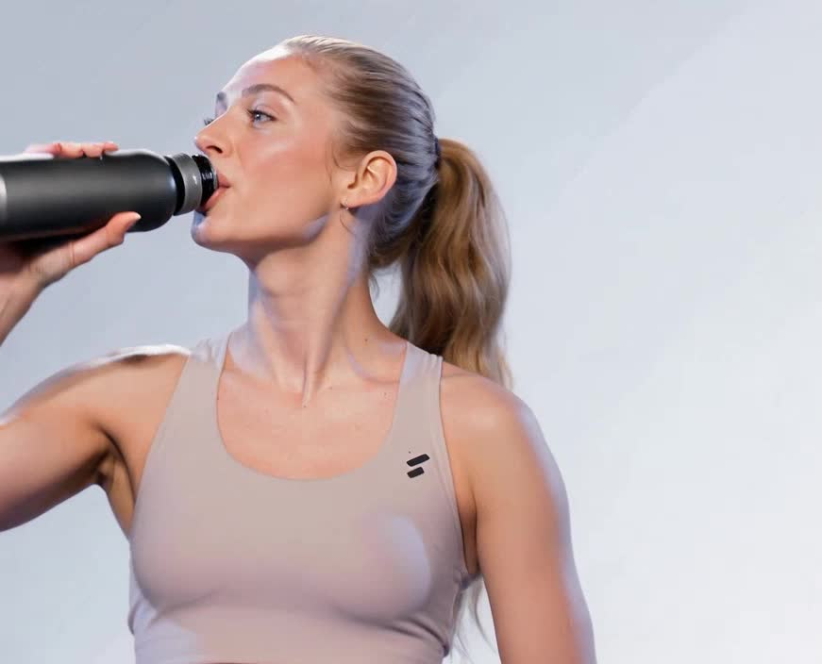
Input
Output

Slide 8
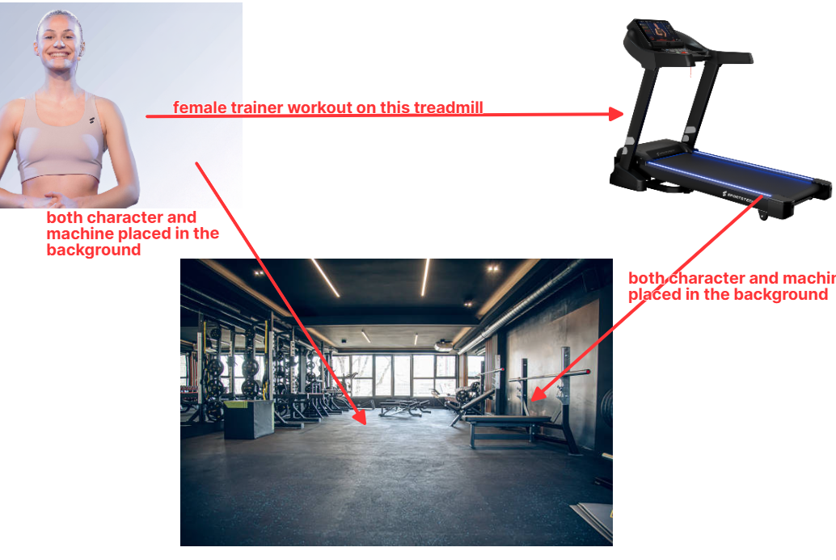
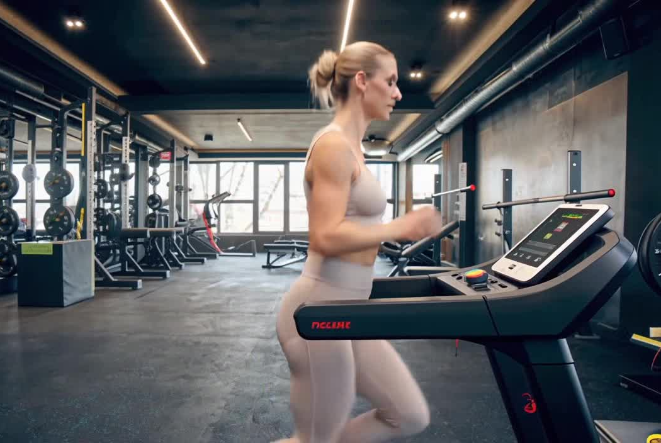
Input
Output

Slide 9
Thank You

