Slide 1
FINSERV GLOBAL · AI ARCHITECT TECHNICAL ASSIGNMENT
AI-POWERED REGULATORY COMPLIANCE ASSISTANT
Solution architecture & technology stack for Basel III, MiFID II, and RBI compliance — open-source, production-aware, fully auditable.
Open-Source First
Production-Aware
Fully Auditable
Confidential — prepared for evaluation
01

Slide 2
AGENDA
EIGHT SECTIONS
From business problem to production roadmap
01
02
03
04
Business Context & Personas
Why FinServ needs this, and who uses it
Core Capabilities
The four scenarios the system must handle
High-Level Architecture
How the components fit together end to end
RAG Pipeline Design
Ingestion, chunking, retrieval, citations
05
06
07
08
LLM Orchestration & Guardrails
Model routing, prompting, safety
Agentic Compliance Workflow
The LangGraph compliance agent
Infrastructure, Security & Cost
Cloud topology, data residency, budget
Technology Stack & Roadmap
Full stack, key decisions, what's next
FinServ Global · AI Regulatory Compliance Assistant
02

Slide 3
BUSINESS CONTEXT
THE COMPLIANCE TEAM IS DROWNING IN DOCUMENTS
~40 compliance officers across India, the EU, and the US — spending most of their week on manual document work
60%+
200+
3
100%
of officer time spent manually searching regulatory PDFs and cross-referencing circulars
new circulars and amendments issued per year across Basel III, MiFID II, and RBI
overlapping jurisdictions — a single cross-border trade can trigger obligations under all of them
of decisions must be traceable — regulators expect documented evidence, not best effort
FinServ Global · AI Regulatory Compliance Assistant
03

Slide 4
WHO USES THIS
THREE PERSONAS, THREE VERY DIFFERENT NEEDS
The system is designed around what each role actually asks of it
C
C
I
DAY-TO-DAY CHECKS
OVERSIGHT & REPORTING
POST-FACTO REVIEW
Compliance Officer
Compliance Head
Internal Auditor
“Does this transaction violate any regulation?” — needs fast, cited answers in seconds, not hours.
Weekly and monthly compliance posture reports with trend analysis, ready for leadership review.
A complete audit trail of every AI-assisted decision, with source citations — nothing taken on faith.
FinServ Global · AI Regulatory Compliance Assistant
04

Slide 5
CORE CAPABILITIES
FOUR SCENARIOS THE SYSTEM MUST HANDLE
Every architectural decision downstream traces back to one of these four
FR-1
FR-2
FR-3
FR-4
Natural-Language Q&A
Transaction Screening
Regulatory Change Impact
Compliance Report Generation
“What are the Tier 1 capital adequacy requirements under Basel III as amended in 2023?” — a cited, versioned answer.
Given amount, counterparty, jurisdiction, and instrument type — flag applicable regulations and rate the risk.
When a new RBI circular is ingested, automatically identify which existing policies or transaction types are affected.
A structured, audit-committee-ready report for a set of transactions over a period.
FinServ Global · AI Regulatory Compliance Assistant
05

Slide 6
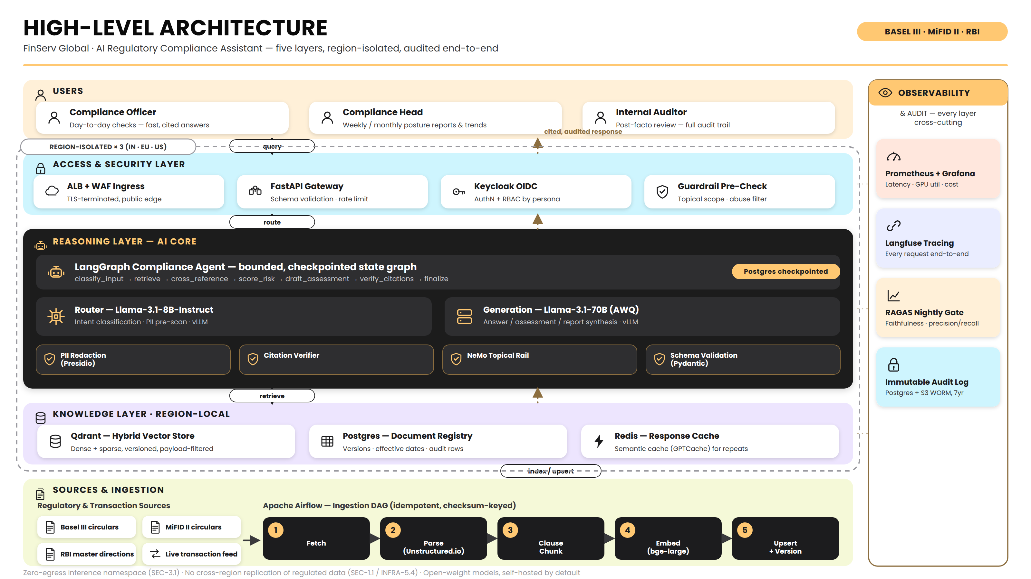

Slide 7
RAG PIPELINE DESIGN
CLAUSE-BOUNDED CHUNKING, BUILT FOR REGULATORY TEXT
Hybrid retrieval purpose-built for numbered regulatory clauses, not generic prose
1
2
3
4
Ingest & Parse
Clause-Bounded Chunking
Embedding
Qdrant Vector Index
Unstructured.io — multi-format (PDF/DOCX/HTML), layout-aware
~512 tokens, 15% overlap; splits on clause numbering, not blind windows
BAAI/bge-large-en-v1.5 (1024-dim), self-hosted via HF TEI
Dense + sparse vectors, payload-filtered by jurisdiction & version
5
6
7
8
Hybrid Retrieval
Re-Ranking
Contextual Compression
Cited, Versioned Answer
Dense + BM25/SPLADE, fused via Reciprocal Rank Fusion — top 50
Cross-encoder BAAI/bge-reranker-large — 50 → top 8 chunks
LLMLingua trims context, preserving numerals & defined terms
Every claim maps to a {doc, clause, version} citation key
Requirements RAG-1 – RAG-7 · document updates append-only, versioned, never overwritten in place
FinServ Global · AI Regulatory Compliance Assistant
07

Slide 8
LLM ORCHESTRATION & GUARDRAILS
TWO MODEL TIERS, ROUTED DETERMINISTICALLY
Open-weight models, self-hosted by default — structural guardrails, not just prompted ones
ROUTER MODEL
GENERATION MODEL
Llama-3.1-8B-Instruct
Llama-3.1-70B-Instruct (AWQ 4-bit)
Intent classification · PII pre-scan · served via vLLM
Answer / assessment / report synthesis · vLLM
PII Redaction
Citation Verifier
NeMo Topical Rail
Schema Validation
Microsoft Presidio
Rejects unresolved keys
Off-topic → fixed decline
Pydantic / outlines
FALLBACK CHAIN & COST CONTROL
PRIMARY
ON TIMEOUT
REPEATED FAILURE
NEVER
Self-hosted vLLM (8B / 70B)
Secondary smaller model
Circuit breaker → degraded response
Silent fallback to external SaaS API
FinServ Global · AI Regulatory Compliance Assistant
08

Slide 9
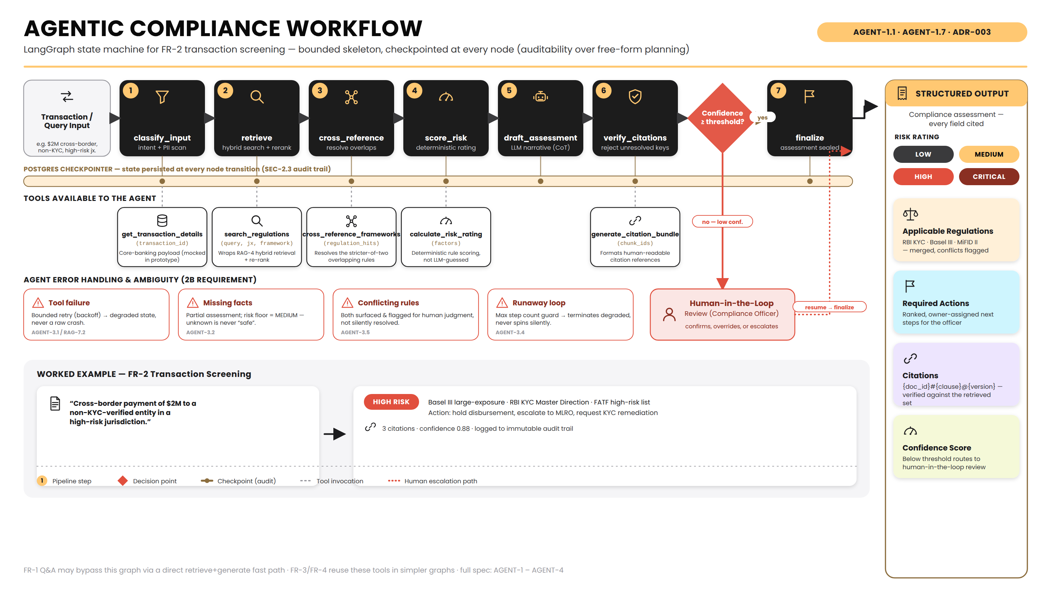

Slide 10
DATA RESIDENCY
REGION ISOLATION BY DESIGN
Regulated document text and transaction data never cross a jurisdictional border by default
India — ap-south-1
EU — eu-central-1
US — us-east-1
RBI Master Directions, KYC, NBFC lending
MiFID II, appropriateness assessments
Basel III (US adoption), cross-border oversight
EKS Cluster
EKS Cluster
EKS Cluster
Qdrant (region-local)
Qdrant (region-local)
Qdrant (region-local)
vLLM (region-local)
vLLM (region-local)
vLLM (region-local)
FastAPI + Keycloak
FastAPI + Keycloak
FastAPI + Keycloak
✕ no cross-border replication
✕ no cross-border replication
✕ no cross-border replication
FinServ Global · AI Regulatory Compliance Assistant
10

Slide 11
SECURITY & COMPLIANCE
CONTROLS ADDRESSED STRUCTURALLY, NOT JUST ON PAPER
The section the assignment grades hardest
Region-Pinned Encryption
KMS customer-managed keys per region; TLS 1.2+ everywhere, Istio mTLS internally
RBAC via Keycloak
Roles mapped to personas: Officer, Head, Auditor — least-privilege by design
Immutable Audit Log
Every request's full lineage in Postgres, mirrored to S3 Object Lock (WORM)
Zero-Egress Inference
Inference namespace has no outbound internet route — enforced at the network layer
PII Redaction
Microsoft Presidio scans and redacts before anything is logged, cached, or exported
Prompt-Injection Containment
Retrieved content treated as untrusted; fixed tool skeleton bounds what it can trigger
FinServ Global · AI Regulatory Compliance Assistant
11

Slide 12
INFRASTRUCTURE & AUTO-SCALING
SIZED FOR 500 CONCURRENT USERS, 10K QUERIES/DAY
AWS · EKS · one cluster per region · GPU-aware autoscaling
CPU Node Pool
GPU Pool A
GPU Pool B
API · Airflow · Qdrant
m6i.xlarge, static
8B router + embeddings + reranker
g5.2xlarge
70B generation (AWQ), tensor-parallel
g5.12xlarge
Karpenter
KEDA
Istio
Node-level autoscaling — GPU capacity is the dominant cost driver
Pod-level autoscaling on vLLM request-queue depth, not CPU%
mTLS mesh; enforces the zero-egress boundary on inference pods
LATENCY SLAs (P95)
< 1.5s
< 6s
< 15s
< 5 min (async)
99.5%
Q&A (cache hit)
Q&A (full RAG)
Transaction screening
Report generation
Availability target
FinServ Global · AI Regulatory Compliance Assistant
12

Slide 13
ESTIMATED MONTHLY COST
SIZED FOR THE ASSIGNMENT'S TARGET LOAD
500 concurrent users, 10,000 queries/day (on-demand blended, us-east-1)
70B generation GPU pool
$16.0K
$22K–$27.5K
8B router + embedding + reranker
$3.8K
per month, on-demand blended — ~$15K–$18K with Reserved Instances / Savings Plans
RDS Postgres (Multi-AZ)
$1.8K
CPU node pool
$1.2K
Observability stack
$0.6K
WHY THIS BEATS A SAAS API HERE
Data transfer / ALB / WAF
$0.5K
~600M tokens/month at this volume lands in a comparable-to-higher cost band on a frontier-model API — before accounting for the fact that a SaaS API cannot satisfy “no regulated data leaves the network” at all.
Qdrant storage
$0.4K
ElastiCache Redis
$0.3K
EKS control plane
$0.2K
FinServ Global · AI Regulatory Compliance Assistant
13

Slide 14
OBSERVABILITY & EVALUATION
QUALITY IS A RELEASE GATE, NOT AN AFTER-THE-FACT REPORT
Continuous evaluation wired into the deploy pipeline
Infra & LLM Monitoring
Prometheus + Grafana for latency/GPU/cost; Langfuse traces every request end to end
Nightly RAGAS Eval Gate
Faithfulness, answer relevance, context precision/recall, plus custom citation checks
Deploy Gate, Not Just Report
A metric drop below its configured floor blocks promotion to production
Corpus Drift Detection
Fixed benchmark query set re-run as the corpus grows past 200+ circulars/year
PROMOTION THRESHOLDS (NIGHTLY GATE)
≥ 0.92
≥ 0.97
≥ 0.88
≥ 0.90
500 queries
Faithfulness
Citation accuracy
Context recall
Answer relevance
Regression suite / night
FinServ Global · AI Regulatory Compliance Assistant
14

Slide 15
TECHNOLOGY STACK
DATA, RAG & AI LAYER
Open source unless marked — the one AI-specific proprietary option considered is flagged
Layer
Choice
License
Why
Document parsing
Unstructured.io
Apache 2.0
Layout-aware multi-format parsing (RAG-1.1)
Data pipeline orchestration
Apache Airflow (self-hosted)
Apache 2.0
Ingestion + eval + impact-scan DAGs
Chunking / RAG glue
LangChain components
MIT
RecursiveCharacterTextSplitter etc. (RAG-2)
Embedding model
BAAI/bge-large-en-v1.5
MIT (weights)
Self-hosted via HuggingFace TEI (RAG-3.1)
Re-ranker
BAAI/bge-reranker-large
MIT (weights)
50 → top 8 chunks (RAG-4.3)
Context compression
LLMLingua
MIT
Trims context, preserves numerals (RAG-4.4)
Vector database
Qdrant (self-hosted)
Apache 2.0
Native hybrid search + payload filters (ADR-001)
Keyword / sparse signal
Qdrant native sparse vectors
Apache 2.0
Avoids a second BM25 search cluster
Foundation models
Llama-3.1-8B / 70B-Instruct
Llama 3.1 Community
Router + generation tiers (LLM-1.1)
Model serving
vLLM
Apache 2.0
High-throughput serving, structured output (LLM-3.5)
[PROPRIETARY] alternative
AWS Bedrock (same OSS models)
Paid AWS
Flagged; prototype uses self-hosted vLLM
Agent orchestration
LangGraph
MIT
Explicit state graph → auditability (ADR-003)
Guardrails — topical
NeMo Guardrails
Apache 2.0
Scope rail (LLM-4.5)
Guardrails — PII redaction
Microsoft Presidio
MIT
Redacts before log/cache/export (LLM-4.3)
Evaluation
RAGAS + custom metrics
Apache 2.0
Faithfulness, relevance, precision/recall
FinServ Global · AI Regulatory Compliance Assistant
15

Slide 16
TECHNOLOGY STACK
INFRASTRUCTURE LAYER
Managed AWS services here hold metadata, cache, and cluster control — never raw regulated document text
Layer
Choice
License
Why
Cloud provider
AWS (EKS, S3, RDS, ElastiCache, KMS)
Commercial
Regions in all 3 markets
Container orchestration
Kubernetes (EKS) + Helm
Apache 2.0
Per-region cluster isolation (INFRA-1.1)
Node/pod autoscaling
Karpenter + KEDA
Apache 2.0
GPU-aware, queue-depth-based scaling
Service mesh
Istio
Apache 2.0
mTLS + network policy for SEC-3.1
Relational store
PostgreSQL (Amazon RDS)
PostgreSQL / managed
Metadata & audit only, no document text
Cache
Redis (Amazon ElastiCache)
BSD / managed
Session / response cache
Metrics
Prometheus + Grafana
Apache 2.0
Latency, GPU, cost (OBS-1.1)
LLM tracing / cost
Langfuse (self-hosted)
MIT
Per-request trace (OBS-1.2)
API framework
FastAPI
MIT
REST endpoints for FR-1–FR-4
Auth
Keycloak (OIDC)
Apache 2.0
AuthN + RBAC (SEC-2.1)
IaC
Terraform
BUSL (source-available)
Cluster / infra provisioning
CI/CD
GitHub Actions
—
Build / test / deploy pipeline
FinServ Global · AI Regulatory Compliance Assistant
16

Slide 17
KEY DECISIONS
THREE ARCHITECTURE DECISION RECORDS
Full context, alternatives, and consequences in the written record
ADR-001
ADR-002
ADR-003
Vector Database
Model Hosting
Agent Orchestration
Qdrant
Self-hosted vLLM
LangGraph
Native hybrid search + payload filters, self-hostable in-VPC. Considered: Weaviate, Milvus, pgvector.
Only option that makes “no regulated data leaves the VPC” architectural, not procedural.
Bounded, checkpointed state graph — auditability over autonomy. Considered: CrewAI, AutoGen.
FinServ Global · AI Regulatory Compliance Assistant
17

Slide 18
DESIGN DISCIPLINE
WHAT THE ASSIGNMENT EXPLICITLY WARNED AGAINST
Each concern is addressed structurally in this design, not just acknowledged
✕ Generic LangChain tutorial repackaged as architecture
✓ LangChain used only for text-splitting utilities; retrieval (Qdrant), agent orchestration (LangGraph), guardrails, and serving (vLLM) are each purpose-fit.
✕ Over-reliance on a single LLM provider, no fallback or cost controls
✓ Two-tier self-hosted models, explicit fallback chain + circuit breaker, token budgets + semantic caching.
✕ Architectures that ignore data sovereignty
✓ Region-pinned deployment (India / EU / US), zero-egress inference namespace enforced at the network layer.
FinServ Global · AI Regulatory Compliance Assistant
18

Slide 19
WHAT'S NEXT
ROADMAP & NEXT STEPS
Development begins only after this plan, tech stack, and feature list are confirmed
PHASE 0
PHASE 1
PHASE 2
PHASE 3
PHASE 4
Requirements & Architecture
RAG Pipeline Prototype
Agentic Compliance Checker
Evaluation Framework
Production Hardening
Micro-requirements, ADRs, tech stack, solution deck
Ingest 5+ docs, hybrid search, re-ranking, citations (2A)
LangGraph agent, structured risk assessment (2B)
15–20 QA ground-truth set, RAGAS scoring, failure analysis (2C)
Multi-region rollout, cost optimization, HA (beyond scope)
Next: confirm the plan, technology stack, and feature list above — then Phase 1 begins.
FinServ Global · AI Regulatory Compliance Assistant
19

