Slide 1
Connectivity view redesign
F. Rappel
2012-12-14

Slide 2
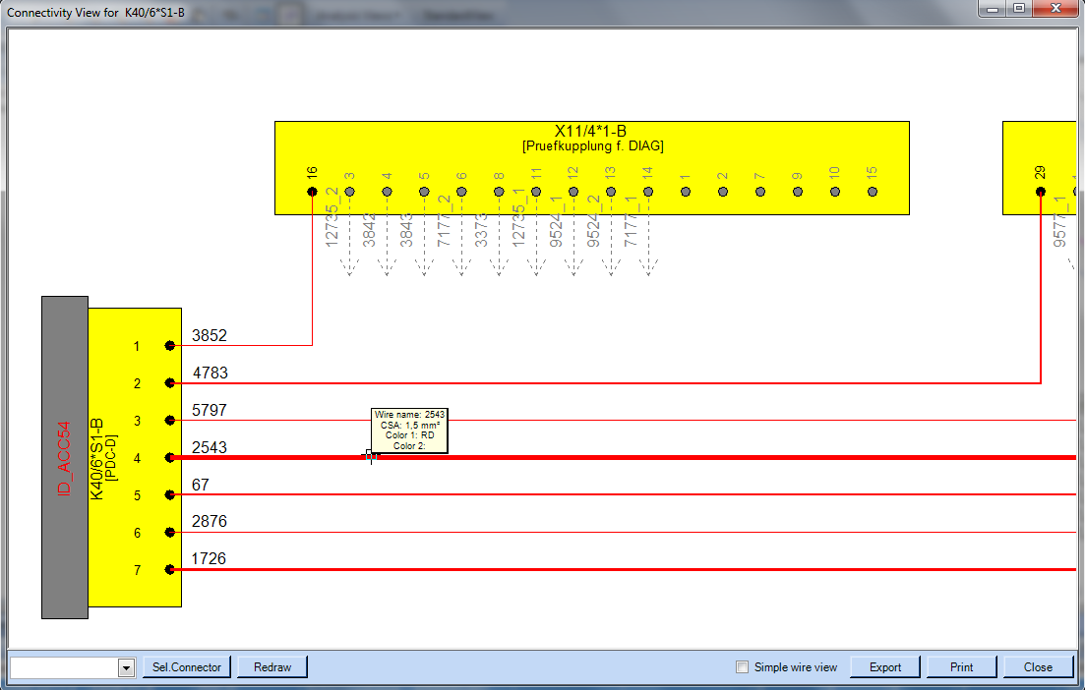
Connectivity view redesign
1. Overview
The connectivity view should help analyzing electrical connections between connectors. EE-Browser offers an own dialog displaying all wire connections from an specific selected connector to their connected connectors.
Selected source connector (with component information) and their related cavities with assigned wire information (wire number)
Connected connectors (destination connectors) and their related cavities with direct connected wire and additional wire information
Wire lines in respect to their CSA (diameter) and color code values with additional tooltip information
User control panel (switch source connector, redraw view, toggle simple wire view, export/print view, close dialog)
2.
1.
3.
4.

Slide 3
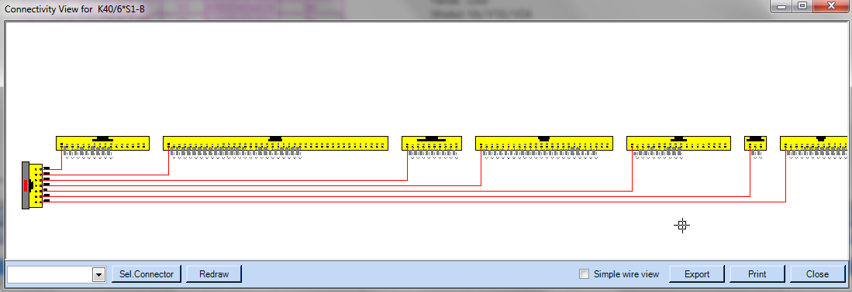
Connectivity view redesign
2. Layout
The layout of the connectivity view should be displayed as mentioned in the below screenshot.
On the very left side (near by the origin point of the drawing) the selected source connector has to be drawn with vertical alignment. All cavities with wire assignment has to be placed first, then all other empty cavities.
All connected connectors with their cavities has to be placed on top horizontally from left to right with an fixed offset in between. All cavities with wire information which can be directly connected to the source connector has to be drawn first, then all other cavities with additional wire information, and at the end all empty cavities.
The active wire lines has be drawn without overlapping junctions and only one vertex point. To achieve this behavior a pre-process has to be calculate the correct draw order of the cavities in respect to their assigned wires on the source connector.
2.
1.
3.

Slide 4
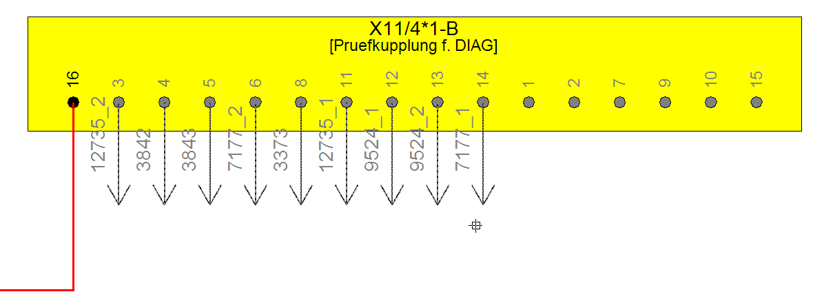
Connectivity view redesign
3. Connector box layout
The connectors itself should be displayed as yellow boxes containing following graphical information:
Connector ID (name) and description (in rectangle brackets and a bit smaller text height)
Cavities of the connector represented as filled circles with regarding cavity number and an fix offset in between
filled black circles represents cavities with a wire connection to the source connector (the source connector only has black filled circles if a wire is assigned!)
filled grey circles represents cavities with a additional wire connection which are NOT connected to the source connector (is also valid for connections between destination connectors)
non-filled circles represents cavities without any wire information (empty cavities)
all of this “cavity groups” has to be drawn in the alphabetically order like displayed in the screenshot below
2.
1.
3.
Not connected wire information has to be displayed as dashed grey arrows going outside from the relevant cavity circle. Each arrow should also display the wire number on the line.
All connected wire information has to be displayed as graphical polyline. Line color originated form the color code information, line width (pen width) has to be calculated from the wire CSA (cross section area) value.
4.

Slide 5
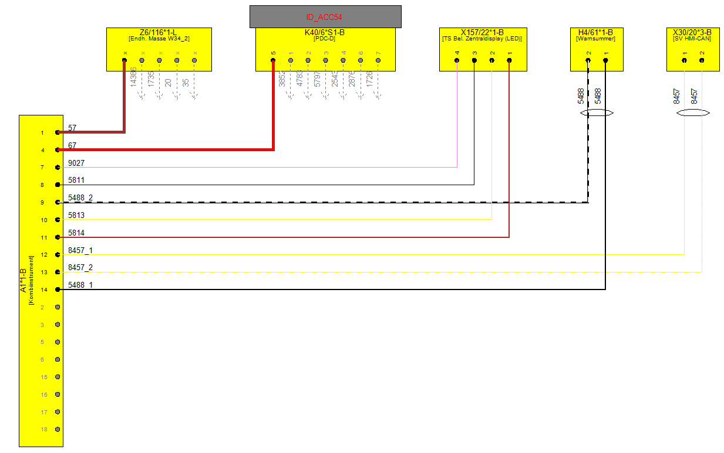
Connectivity view redesign
3. Connector box layout
Sometimes connectors are assigned to components. This has to be considered while generated the connector box
graphic.
Components has to be displayed as additional light-grey filled box on top of the regarding connector box. The width of the component box should be minimal wider as the overall with of the connector box. The box height should be fix. Inside this box the component ID (name) and (if available) the component description (in rectangle brackets) has to be displayed in red text color.
The connector box height is a fix value depending on the predefined text height and offset values. But the connector box width is a calculated value consist of the cavity count + offsets in between. If the text width is wider as the calculated connector box width originated from the cavity count the overall connector box width has to be calculated in respect to the displayed connector ID/description texts.
1.
2.

Slide 6
Connectivity view redesign
4. Wire line layout
Wires has to be drawn as simple polylines with only one vertex point in between. During generation of the view it is very important that no overlapping wire lines will be drawn. This is a golden rule and has to be strongly considered!
Each wire line should be drawn from source cavity to the destination cavity circle.
Different wires contains different appearance. The color code can contain one or two colors. If two colors are assigned, both has to be displayed as base and secondary color. Also the CSA value should be displayed by setting the pen width of the wire line.
If cores of cables are existent, both core lines has to be drawn side-by-side and an ellipse indicator must be displayed on one or both ends of the lines.
1.
3.
2.

Slide 7
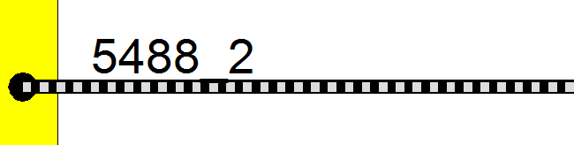
Connectivity view redesign
4. Wire line layout
If the wire color code contains a base and a secondary color, the layout of the wire line should be drawn like mentioned
on the screenshot below.
Every line has to display the name on the wire beside the start cavity circle outside of the connector box
This wire line is a combination of the VectorDraw polyline objects: the underlying solid polyline (here black) is a bit wider as the overlying dashed (here gray) polyline. The wire base color (color 1 or first color) has to be used for the underlying polyline, the secondary color (color 2 or additional color) has to be used for the overlaying (dashed) polyline.
The tooltip appears on every wire line and should contain information about “Wire name”, “CSA” and both color values.
1.
2.
3.

Slide 8
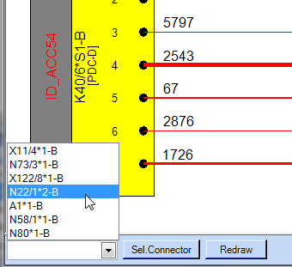
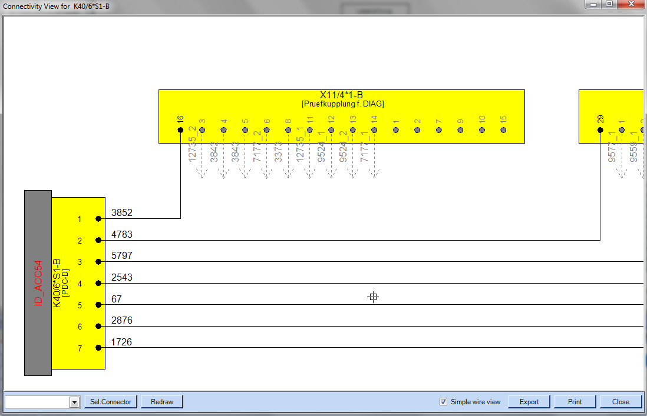
Connectivity view redesign
5. User interactions
On the bottom edge of the dialog a control panel has to be added offering the user some the following actions:
A combo box containing all connected destination connectors based on the selected source connector. The user can select one connector and by pressing the “Sel. Connector” button the connectivity view has to be reinitialized with the chosen connector as new source connector (left anchored one).
“Redraw” reinitialize the complete view with given source connector.
The “Export” button opens and save file dialog where the user is able to export the view to a CAD or picture-based file format.
“Print” opens the VectorDraw print dialog for plotting the view on a printer.
3.
4.
5.
1.
2.
5. “Close” closes the connectivity view dialog.

Slide 9
Connectivity view redesign
5. User interactions
For an simplified visualization of the wire connectivity between the different connectors an checkbox “Simple wire view”
should allow the user to change the appearance of the wire lines to an basic layout.
A checkbox has to be added to the bottom control panel allowing the switch between normal and simple wire view.
If the simple wire view is activated, every wire line will be presented as thin solid black-colored wire line without any pen width or additional color information.
2.
1.

Slide 10
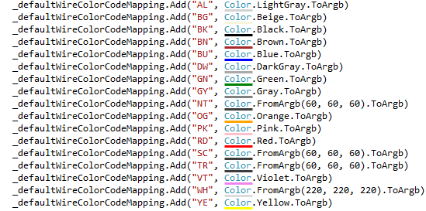
Connectivity view redesign
6. Default wire color code mappings
The displayed wire lines represents an individual color appearance based on the wire color code of the relevant data object. Later the user can adjust the color code mappings in the application settings. By default each color code are mapped against the below listed colors.

