Slide 1
Brückenstecker
1
2
3
5
Hash Leitungs Mist
1,2
Bräuchte Sonderlogik

Slide 2
CV.Insert
CV.BridgerInsert
Draws one contact point and connection
CV.BaseCavity
CV.Cavity
Draws short connection
Connector
CV.BridgeInsert
inserts
CV.Insert
BaseCavity
Cavity
Insert
BridgeInsert

Slide 3
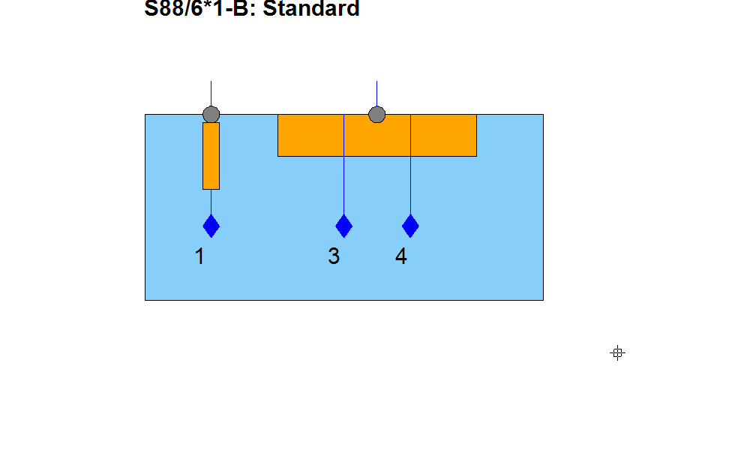
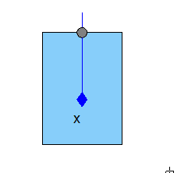
Splice/ring Terminal
x

Slide 4
Hash Leitungs Mist
x
S
x
S

Slide 5
Contactpoint to wire mapper
„Wire“
ext
ext
ext
Contact
point
ext
Connector
ext
ext
Term, (Seal)
slot
Cavity
1
2

Slide 6
TermOccId-> List(of CP)
A2/167*1B_V1
Bridge insert
insert
insert
insert
Std
HashLtg
1
1
1
2
1
2
1
x
S
cavOcc-> List(of Cp)
Reduce to one proxy contactpoint -> use one with terminal(s) if present
Group remaining cps in dictValues to bridgeinserts respectively inserts

