Slide 1
Dimensional report for sampling process

Slide 2
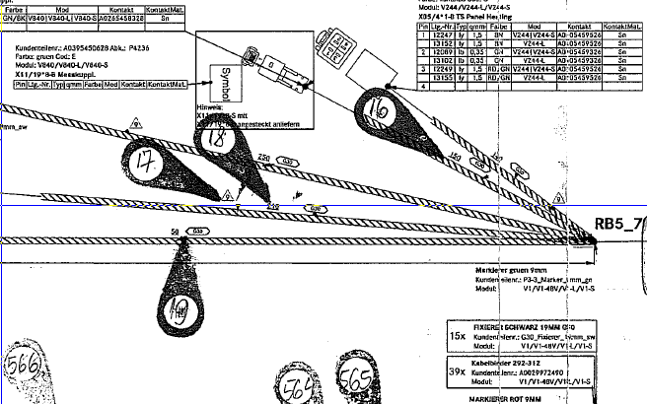
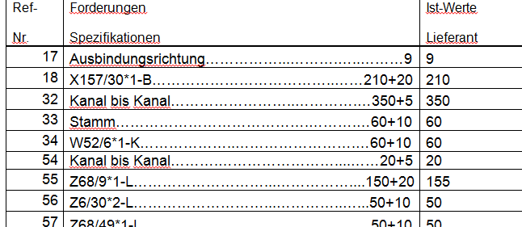
Clip orientation
13.01.2017/V.Filip

Slide 3
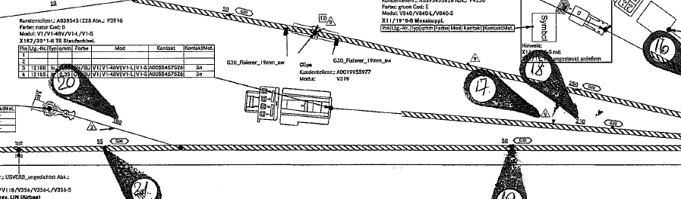
Branch
13.01.2017/V.Filip

Slide 4
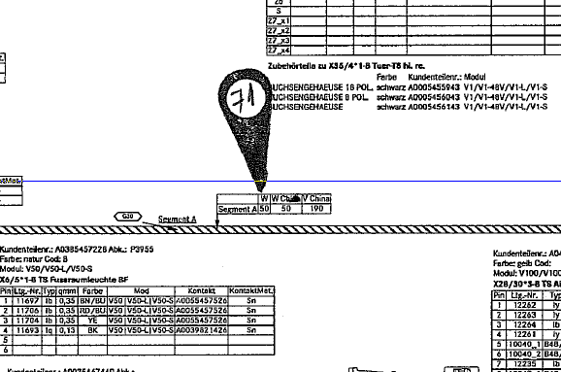
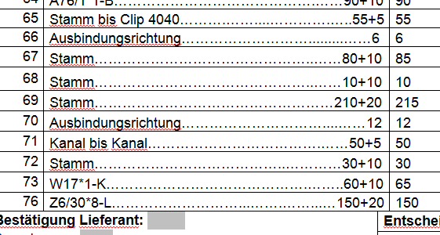
Quota between the channels
13.01.2017/V.Filip

Slide 5
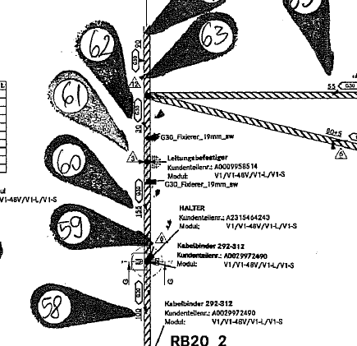
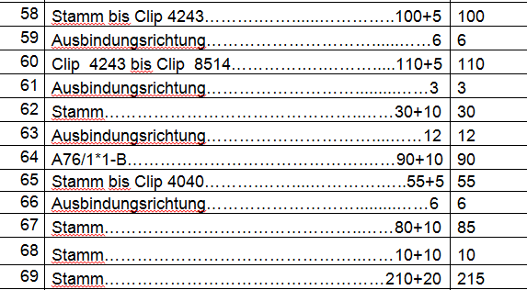
Quota between the clipses
13.01.2017/V.Filip

Slide 6
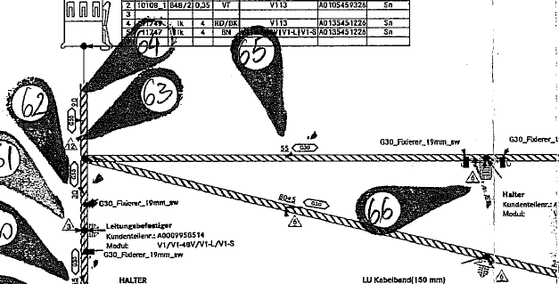
Quota between exit and clip
13.01.2017/V.Filip

Slide 7
Quota from a clip to an exit
13.01.2017/V.Filip

Slide 8
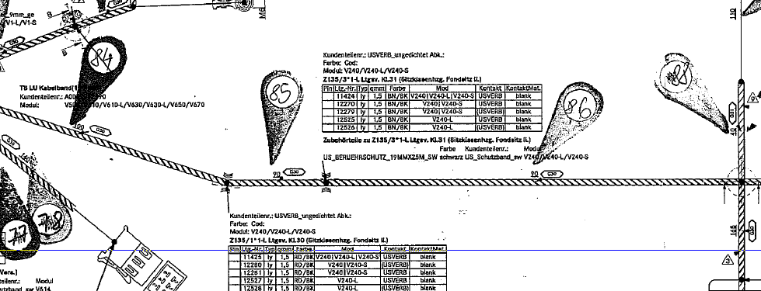
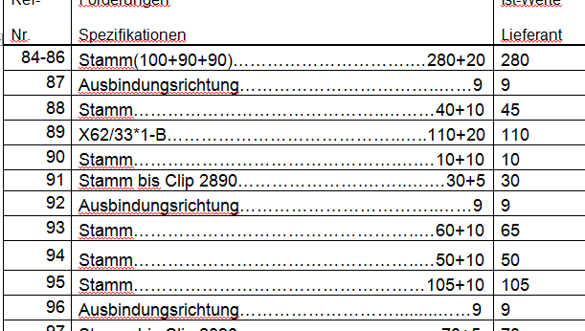
Cumulated quotas
13.01.2017/V.Filip

Slide 9
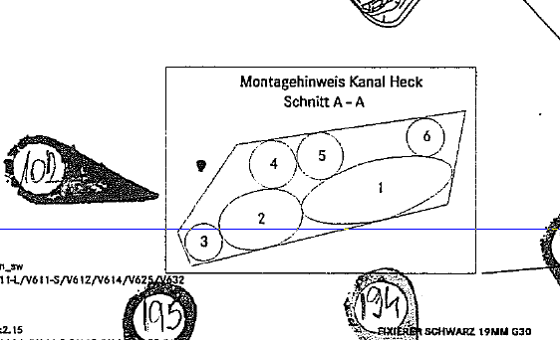
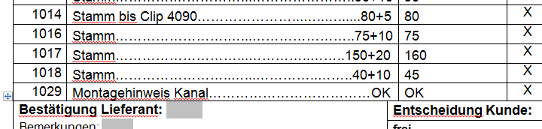
Montagehinweis
13.01.2017/V.Filip

Slide 10

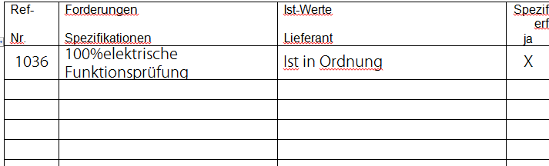
Electrical test
13.01.2017/V.Filip

