Slide 1

Introduction into
Actor Network Theory
Stefan Kasberger
@stefankasberger
VU Technical English in Human Geography
10th of June 2013
For more license details look here:
https://creativecommons.org/licenses/by-sa/3.0/at/

Slide 2
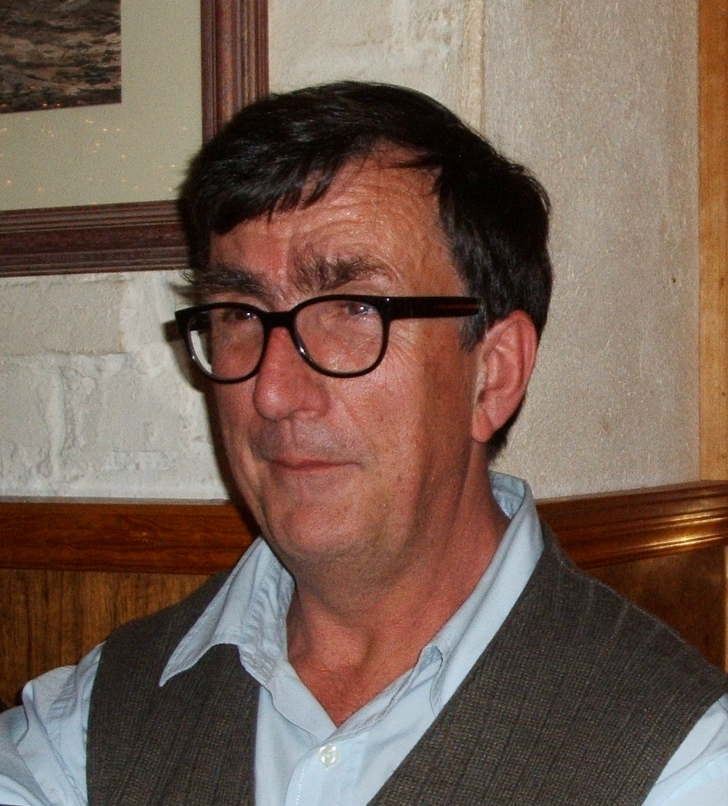
Bruno Latour
French sociologist and philosopher
Science & Technology Studies (STS)
Creator of ANT
School of post-structuralism
www.bruno-latour.fr
Introduction into Actor Network Theory
10th of June 2013

Slide 3
Social constructionism
„Social constructionism explores the ways how social reality and single phenomenons are constructed.
...how people create social phenomena, institutionalize it and propagate it to new generations through traditions.“ – Wikipedia
Post-structuralism: language isn't only describing reality, it is creating reality
Use in Gender Studies & Cultural Studies
ANT brings this into Social Science
Introduction into Actor Network Theory
10th of June 2013

Slide 4

Actor Network Theory
More method or practice
Since the 80s
Qualitative
Used to explain scientific and technological innovation, now used in other fields too
Use of human vocabulary for technical and natural phenomena => neutral language
Focus on observations, tries to ignore preexisting (constructed) knowledge at the beginning
Introduction into Actor Network Theory
10th of June 2013

Slide 5
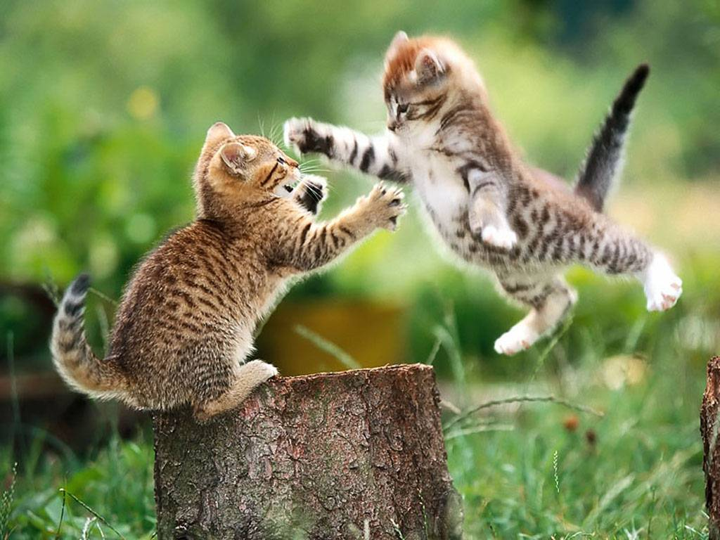
„Explanans“ and „Explananda“
Explanans:
(L) Every time, when a fiber with the strength r is stressed with the weight K, the fiber tears.
(C1) This is a fiber with the strength r.
(C2) The attached weight is
minimum K.
Explananda:
(E) The fiber tears.
– Example by Karl Popper from WIkipedia
Introduction into Actor Network Theory
10th of June 2013

Slide 6
Diversity and Integrity
„One argument is, that social innovation are forms of connections between heterogeneous networks. The other, that human society, nature and technology are admixed in a way, that it is not possible to understand one side without the other in any social studies.“
– Ingo Schulz-Schaeffer, 2000: 208
Introduction into Actor Network Theory
10th of June 2013

Slide 7
Explaining through networks
Why? → Activity- and structure-oriented observations
How? → Combination of two perspectives:
1: the observer follows the actants, to find out how they define and connect different things to explain the world.
2: the observer follows the translations, through which the actants are defined
→ change steadily between those two perspectives
Introduction into Actor Network Theory
10th of June 2013

Slide 8
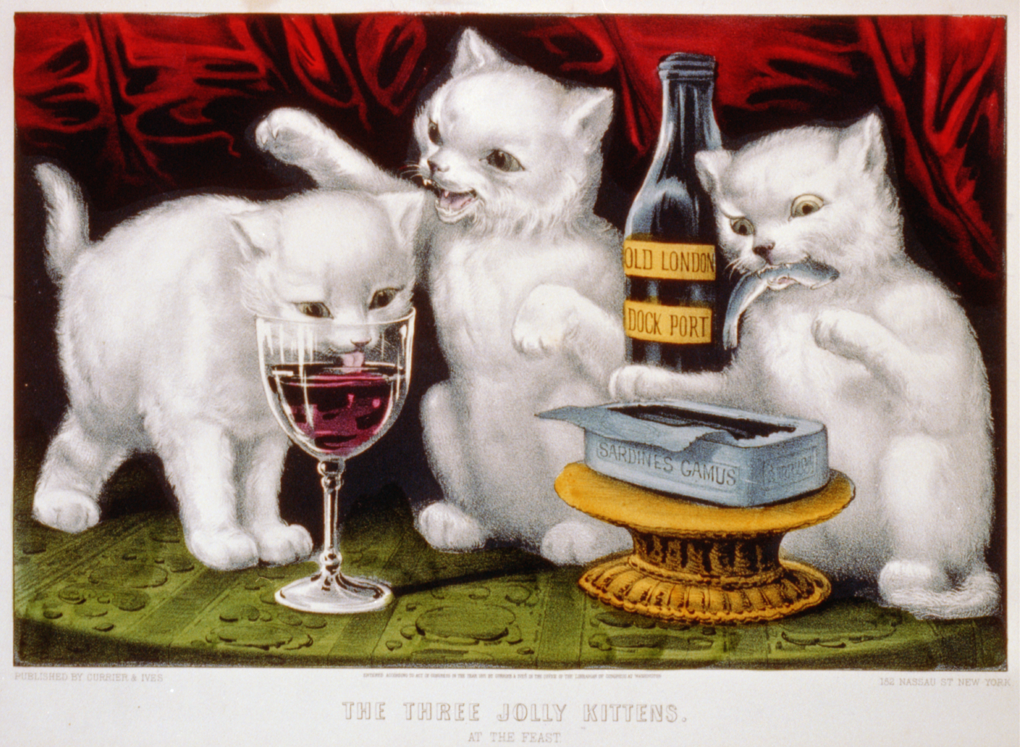
Symmetry
Ideas of asymmetry:
Object / Subject
Society and Technology
Society and Nature
→ Determinism
ANT tries symmetry
of actants (actors): no presupposed characteristics of actants - social, natural or technological
of vocabulary: use of human vocabulary for technical and natural things → neutral language
Introduction into Actor Network Theory
10th of June 2013

Slide 9
Case study
Problem of keeping doors closed
No door closer
Doorman
Automatic door closer
Add hydraulic ram
Sensor controlled
“Those door closers play the role of a very coarse, illiterate and relatively dull doorman“ (Latour 1996a: 68)
Introduction into Actor Network Theory
10th of June 2013

Slide 10
Critics
Also in ANT there is social construction
Real problems are hard
„Everything is connected with everything somehow“ → sociotheoretical holism is as true in his universality as it is uninteresting
Introduction into Actor Network Theory
10th of June 2013

Slide 11
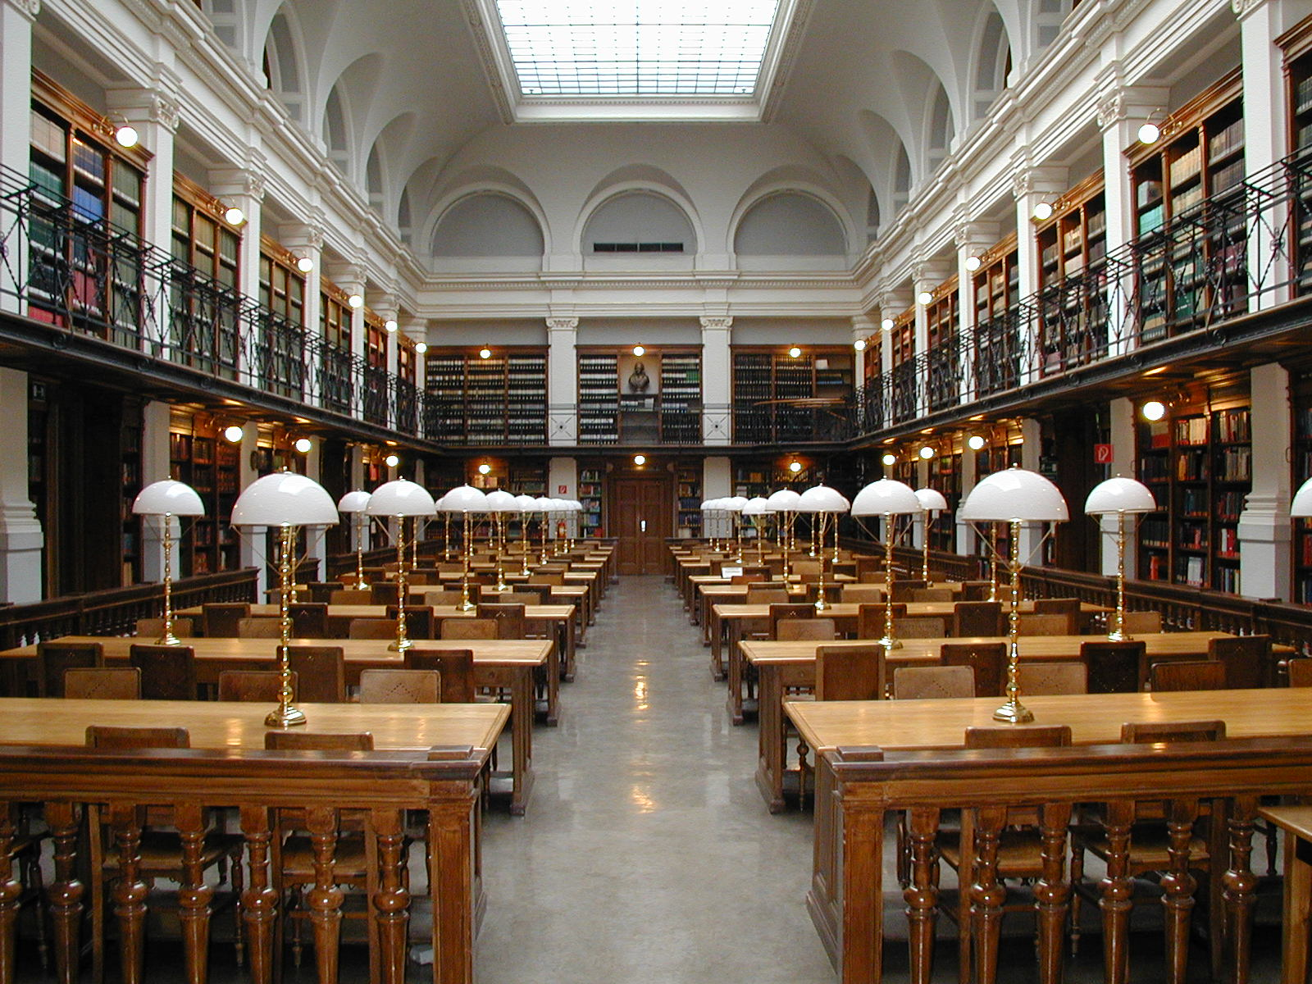
ANT in Graz
KF Graz: Ulrich Ermann
FH Joanneum: Heinz Wittenbrink
No course in UGO
Introduction into Actor Network Theory
10th of June 2013

Slide 12
Read more...
www.bruno-latour.fr
Schulz-Schaeffer, I. (2000). Akteur-Netzwerk-Theorie. Zur Koevolution von Gesellschaft, Natur und Technik. In Weyer, Johannes (Ed.), Soziale Netzwerke. Konzepte und Methoden der sozialwissenschaftlichen Netzwerkforschung. (pp. 187-211). München u.a.: Oldenbourg. Retrieved from http://www.uni-due.de/imperia/md/content/soziologie/akteurnetzwerktheorie.pdf
Wikipedia
Introduction into Actor Network Theory
10th of June 2013

Slide 13
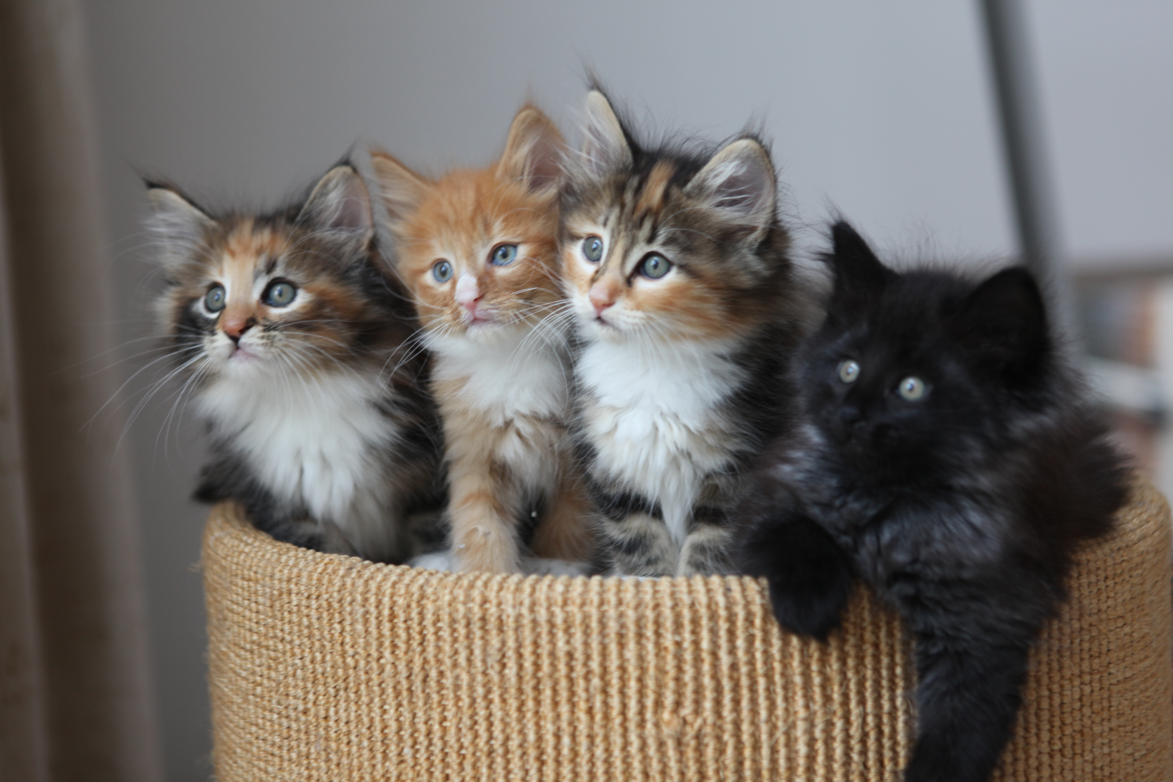

Thank You!
Try to look at a the whole interconnected world, rethink and overcome the social artifacts and be aware of your human preconditions as far as you can.
https://github.com/skasberger/technical-english-in-human-geography
For more license details look here:
https://creativecommons.org/licenses/by-sa/3.0/at/
Introduction into Actor Network Theory
10th of June 2013

Slide 14
Sources
Genral Sources:
  Schulz-Schaeffer, I. (2000). Akteur-Netzwerk-Theorie. Zur Koevolution von Gesellschaft, Natur und Technik. In Weyer, Johannes (Ed.), Soziale Netzwerke. Konzepte und Methoden der sozialwissenschaftlichen Netzwerkforschung. (pp. 187-211). München u.a.: Oldenbourg. Retrieved from http://www.uni-due.de/imperia/md/content/soziologie/akteurnetzwerktheorie.pdf
  Wikipedia de & en
Slide 2: Photo Bruno Latour
  Source: https://commons.wikimedia.org/wiki/File:Bruno_Latour_Gothenburg_2006_cropped.jpg
  Author: Toter Alter Mann
  License: CC BY-SA Generic 2.0 https://creativecommons.org/licenses/by-sa/2.0/deed.en
Slide 3: Quote Social Constructionism
  Source: https://de.wikipedia.org/wiki/Sozialkonstruktivismus
  Author: Wikipedia
  Date: 2013-06-09
Slide 4: Image Cats
  Source: https://commons.wikimedia.org/wiki/File%3AThe_Globe_kittens_%28HS85-10-13446-3%29.jpg
  License: Public Domain
Slide 5: Photo Cats
  Source: https://commons.wikimedia.org/wiki/File:Fighting_kittens-1340.jpg
  Author: Jhartenfeld
  License: CC BY-SA 3.0 Unported https://creativecommons.org/licenses/by-sa/3.0/deed.en
Introduction into Actor Network Theory
10th of June 2013

Slide 15
Sources
Slide 5: Explanans and Explananda Example
  Source: https://de.wikipedia.org/wiki/Deduktiv-nomologisches_Modell
  Author: Wikipedia
  License: CC BY-SA 3.0 Unported https://creativecommons.org/licenses/by-sa/3.0/
  Date: 2013-06-05
Slide 6: Quote Networks
  Schulz-Schaeffer, I. (2000). Akteur-Netzwerk-Theorie. Zur Koevolution von Gesellschaft, Natur und Technik. In Weyer, Johannes (Ed.), Soziale Netzwerke. Konzepte und Methoden der sozialwissenschaftlichen Netzwerkforschung. (pp. 187-211). München u.a.: Oldenbourg. Retrieved from http://www.uni-due.de/imperia/md/content/soziologie/akteurnetzwerktheorie.pdf
Slide 8: Image Cats
  Source: http://de.m.wikipedia.org/wiki/Datei:Three_jolly_kittens.png
  License: Public Domain
Slide 9: Quote Bruno Latour
  Latour 1996a: 68
Slide 11: Photo KF University Graz Library
  Source: https://commons.wikimedia.org/wiki/File:Graz_University-Library_reading-room.jpg
  Author: Dr. Marcus Gossler
  License: CC BY-SA 3.0 Unported https://creativecommons.org/licenses/by-sa/3.0/deed.en
Slide 13: Photo Cats
  Source: https://commons.wikimedia.org/wiki/File:4_Kittens.jpg
  Author: oxyman
  License: CC BY 2.0 Generic https://creativecommons.org/licenses/by/2.0/deed.en
Introduction into Actor Network Theory
10th of June 2013

