Slide 1
Programming with MySQL
C# and PHP

Slide 2
MySQL Introduction
MySQL is a relational database management system written in C and C++
It’s open source, so it’s source code is available for tinkering.
It was developed in 1995 and has frequent releases, updating the stability.
The current version is 5.5.19 which was released on December 8th.

Slide 3
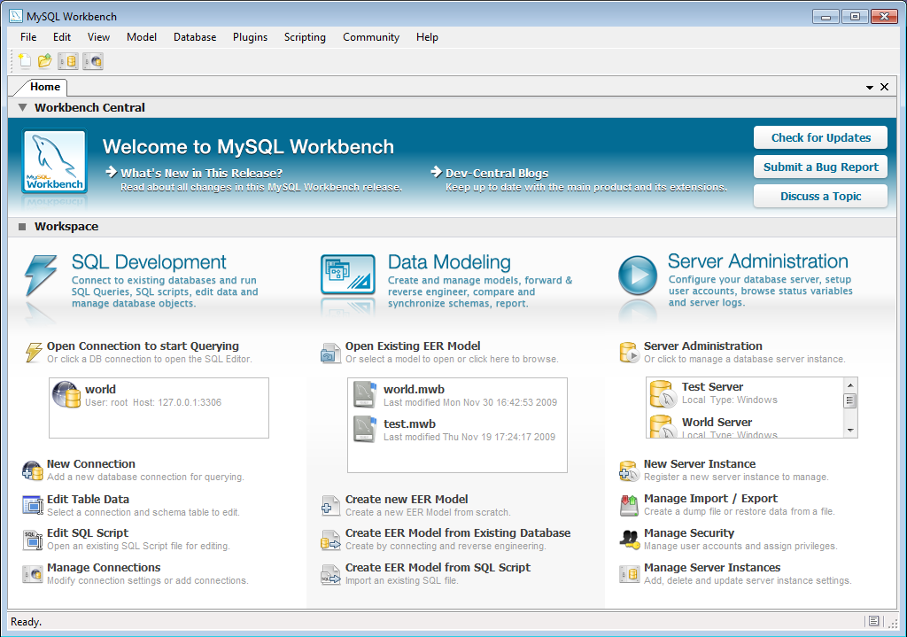
Cross-Platform Use
While the most popular distributions of MySQL are packaged in the “AMP” bundles (LAMP, MAMP, WAMP), recently MySQL has released the MySQL Workbench which allows users to utilize MySQL features without the need for Apache and PHP/Perl/Python.

Slide 4
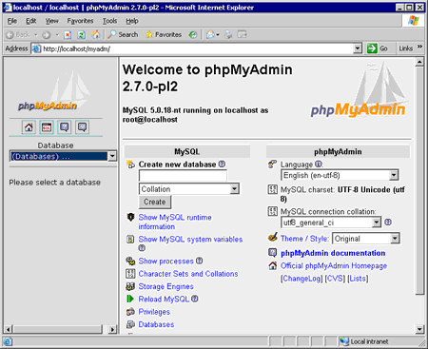
Third Party Programs
While there are many different front ends for MySQL (which is done mostly through command line), the most popular is phpMyAdmin, which is a free web-based front end, is widely installed on web hosts, written in PHP and is included in LAMP, WAMP, and MAMP.

Slide 5
Uses in Today’s World
Facebook
Wikipedia
Google
Twitter
Flickr
Youtube

Slide 6
Limitations
Max DB Size | Max Table Size | Max Row Size | Max Columns per row | Max Blob/Clob Size | Max Char Size | Max Number Size | Min Date Value | Max Date Value | Max Column name size
Unlimited | 256 TB | 64 kb³ | 4096⁴ | 4GB | 64 kb | 64 bits | 1000 | 9999 | 64

Slide 7
PHP Introduction
PHP is a general purpose scripting language used for creating dynamic web pages.
Syntax similar to C
Stands for PHP Hypertext Preprocessor
Created in 1995; most recent update August 2011 (5.3.8)

Slide 8
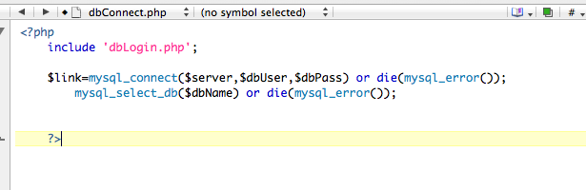
PHP and MySQL
PHP is often bundled with MySQL as part of the “AMP” packages.
While MySQL queries do not need it’s own class, for readability and the programmer’s sanity, it is much more efficient.

Slide 9
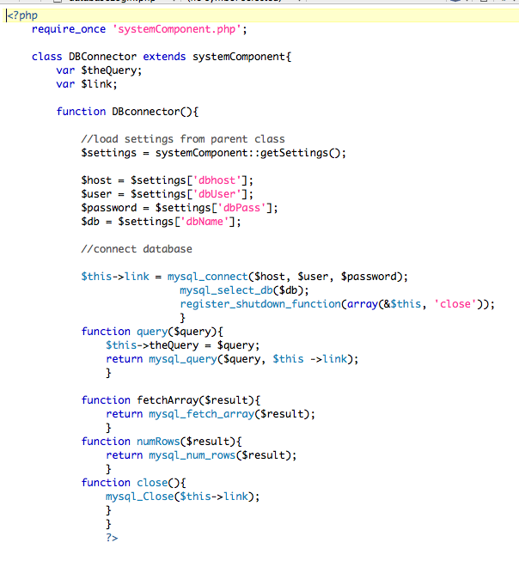

PHP and MySQL

Slide 10
C# and MySQL
While there are many issues with the MySQL++, the MySQL C# connector works beautifully.
Written in 100% C#, the C# connector uses the .NET framework.
Fully manages, it doesn’t use the MySQL client library (like C++ does)

Slide 11
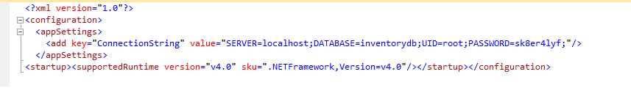
C# and MySQL Code
Connection String used to authenticate with MySQL server

Slide 12
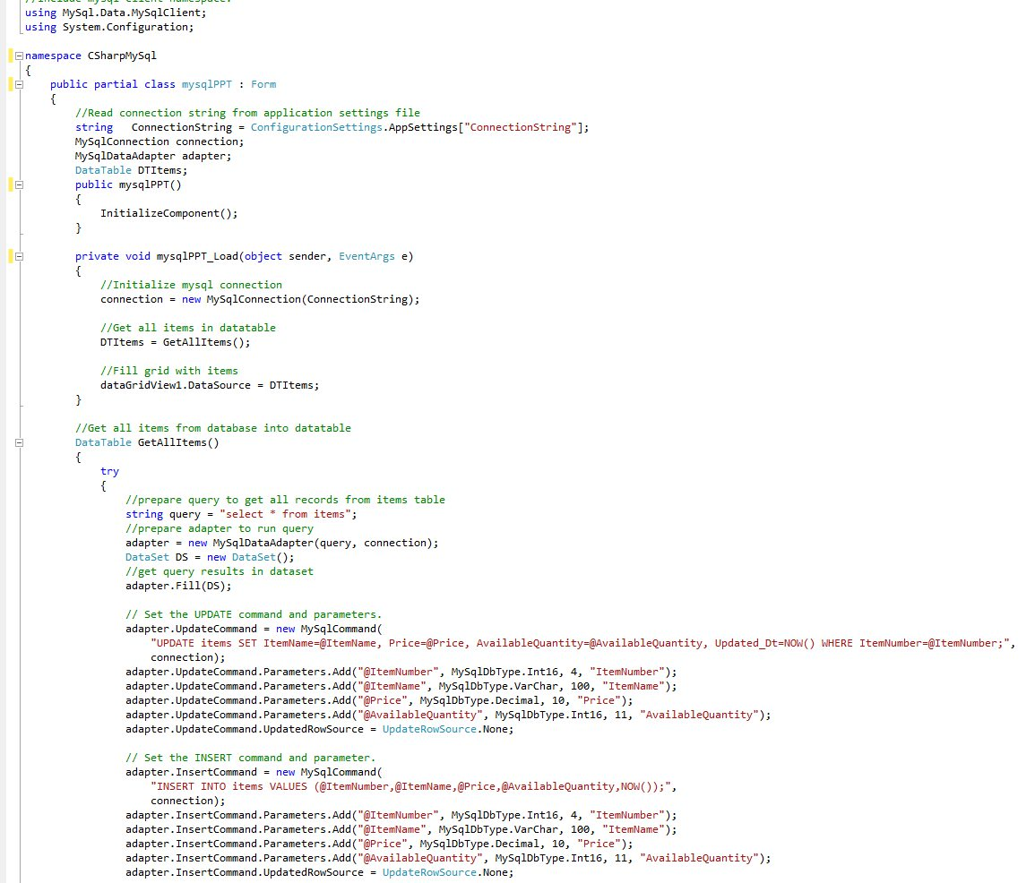
MySQL and C# code

Slide 13
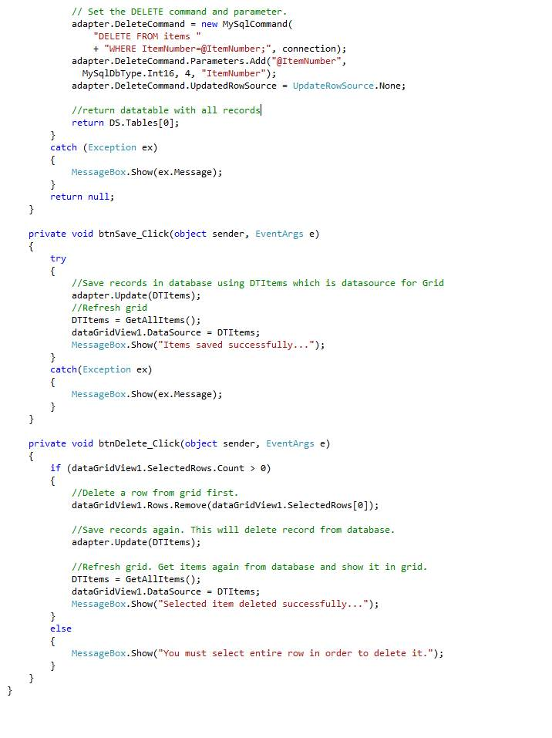
MySQL and C# code

Slide 14
Summary
MySQL is a great, flexible database management system that works well on the web or with local applications.
C++ does not work well at all with MySQL and therefor I do not like it…

Slide 15
Sources
http://dev.mysql.com/doc/refman/5.0/en/connector-net.html
http://itc.conversationsnetwork.org/shows/detail3298.html#
http://dev.mysql.com/doc/refman/5.1/en/what-is-mysql.html

