Slide 1
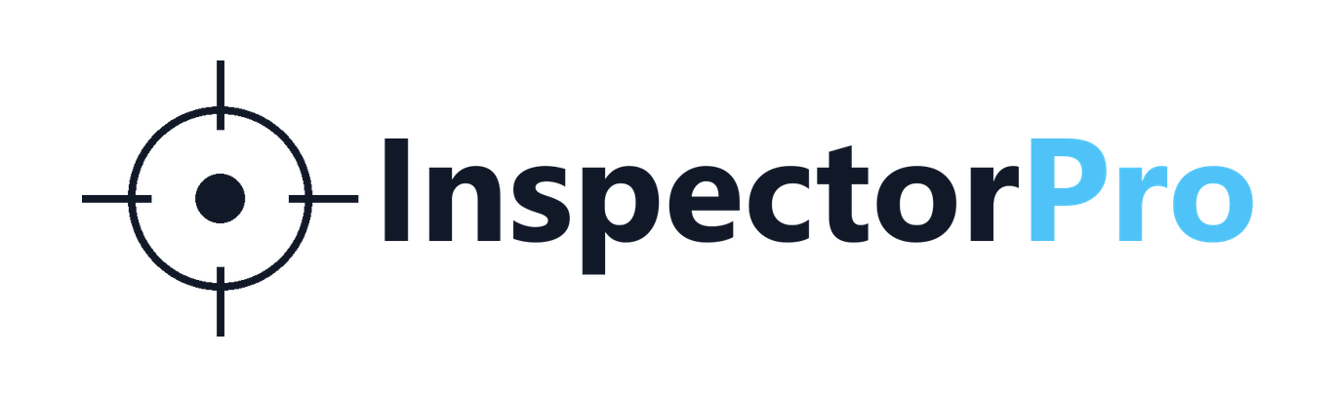
Cross-functional product-context AI for manufacturing
Connecting CAD, drawings, FAI, BOM, suppliers, and department knowledge into role-aware manufacturing decisions.
Conversation deck for Steve Banks / Improving Minnesota
June 2026

Slide 2
Before: scattered context
After: InspectorPro product-context layer
Data exists, but it is loosely connected or only searchable.
The product travels with context, so agents reason across
departments and organizations.
Engineering
Manufacturing
Machine shops
InspectorPro context environment
Engineering
Manufacturing
Machine shops
CAD / Product
Suppliers
CAD / Product
Suppliers
Quality / FAI
Service / Sales
Purchasing
Quality / FAI
Service / Sales
Purchasing
Example query
limited context -> email loop, delayed disposition
Same query
Agent checks assembly role + dimension function.
accept, rework, or escalate with evidence
Mounting-hole diameter out of tolerance.
Can we still use this part?
same mounting-hole question
InspectorPro - discussion deck - June 2026

Slide 3
The supplier disposition problem
When FAI finds a deviation, the supplier often has the measurement - but not the product context.
1. Package sent
2. Part made
3. FAI deviation
4. Missing context
5. Decision stalls
CAD, drawing, specs, and purchase requirements are sent to the supplier.
The shop manufactures the part and completes first article inspection.
A feature is out of tolerance, such as a mounting-hole diameter.
The supplier may not know the assembly role, mating parts, or function of that dimension.
Work stops for clarification: scrap, rework, accept, or escalate?
The supplier knows:
The supplier may not know:
Demo setup
measured value
tolerance
inspection result
what the feature does
what assembly fit it affects
whether the deviation matters
InspectorPro uses CAD, drawing, FAI, and assembly/function context to answer: keep, rework, scrap, or escalate with evidence.
Core pain: disposition decisions get delayed because product function does not travel with the part.
This is the workflow the FAI supplier demo is meant to prove.

Slide 4
Engineering intelligence for every manufacturing workflow.
Product context compounds across the manufacturing lifecycle
CAD starts the context layer; each department adds and reuses product understanding.
Engineering
Manufacturing
Sales / Training
Checks drawings, features, compare, and DFM.
Value: cleaner releases; fewer late changes.
Process maps, assembly sequence, in-house and supplier capability.
Value: faster prototypes; less scrap/rework.
Role-aware product coaching and two-way onboarding.
Value: faster product knowledge transfer.
CAD / product context backbone
1
2
3
4
5
6
Purchasing
Quality / Supplier
Service / Operations
Purchased/custom split, replacement search, cost and lead-time signals.
Value: faster sourcing; less engineering back-and-forth.
FAI consequence analysis and disposition evidence.
Value: faster accept/rework/scrap decisions.
Service guidance plus facility flow, capacity, and clearance.
Value: better field support and layout decisions.
The value is accumulated product understanding reused across departments - not a collection of disconnected demos.
InspectorPro compounds CAD context around how the product is made, sourced, inspected, sold, serviced, and improved.

Slide 5
Engineering intelligence for every manufacturing workflow.
Market reach: CAD-driven manufacturers, multi-seat expansion
The buyer is not just engineering. The same product context becomes useful across the manufacturing organization.
Expansion users inside one account
Where InspectorPro fits
Companies that make physical products from CAD and need product knowledge to move across teams.
One shared product-context layer
Engineering
Manufacturing
CAD + drawing + BOM + FAI + assembly + supplier evidence
Quality
Purchasing
Representative markets
Suppliers
Service
The same product understanding supports different decisions depending on who is asking.
Medical devices
Industrial equipment
Aerospace / defense
Automotive / mobility
Electronics / high-tech equipment
Contract manufacturers / machine shops
Sales / Training
Operations
Land with one workflow
Expand across departments
Become a product-context system
Market logic: one CAD-driven product account can create many role-specific use cases and seats.

Slide 6
Engineering intelligence for every manufacturing workflow.
Product data in, role-specific answers out
InspectorPro converts product files into shared context for role-aware agents.
Human review gate
new context from use
approved context only
Role-aware
AI agents
Manufacturing
InspectorPro
Product data injection
Context + reasoning engine
Sales
CAD model + drawing / PDF
BOM + specifications
FAI / inspection evidence
Assembly context
Factory capacity
- feature + dimension mapping
- product semantics
- prompting + workflow logic
- RAG / trusted references
- fine-tuning path
Agent 1
Purchasing
Service
Agent 2
turns files into product understanding
Engineering
Agent 3
Production
company vision / mission / product strategy
same context
different answer
Machine shops
Questions and answers move both ways. New notes, decisions, and issues flow back through human review before becoming product context.
The prototype is not just a viewer; it is a role-aware product-context system.

Slide 7
Engineering intelligence for every manufacturing workflow.
Pilot proof: shorten real manufacturing decisions
After the demo, the next step is a narrow pilot that measures whether product context changes decisions.
1. Select real cases
2. Run controlled workflows
3. Measure the delta
Time to answer.
Email clarification loops.
Missed context found.
Evidence quality and failure cases.
What has to be true for the pilot to matter?
Repeatable install
Trusted evidence
Faster disposition
Lower rework risk
Clear next workflow
Success is not broad deployment. Success is proving that one real workflow gets faster, clearer, and more defensible.
A good pilot turns the prototype from an interesting demo into evidence for a customer, partner, or investor conversation.

Slide 8
Engineering intelligence for every manufacturing workflow.
What I would value from this conversation
The ask is guidance, introductions, and path clarity - not a forced close.
Market read
Pilot introductions
Startup path
Where does this fit best: product company, pilot-led enterprise sale, startup program, or strategic partnership?
Who are 1-3 manufacturers where drawing, FAI, supplier handoffs, or revision context create real pain?
Is CodeLaunch, an Improving relationship, or another Minnesota ecosystem path worth pursuing?
Investor/operator intros
Partnership advice
If the product story is credible, who should see the 12-month pilot-readiness plan?
If technical hardening help makes sense, define it cleanly while preserving core InspectorPro IP.
Best outcome: clear next step, warm introductions, or a scoped follow-up conversation.

