Slide 1

InspectorPro
InspectorPro
Product-context AI for manufacturing workflows
Turning CAD, drawings, assemblies, inspection records, and supplier evidence into shared manufacturing intelligence.
One product truth across teams, suppliers, and customers.
Phase 1 raise: $500K to reach controlled production pilot readiness
Engineering intelligence for every manufacturing workflow.

Slide 2
InspectorPro
Manufacturing decisions are made with incomplete product context.
The data exists, but it is trapped across CAD, drawings, inspection records, supplier emails, revision history, and expert memory.
Fragmented product data
CAD models
Drawings and callouts
FAI / inspection records
Supplier emails
Revision history
Expert memory
Broken handoffs
Engineering to Quality
Quality to Machine Shops
Customer to supplier
Supplier back to customer
Sourcing to Engineering
Training and service teams
Business consequences
Longer review cycles
Scrap / rework from incomplete context
Quality escapes from missed details
Supplier clarification loops
Expert bottlenecks
Slower sourcing decisions
Why this matters financially
$15.8B / year
NIST estimate for inadequate interoperability in U.S. capital facilities
~$12.9M / year
cited average organizational cost of poor data quality
10%+ of sales
poor quality cost can reach this level when full impact is counted
Sources: NIST interoperability cost study; Gartner-cited data quality benchmark; WSJ manufacturing quality reporting.
Engineering intelligence for every manufacturing workflow.

Slide 3
InspectorPro
Generic AI lacks the manufacturing context layer.
Foundation models can reason over language, but manufacturing workflows require extracted, structured, and validated product context.
Foundation models alone
Broad public/general training data
Limited company-specific standards
No native CAD/assembly ingestion
Weak feature, tolerance, FAI, and revision grounding
Answers may lack evidence or traceability
Missing manufacturing layer
CAD + drawing extraction
Feature geometry + GD&T
Assembly relationships
Tolerance / FAI context
Revision history + supplier evidence
Company decision rules
InspectorPro approach
Builds product context before AI reasoning
Grounds outputs in CAD, drawing, inspection, and assembly evidence
Supports fine-tuning where workflow expertise is needed
Creates reusable intelligence across teams and suppliers
The foundation model is not the product. The product is the manufacturing context layer around it.
Engineering intelligence for every manufacturing workflow.

Slide 4
InspectorPro
InspectorPro turns product data into decision-ready manufacturing intelligence.
InspectorPro captures product context, connects it, and turns it into department-specific decisions across teams, suppliers, and customers.
1
Capture
CAD, drawings, assemblies, inspection records, revisions, and supplier evidence.
2
Connect
Features, tolerances, function, assembly impact, supplier context, and company rules.
3
Reason
AI workflows answer manufacturing questions with engineering evidence.
4
Collaborate
Shared decisions across Engineering, Quality, Machine Shops, Sourcing, Service, Sales, Training, suppliers, and customers.
InspectorPro gives every manufacturing decision the product context it was missing.
Business result: faster review, fewer blind handoffs, better supplier decisions, and reusable manufacturing knowledge.
Engineering intelligence for every manufacturing workflow.

Slide 5
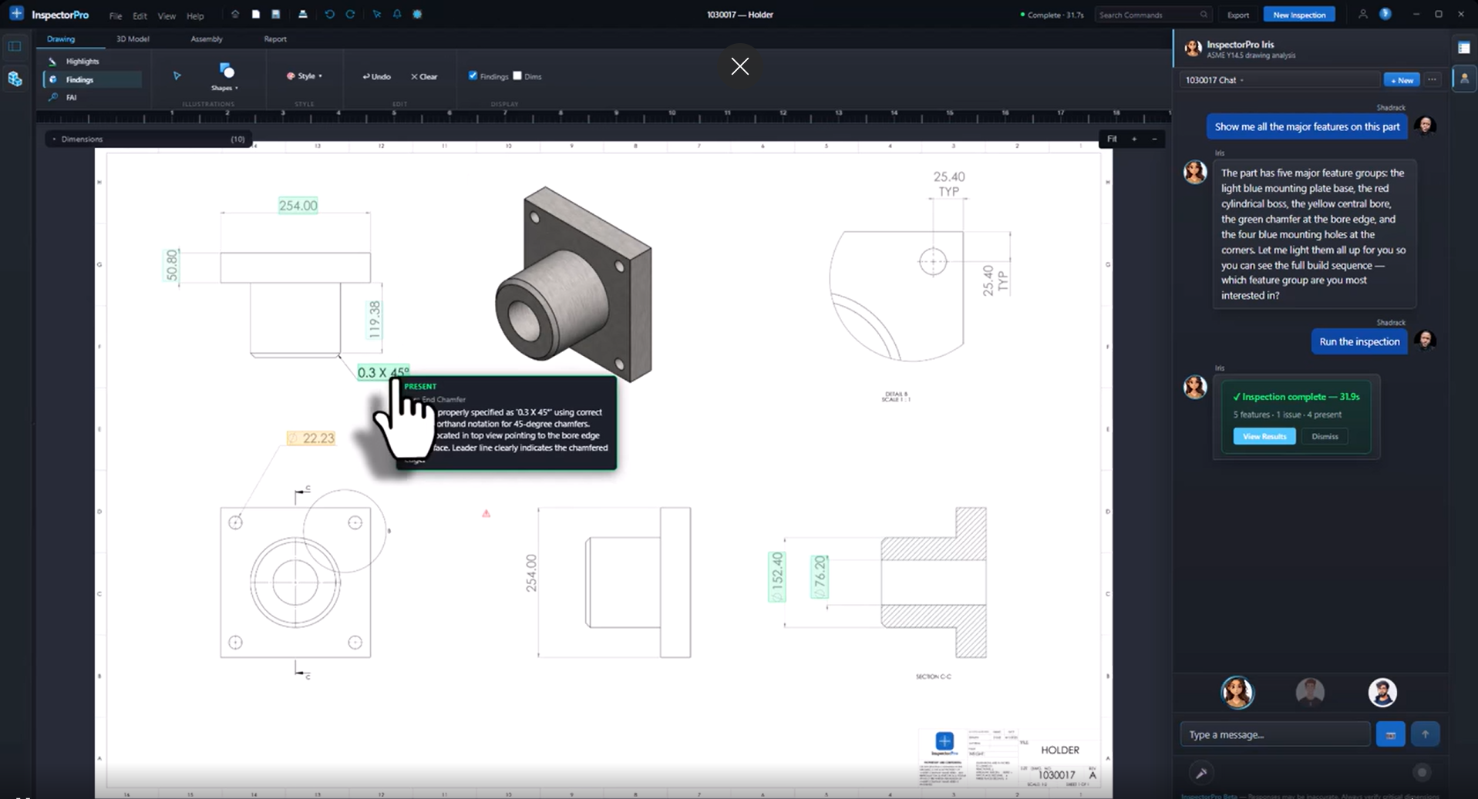
InspectorPro
The prototype already runs on real engineering data.
A working InspectorPro workflow: drawing context, highlighted findings, AI explanation, and inspection completion in the same product workspace.
What this proves
Real drawing data enters the system
Findings are linked to visible evidence
AI agent explains the workflow context
Inspection results are actionable, not just chat output
The wedge is drawing and inspection.
The platform is product-context intelligence for manufacturing.
Engineering intelligence for every manufacturing workflow.

Slide 6
InspectorPro
Start with the workflows manufacturers already feel every day.
InspectorPro lands first in Engineering and Quality because drawing review, FAI, revision changes, and supplier clarification are painful, frequent, and measurable.
First paid use cases
Drawing checker
FAI consequence analysis
Revision / geometry change review
Supplier clarification support
Why this wedge works
Clear pain today
Uses existing CAD/drawing data
Measurable time and quality outcomes
Fits current prototype maturity
Buyer: Engineering / Quality leadership
Expansion path
Machine Shops
Sourcing
Service
Sales / Applications
Training
Suppliers / Customers
Land in Engineering + Quality. Expand through every team that depends on product context.
Engineering intelligence for every manufacturing workflow.

Slide 7
InspectorPro
One product context layer expands across the manufacturing business.
Once InspectorPro understands the product, the same context powers workflows beyond drawing inspection.
Engineering
drawing review / revision impact / design intent
Service
troubleshooting / part function / failure context
Quality
FAI / inspection risk / disposition support
InspectorPro Product Context Layer
CAD | drawings | assemblies | inspection | revisions | supplier evidence | company knowledge
Sales / Applications
customer walkthroughs / capability coaching
Machine Shops
manufacturability / setup risk / tolerance context
Training
process maps / assembly guidance / plant explanation
Sourcing
replacement specs / supplier evidence / purchased parts
Suppliers / Customers
shared part context / fewer clarification loops
The wedge is inspection. The opportunity is cross-functional manufacturing intelligence.
Engineering intelligence for every manufacturing workflow.

Slide 8
InspectorPro
Start with manufacturers where product context already creates daily friction.
Enter through painful Engineering + Quality workflows, then expand as the same product context becomes useful across the business and supplier network.
Target customers
Machine builders
Industrial equipment companies
Automation integrators
Precision manufacturers
Supplier-heavy manufacturers
Why they feel the pain
Complex assemblies
Drawing-heavy workflows
Supplier/vendor handoffs
Quality and inspection burden
Revision control issues
Expert knowledge bottlenecks
Entry motion
Land with Engineering + Quality
Use real parts and drawings
Measure review time and rework risk
Reduce supplier clarification loops
Expand to sourcing, service, training, and supplier collaboration
Land where drawing, inspection, and supplier handoffs are painful. Expand where product context creates leverage.
Engineering intelligence for every manufacturing workflow.

Slide 9
InspectorPro
12 months to controlled production pilot readiness.
The $500K Phase 1 raise funds a disciplined path from working prototype to reliable pilot package with measurable outcomes.
Months 1-2
Stabilize
Clean-machine install
Bridge/extractor reliability
Library intake flow
Diagnostics
Months 3-4
Build context layer
CAD + drawing + FAI links
Assembly/revision context
Supplier intake
Readiness checks
Months 5-6
Harden pilot workflows
Drawing checker
FAI consequence analysis
Revision/geometry compare
Supplier clarification
Months 7-9
Controlled pilot
Real parts and drawings
Measure review time
Capture failure cases
Security/deployment hardening
Months 10-12
Pilot package
Installer + support docs
Metrics dashboard
Onboarding process
1-3 production pilots
The goal is not broad deployment in year one.
The goal is a reliable pilot package with measurable workflow outcomes.
Engineering intelligence for every manufacturing workflow.

Slide 10
InspectorPro
Raising $500K to reach production pilot readiness.
A focused Phase 1 raise to convert the working prototype into a reliable pilot package with measurable customer outcomes.
Phase 1 ask
$500K
12-month runway to controlled production pilot readiness
Use of funds
Technical talent - 50%
$250K - core engineering, extractor/bridge, context layer
Compute + infrastructure - 20%
$100K - AI usage, cloud, pipelines, tuning experiments
Data acquisition + QA - 15%
$75K - labels, test data, validation sets, telemetry
Hardware + edge testing - 10%
$50K - workstations, edge nodes, clean-machine testing
What this buys
Installable software, hardened SOLIDWORKS extraction, pilot metrics, support docs, and 1-3 controlled production pilots.
Legal, IP + compliance - 5%
$25K - IP filings, pilot contracts, privacy terms
$500K funds the path from working prototype to measurable production pilot value.
Engineering intelligence for every manufacturing workflow.

Slide 11
InspectorPro
REFERENCES FOR BENCHMARK NUMBERS
These are directional market benchmarks used to show that fragmented data, poor quality, and interoperability gaps create material operating cost. They are not InspectorPro-specific savings claims.
$15.8B / year
Interoperability cost benchmark
NIST GCR 04-867, Cost Analysis of Inadequate Interoperability in the U.S. Capital Facilities Industry. The report estimated $15.8B/year in 2002 industry costs from inadequate interoperability.
https://nvlpubs.nist.gov/nistpubs/gcr/2004/nist.gcr.04-867.pdf
~$12.9M / year
Poor data quality benchmark
Gartner-cited benchmark for average annual organizational cost of poor data quality, referenced in ITPro coverage on data quality and AI readiness.
https://www.itpro.com/technology/artificial-intelligence/dont-throw-out-bi-and-data-analytics-in-the-race-for-ai
10%+ of sales
Poor quality / COPQ benchmark
Wall Street Journal manufacturing quality reporting cited the scale of poor-quality costs when scrap, rework, warranty, and problem-solving time are included.
https://www.wsj.com/business/american-manufacturers-seek-perfection-as-quality-issues-mount-6883d6b8
Deck usage: use these numbers as context for the size of the pain; customer ROI should be measured during pilots using actual scrap, rework, review-time, and supplier-clarification baselines.
Engineering intelligence for every manufacturing workflow.

