Slide 1

InspectorPro
Investor discussion deck
confidential draft
MISSION
The engineering data already exists.
Engineering data
Manufacturing workflows
CAD
Engineering
Quality
Drawings
Machine Shops
InspectorPro turns it into shared technical intelligence for every manufacturing workflow.
InspectorPro
Assemblies
Sourcing
CAD, drawings, assemblies, inspection context, supplier evidence, and product knowledge translated into each department's language.
Service
Inspection
Sales / Apps
One product truth. Many department languages.
Investor discussion draft | Engineering intelligence for every manufacturing workflow.

Slide 2
InspectorPro
Investor deck
confidential draft
PROBLEM
Every department sees the same product differently.
Engineering, Quality, Machine Shops, Sourcing, Service, and Sales all need different answers from the same CAD, drawing, and product history.
Different operating languages
Now they can question each other
Engineering
Quality
Engineering: can this redesign shorten lead time?
design intent
inspection risk
Machine Shops
Sourcing
2
Sourcing history
setup + tooling
cost + lead time
Engineering
1
InspectorPro
Service
Sales / Apps
3
Machine-shop constraints
failure modes
customer fit
Answer returns in Engineering language, with sourcing and manufacturing consequences preserved.
InspectorPro becomes the translator between departments, grounded in product truth.
Engineering intelligence for every manufacturing workflow.

Slide 3
InspectorPro
Investor deck
confidential draft
WHY GENERIC AI IS NOT ENOUGH
The hard part is not summarizing documents. It is grounding answers in engineering evidence.
Text
Geometry
Drawings
Process
PDFs, emails, notes
CAD faces, parts, assemblies
views, dimensions, annotations
quality, sourcing, service, sales
InspectorPro turns these evidence layers into workflow-specific decisions.
Engineering intelligence for every manufacturing workflow.

Slide 4
InspectorPro
Investor deck
confidential draft
PLATFORM ARCHITECTURE
A manufacturing intelligence layer built from real engineering context.
Department workflows
Engineering | Quality | Sourcing | Service | Training | Sales/Application
Workflow agents
Sage, Scout, quality review, procedure guidance, coaching
Engineering context engine
Drawing maps, dimensions, annotations, revisions, assemblies, evidence
Data capture layer
SOLIDWORKS add-in, .inspectorpkg packages, CAD/drawing extraction
The LLM is not the product. The engineering context layer is.
Engineering intelligence for every manufacturing workflow.

Slide 5
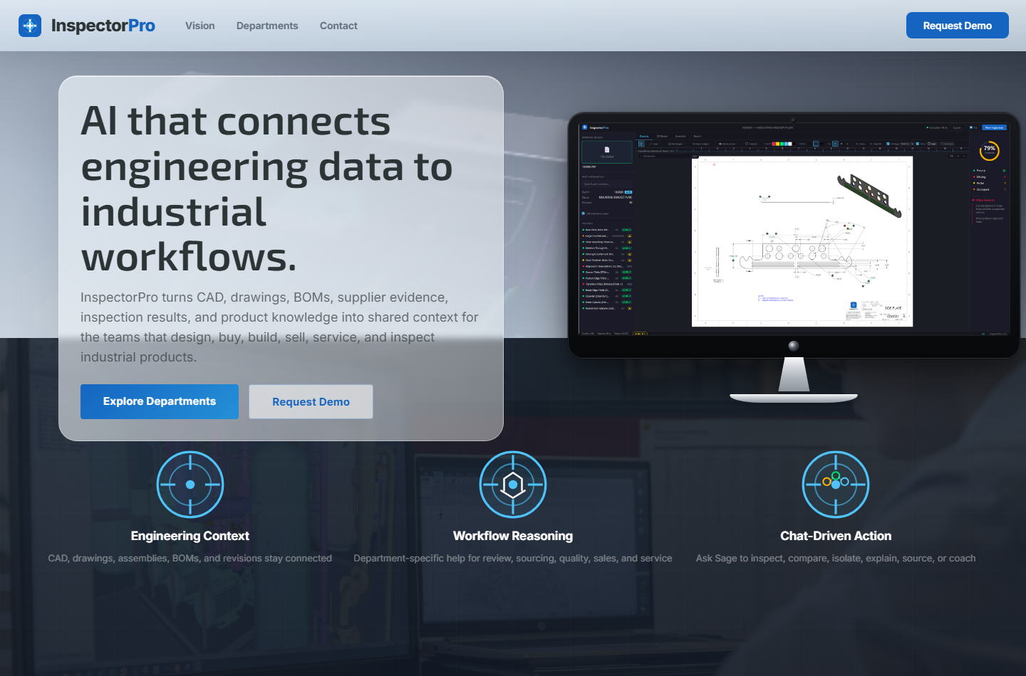
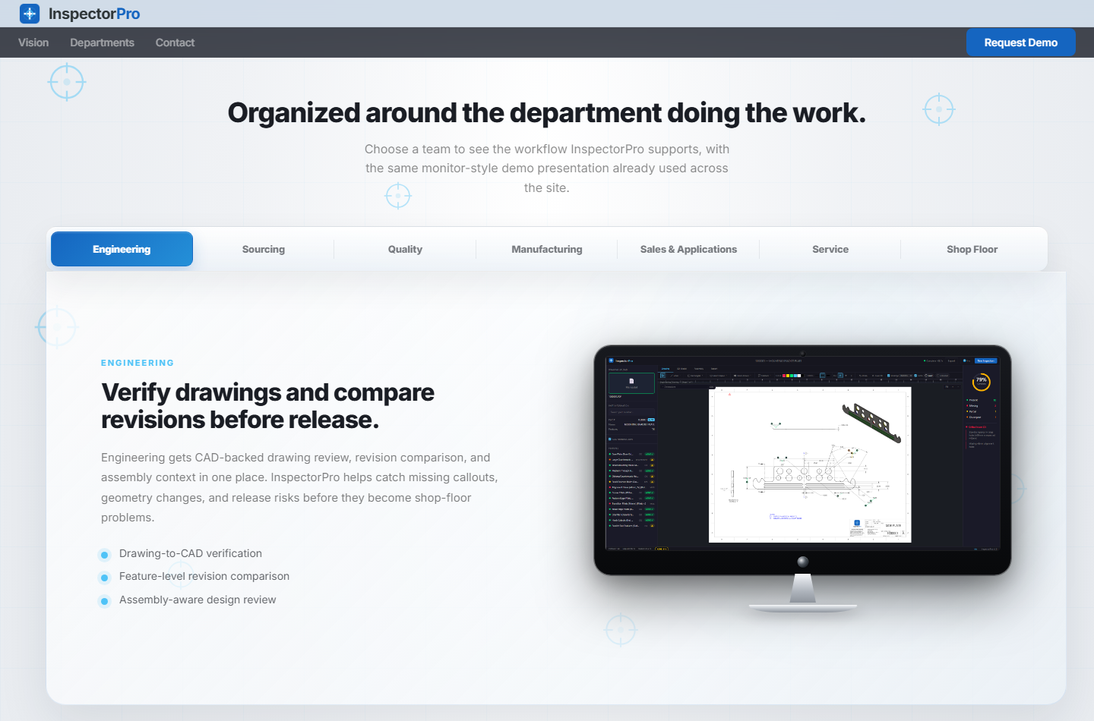
InspectorPro
Investor deck
confidential draft
PROTOTYPE PROOF
The prototype already proves the platform direction across departments.
CAD + drawing intelligence
Department workflow expansion
Engineering intelligence for every manufacturing workflow.

Slide 6
InspectorPro
Investor deck
confidential draft
LIVE INTEGRATION MILESTONE
From web app to live SOLIDWORKS data, with user approval.
1
2
3
4
5
App request
Approval
Extraction
Package
Refresh
Re-extract from SOLIDWORKS
SOLIDWORKS modal
active drawing
validated .inspectorpkg
drawing map updates
Proof point: fresh, user-approved engineering data now flows directly from SOLIDWORKS into InspectorPro without manual file copying.
Engineering intelligence for every manufacturing workflow.

Slide 7
InspectorPro
Investor deck
confidential draft
INITIAL CUSTOMER WEDGE
Start where CAD and drawing context already creates daily operational pain.
Machine builders
Industrial equipment
Automation integrators
complex assemblies, service knowledge
drawings, revisions, BOMs, suppliers
applications engineering and customer fit
Precision manufacturers
Regulated suppliers
quality and drawing interpretation
traceability, inspection, consistency
Wedge: SOLIDWORKS-heavy manufacturers with drawing, revision, and product-knowledge pain.
Engineering intelligence for every manufacturing workflow.

Slide 8
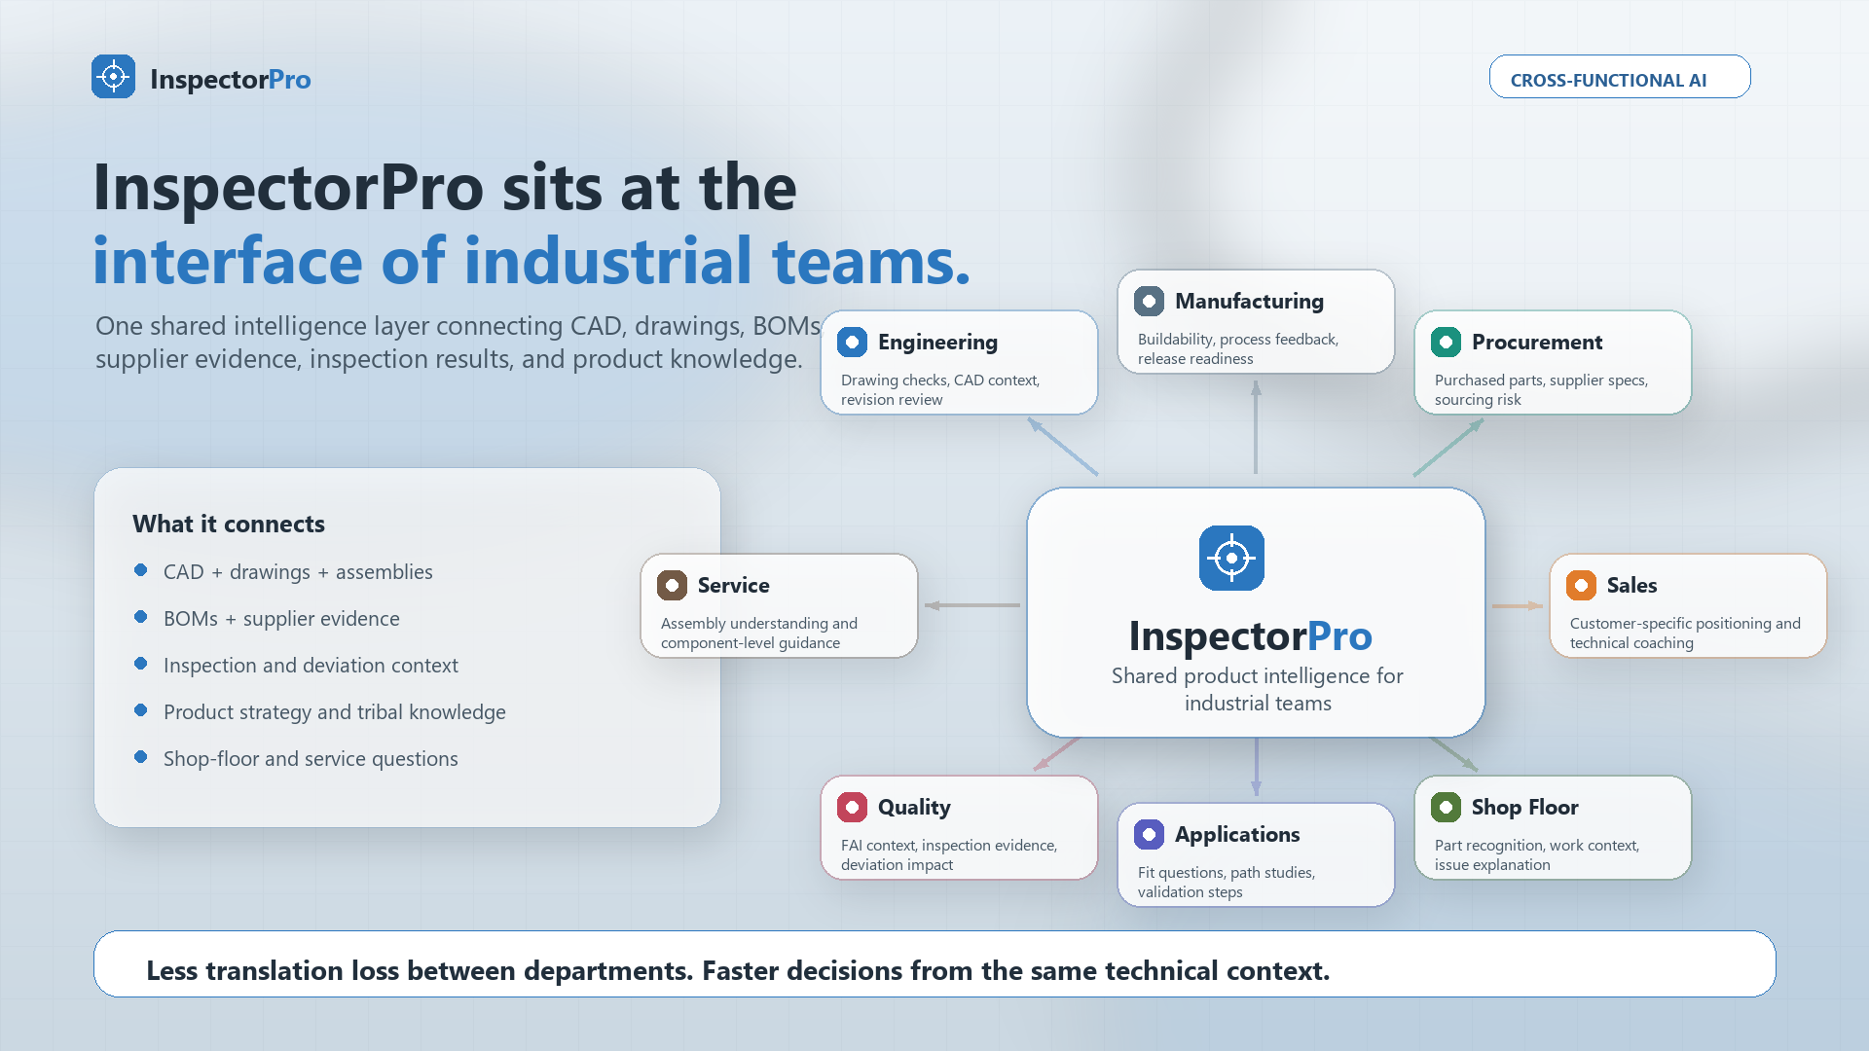
InspectorPro
Investor deck
confidential draft
EXPANSION MAP
One shared technical context, many department-specific workflows.
Each department gets a workflow-specific lens on the same product truth.
Engineering intelligence for every manufacturing workflow.

Slide 9
InspectorPro
Investor deck
confidential draft
WHY THIS CAN COMPOUND
The moat is not a chatbot. It is the engineering evidence graph plus company-specific know-how.
Extraction depth
Evidence grounding
.inspectorpkg, drawing maps, SOLIDWORKS bridge
claims tied to drawing/CAD/assembly context
Workflow packets
Tribal knowledge
engineering reasoning rendered for each department
best practices from senior engineers and application teams
Feedback loop
which packets help, which claims fail, which workflows convert
Engineering intelligence for every manufacturing workflow.

Slide 10
InspectorPro
Investor deck
confidential draft
BUSINESS VALUE
InspectorPro spreads engineering judgment across the business.
Team
Problem today
InspectorPro outcome
Engineering
manual drawing and CAD review
faster evidence-backed review
Quality
slow interpretation of requirements
clearer inspection context
Sourcing
part requirements disconnected from suppliers
faster technically grounded sourcing
Service/training
procedures detached from assemblies
CAD-guided learning and troubleshooting
Sales/application
tribal product strategy hard to scale
better-prepared customer conversations
Engineering intelligence for every manufacturing workflow.

Slide 11
InspectorPro
Investor deck
confidential draft
MARKET ENTRY
A large manufacturing base is ready for practical AI that respects engineering rigor.
$2.93T
10%
8M+
U.S. manufacturing value added in Q3 2024
U.S. GDP represented by manufacturing
SOLIDWORKS community users globally
Initial beachhead:
SOLIDWORKS-heavy manufacturers with drawing, revision, and product-knowledge pain.
Draft sources: NIST Manufacturing in America; NIST 2025 Manufacturing Economy Report; SOLIDWORKS community page. Final TAM/SAM/SOM still to be sourced.
Engineering intelligence for every manufacturing workflow.

Slide 12
InspectorPro
Investor deck
confidential draft
GO TO MARKET
Land with a painful engineering workflow. Expand into the departments around the product.
Land
Prove
Expand
Institutionalize
CAD/drawing intelligence
paid pilot
department modules
company knowledge
show faster review and less manual file work
measure review time, extraction flow, and error reduction
quality, sourcing, service, training, applications
capture best practices and product-family strategy
Engineering intelligence for every manufacturing workflow.

Slide 13
InspectorPro
Investor deck
confidential draft
STRATEGIC FIT
SWOT: product-context AI for manufacturing.
Investor read: the strength is not one isolated feature; it is an integrated product-context layer.
STRENGTHS
OPPORTUNITIES
-
Low barrier to engineering context through natural-language prompts.
-
Practical AI for manufacturing workflows, not generic chat.
-
Unified product decision context around each part or assembly.
-
Scattered engineering data can become usable decision context.
-
CAD intelligence for non-CAD users through a browser workspace.
-
Broader access to CAD knowledge without broader CAD seat and workstation cost.
-
Cross-functional decision support across engineering, quality, manufacturing, sales, service, purchasing, and suppliers.
-
Cross-functional decisions grounded in the same product truth.
-
Supplier/customer collaboration without sending editable CAD or constant clarification emails.
-
Supplier/customer shared CAD intelligence can reduce email loops.
-
Institutional knowledge becomes actionable instead of trapped in people or files.
-
Knowledge retention and workforce transition for newer employees.
-
Controlled AI: approval gates, validation, no CAD write-back, and readiness checks.
-
Trustworthy AI adoption in engineering with human control and evidence.
-
Performance and cost transparency through usage, token, latency, and workflow metrics.
-
Measurable AI governance: cost, latency, reliability, and bottlenecks.
-
Interactive product learning and content generation from CAD visuals plus grounded Q&A.
-
Modern training, onboarding, service, and sales enablement.
WEAKNESSES
THREATS
-
Production packaging, installer hardening, licensing, and deployment controls are still maturing.
-
CAD and PLM incumbents may bundle AI into existing ecosystems.
-
Outcome quality depends on complete and accurate CAD, profile, supplier, and quality data.
-
Engineering buyers require trust, security, traceability, and clear AI decision boundaries.
-
Inspection profile generation still needs review/approval automation beyond intake stubs.
-
Enterprise IT, procurement, and data governance cycles can slow adoption.
-
Current value is strongest in SOLIDWORKS-centered environments.
-
Customer data may be fragmented, incomplete, or unavailable at pilot start.
-
Enterprise security, integrations, and repeatable deployment playbooks still need hardening.
-
Supplier-specific DFM depends on suppliers sharing and maintaining accurate capability data.
Engineering intelligence for every manufacturing workflow.

Slide 14
InspectorPro
Investor deck
confidential draft
BUSINESS STRENGTHS
Nine strengths investors should understand explicitly.
Each strength is stated as a business capability, with the mechanism and business impact made visible.
1
Lowers the use barrier
2
Unifies product context
3
Extends CAD intelligence
Users ask one prompt in a browser instead of learning specialized CAD or inspection commands.
CAD, drawings, inspection forms, spreadsheets, quality records, supplier docs, and revisions become one part-centered context.
Features, dimensions, drawings, 3D context, and explanations are available without high-spec CAD hardware or a native CAD seat.
Impact: faster access for non-specialists and fewer handoffs.
Impact: decisions use the full product story, not scattered fragments.
Impact: CAD knowledge reaches more people at lower access cost.
4
Encourages cross-functional thinking
5
Improves supplier lead time
6
Activates institutional knowledge
Agents answer with whole-product context and flag effects on other departments when relevant.
Controlled context helps quote, hold, rework, scrap, or carry-on decisions without editable CAD or clarification loops.
Prompts, workflows, examples, and future fine-tuning encode expert practices and company preferences.
Impact: decisions consider engineering, quality, manufacturing, sales, service, purchasing, and suppliers together.
Impact: faster supplier/customer decisions and less interruption.
Impact: experienced-worker knowledge becomes reusable by newer employees.
7
Builds trust before automation
8
Shows system performance
9
Creates interactive learning
Human approval, validation gates, no CAD write-back, profile readiness, and review workflows keep AI controlled.
Usage tracking captures tokens, estimated cost, endpoint latency, workflow timing, approval wait, errors, and bottlenecks.
CAD visuals plus grounded agents turn training, onboarding, service, sales, and support into two-way product conversations.
Impact: users get decision-ready context without surrendering engineering authority.
Impact: management can govern cost, reliability, and ROI.
Impact: faster onboarding and more inclusive technical communication.
Engineering intelligence for every manufacturing workflow.

Slide 15
InspectorPro
Investor deck
confidential draft
STRENGTH TO OPPORTUNITY
How InspectorPro turns strengths into market opportunities.
This is the investor logic: each internal capability points to a specific external market need.
Strength
Opportunity
Business move enabled
Low use barrier
Practical AI for manufacturing
Simple prompt-based access to CAD and inspection context.
Unified product context
Scattered data becomes usable
Fragmented files become decision-ready product context.
Browser CAD intelligence
Lower CAD access cost
Non-CAD users see features, dimensions, and explanations without a CAD seat.
Cross-functional answers
Better departmental decisions
Every department can see how its choice affects the larger system.
Supplier collaboration
Fewer clarification loops
Suppliers can make quote, hold, rework, or scrap decisions from controlled context.
Institutional knowledge
Workforce transition
Expert practices become accessible to newer workers through grounded agents.
Controlled AI boundaries
Trustworthy adoption
Approval, validation, readiness, and no-writeback reduce engineering risk.
Performance transparency
AI governance
Cost, latency, errors, and workflow bottlenecks become measurable.
Interactive product content
Modern training and sales enablement
CAD visuals plus conversation improve onboarding, service, sales, and support.
Core thesis: InspectorPro can become the product-context intelligence layer between CAD, quality, manufacturing, suppliers, and business teams.
Engineering intelligence for every manufacturing workflow.

Slide 16
InspectorPro
Investor deck
confidential draft
CAPITAL NEEDED
First production-grade version: raise around $900K.
A disciplined pre-seed ask to move from validated prototype to customer-ready production pilots.
Recommended ask
Use of funds
$900K
Workstream
Budget
Purpose
Engineering + product hardening
$350K-$650K
core software + reliability
credible range: $750K-$1.2M
QA across SW2023 + SW2024
$40K-$100K
clean-machine validation
Installer, signing, security
$20K-$60K
MSI, signing, diagnostics
Funds 6-9 months of production work
Pilot implementation + support
$30K-$100K
deployment + training
Target: 2-3 customer pilots with installable software, support docs, and measurable workflow outcomes.
Legal, cloud, AI, sales material
$75K-$200K
contracts + infrastructure
Operating buffer
$100K-$250K
bug-fix runway
What this capital buys
Production installer + SOLIDWORKS reliability + bridge integration + first referenceable customer pilots.
Investor framing: enough capital to reach production pilots, not a bloated feature buildout.
Engineering intelligence for every manufacturing workflow.

Slide 17
InspectorPro
Investor deck
confidential draft
ROADMAP AND USE OF FUNDS
Use funding to turn the working prototype into production infrastructure and paid pilots.
Product hardening
Pilot motion
Platform expansion
•
bridge token auth
•
3-5 customer pilots
•
part + assembly extraction
•
production add-in installer
•
workflow success metrics
•
quality and sourcing modules
•
extraction reliability
•
case studies
•
training/service workflows
•
enterprise diagnostics
•
implementation playbook
•
company-specific knowledge
Target raise: ~$900K for 6-9 months to customer-ready production pilots.
Engineering intelligence for every manufacturing workflow.

Slide 18
InspectorPro
Investor deck
confidential draft
FUTURE WEDGE
The long-term opportunity is supervised CAD automation.
Sage recommends a controlled change. The user approves. The SOLIDWORKS add-in executes. InspectorPro verifies the before/after evidence.
Recommend
Approve
Execute
Verify
e.g. add a 3 mm fillet
human-controlled CAD change
SOLIDWORKS API command
updated package + drawing context
Positioning: supervised engineering automation, not autonomous design authority.
Engineering intelligence for every manufacturing workflow.

Slide 19
InspectorPro
Closing
confidential draft
Manufacturers already have the data.
InspectorPro turns it into engineering intelligence for the workflows that move the business.
Engineering intelligence for every manufacturing workflow.
Investor discussion draft - funding ask and pilot terms to be finalized.
InspectorPro | Engineering intelligence for every manufacturing workflow.

Slide 20
InspectorPro
Investor deck
confidential draft
SWOT APPENDIX
Exact strength wording: 1.
Full wording preserved from the SWOT discussion: strength, how it works, and business impact.
1
Lowers the barrier to engineering data access and collection
HOW
InspectorPro extracts structured CAD context from SOLIDWORKS and makes it available through one AI-assisted workspace where users can ask questions in natural language.
BUSINESS IMPACT
Teams spend less time learning complex tools, searching files, copying data, or waiting on specialists, which speeds up decision-making across departments.
Engineering intelligence for every manufacturing workflow.

Slide 21
InspectorPro
Investor deck
confidential draft
SWOT APPENDIX
Exact strength wording: 2.
Full wording preserved from the SWOT discussion: strength, how it works, and business impact.
2
Creates a unified product decision context
HOW
InspectorPro connects CAD data, drawings, inspection profiles, supplier documents, quality records, revision history, and related metadata around each part or assembly.
BUSINESS IMPACT
Teams can make faster, better-informed decisions because they are working from the full product context instead of piecing together partial information from separate files, systems, emails, and people.
Engineering intelligence for every manufacturing workflow.

Slide 22
InspectorPro
Investor deck
confidential draft
SWOT APPENDIX
Exact strength wording: 3.
Full wording preserved from the SWOT discussion: strength, how it works, and business impact.
3
Extends CAD intelligence to non-CAD users at lower access cost
HOW
InspectorPro exposes part features, dimensions, drawings, inspection context, assembly knowledge, and AI-guided explanations through a browser-based workspace instead of requiring every user to open SOLIDWORKS on a high-spec CAD workstation.
BUSINESS IMPACT
Quality, manufacturing, sales, purchasing, service, training, suppliers, and management can access engineering knowledge without needing a full CAD seat, specialized graphics hardware, or deep CAD training for every question. This helps reserve expensive CAD resources for true design work while broadening access to product information.
Engineering intelligence for every manufacturing workflow.

Slide 23
InspectorPro
Investor deck
confidential draft
SWOT APPENDIX
Exact strength wording: 4.
Full wording preserved from the SWOT discussion: strength, how it works, and business impact.
4
Encourages cross-functional decision-making
HOW
InspectorPro gives each department access to product-centered AI answers grounded in the broader engineering, quality, manufacturing, supplier, and service context. When a question has implications beyond one department, the system can surface those dependencies, risks, or missing inputs.
BUSINESS IMPACT
Teams are less likely to make isolated decisions based only on their departments view. Engineering, quality, manufacturing, sales, purchasing, supplier quality, service, training, and management can better understand how their decisions affect one another, creating a more collaborative environment and better-informed decisions across the business.
Engineering intelligence for every manufacturing workflow.

Slide 24
InspectorPro
Investor deck
confidential draft
SWOT APPENDIX
Exact strength wording: 5.
Full wording preserved from the SWOT discussion: strength, how it works, and business impact.
5
Improves supplier/customer collaboration and lead time
HOW
InspectorPro can share controlled product context such as drawings, features, dimensions, inspection requirements, revision history, supplier/spec information, and AI-guided explanations without distributing editable native CAD files. If a supplier still needs clarification, the customer team can surface the answer faster because the relevant context lives in one workspace.
BUSINESS IMPACT
Suppliers can make faster carry-on, hold, quote, rework, or scrap decisions with fewer interruptions caused by missing context. Customer engineering teams spend less time answering repetitive clarification emails, and newer or less-experienced employees can respond more confidently because the system helps them find grounded answers quickly.
Engineering intelligence for every manufacturing workflow.

Slide 25
InspectorPro
Investor deck
confidential draft
SWOT APPENDIX
Exact strength wording: 6.
Full wording preserved from the SWOT discussion: strength, how it works, and business impact.
6
Preserves institutional knowledge and makes it actionable
HOW
InspectorPro combines existing product data with company-specific knowledge, inspection practices, decision rules, and expert techniques captured through prompts, workflows, training examples, or future fine-tuning. Instead of leaving knowledge scattered in files or experienced employees heads, the system makes it available through AI agents grounded in product context.
BUSINESS IMPACT
Companies can preserve a culture of excellence even as experienced workers retire, change roles, or leave. Product data becomes active and useful: employees do not just search for documents; they receive contextual answers shaped by company knowledge, best practices, and historical experience.
Engineering intelligence for every manufacturing workflow.

Slide 26
InspectorPro
Investor deck
confidential draft
SWOT APPENDIX
Exact strength wording: 7.
Full wording preserved from the SWOT discussion: strength, how it works, and business impact.
7
Builds trust by surfacing controlled, decision-ready information
HOW
InspectorPro uses human approval, validation gates, no CAD write-back, profile readiness checks, and review workflows so AI outputs are grounded, traceable, and controlled before being treated as trusted information.
BUSINESS IMPACT
Instead of blindly automating decisions, InspectorPro surfaces the best available context to the requester so they can make informed decisions with confidence. Engineering and quality teams keep control while still benefiting from AI speed and assistance.
Engineering intelligence for every manufacturing workflow.

Slide 27
InspectorPro
Investor deck
confidential draft
SWOT APPENDIX
Exact strength wording: 8.
Full wording preserved from the SWOT discussion: strength, how it works, and business impact.
8
Provides performance transparency
HOW
InspectorPro tracks token usage, estimated AI cost, provider latency, endpoint latency, workflow stage timing, approval wait time, errors, and bottlenecks.
BUSINESS IMPACT
Managers and technical teams can see how the system is performing, what AI usage costs, where delays happen, and whether workflows are improving over time. This makes the platform easier to govern, optimize, and justify.
Engineering intelligence for every manufacturing workflow.

Slide 28
InspectorPro
Investor deck
confidential draft
SWOT APPENDIX
Exact strength wording: 9.
Full wording preserved from the SWOT discussion: strength, how it works, and business impact.
9
Enables interactive product learning and content generation
HOW
InspectorPro combines CAD visuals, product context, assembly data, inspection knowledge, and AI agents to generate training, onboarding, service, sales, and support content that users can interact with. Instead of a one-way document or video, users can ask follow-up questions, pause the narrative, explore specific features, and have a grounded conversation about the product.
BUSINESS IMPACT
Companies can speed up onboarding, training, service preparation, and technical knowledge transfer. The experience becomes more inclusive because non-experts can learn visually and conversationally, while still being grounded in real CAD and product data.
Engineering intelligence for every manufacturing workflow.

