Slide 1
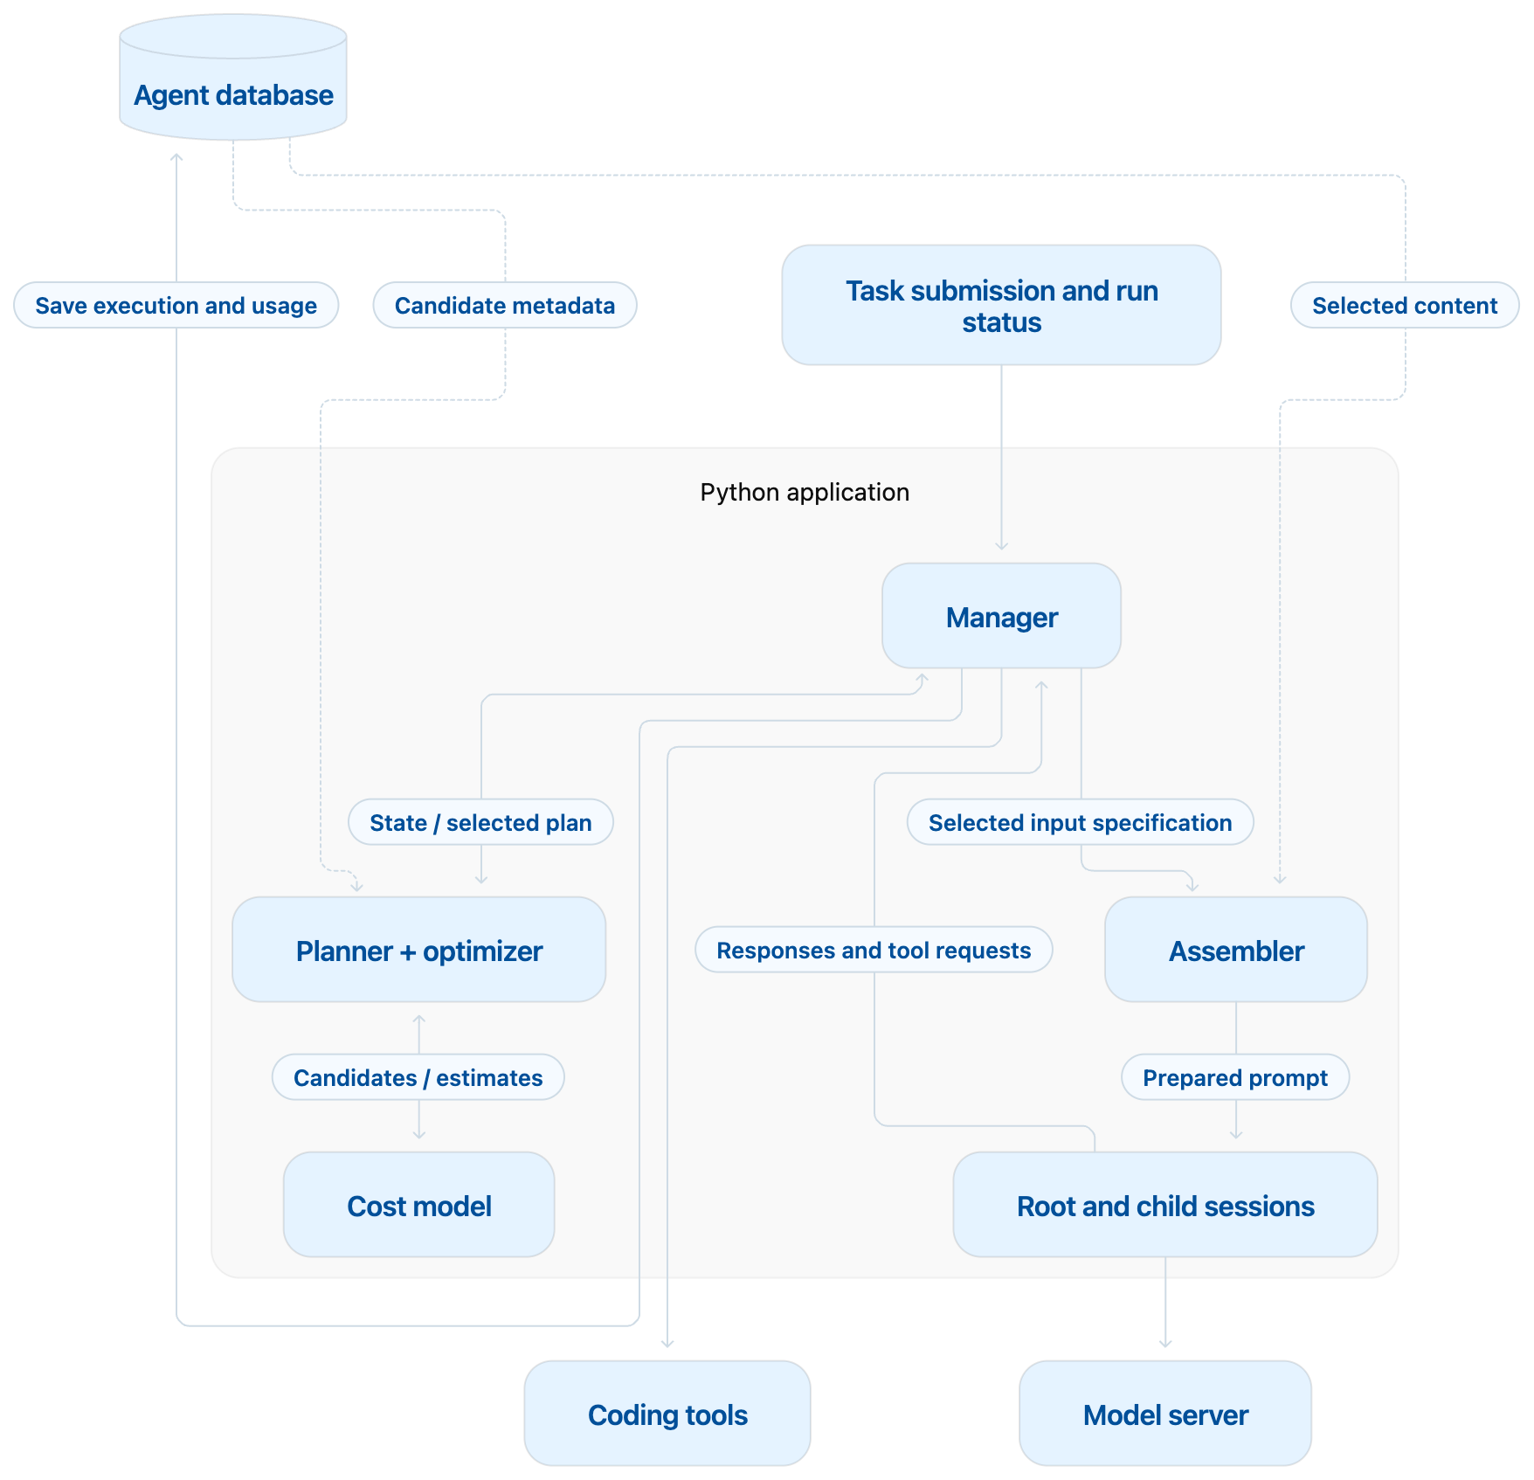
Base prototype architecture

Slide 2
Planner and optimizer implementation
The planner uses structured runtime information to build candidates.
1. Identify the operation. Use the existing tool request, delegation request or configured processing task. Tool names, arguments, artifact IDs and source versions supply lookup keys.
PLAN
CONSTRUCTION RULE
2. Retrieve candidate metadata. Ask the database for matching observations, published results and directly related evidence IDs, versions, sizes and applicability conditions first.
Continue
Keep the current session and add the required new evidence.
Focused child
Use a bounded assignment with directly required evidence.
3. Construct the available plans
Broader child
Use the same assignment and add permitted related records, within a configured token limit.
Reuse
Select an existing result that matches the operation and required source versions.
4. Pass candidates to the cost model. Each candidate specifies its execution mode, assignment, evidence references, expected result and resource limits.
5. Planner/optimizer selects one passes to assembler & manager. Remove candidates that violate known requirements or exceed the estimated budget or latency limit; select the remaining candidate with the lowest estimated cost; return the selected plan to the manager.

Slide 3
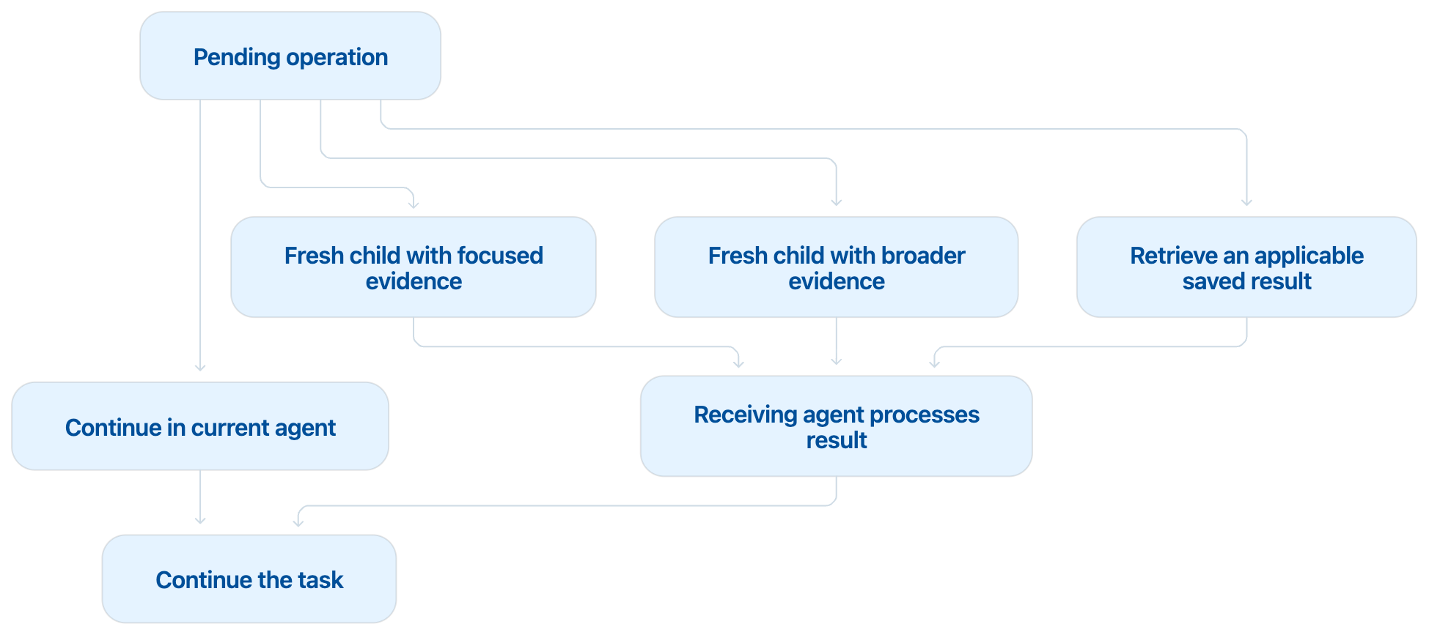
The four candidate plans –v1
Each candidate addresses the same pending operation.
CANDIDATE
MAIN COST TRADE-OFF
Continue
Avoids child setup and communication, but keeps processing the current agent's context.
Focused child
Uses a smaller context, but adds a child call and result integration.
Broader child
Processes more evidence upfront, potentially reducing later information requests.
Reuse
Avoids repeating completed work, but still requires lookup, applicability checks and processing the retrieved result.
Estimate input size from existing context and selected evidence.
Predict output size and call count using measured operation profiles.
Include child execution and result integration.
Include expected repeated inputs and follow-up work.
Return estimated cost, latency and uncertainty.
Compare predictions with actual measurements after execution.

Slide 4
Shared agent database ( To be shared after running v1 prototype)
01 · Agent network
02 · Context
run
task
worker
step
parent/child links
prompt manifests
context blocks
worker status
task scope
result contract
prompt versions per worker
source files (content-addressed)
published results
reuse conditions
evidence relationships
03 · Cost
04 · Self-logging
tokens per worker
remaining window per worker
candidate plans considered
cost estimate per candidate
uncached input / cache read / cache write / output tokens
selected plan + reason
cache prefix-hit length
cache residency + TTL
dollar cost per call
dollar cost per run
latency per call
prompts and solutions that worked
Notes:
Placeholder — details on how the agent database stores and shares observations, results, and execution relationships to be added.

