Slide 1
Long tasks need better control over what enters context
Agent histories grow as tools produce observations and intermediate work.
KV cache grows with every turn until it presses against the context window limit.
Models can use information unevenly across prompt positions; middle information is sometimes harder to exploit, with effects depending on model and task.
AGENT HISTORY (GROWING) →
Replacing history with a summary can omit details and disrupt prefix reuse after the rewritten portion.
↑ important middle fact
↗ Lost in the Middle
Our goal: preserve accessible evidence while keeping each working context useful and bounded.
shared prefix
compact replacement
↓ replace, preserve reference
Notes:
Opening framing slide for the research talk.

Slide 2
Multilayer recursive delegation with shared agent memory
DELEGATED AGENTS
Root agent
SINGLE LONG-RUNNING AGENT
locate bug
write patch
KV cache grows with every turn until it presses against the context window limit.
Detailed subtask work stays in worker contexts. The parent receives concise results, slowing its context growth.
Notes:
Contrast one long-running agent's growing KV cache against per-agent bounded caches under delegation.

Slide 3
The dependency graph connects work to its evidence
Nodes are agents in the delegation network — a root agent and the workers it spawns.
Root agent: "diagnose this failure"
Follow dependencies to retrieve supporting evidence or identify results that need review after an input changes.
delegates ▾
delegates ▾
The graph stays outside the root prompt. Its edges come from runtime records; they do not prove which input caused the model's reasoning.
Agent: locate bug
Agent: write patch
diagnosis.md →
evidence: test_log.txt
evidence: patch.diff
delegation
input / output
Notes:
Walk the coding example: dashed edges are delegation, solid edges are recorded input/output. Nodes are agents in the delegation network.

Slide 4
The shared database holds the history
A lightweight database stores tasks, workers, observations, results, versions, and dependencies.
DATABASE tasks · workers · observations results · versions · deps · hash ids
Worker A
⇄
⇄
Worker B
Agent Workers can delegate recursively when useful.
Agent Workers publish structured results and evidence references.
Worker B ┄delegates┄▾
Information can be retrieved directly from storage; invoking an LLM is needed when further reasoning is required.
Sub-worker B1
// return to root "Diagnosis available; revision 8; evidence_id: 8f21e0; patch still required."
Notes:
Shared DB with hash-versioned evidence; this is the slide that restores the original shared context source idea.

Slide 5
The cost model : To be designed – Borrow from Abacus/ Palimpzest?
Count ready input tokens exactly.
Predict output length, future use, cache availability, and timing.
Include retrieval, preparation, model calls, retries, and integration.
Compare resource use at matched task quality, or quality under matched budgets.
Notes:
The cost model spans the whole execution, not just token counts.

Slide 6
The planner chooses how to perform the next operation
For "diagnose this failure," compare:
01
02
03
04
05
Read an existing applicable result.
Continue the current worker.
Resume a relevant worker.
Create a worker with selected evidence.
Rebuild a bounded context when necessary.
The planner considers evidence validity, context size, predicted work, reuse opportunities, and resource budgets. Only the selected plan executes.
Notes:
Explain the planner's five options for the next operation.

Slide 7
Learning predicts demand and improves decisions
Learned component
Its job
Forecasting
Predict output length, relevant future calls, evidence reuse, and view changes - with uncertainty.
Planner policy
Learn when to retrieve, continue, resume, or delegate.
Evidence-selection policy
Learn which optional evidence and permitted layout best support the next decision.
Train using agent trajectories, we might need to synthetically create new agent trajectories
Notes:
Cover the three learned components; note there is no single universal probability.

Slide 8
The assembler turns selected evidence into the actual prompt : To be Explored & Designed
Receive selected evidence IDs, worker history, and layout decisions.
Render the exact messages and count their tokens.
Preserve compatible prefixes where the chosen context permits.
FROZEN
instructions
Enforce message structure, mandatory evidence, and window limits.
SLOW
task state
The learned policy selects content and permitted placement; deterministic code performs the final rendering.
WARM
reusable evidence
VOLATILE
current request + observations
Ordinary turns append selected information. Ordering changes occur at context creation or an explicit rebuild (compaction etc)
Notes:
Walk the four zones from frozen instructions to volatile request.

Slide 9
The manager executes and publishes work consistently: To be Explored & Designed
Schedule workers and route requests to the serving backend.
Control concurrency and conflicting writes.
Recheck source versions before execution and result publication.
Scheduler
→
Workers
→
Serving backend
Record outputs, dependencies, failures, and resource usage.
Managed records can be published atomically. Filesystem changes and external tool effects require their own execution controls.
Notes:
Manager scheduling, concurrency, and publication guarantees.

Slide 10
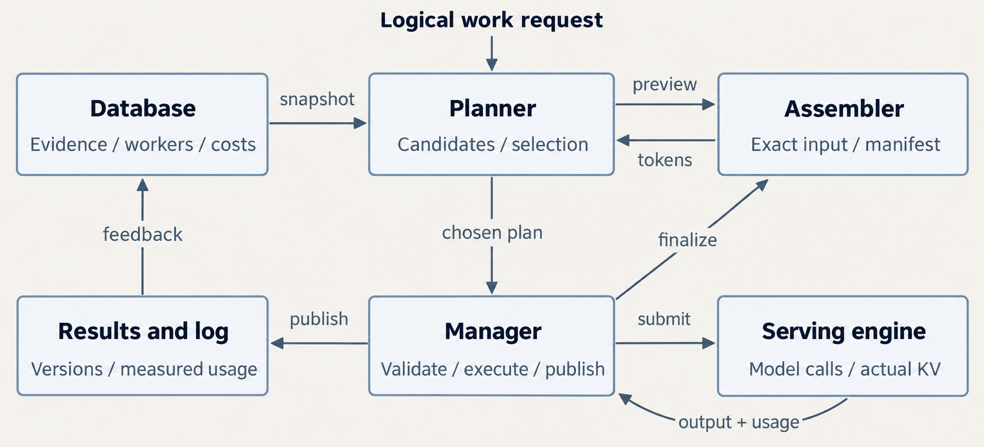
Example pipeline that connects Database, planner, assembler, and manager
Notes:
Walk the end-to-end pipeline before covering each component in detail.

Slide 11
Proposed Contribution, the goal, the experiments
Contribution
Architecture: We investigate multilayer recursive delegation over shared, versioned agent memory. Workers create scoped child workers while retaining detailed histories and recorded evidence dependencies outside parent prompts.
Planner: A learned, cost-aware planner jointly selects workers, evidence, and context-management operations, choosing among direct retrieval, continuation, resumption, and recursive delegation.
GOAL
Reduce total run cost at comparable or better verified task success. Plan selection accounts for agent calls, retrieval, communication, context maintenance, and planner overhead, including compatible KV-cache reuse and memory residency.
EXPERIMENTS
Evaluate task success, total cost, latency, and context growth under matched resource budgets. Compare joint planning with independent policies, and use controlled ablations to measure the effects of recursive delegation, learning, and cache reuse.
Notes:
State the contribution, the cost-minimization framing, and how we'll evaluate it.

Slide 12
We test three versions of the planner's selection logic
Experimental version
How it chooses
Question?
Fixed rules
Uses simple triggers for retrieval, continuation, and delegation.
Does the architecture help before adding an optimizer?
Cost-based selection
Compares candidate plans using measured profiles and simple forecasts.
Does explicitly comparing costs improve decisions?
Learned selection
Uses trained forecasts and a learned policy informed by the cost model.
Does learning improve on the simpler cost-based selector?
In the full system, the responsibilities fit together:
Cost model — estimates the resource cost of each candidate.
Assembler — builds its exact prompt.
Learned policy within the planner — uses those estimates, task state, and dependencies to select a plan.
Manager — executes it and records the outcome.
There is one selected plan per decision. Deterministic checks enforce versions, permissions, and context limits in every experimental version.
Notes:
Three versions of the planner's selection logic, each isolating what it adds; then how cost model, policy, assembler, and manager fit together.

Slide 13
Compare the architecture and the learning separately
CORE COMPARISONS
Flat agent with tuned append-only execution and compaction.
ACM.
Scroll.
Context-Folding.
LCM.
React
Notes:
Separate architecture comparisons from learning comparisons; label ports vs native reproductions.

Slide 14
Existing systems provide different parts of the solution
Direction
Examples
Learned context management and folding
ACM, Context-Folding
Programmatic access to external context
Scroll, Recursive Language Models
Persistent memory and recursive operators
LCM
Automated worker creation
AOrchestra
Context assembly and execution optimization
ContextPipe, Palimpzest
Predictive KV management
PBKV
The research question is whether coordinating these decisions around shared, versioned agent memory produces a measurable benefit.
LCM already includes persistent history, a summary dependency structure, and subagent operators. Our contribution must go beyond their existence.
Notes:
Survey table of related systems.

Slide 15
Comparing ACM, Context-Folding, and LCM to our approach
ACM
Trains the agent's context-management behavior. A teacher reviews student trajectories and supplies corrections about when context management should or should not occur. The student learns through on-policy distillation. Its runtime summarizes history, archives the original messages, and uses a querier LLM to retrieve relevant information from the archive.
Context-Folding
Trains task decomposition and branch/return behavior. Its FoldGRPO reinforcement-learning objective combines task success with penalties for excessive main-thread context, work outside a branch's assigned scope, and failed tool calls. The presented setup executes branches sequentially and disables nested branching. Returning restores the preserved parent-prefix KV state and appends the branch result.
LCM
It provides an engine-managed memory architecture around existing models: immutable history, hierarchical summaries, direct memory-access tools, and recursive subagent operators. Its lcm_grep searches stored history directly; expansion of large archived sections is delegated to subagents. Introduces no new model-training pipeline.
Ours
Proposes learning execution-plan selection: forecasts of resource demand and future evidence use. Train an RL policy that chooses workers and context plans. The assembler and manager remain deterministic code.
We treat retrieval, worker continuation, worker reuse, recursive delegation, and context reconstruction as alternative execution plans over shared memory. We investigate whether choosing the worker and its context jointly improves task success and complete-run efficiency (cost, latency, scores on benchmarks)
Direct lookup can avoid an additional reasoning call when the required information already exists. LCM already supports this; we would make it one alternative within a broader execution decision.
Notes:
Compare ACM, Context-Folding, and LCM training approaches against our proposed learned planner.

Slide 16
Open questions
01
Cost of ACM and other benchmarks first?
02
Does recursive delegation outperform a flat agent at the same total budget?
03
Does the dependency graph improve retrieval over simpler indexes?
04
Which forecasts improve decisions enough to justify training?
Notes:
Frame these as the open decisions still to resolve.

Slide 17
Next steps
1
Run a baseline in a benchmark and measure tokens and estimated cost; implement a reusable microservice-based architecture.
2
Build a simple shared agent memory infrastructure and a minimal delegation pipeline.
Version observations, evidence, results, dependencies, and worker histories.
Core operations: create agent worker, delegate task, retrieve evidence, return result, resume worker. (Context Fold baseline)
Hardcoded delegation policy; workers return concise results plus evidence references; count communication and retrieval cost.
3 Architect Cost model, theory
Notes:
Close on the concrete build order.

