Slide 1
Efficient RNN
Team MuffinTime
[MLDL] 2018Fall

Slide 2
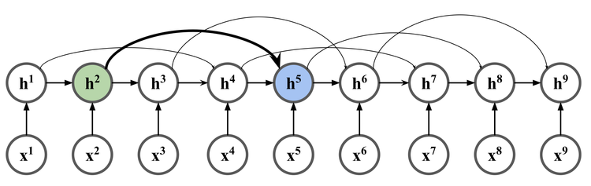
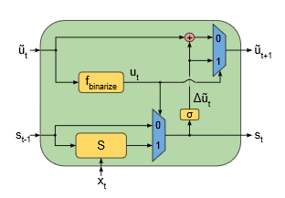
Motivation
In Vision area, they reduce parameters by splitting kernels.
Skip connection is a widely adopted method.
“But these are not yet common in the variants of RNN”
Prior Works
SkipRNN(2017)
RNN-ELC(2016)

Slide 3
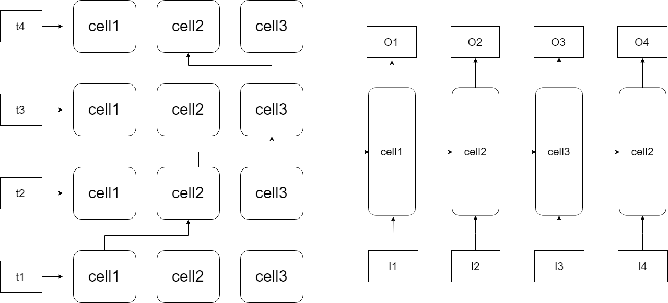
Objective
We try to reduce the number of paremeters
While maintaining the performance
Try residual approach in RNN-variant Cells

Slide 4
Linear layer
Cell1
cell2
cell3
cell
Our model
Basic RNN

Slide 5
Linear layer
Cell1
cell2
cell3
cell
Our model
Basic RNN

Slide 6
Linear layer
Cell1
cell2
cell3
cell
Our model
Basic RNN

Slide 7
Linear layer
Cell1
cell2
cell3
cell
Our model
Basic RNN

