Slide 1

OMEGA
TREX DINO BOT

Slide 2





Technology
AGENDA
Preliminary Scope
Introduction
Use Cases

Slide 3



INTRODUCTION
The Dino Game is a popular offline game in Google Chrome, playable when there's no internet connection.
In this project, we aim to develop an AI algorithm for the Dino Game that learns from its mistakes.

Slide 4







PRELIMINARY SCOPE
Software Development
We will design and implement the AI algorithm for the Dino Game.
AI Agent
The AI agent will interact with the game environment, learn from its actions, and improve its performance over time.

Slide 5



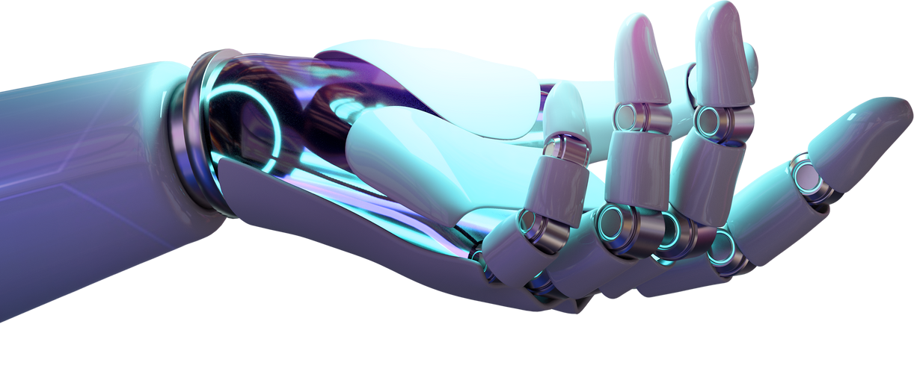

TECHNOLOGY
Machine Learning: We will utilize reinforcement learning, a branch of machine learning, to train the AI agent.
Python: The algorithm will be developed using the Python programming language, which offers a wide range of libraries for machine learning.

Slide 6



USE CASES
Use Case 1
Use Case 2
Use Case 3
The AI agent's ability to successfully interact with the game environment and accurately determine the timing of jumps.
The agent's learning capability, as demonstrated by its ability to learn from mistakes and adapt its actions accordingly.
Evaluation of the agent's performance
improvement over
time, m_{xp}easur.ing its ability to achieve higher scores in the Dino Game.

Slide 7
THANK YOU
Vishal Binu Hisham Immanat Sarah

