Slide 1
VLANs and VTP
Notes:
3 – VLANs
3.1 – Overview of VLANs

Slide 2
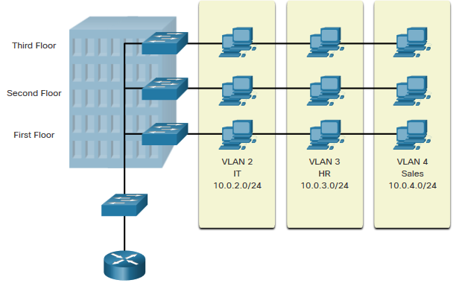
Overview of VLANs VLAN Definitions
VLANs are logical connections with other similar devices.
Placing devices into various VLANs have the following characteristics:
Provides segmentation of the various groups of devices on the same switches
Provide organization that is more manageable
Broadcasts, multicasts and unicasts are isolated in the individual VLAN
Each VLAN will have its own unique range of IP addressing
Smaller broadcast domains

Slide 3
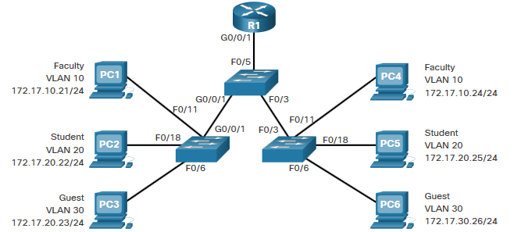
Overview of VLANs Benefits of a VLAN Design
Benefits of using VLANs are as follows:
Benefits | Description
Smaller Broadcast Domains | Dividing the LAN reduces the number of broadcast domains
Improved Security | Only users in the same VLAN can communicate together
Improved IT Efficiency | VLANs can group devices with similar requirements, e.g. faculty vs. students
Reduced Cost | One switch can support multiple groups or VLANs
Better Performance | Small broadcast domains reduce traffic, improving bandwidth
Simpler Management | Similar groups will need similar applications and other network resources

Slide 4
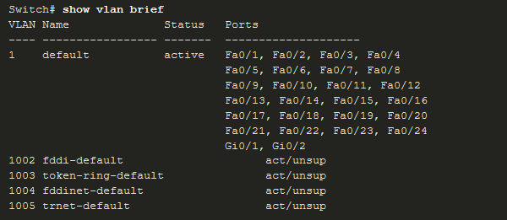
Overview of VLANs Types of VLANs
Default VLAN
VLAN 1 is the following:
The default VLAN
The default Native VLAN
The default Management VLAN
Cannot be deleted or renamed
Note: While we cannot delete VLAN1 Cisco will recommend that we assign these default features to other VLANs

Slide 5
Overview of VLANs Types of VLANs (Cont.)
Data VLAN
Dedicated to user-generated traffic (email and web traffic).
VLAN 1 is the default data VLAN because all interfaces are assigned to this VLAN.
Native VLAN
This is used for trunk links only.
All frames are tagged on an 802.1Q trunk link except for those on the native VLAN.
Management VLAN
This is used for SSH/Telnet VTY traffic and should not be carried with end user traffic.
Typically, the VLAN that is the SVI for the Layer 2 switch.

Slide 6
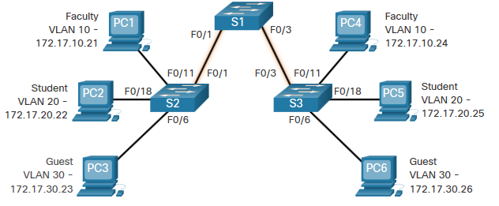
Defining VLAN Trunks
A trunk is a point-to-point link between two network devices.
Cisco trunk functions:
Allow more than one VLAN
Extend the VLAN across the entire network
By default, supports all VLANs
Supports 802.1Q trunking

Slide 7
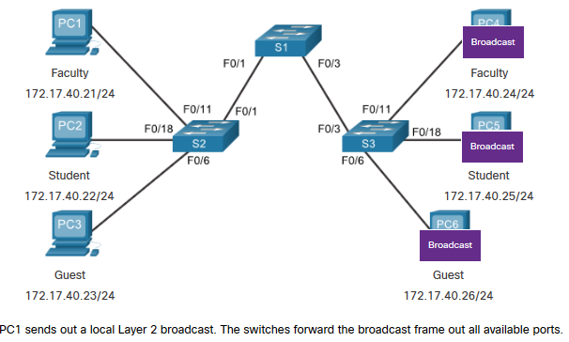
Networks without VLANs
Without VLANs, all devices connected to the switches will receive all unicast, multicast, and broadcast traffic.
Notes:
3 – VLANs
3.2 – VLANs in a Multi-Switched Environment
3.2.2 – Networks without VLANs

Slide 8
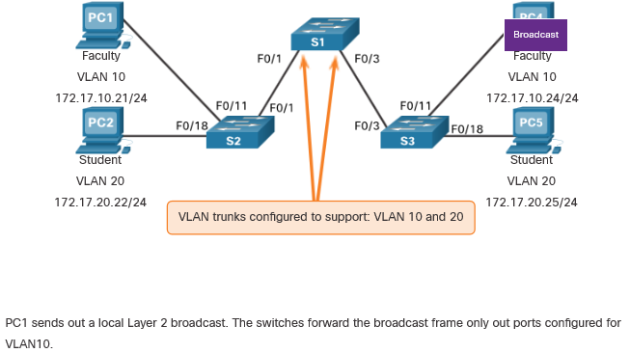
Networks with VLANs
With VLANs, unicast, multicast, and broadcast traffic is confined to a VLAN. Without a Layer 3 device to connect the VLANs, devices in different VLANs cannot communicate.
Notes:
3 – VLANs
3.2 – VLANs in a Multi-Switched Environment
3.2.3 – Networks with VLANs

Slide 9
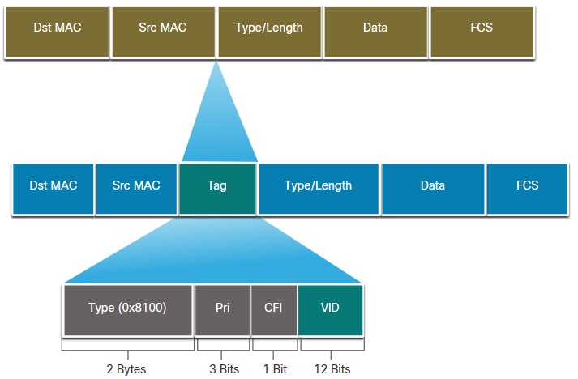
VLANs in a Multi-Switched Environment VLAN Identification with a Tag
The IEEE 802.1Q header is 4 Bytes
When the tag is created the FCS must be recalculated.
When sent to end devices, this tag must be removed and the FCS recalculated back to its original number.
802.1Q VLAN Tag Field | Function
Type | 2-Byte field with hexadecimal 0x8100 This is referred to as Tag Protocol ID (TPID)
User Priority | 3-bit value that supports
Canonical Format Identifier (CFI) | 1-bit value that can support token ring frames on Ethernet
VLAN ID (VID) | 12-bit VLAN identifier that can support up to 4096 VLANs
Notes:
3 – VLANs
3.2 – VLANs in a Multi-Switched Environment
3.2.4 – VLAN Identification with a Tag

Slide 10
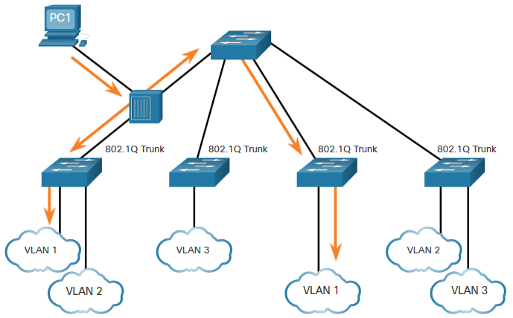
VLANs in a Multi-Switched Environment Native VLANs and 802.1Q Tagging
802.1Q trunk basics:
Tagging is typically done on all VLANs.
The use of a native VLAN was designed for legacy use, like the hub in the example.
Unless changed, VLAN1 is the native VLAN.
Both ends of a trunk link must be configured with the same native VLAN.
Each trunk is configured separately, so it is possible to have a different native VLANs on separate trunks.
Notes:
3 – VLANs
3.2 – VLANs in a Multi-Switched Environment
3.2.5 – Native VLANs and 802.1Q Tagging

Slide 11
VLAN Configuration
Notes:
3 – VLANs
3.3 – VLAN Configuration

Slide 12
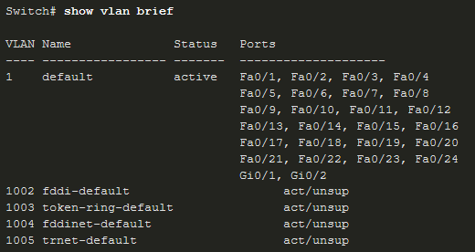
VLAN Configuration VLAN Ranges on Catalyst Switches
Catalyst switches 2960 and 3650 support over 4000 VLANs.
Normal Range VLAN 1 – 1005 | Extended Range VLAN 1006 - 4095
Used in Small to Medium sized businesses | Used by Service Providers
1002 – 1005 are reserved for legacy VLANs | Are in Running-Config
1, 1002 – 1005 are auto created and cannot be deleted | Supports fewer VLAN features
Stored in the vlan.dat file in flash | Requires VTP configurations
VTP can synchronize between switches
Notes:
3 – VLANs
3.3 – VLAN Configuration
3.3.1 – VLAN Ranges on Catalyst Switches

Slide 13
VLAN Configuration VLAN Creation Commands
VLAN details are stored in the vlan.dat file. You create VLANs in the global configuration mode.
Task | IOS Command
Enter global configuration mode. | Switch# configure terminal
Create a VLAN with a valid ID number. | Switch(config)# vlan vlan-id
Specify a unique name to identify the VLAN. | Switch(config-vlan)# name vlan-name
Return to the privileged EXEC mode. | Switch(config-vlan)# end
Enter global configuration mode. | Switch# configure terminal

Slide 14
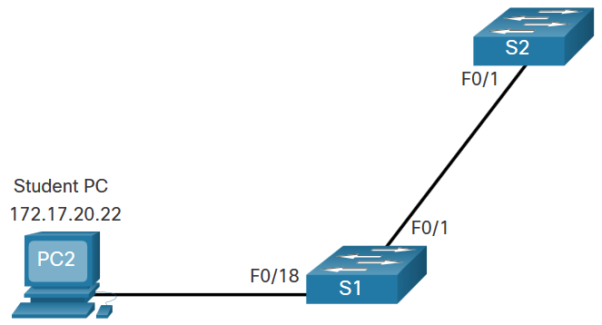
VLAN Configuration VLAN Creation Example
If the Student PC is going to be in VLAN 20, we will create the VLAN first and then name it.
If you do not name it, the Cisco IOS will give it a default name of vlan and the four digit number of the VLAN. E.g. vlan0020 for VLAN 20.
Prompt | Command
S1# | Configure terminal
S1(config)# | vlan 20
S1(config-vlan)# | name student
S1(config-vlan)# | end
Notes:
3 – VLANs
3.3 – VLAN Configuration
3.3.3 – VLAN Creation Example

Slide 15
VLAN Configuration VLAN Port Assignment Commands
Once the VLAN is created, we can then assign it to the correct interfaces.
Task | Command
Enter global configuration mode. | Switch# configure terminal
Enter interface configuration mode. | Switch(config)# interface interface-id
Set the port to access mode. | Switch(config-if)# switchport mode access
Assign the port to a VLAN. | Switch(config-if)# switchport access vlan vlan-id
Return to the privileged EXEC mode. | Switch(config-if)# end

Slide 16
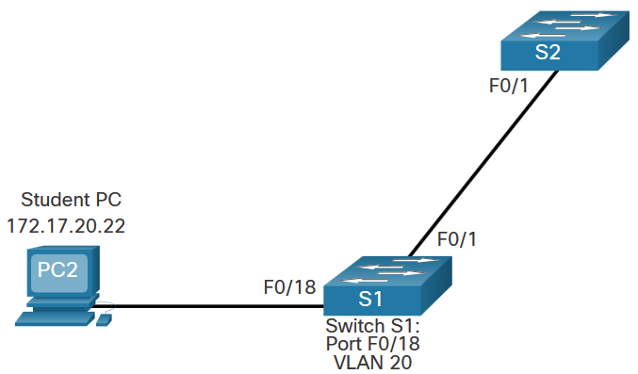
VLAN Configuration VLAN Port Assignment Example
We can assign the VLAN to the port interface.
Once the device is assigned the VLAN, then the end device will need the IP address information for that VLAN
Here, Student PC receives 172.17.20.22
Prompt | Command
S1# | Configure terminal
S1(config)# | Interface fa0/18
S1(config-if)# | Switchport mode access
S1(config-if)# | Switchport access vlan 20
S1(config-if)# | end
Notes:
3 – VLANs
3.3 – VLAN Configuration
3.3.5 – VLAN Port Assignment Example

Slide 17

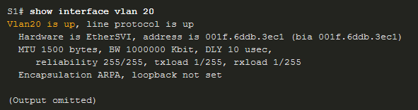
VLAN Configuration Verify VLAN Information
Use the show vlan command. The complete syntax is:
show vlan [brief | id vlan-id | name vlan-name | summary]
Task | Command Option
Display VLAN name, status, and its ports one VLAN per line. | brief
Display information about the identified VLAN ID number. | id vlan-id
Display information about the identified VLAN name. The vlan-name is an ASCII string from 1 to 32 characters. | name vlan-name
Display VLAN summary information. | summary

Slide 18
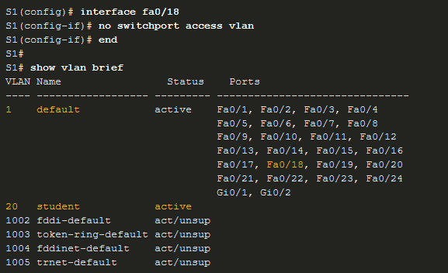
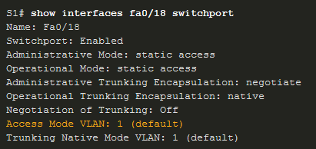
VLAN Configuration Change VLAN Port Membership
There are a number of ways to change VLAN membership:
re-enter switchport access vlan vlan-id command
use the no switchport access vlan to place interface back in VLAN 1
Use the show vlan brief or the show interface fa0/18 switchport commands to verify the correct VLAN association.

Slide 19
VLAN Configuration Delete VLANs
Delete VLANs with the no vlan vlan-id command.
Caution: Before deleting a VLAN, reassign all member ports to a different VLAN.
Delete all VLANs with the delete flash:vlan.dat or delete vlan.dat commands.
Reload the switch when deleting all VLANs.
Note: To restore to factory default – unplug all data cables, erase the startup-configuration and delete the vlan.dat file, then reload the device.

Slide 20
VLAN Trunks

Slide 21
VLAN Trunks Trunk Configuration Commands
Configure and verify VLAN trunks. Trunks are layer 2 and carry traffic for all VLANs.
Task | IOS Command
Enter global configuration mode. | Switch# configure terminal
Enter interface configuration mode. | Switch(config)# interface interface-id
Set the port to permanent trunking mode. | Switch(config-if)# switchport mode trunk
Sets the native VLAN to something other than VLAN 1. | Switch(config-if)# switchport trunk native vlan vlan-id
Specify the list of VLANs to be allowed on the trunk link. | Switch(config-if)# switchport trunk allowed vlan vlan-list
Return to the privileged EXEC mode. | Switch(config-if)# end
Notes:
3 – VLANs
3.4 – VLAN Trunks
3.4.1 – Trunk Configuration Commands

Slide 22
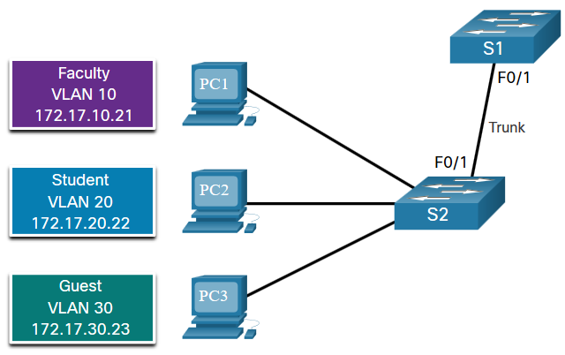
VLAN Trunks Trunk Configuration Example
The subnets associated with each VLAN are:
VLAN 10 - Faculty/Staff - 172.17.10.0/24
VLAN 20 - Students - 172.17.20.0/24
VLAN 30 - Guests - 172.17.30.0/24
VLAN 99 - Native - 172.17.99.0/24
F0/1 port on S1 is configured as a trunk port.
Note: This assumes a 2960 switch using 802.1q tagging. Layer 3 switches require the encapsulation to be configured before the trunk mode.
Prompt | Command
S1(config)# | Interface fa0/1
S1(config-if)# | Switchport mode trunk
S1(config-if)# | Switchport trunk native vlan 99
S1(config-if)# | Switchport trunk allowed vlan 10,20,30,99
S1(config-if)# | end
Notes:
3 – VLANs
3.4 – VLAN Trunks
3.4.2 – Trunk Configuration Example

Slide 23
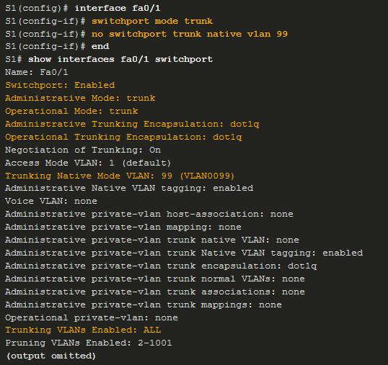
VLAN Trunks Verify Trunk Configuration
Set the trunk mode and native vlan.
Notice sh int fa0/1 switchport command:
Is set to trunk administratively
Is set as trunk operationally (functioning)
Encapsulation is dot1q
Native VLAN set to VLAN 99
All VLANs created on the switch will pass traffic on this trunk
Notes:
3 – VLANs
3.4 – VLAN Trunks
3.4.3 – Verify Trunk Configuration

Slide 24
Inter-VLAN Routing
Notes:
4- Inter-VLAN Routing
4.1 – Inter-VLAN Routing Operation

Slide 25
Inter-VLAN Routing Operation What is Inter-VLAN Routing?
VLANs are used to segment switched Layer 2 networks for a variety of reasons. Regardless of the reason, hosts in one VLAN cannot communicate with hosts in another VLAN unless there is a router or a Layer 3 switch to provide routing services.
Inter-VLAN routing is the process of forwarding network traffic from one VLAN to another VLAN.
There are three inter-VLAN routing options:
Legacy Inter-VLAN routing - This is a legacy solution. It does not scale well.
Router-on-a-Stick - This is an acceptable solution for a small to medium-sized network.
Layer 3 switch using switched virtual interfaces (SVIs) - This is the most scalable solution for medium to large organizations.
Notes:
4 – Inter-VLAN Routing
4.1 – Inter-VLAN Routing Operation
4.1.1 - What is Inter-VLAN Routing?

Slide 26
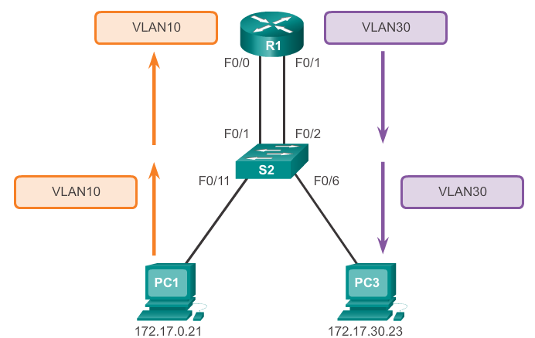
Legacy Inter-VLAN Routing
The first inter-VLAN routing solution relied on using a router with multiple Ethernet interfaces.
Each router interface was connected to a switch port in different VLANs.
However, it is not scalable because routers have a limited number of physical interfaces. Requiring one physical router interface per VLAN
Note: This method of inter-VLAN routing is no longer implemented and is included for explanation purposes only.
Notes:
4 – Inter-VLAN Routing
4.1 – Inter-VLAN Routing Operation
4.1.2 – Legacy Inter-VLAN Routing

Slide 27
What is Inter-VLAN routing?
Layer 2 switches cannot forward traffic between VLANs without the assistance of a router.
Inter-VLAN routing is a process for forwarding network traffic from one VLAN to another, using a router.
Notes:
5.1.1.1 What is Inter-VLAN routing?

Slide 28
Router-on-a-Stick Inter-VLAN Routing
The ‘router-on-a-stick’ inter-VLAN routing method overcomes the limitation of the legacy inter-VLAN routing method.
It only requires one physical Ethernet interface to route traffic between multiple VLANs on a network.
A Cisco IOS router Ethernet interface is configured as an 802.1Q trunk and connected to a trunk port on a Layer 2 switch. Specifically,
The router interface is configured using subinterfaces to identify routable VLANs.
The configured subinterfaces are software-based virtual interfaces.
Each subinterface is independently configured with an IP address and VLAN assignment.
When VLAN-tagged traffic enters the router interface, it is forwarded to the VLAN subinterface. After a routing decision is made based on the destination IP network address, the router determines the exit interface for the traffic. If the exit interface is configured as an 802.1q subinterface, the data frames are VLAN-tagged with the new VLAN and sent back out the physical interface
Notes:
4 – Inter-VLAN Routing
4.1 – Inter-VLAN Routing Operation
4.1.3 – Router-on-a-Stick Inter-VLAN Routing

Slide 29
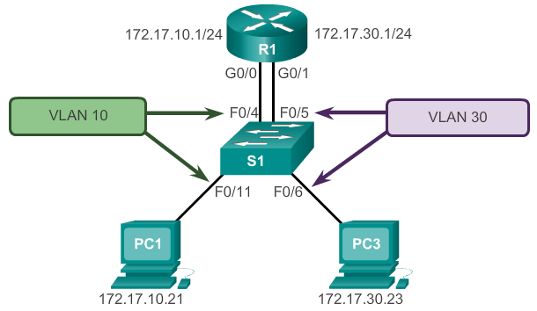
Configure Legacy Inter-VLAN Routing

Slide 30
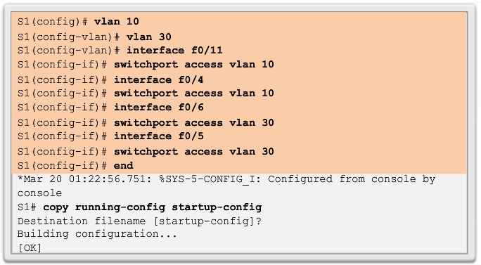
Configure Legacy Inter-VLAN Routing Switch Configuration
Notes:
5.1.2.2 Configure Legacy Inter-VLAN Routing: Switch Configuration

Slide 31
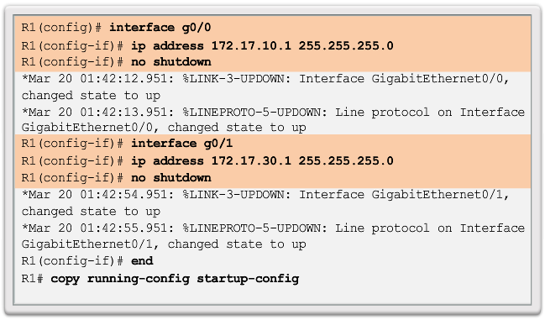
Configure Legacy Inter-VLAN Routing Router Interface Configuration
Notes:
5.1.2.3 Configure Legacy Inter-VLAN Routing: Router Interface Configuration

Slide 32
Router-on-a-Stick Inter-VLAN Routing
Notes:
4- Inter-VLAN Routing
4.2 – Router-on-a-Stick Inter-VLAN Routing

Slide 33
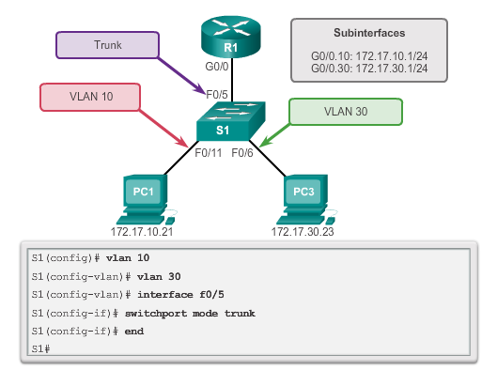
Configure Router-on-a-Stick Switch Configuration
Notes:
6.1.3.2 Configure Router-on-a-Stick: Switch Configuration

Slide 34
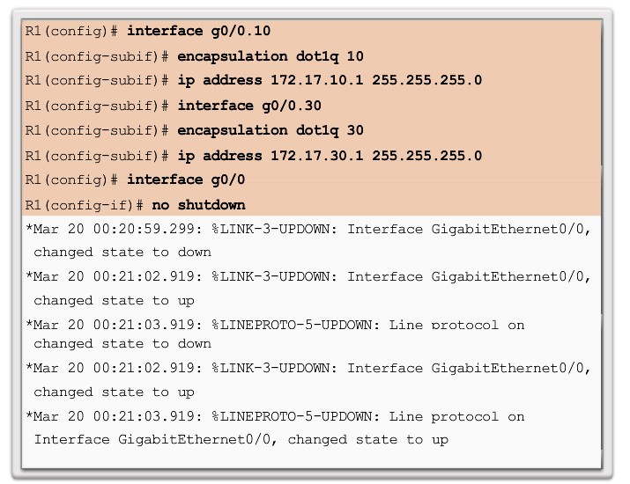
Router Subinterface Configuration

Slide 35
Inter-VLAN Routing using Layer 3 Switches

Slide 36
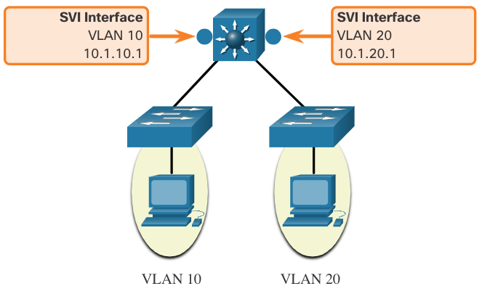
Inter-VLAN Routing Operation Inter-VLAN Routing on a Layer 3 Switch
The modern method of performing inter-VLAN routing is to use Layer 3 switches and switched virtual interfaces (SVI). An SVI is a virtual interface that is configured on a Layer 3 switch, as shown in the figure.
Note: A Layer 3 switch is also called a multilayer switch as it operates at Layer 2 and Layer 3. However, in this course we use the term Layer 3 switch.

Slide 37
Inter-VLAN Routing Operation Inter-VLAN Routing on a Layer 3 Switch (Cont.)
Inter-VLAN SVIs are created the same way that the management VLAN interface is configured. The SVI is created for a VLAN that exists on the switch. Although virtual, the SVI performs the same functions for the VLAN as a router interface would. Specifically, it provides Layer 3 processing for packets that are sent to or from all switch ports associated with that VLAN.
The following are advantages of using Layer 3 switches for inter-VLAN routing:
They are much faster than router-on-a-stick because everything is hardware switched and routed.
There is no need for external links from the switch to the router for routing.
They are not limited to one link because Layer 2 EtherChannels can be used as trunk links between the switches to increase bandwidth.
Latency is much lower because data does not need to leave the switch in order to be routed to a different network.
They more commonly deployed in a campus LAN than routers.
The only disadvantage is that Layer 3 switches are more expensive.

Slide 38
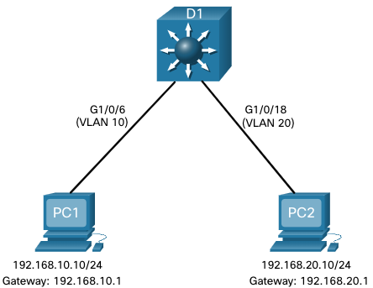
Inter-VLAN Routing using Layer 3 Switches Layer 3 Switch Scenario
In the figure, the Layer 3 switch, D1, is connected to two hosts on different VLANs. PC1 is in VLAN 10 and PC2 is in VLAN 20, as shown. The Layer 3 switch will provide inter-VLAN routing services to the two hosts.

Slide 39
Inter-VLAN Routing using Layer 3 Switches Layer 3 Switch Configuration
Complete the following steps to configure S1 with VLANs and trunking:
Step 1. Create the VLANs. In the example, VLANs 10 and 20 are used.
Step 2. Create the SVI VLAN interfaces. The IP address configured will serve as the default gateway for hosts in the respective VLAN. Int vlan 10 ; ip address
Step 3. Configure access ports. Assign the appropriate port to the required VLAN.
Step 4. Enable IP routing. Issue the ip routing global configuration command to allow traffic to be exchanged between VLANs 10 and 20. This command must be configured to enable inter-VAN routing on a Layer 3 switch for IPv4.

Slide 40
Inter-VLAN Routing using Layer 3 Switches Routing on a Layer 3 Switch
If VLANs are to be reachable by other Layer 3 devices, then they must be advertised using static or dynamic routing. To enable routing on a Layer 3 switch, a routed port must be configured.
A routed port is created on a Layer 3 switch by disabling the switchport feature on a Layer 2 port that is connected to another Layer 3 device. Specifically, configuring the no switchport interface configuration command on a Layer 2 port converts it into a Layer 3 interface. Then the interface can be configured with an IPv4 configuration to connect to a router or another Layer 3 switch.

