Slide 1
McGuire1
A 16-bit Simulator
By:
Seth Bane, Stephanie Carter, Steven Lenig,
& Sergio Rocha

Slide 2
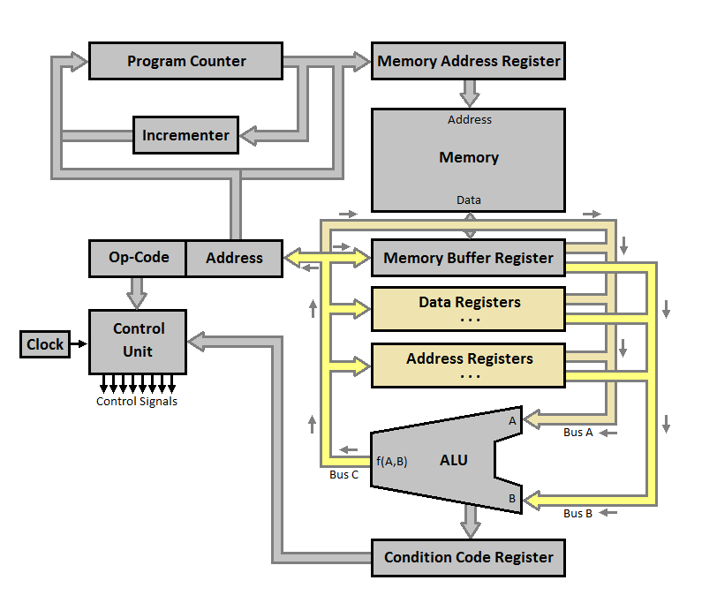
Basic Design

Slide 3
Instruction
16-bit instruction
4-bit Op-Code
3-bit Destination Mode
3-bit Destination Register
3-bit Source Mode
3-bit Source Register
Op-Code | DMode | DReg | Smode | SReg

Slide 4
Op-Codes
Arithmetic/Logic
0000 - MOV
0001 - NOT
0010 - ADD
0011 - SUB
0100 - OR
0101 - AND
0110 - CMP
0111 - XOR
Branches
1000 - BRA
1001 - BEQ
1010 - BNE
1011 - BGT
1100 - BLT
1101 – BRZ
Shifts
1110 – SHR
1111 – SHL

Slide 5
Addressing Modes
000 – Register Direct D0
001 – Register Indirect (D0)
010 – Auto-Increment (D0)+
011 – Auto-Increment Deferred @(D0)+
100 – Auto-Decrement -(D0)
101 – Auto-Decrement Deferred @-(D0)
110 – Reserved
111 – Index Deferred @X(D0)

Slide 6
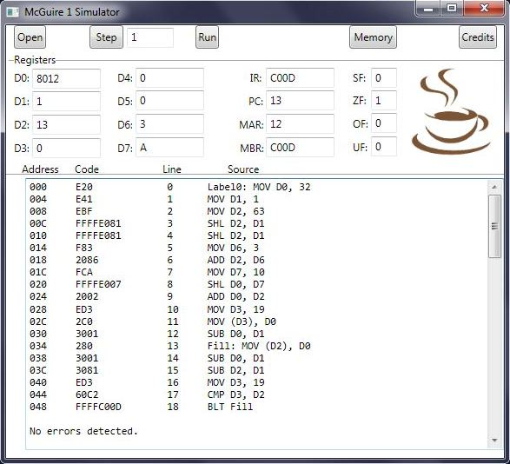
McGuire1 Simulator

