Slide 1
Mainframe Automation Perl(MAP) Training
July 7 – 12 2009
Scott Barth
Notes:
Overview

Slide 2
MAP Components
Eclipse Java EE IDE for Web Developers.
Version: Juno Service Release 2Build id: 20130225-0426
Perl EPIC Plug-in 0.5.x
SubEclipse (SVN) Plug-in 1.5.x
Perl Version v.5.8.8
IBM PCOM 5.9
Documentation
http://www.epicide.org/guide/index.php
http://svnbook.red-bean.com/

Slide 3
MAP Installation
unzip the perl.zip and eclipse.zip to your local drive at the root level
(prv on usmgh3fs1)R:\Automation\MAP\ClientSoftware
add the following line to your Windows PATH environment variable [drive]:\Perl\site\bin;[drive]:\Perl\bin
from a DOS prompt issue the following command: perl -version
Notes:
Usmghfs1
Open RFS to allow phx access to the above drive

Slide 4
MAP Installation
from a DOS prompt issue the following command: java -version
Verify the output looks like this: Java(TM) SE Runtime Environment (build 1.5.0_11-b03) or above
Verify the output looks like this: This is perl, v5.8.8 built for MSWin32-x86-multi-thread

Slide 5
MAP Installation
navigate to the eclipse.exe located on [drive]:\eclipse\
right mouse click on eclipse.exe and create shortcut on desktop (send to desktop)
launch eclipse shortcut

Slide 6
Verify the installation
Close the welcome page
Select the Perl perspective
This will validate the EPIC plug-in
Switch to the SVN Repository Exploring perspective
This will validate the Subversion plug-in

Slide 7
Setting up Eclipse workspace from the repository
Make sure you’re in the SVN perspective
Right mouse click in the Repository view
Select new->Repository location…
Add the url: http://usmghcentosqa/repos/map-automation
Checkout the MAP project trunk from the repository by right mouse clicking on the trunk folder and selecting checkout
Select “Check out as a project in the workspace” radio button and give it the name MAP2_0 and select finished
Return to the Perl perspective
Add Perl nature to project MAP2_0 by right mouse clicking the MAP2_0 folder in the Navigator view then select add perl nature
This will allow you to select the Perl include path
Now we must tell Eclipse/Perl where to find the MAP routines
Right mouse click on the MAP2_0 project and select properties
Select Perl Include Path and add the lib folder
The lib folder contains the perl package/routines used by MAP.

Slide 8
Configuring PCOM to MAP
In order for MAP to launch the PCOM tn3270 emulator your *.ws file must be in a well known location. When you installed PCOM that folder was created and it’s located at : C:\Documents and Settings\yourID\ApplicationData\IBM\Personal Communications I
Copy your pcom.ws file to this folder
Make sure your screen size is set to 43X80

Slide 9
Eclipse overview
July 7 – 12 2009
Scott Barth
Notes:
Overview

Slide 10
Eclipse Overview
Help system
The workbench
Navigator Window
EPIC Editor Window
Search/Replace in files
Search/Replace in Project
Perspectives
SVN perspective

Slide 11
Eclipse Overview
Exercise
Create a perl file called hello.pl
Print “hello world” to the console.

Slide 12
Subversion
July 7 – 12 2009
Scott Barth
Notes:
Overview

Slide 13
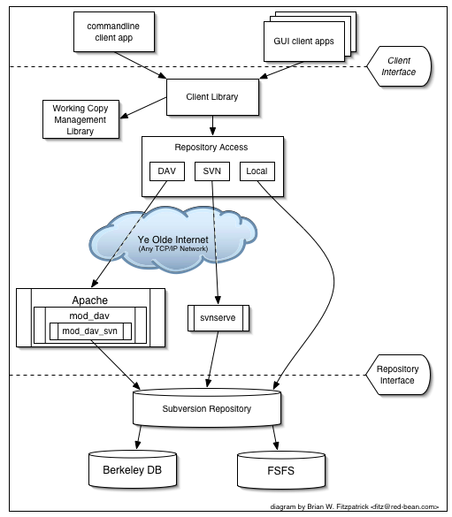
Subversion (SVN) Subversion's Architecture

Slide 14
The Repository
Subversion is a centralized system for sharing information. At its core is a repository, which is a central store of data. The repository stores information in the form of a filesystem tree—a typical hierarchy of files and directories. Any number of clients connect to the repository, and then read or write to these files. By writing data, a client makes the information available to others; by reading data, the client receives information from others.

Slide 15
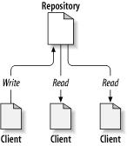
The Repository
A typical client/server system

Slide 16
The problem to avoid
Suppose we have two coworkers, Harry and Sally. They each decide to edit the same repository file at the same time. If Harry saves his changes to the repository first, it's possible that (a few moments later) Sally could accidentally overwrite them with her own new version of the file. While Harry's version of the file won't be lost forever (because the system remembers every change), any changes Harry made won't be present in Sally's newer version of the file, because she never saw Harry's changes to begin with. Harry's work is still effectively lost—or at least missing from the latest version of the file—and probably by accident. This is definitely a situation we want to avoid!

Slide 17
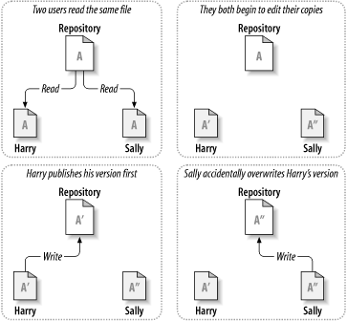
The problem to avoid

Slide 18
The Copy-Modify-Merge Solution
Subversion, CVS, and many other version control systems use a copy-modify-merge model
In this model, each user's client contacts the project repository and creates a personal working copy—a local reflection of the repository's files and directories.
Users then work simultaneously and independently, modifying their private copies.
Finally, the private copies are merged together into a new, final version.
The version control system often assists with the merging, but ultimately, a human being is responsible for making it happen correctly.
Notes:
Most people are familiar with the lock-modify-unlock solution. Explain.

Slide 19
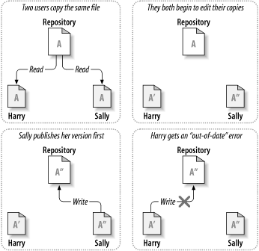
The copy-modify-merge solution

Slide 20
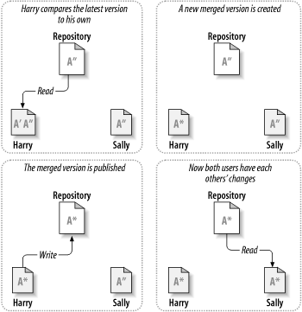
The copy-modify-merge solution (continued)

Slide 21
The copy-modify-merge solution (continued)
But what if Sally's changes do overlap with Harry's changes? What then? This situation is called a conflict, and it's usually not much of a problem
When Harry asks his client to merge the latest repository changes into his working copy, his copy of file A is somehow flagged as being in a state of conflict: he'll be able to see both sets of conflicting changes and manually choose between them
Note that software can't automatically resolve conflicts;
only humans are capable of understanding and making the necessary intelligent choices
Once Harry has manually resolved the overlapping changes—perhaps after a discussion with Sally—he can safely save the merged file back to the repository

Slide 22
Merge/Conflict/Resolve Exercise
From the SVN perspective, Check-out project MAP_Exercises from http://usmghcentosqa/repos/automation
Authenticate with User: franka|carolc Password: automation
From the perl perspective, navigate to the merge_conflict.pl script located in the exercise1 folder
Update line 5, save and commit the changes

Slide 23
Merge/Conflict/Resolve (cont.)
We have a conflict so let’s correct it and resolve it
How did we commit the script?
What command did we use to refresh our out-of date script?
How did we resolve the conflict?

Slide 24
Perl
July 7 – 12 2009
Scott Barth
Notes:
Overview

Slide 25
Perl Scalar Variable
The most basic kind of variable in Perl is the scalar variable. Scalar variables hold both strings and numbers, and are remarkable in that strings and numbers are completely interchangable
$a = 1 + 2; # Add 1 and 2 and store in $a
$a = 3 - 4; # Subtract 4 from 3 and store in $a
$a = 5 * 6; # Multiply 5 and 6
$a = 7 / 8; # Divide 7 by 8 to give 0.875
$a = 9 ** 10; # Nine to the power of 10
$a = 5 % 2; # Remainder of 5 divided by 2
++$a; # Increment $a and then return it
$a++; # Return $a and then increment it
--$a; # Decrement $a and then return it
$a--; # Return $a and then decrement it

Slide 26
Interpolation
The following code prints apples and pears using concatenation:
$a = 'apples';
$b = 'pears';
print ‘$a and $b’;
It would be nicer to include only one string in the final print statement, but the line print '$a and $b'; prints literally $a and $b which isn't very helpful. Instead we can use the double quotes in place of the single quotes: print "$a and $b";

Slide 27
Interpolation exercise
Assign ‘Apples’ to $a
Assign ‘Pears’ to $b
Print $a and $b using single quotes
Print $a and $b using double quotes
Explain the differences

Slide 28
Array variables
A slightly more interesting kind of variable is the array variable which is a list of scalars (ie numbers and strings). Array variables have the same format as scalar variables except that they are prefixed by an @ symbol. The statement
@food = ("apples", "pears", "eels");
@music = ("whistle", "flute");
assigns a three element list to the array variable @food and a two element list to the array variable @music. The array is accessed by using indices starting from 0, and square brackets are used to specify the index. The expression
$food[2]
returns eels. Notice that the @ has changed to a $ because eels is a scalar.

Slide 29
Array assignments
In Perl, the same expression in a different context can produce a different result. The first assignment below explodes the @music variable so that it is equivalent to the second assignment.
@moremusic = ("organ", @music, "harp");
@moremusic = ("organ", "whistle", "flute", "harp");
Another way to add to the Array:
push(@moremusic, “guitar");
Notes:
http://www.comp.leeds.ac.uk/Perl/arrays.html

Slide 30
Array assignments (cont.)
It is also possible to assign an array to a scalar variable. As usual context is important. The line
$f = @food;
assigns the length of @food, but
$f = "@food";
turns the list into a string with a space between each element.
Notes:
http://www.comp.leeds.ac.uk/Perl/arrays.html

Slide 31
Displaying arrays
Since context is important, it shouldn't be too surprising that the following all produce different results:
print @food; # By itself
print "@food"; # Embedded in double quotes print @food.""; # In a scalar context
Exercise
Try out each of the above three print statements to see what they do
Notes:
http://www.comp.leeds.ac.uk/Perl/arrays.html

Slide 32
Associative arrays (hash)
To define an associative array we use the usual parenthesis notation, but the array itself is prefixed by a % sign. Suppose we want to create an array of people and their ages. It would look like this:
%ages = ( “Michael Caine", 39,
“Dirty Den", 34,
"Angie", 27,
"Willy", "21 in dog years",
"The Queen Mother", 108);
Now we can find the age of people with the following expressions
$ages{"Michael Caine"}; # Returns 39
$ages{"Dirty Den"}; # Returns 34
$ages{"Angie"}; # Returns 27
$ages{"Willy"}; # Returns "21 in dog years"
$ages{"The Queen Mother"}; # Returns 108
Notice that like list arrays each % sign has changed to a $ to access an individual element because that element is a scalar. Unlike list arrays the index (in this case the person's name) is enclosed in curly braces, the idea being that associative arrays are fancier than list arrays

Slide 33
File handling
Here is the basic perl program which does the same as the UNIX cat command on a certain file
#!/usr/local/bin/perl
# Program to open the password file, read it in,
# print it, and close it again.
$file = '/etc/passwd'; # Name the file
open(INFO, $file); # Open the file
@lines = <INFO>; # Read it into an array
close(INFO); # Close the file
print @lines; # Print the array

Slide 34
File handling exercise
Run exercise1.pl in the Eclipse MAP_Exercises project
Now change the context of the lines array to string and rerun.
What changed in the output?
Notes:
http://affy.blogspot.com/p5be/ch12.htm
Special vars list

Slide 35
Control structures
foreach
To go through each line of an array or other list-like structure (such as lines in a file) Perl uses the foreach structure. This has the form
foreach $morsel (@food) # Visit each item in turn
# and call it $morsel
{
print "$morsel\n"; # Print the item
print "Yum yum\n"; # That was nice
}
The actions to be performed each time are enclosed in a block of curly braces. The first time through the block $morsel is assigned the value of the first item in the array @food. Next time it is assigned the value of the second item, and so until the end. If @food is empty to start with then the block of statements is never executed.
Notes:
http://www.comp.leeds.ac.uk/Perl/control.html

Slide 36
Control structures
Testing
The next few structures rely on a test being true or false. In Perl any non-zero number and non-empty string is counted as true. The number zero, zero by itself in a string, and the empty string are counted as false. Here are some tests on numbers and strings
$a == $b # Is $a numerically equal to $b?
# Beware: Don't use the =operator.
$a != $b # Is $a numerically unequal to $b?
$a eq $b # Is $a string-equal to $b
$a ne $b # Is $a string-unequal to $b?

Slide 37
Control structures
While
while ($line = <INFO>)
{
$i++;
printf ('%04d %s', $i, $line);
}

Slide 38
Conditionals
Of course Perl also allows if/then/else statements. These are of the following form
if ($a) {
print "The string is not empty\n";
} else {
print "The string is empty\n";
}

Slide 39
Conditionals
It is also possible to include more alternatives in a conditional statement:
if ($a == 0) # The ! is the not operator
{
print "The string is empty\n";
} elsif (length($a) == 1) # If above fails, try this
{
print "The string has one character\n";
} elsif (length($a) == 2) # If that fails, try this
{
print "The string has two characters\n";
} else # Now, everything has failed
{
print "The string has lots of characters\n";
}

Slide 40
Subroutines
Like any good programming langauge Perl allows the user to define their own functions, called subroutines. They may be placed anywhere in your program but it's probably best to put them all at the beginning or all at the end. A subroutine has the form
sub mysubroutine {
# always returns complete
print "Not a very interesting routine\n";
print "This does the same thing every time\n";
my $status = 1;
return “complete”, $status;
}
($completed, $status) = mysubroutine();

Slide 41
Subroutines
mysubroutine; # Call the subroutine
mysubroutine($_); # Call it with a parameter
mysubroutine(1+2, $_); # Call it with two parameters

Slide 42
Regular expressions
Update your Docs/training folder in the perl_automation project
Launch the regular-expression-cheat-sheet-v1.pdf
Go to: http://www.sthomas.net/roberts-perl-tutorial.htm#77-BasicRegularExpressions

Slide 43
MAP
July 7 – 12 2009
Scott Barth
Notes:
Overview

Slide 44
MAP packages
Cfg - Contains the input parameters to the MAP session and global getters and setters
Common – houses the common routines used by the MAP
Hllapi – the low level routines used to access and drive the PCOMM session
Util – routines that are not necessarily related to MAP. e.g. compareArrays
MAP – the routines called by the test writer. e.g. navigate2panel()

Slide 45
Product Packages
PROJCL::PanelsMap.pm
PROJCL::ProJcl.pm
SMARTFILE:: PanelsMap.pm
SMARTFILE:: SmartFile.pm

Slide 46
SMARTFILE:: PanelsMap.pm
Contains a hash of hashes that describe a SMARTFILE ISPF panel. The data structure or container is used to translate text labels on a panel to their associated command number
This allows the our scripts to decouple from the actual format of the panel
If the application rearranges the panel fields or changes a label or command then we only need update the PanelsMap rather than all scripts that use that panel

Slide 47
SMARTFILE:: SmartFile.pm
Contains routines that specific to AUT (Application Under Test). This is where you will find the dataReset routine
The dataReset routine is used setup the AUT’s environment to a known state for starting a test

Slide 48
MAP Cfg.pm
my %cfg = (
'UserID' => uc 'qa057a', # change to your userid
'Password' => 'jul09',
'Host' => 'asgz18a',
'DeleteProfileCMD' => 'QAL.MGH.PGR.CLIST(DELPROF)',
'CurrentFolderName' => 'current_data',
'ExpectedFolderName' => 'exp_data',
'ResultsFolderName' => 'Results',
'DifferencesFolderName' => 'Differences',
'LPAR' => 'tz18a',
'SessionID' => 'T', # name of the pcomm session
'STCID' => '8',
'StartedTask' => 'DSSISTC8', # your stc name
'MapLibPath' => 'D:/Eclipse_projects/map2.0/perl_automation/lib',
'RtsMember' => 'QARTS', # should be set to QARTS for test runs
'Testbucket' => 'QAL.MGH.PGR.TESTBCKT',
'TerminalEmulator' => 'PComm',
'PCOM_Profile_Name' => 'qa057a', # name of your PCOMM .ws file
'Logon_Procedure' => 'QAMHPROC', # Name of the TSO logon procduere to us/e
#'AUT' => 'SMARTFILE', # application under test
'AUT' => 'PROJCL', # application under test
'COPYRIGHT' => 'Copyright (c) 2009',
'InitExpFile' => '0', # set to 1 to created the expected file.
);

Slide 49
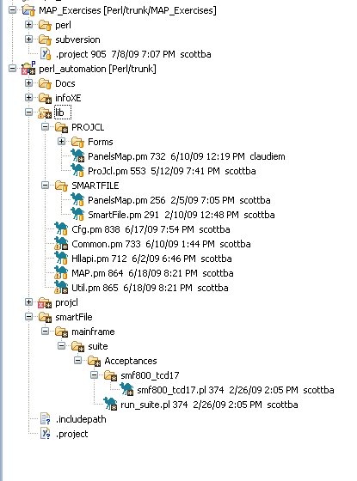
MAP file structure

Slide 50
MAP routines – navigate2Panel
Navigate2panel
Uses the panelsMap to lookup the command to issue
Takes 2 parameters
Session ID
Key value (panel command found in panelsMap)
Takes an optional panelID used to verify that we navigated to the correct panel
$status = navigate2Panel( $session, "Command","ISRTSO" ) if ( not $status );

Slide 51
MAP – navigate2Panel
Things to consider
When new panels are encountered then the panelsMap must be updated to recognize the new panel
By using execPanelCmd instead navigate2panel you eliminate the need to update panelsMap

Slide 52
MAP - navigateBack2Panel
Used to ‘F3’ back to a given panel
Most scripts use the routine to get back to ISPF Primary
Takes a sessionID and panelid. The panelid is used to determine the panel you want to navigate back to
navigateBack2Panel( $session, 'ISP@MST1');
Notes
No need to check the status variable

Slide 53
MAP write2CommandLine
Used to write a string of text to the panel’s command line and optionally hit the enter key
Parameters
SessionID
Text string (command) to write on the command line
Optional enter key
Optional command line text string
This is used to circumvent the panelsMap lookup
write2CommandLine( $session, "ex 'qal.phx.sfm800.clist(libdef)'", '[enter]')

Slide 54
MAP execPanelCmd
Uses the label supplied in the second parameter to extract the command from the panel and issue it on the command line
Parameters
SessionID
Command label
Expected panelID
Optional command line key

Slide 55
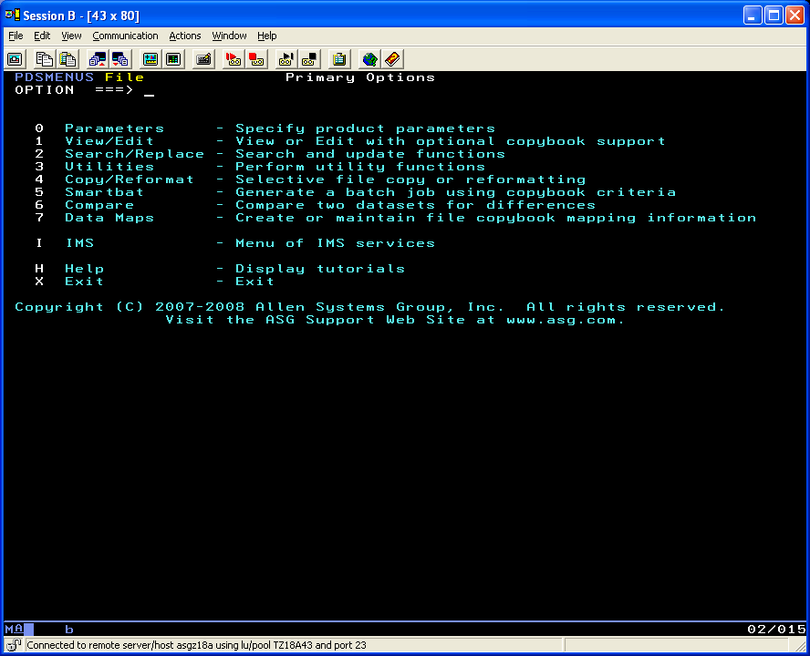
MAP execPanel

Slide 56
MAP execPanelCmd
execPanelCmd($session, "View/Edit","PDSM04E" )

Slide 57
MAP Panel Forms
Often times it’s necessary to fill out several panel input fields with data. There are several ways to accomplish this but MAP supplies a form based approach by creating a tie hash container and writing it to panel via write2panelCmd
For example, the SMARTFILE panel PDSM04e panel is filled out by using the following MAP script code:
my $form = tie(
%form, Tie::IxHash,
'DATASET NAME' => "'QAL.PHX.SFM800.B118.TCD017.SEQVB'",
'DISPOSITION' => "SHR",
'View mode' => 'EDIT',
'Use copybook' => 'NO',
'Record select' => 'NO',
'Audit changes' => 'YES',
'Extended prompt' => 'YES',
);
write2Panel( $session, $form, '[enter]')

Slide 58
MAP Panel Forms
By using a combination of a TIE::hash variable and using the write2Panel routine the panel’s input fields will get loaded from %forms TIE::hash variable
Notes:
The left side values in the form are searched on the panel and when found the right side values are loaded onto the panel
The left side values (lvalue) must be unique
If you have 2 lvalues that are identical you can append a & to the lvalue to make it unique

Slide 59
MAP findStringOnPanel
Used to find a text string on a panel. If the string is found a zero is returned if the string isn’t found then a -1 is returned
$status = findStringOnPanel( $session, "Process Completed");

Slide 60
MAP verifyStingNotFoundOnPanel
Used to return a passed value (return value of zero) if a string isn’t found on a panel
Used in PROJCL to insure that an error message wasn’t generated when an command was issued
Example:
$status = verifyStingNotFoundOnPanel( $session, "FIRSTPROCLIB=QAL.MGH.PGR.PROC01" );

Slide 61
MAP verifyPanel
Used to compare the current ISPF panel with a copy stored in the exp_data folder
Stores the current ISPF panel in the current_data folder
Creates a difference report in the Difference folder

Slide 62
MAP verifyPanelReport

Slide 63
MAP - dataReset

Slide 64
MAP flow of control
$status
if ( not $status );
ln __LINE__;

Slide 65
Map debugging
July 7 – 12 2009
Scott Barth
Notes:
Overview

