Slide 1
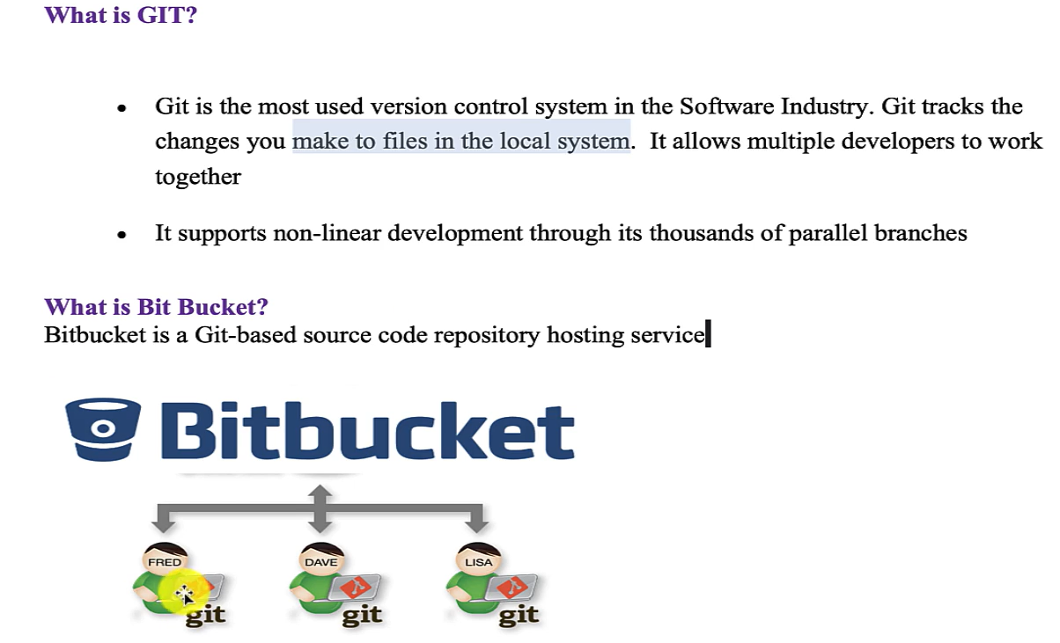
Git and Bit Bucket

Slide 2
Download Git and create account on Bit Bucket
1. Download git from : Git – Install
2. Check git : in CMD : git --version
3. Create Bitbucket account: Bitbucket | Git solution for teams using Jira
4. Create workspace and remote repository in Bit Bucket
5. Clone the remote repository into local system

Slide 3
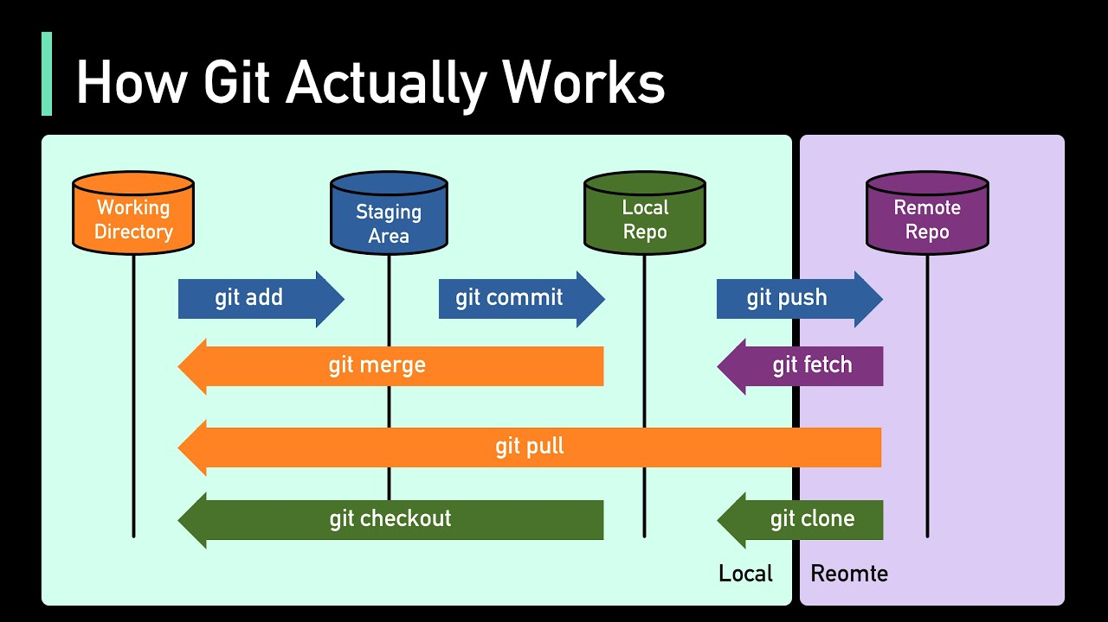

Git and Bit Bucket Stages

Slide 4
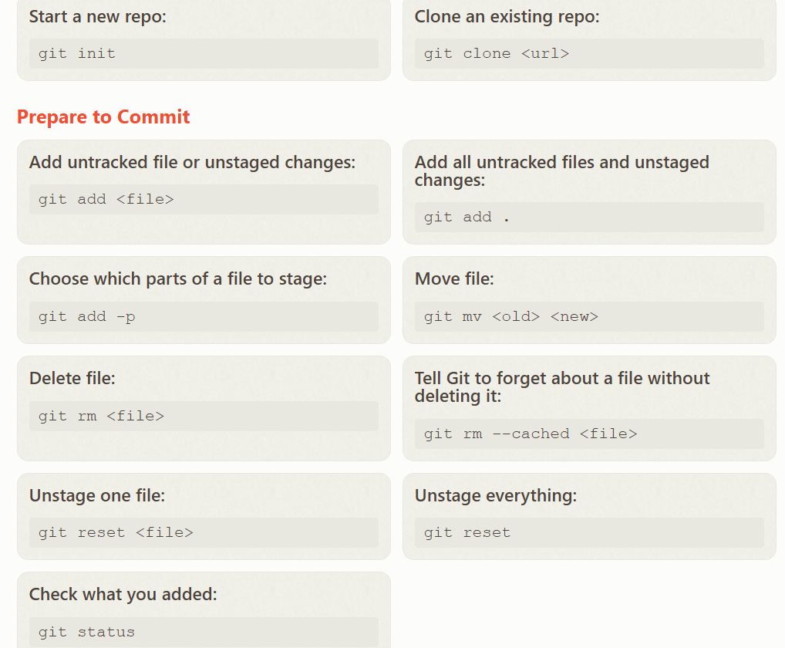
Important GIT Commands

Slide 5
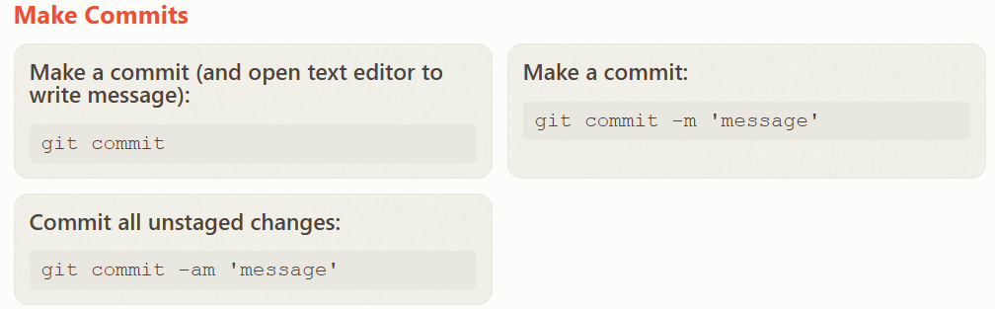
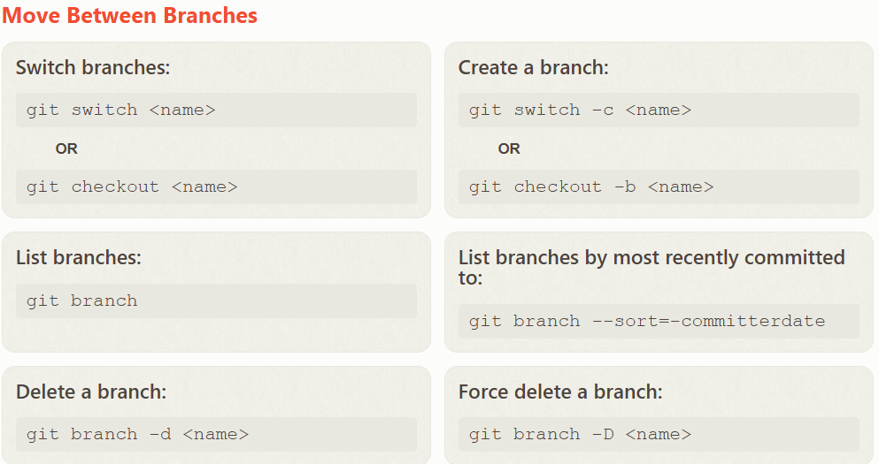
GIT Commands

Slide 6
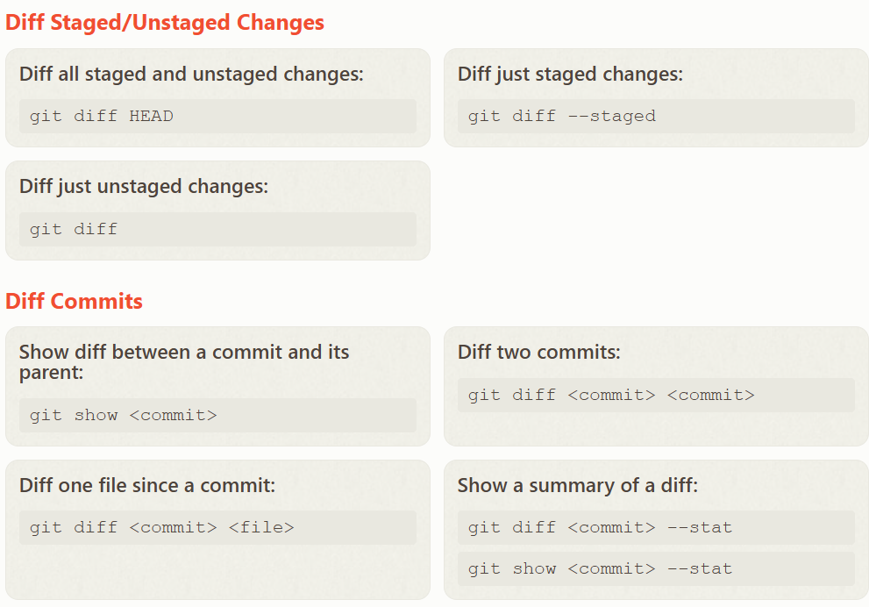
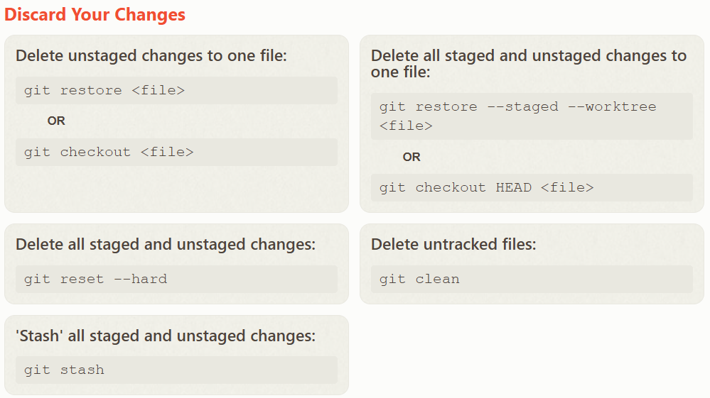
Git Commands

Slide 7
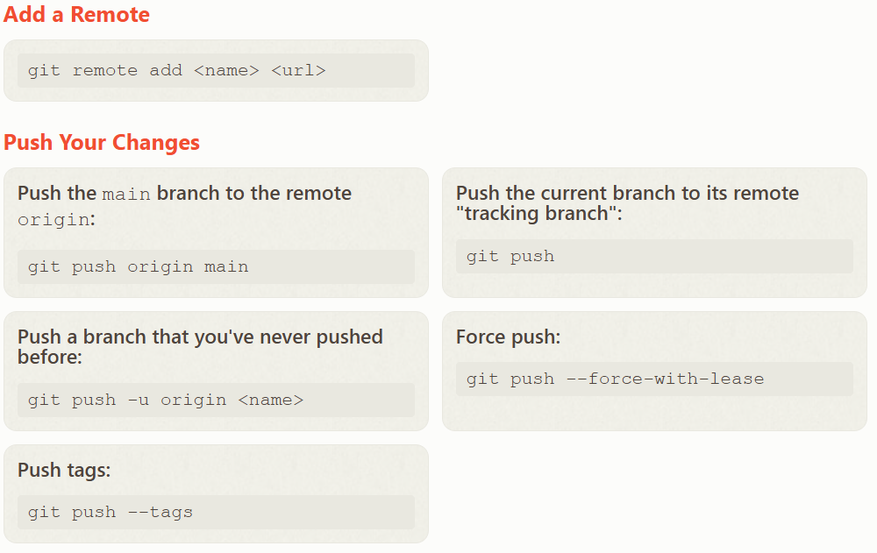
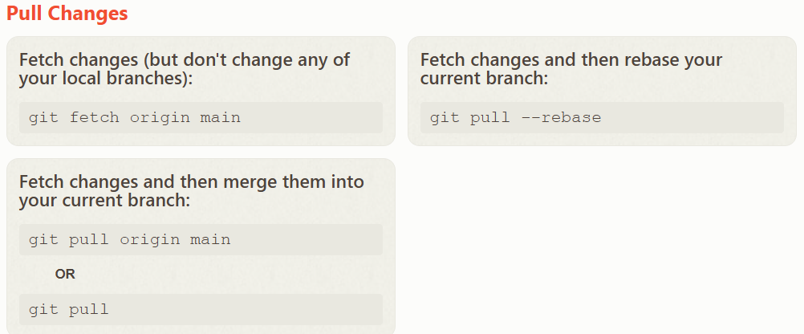
Git Commands

Slide 8
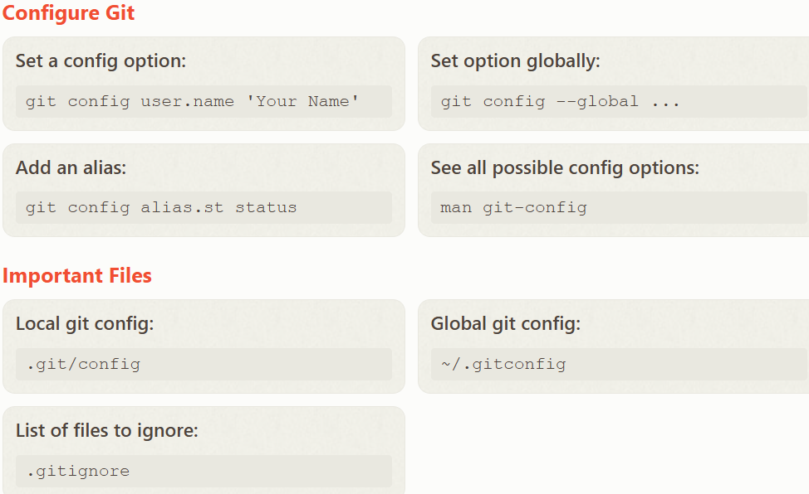
Git Commands

Slide 9

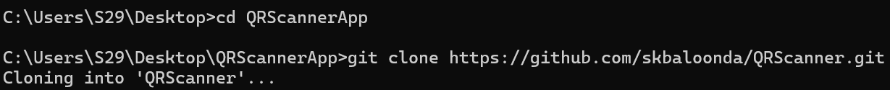
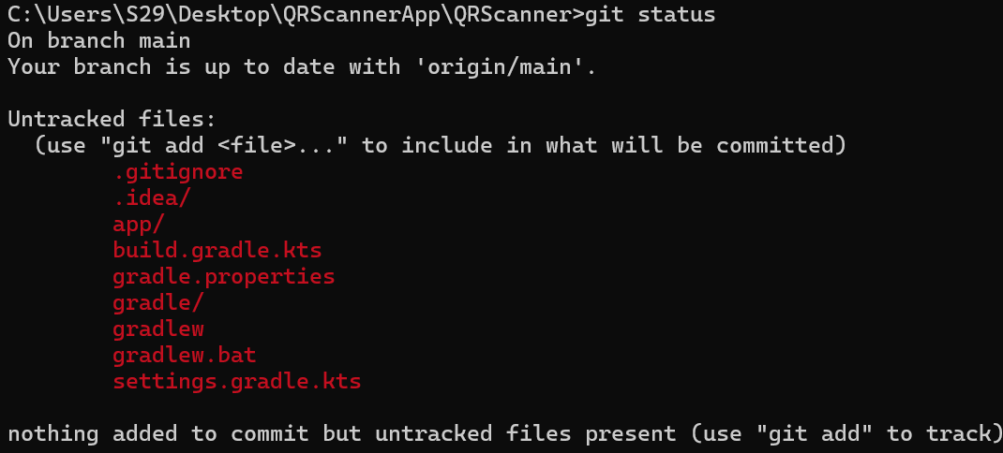
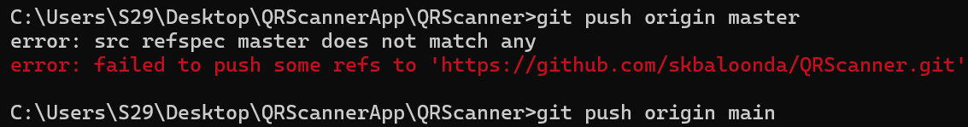
Execution of certain commands

Slide 10
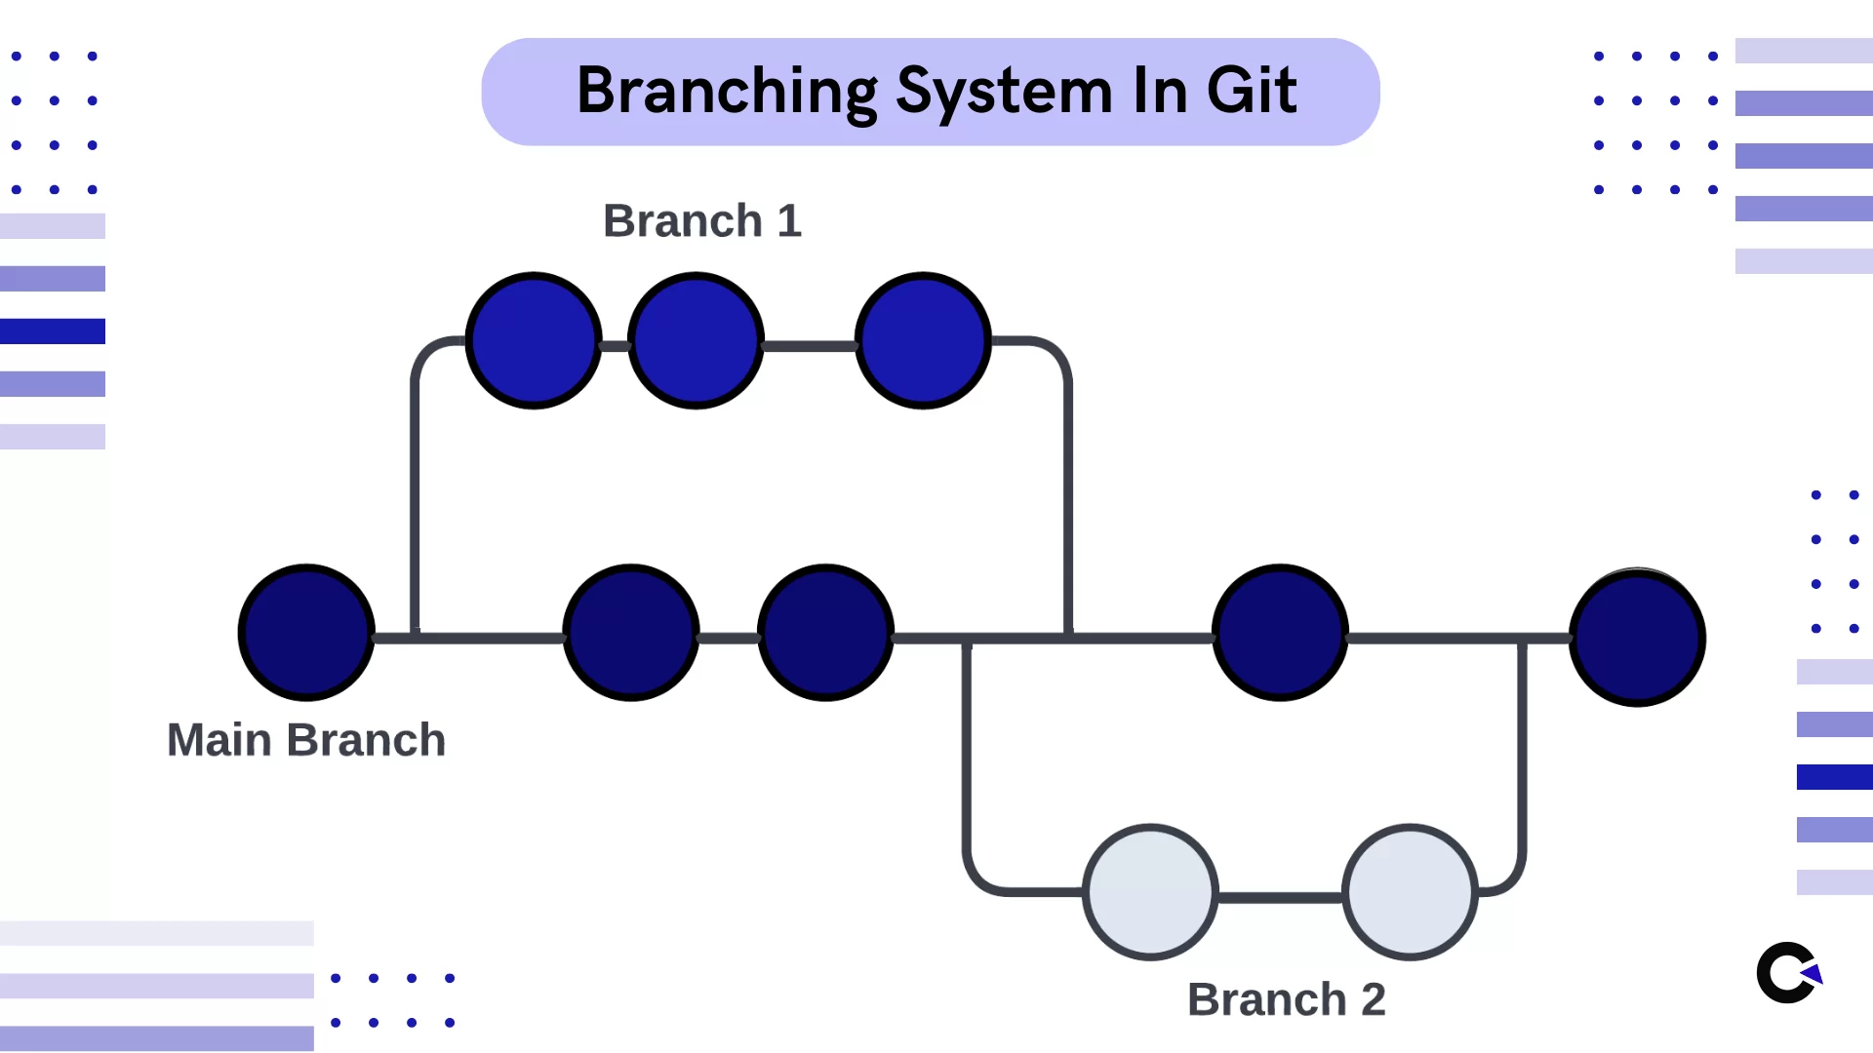
Branching in Git
Command to create and checkout new branch from main/master branch : first checkout to master branch and then below command.
git checkout -b feature/fingerprintscanner

Slide 11
Merging Pull Request with Master Branch
when all the changes in the code occur on different lines or in different files, Git will successfully merge the commits without your help.
But you will run into Merge Conflicts when same lines of the code which you changed are already changed by others in main branch after you cut the branch.

Slide 12
Merging latest changes from Master/Main to Our branch
1. git checkout master/main
2. git pull
3. git checkout branch(our branch)
4. git merge master/main

Slide 13
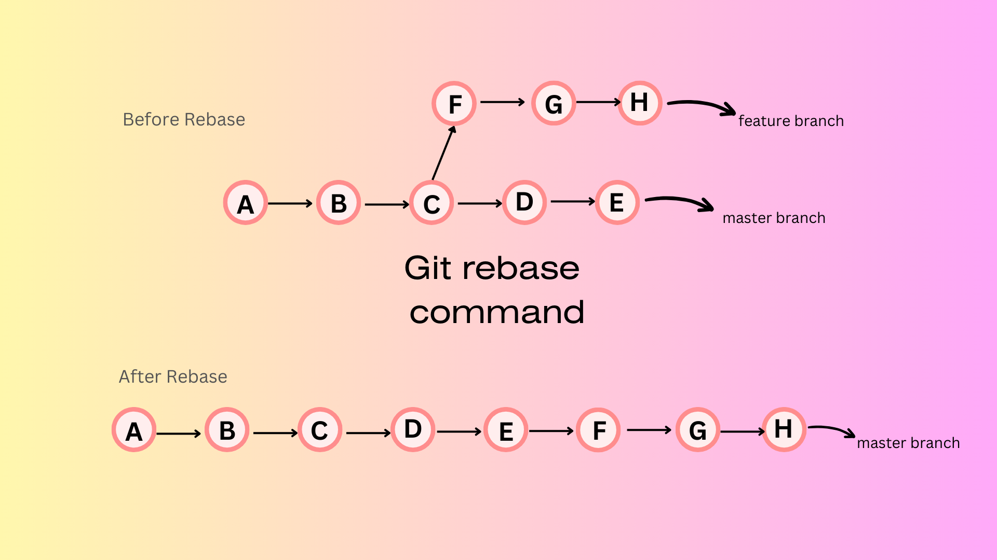
Git Rebase
1. git checkout master/main
2. git pull
3. git checkout branch(our branch)
4. git rebase master/main

Slide 14
Git Squash
Git squash is a technique used to combine multiple commits into a single commit, simplifying the commit history. This is particularly useful when working on feature branches with numerous small or experimental commits, as it creates a cleaner and more cohesive history for collaboration and review.

Slide 15
Git Stash
Git stash is a powerful feature that allows you to temporarily save changes in your working directory(current branch) without committing them. This is particularly useful when you need to switch branch quickly or work on something else without losing your current progress.
Command : git stash
Command to get back the changes: git stash pop

Slide 16
Git Fetch
Git fetch is a fundamental command for retrieving updates(someone created new branch) from a remote repository without merging them into your local repository. This makes git fetch a safe way to review commits before integrating them into your local repo.

Slide 17
Git Fetch vs Git Pull
Both git fetch and git pull are used to retrieve updates from a remote repository, but they differ in how those updates are applied to your local branch.
git fetch downloads new commits, branches, and tags from the remote repository into your local .git directory, updating remote-tracking branches (e.g., origin/main) without touching your current working directory. This allows you to review changes before integrating them.
git pull is essentially git fetch + git merge (or git rebase if configured). It fetches changes from the remote and immediately merges them into your current branch, potentially causing merge conflicts if both local and remote have diverged.

Slide 18
Git Tagging
Creating and Pushing Tags in Git
Tags in Git are used to mark specific points in a repository's history, often used for marking release points like v1.0, v2.0, etc. There are two types of tags in Git: lightweight and annotated. Lightweight tags are simple pointers to a commit, while annotated tags store additional metadata such as the tagger's name, email, date, and a message.
To create tag : git tag <tag_name>
Tag with message : git tag <tag_name> -a -m "Message„
Tag to previous commits: git tag <tag name> commit_id
Verify Tag : git tag
Push Tag : git push origin <tag_name>
Push All tags : git push origin --tags

