Slide 1
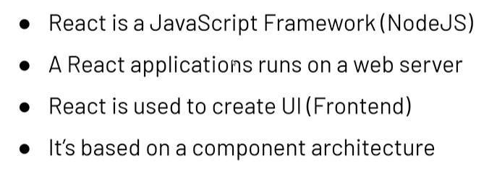
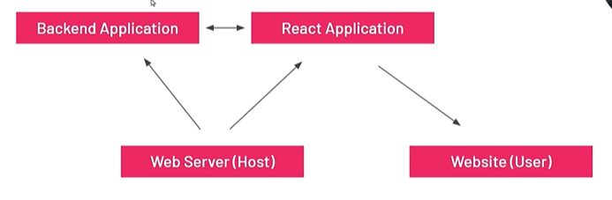
React Introduction
1.Used to build Web based application
2. Create User interfaces(frontend)

Slide 2
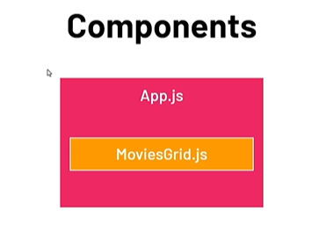
Component Architecture
Root Component
App.js
Other Custom Components
MovieGrid.js
Components are building blocks.
Components are Reusable pieces of UI and Functionality.

Slide 3
Setup Tools
Visual Studio
Node JS
Extensions in VS code: Eslint, Prettier
Setting modification: File->Preferences->Setting -> Search Format on Save -> Check the box

Slide 4
Command to create and run React App
In Terminal of VS code :
command : npx create –react-app Moviedux
Run Command : npm start

Slide 5
React Components: Nested, Reusable
React Application
Movie Grid
Watchlist
Movie Card
(reusable)
Movie Card
Movie Card
Movie Card

Slide 6
React State
State = Manage Component data
->When the state value changes the UI re-renders the value

Slide 7
React Props
React Props used to pass Data, event handlers and functions to components.
We can pass props to nested components “Props Drilling”.

Slide 8
React Router
Router = Navigation between components/routes
Use Routes to configure the routing
Use Link to navigate the user.
Install router :
  npm i react-router-dom@6.22.3

Slide 9
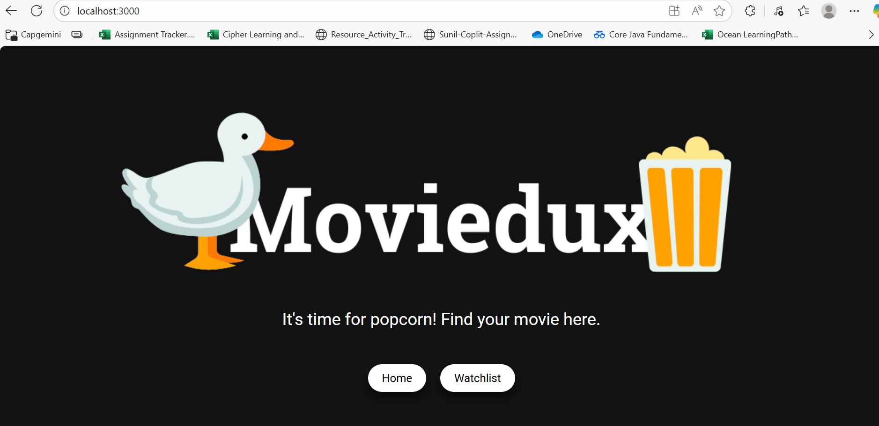
Basic React Application: Movie Dashboard

Slide 10
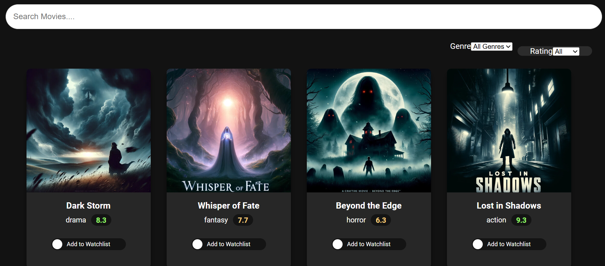
Continue….

Slide 11
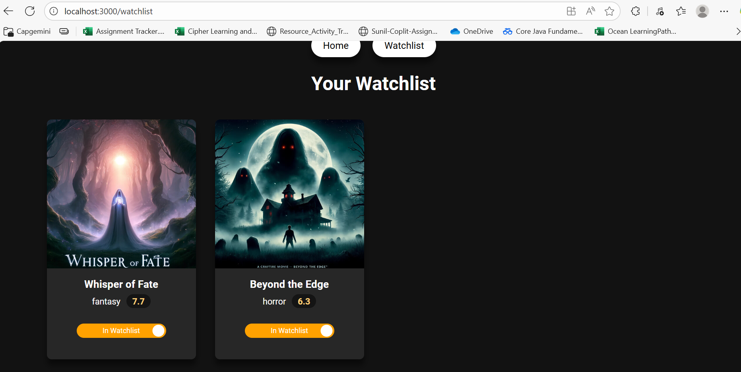
Continue….

