Slide 1
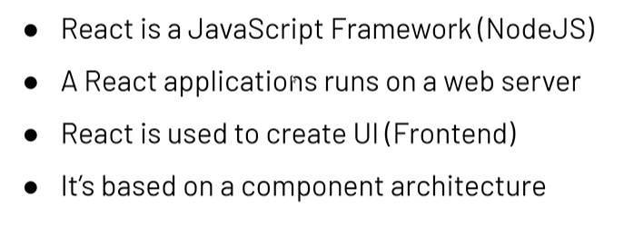

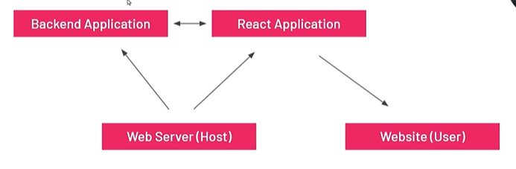
React JS Introduction

Slide 2
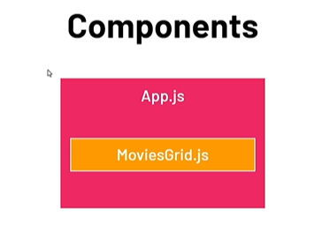
Component Architecture
Root Component
App.js
Other Custom Components
MovieGrid.js
Components are building blocks.
Components are Reusable pieces of UI and Functionality.

Slide 3
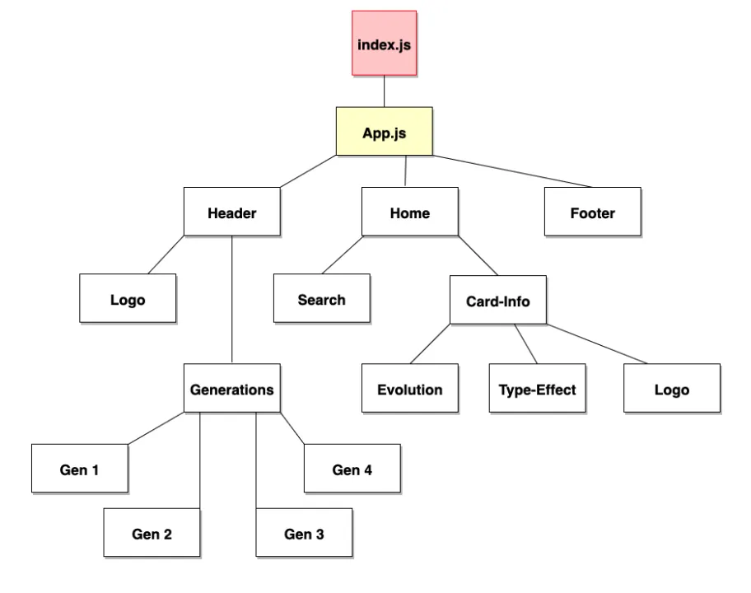
Components Hierarchy

Slide 4
Command to create and run React App
In CMD or Terminal :
npx create –react-app taskmanager
Run Command : npm start

Slide 5
React useState
State = Manages Component data
When the state value changes the UI re-renders the value

Slide 6
React useEffect
useEffect is a way of React to handle “side effects”
When the component first appears on the screen
  Fetch data from an API when page loads
When a state or props changes
  Run any logic when count changes

Slide 7
React Props
React Props used to pass Data, event handlers and functions from one component to other components.
We can pass props to nested components known as “Props Drilling”.

Slide 8
React Router
Router = Navigation between components/pages
Use Routes to configure the routing.
Use Route to specify the path.
Use NavLink to specify link to navigate
Install React Router :
  npm install react-router-dom@6

Slide 9
React Styling
Ways to apply style in React.
1. Global Level styling
2. Component level styling
  (Applied to whole component)
3. Inline styling
4. Module Level styling
  (scope is restricted within a component)

Slide 10
Thank You!

