Slide 1
Hcal DAQ Update
Scott Barcus
2/7/2020

Slide 2
TDC Timing Resolution
Require 3 tubes vertically in coincidence to fire.
Reference time is the average of the TDC times of the top and bottom tubes.
Require surrounding 6 tubes not to have fired.
Red timing resolution σ₁:
  TDC time – TDC reference
Blue timing resolution σ₂:
  Reference resolution (Top TDC -Bottom TDC)
Want timing resolution of only center PMT σ₃.
  σ₁² = σ₂² + σ₃²

Slide 3
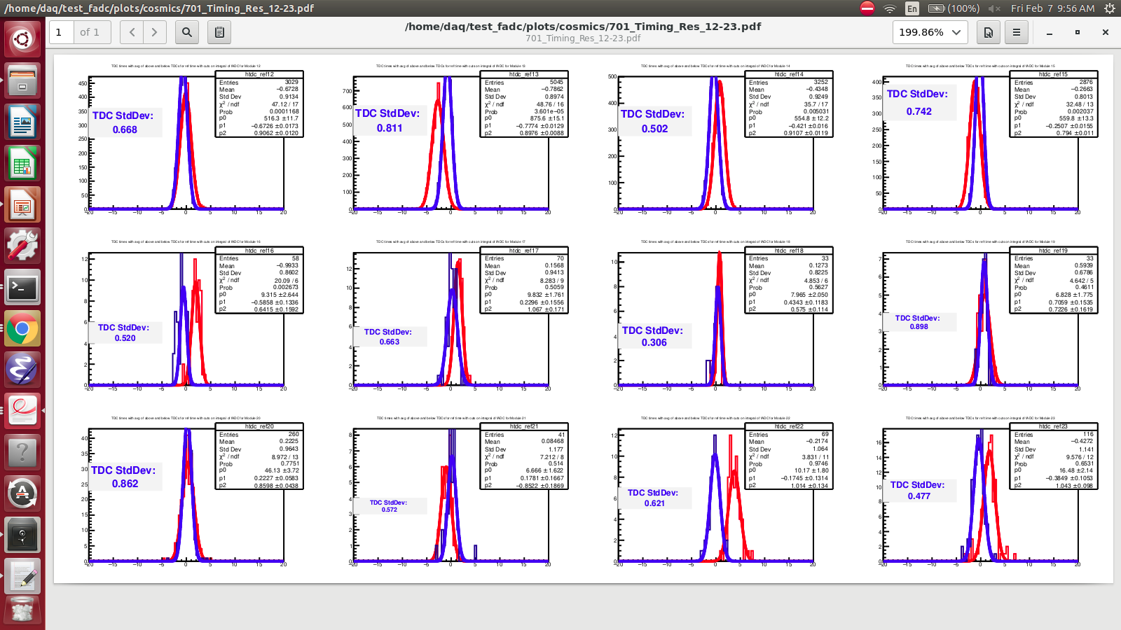
TDC Timing Resolution Run 701 (Modules 12-23)

Slide 4
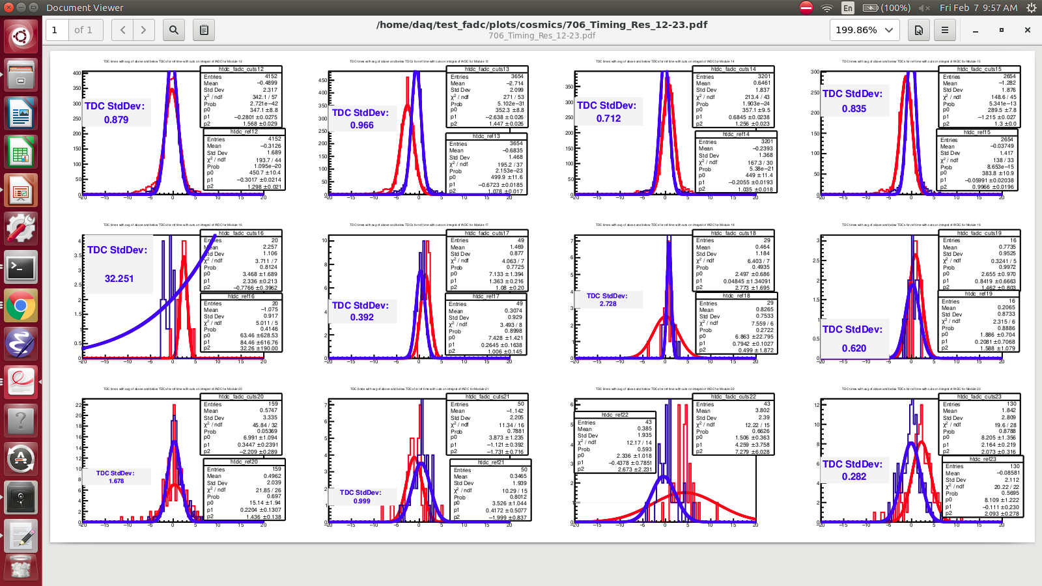
TDC Timing Resolution Run 706 (Modules 12-23)

Slide 5
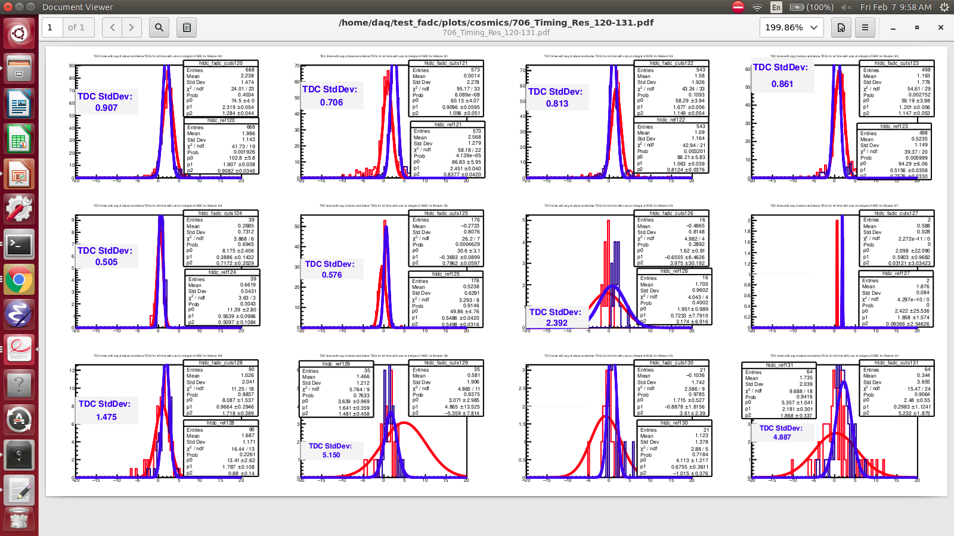
TDC Timing Resolution Run 706 (Modules 120-131)

Slide 6
fADC Time Walk Corrections
Define time over threshold for fADC times.
  ¼ average fADC peak height.
  Landau fit to fADC pulses.
Bigger fADC pulses cross threshold earlier.
  Want to correct for this time walk.
Plot fADC integral vs time over threshold.
  Fit this spectrum. f(fADC integral)
  Using a sum of an exponential and a log.
    Probably could simplify this.
Correct raw fADC times as follows (blue plots):
  Raw time over threshold – f(fADC integral)

Slide 7
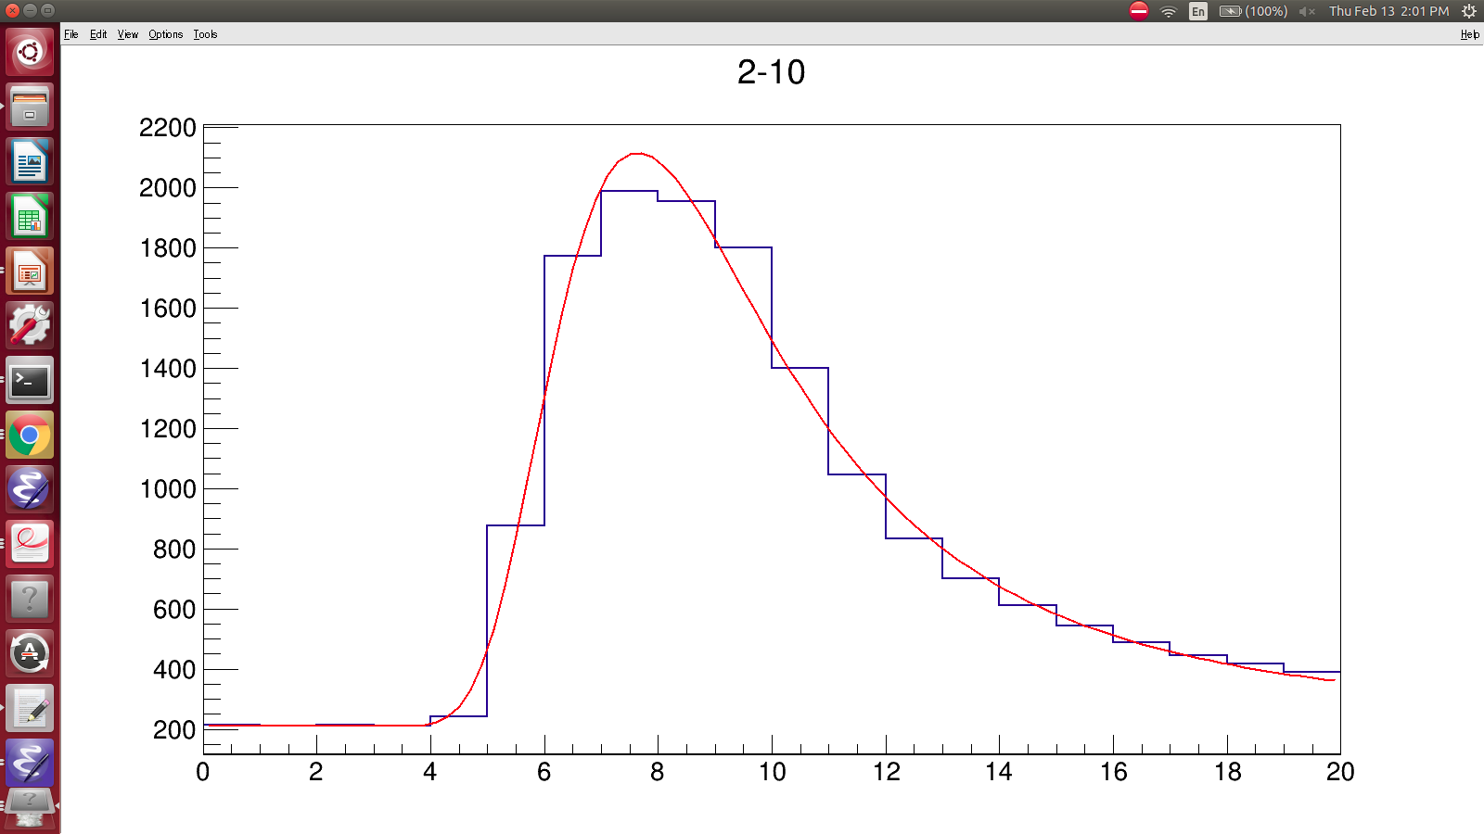
Landau Fit to fADC Signal

Slide 8
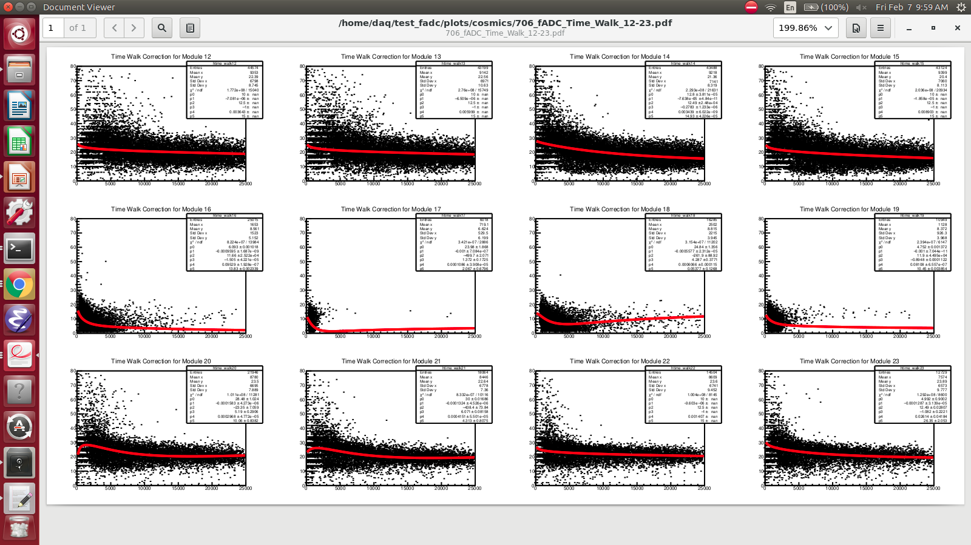
Time Walk for 706 (mods 12-23)

Slide 9
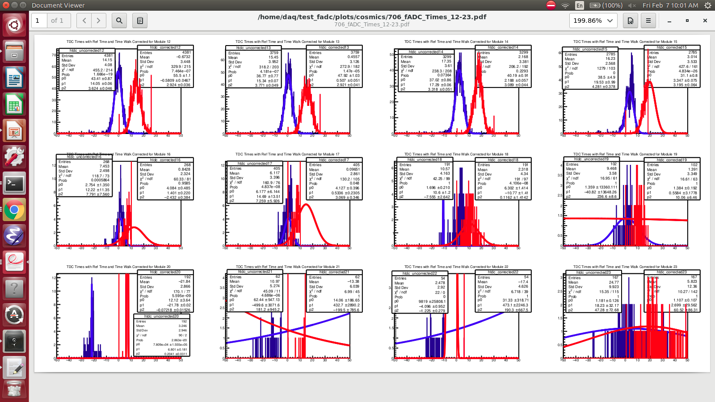
fADC Timing Resolutions (Corrected and Uncorrected) Run 706 (mods 12-23)

Slide 10
706 Time Walk Cont.
Time walk corrections (blue) slightly improve resolution.
JLab tubes and far right tubes see very little rate.
Go back and use same reference time method used for the TDC times with fADC times.
Need resolutions of 0.5 ns for G_{E}^{n}.
  Just single TDC resolution?
  Can add stricter cuts for verticallity etc.
  Want to combine TDC and fADC for better timing resolution.
    Plot TDC time – fADC time for time walk and correct for combined result?

Slide 11
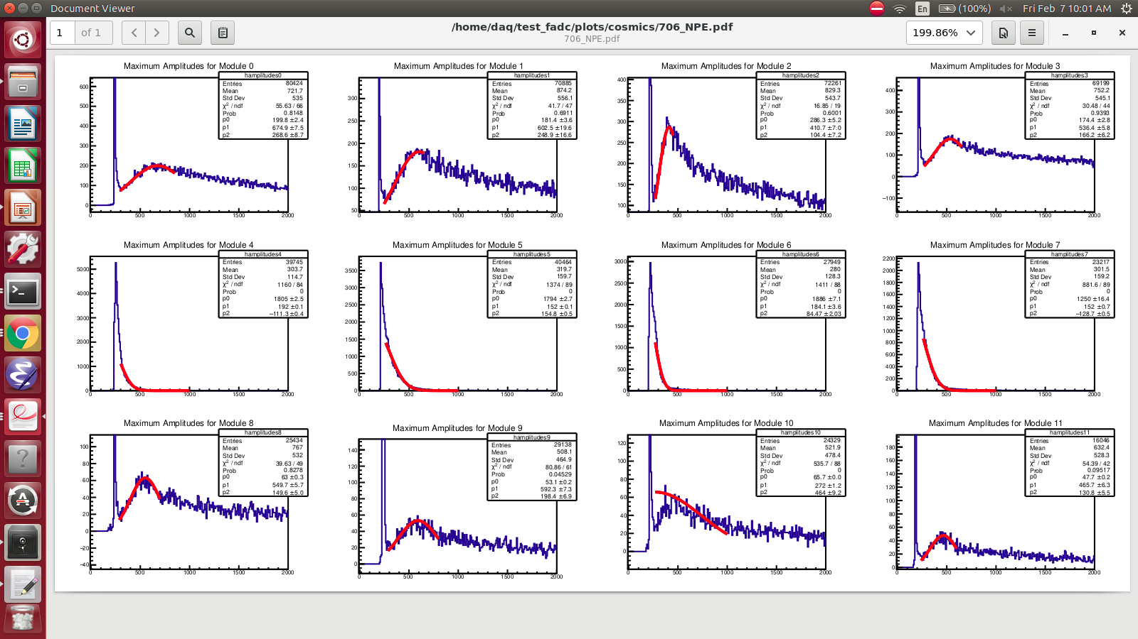
706 Number of Photoelectrons
Calibrate HV to create distinct SPE peak.
  Fit SPE peak with a Gaussian.
  NPE = (Avg fADC height/StdDev fADC height)^2

Slide 12
NPE Cont.
Module | Avg. NPE | rChi^2 of Fit | Visual Fit Quality
0 | 6.31 | 0.84 | Good
1 | 5.86 | 0.89 | Decent
2 | 15.49 | 0.89 | Decent
3 | 10.42 | 0.69 | Decent
4 | 13.5 | 0.81 | Decent
5 | 8.91 | 1.33 | Good
6 | 0.34 | 6.09 | Bad
7 | 12.68 | 1.30 | Decent
Need to improve fits (maybe adjust HV again).
JLab tubes can't separate SPE peak.
  HV max -2200 V.
Compare with G4SBS cosmic results.

