Slide 1
HCal fADC Timing Resolution
3/13/2020
Scott Barcus

Slide 2
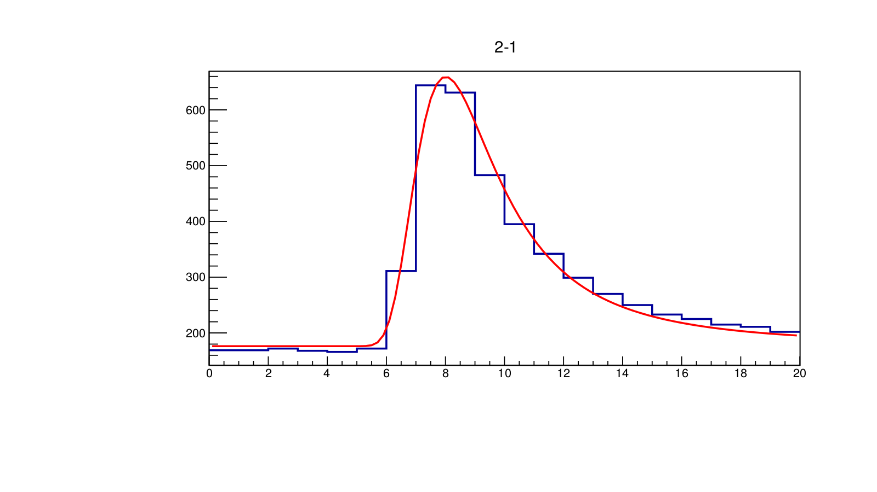
fADC Time Over Threshold
Threshold crossing defines fADC time.
  Threshold defined as ¼ average fADC peak height.
fADC signals fit with Landau function.

Slide 3
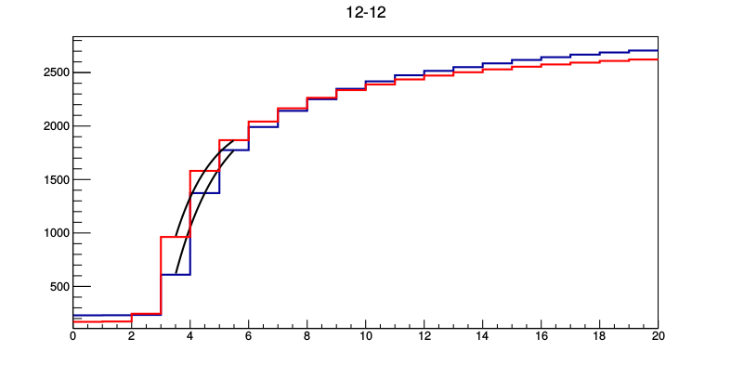
fADC Reference Time
Send two trigger copies over long cables to two fADC channels to get sloped edge for timing.
Fit the leading edge of trigger copies with an exponential. (Linear fit was tested and worse.)
  Ref time defined by threshold of fADC=1250.
  PMT Time = fADC T.O.T. - ref time.

Slide 4
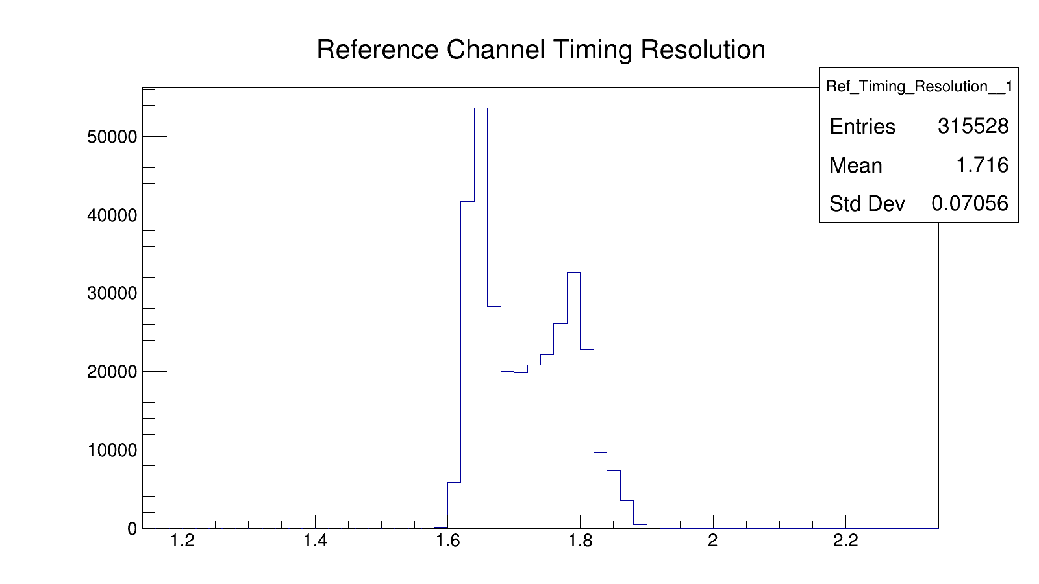
Timing Jitter Between Ref Ch.s
Histogram of ref_time1 – ref_time2.
Oddly shaped (other thresholds even worse).

Slide 5
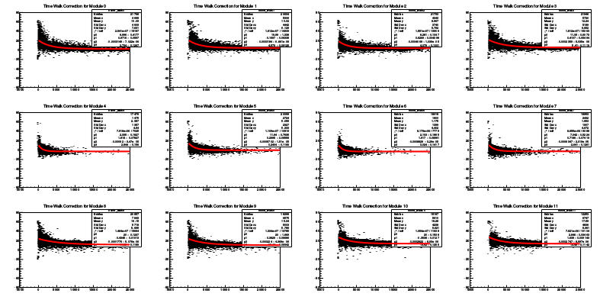
Time Walk Effect
Plot fADC signal integral vs. fADC T.O.T.
Fit with exponential.

Slide 6
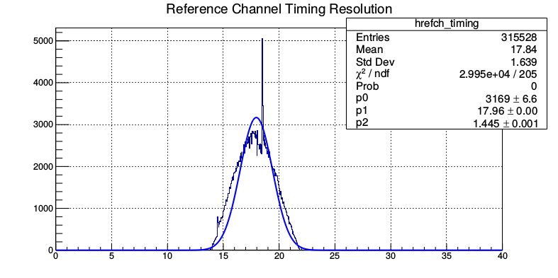
Time Walk Correction
Corrected Time = fADC T.O.T. - ref time – f(exp fit)
Both T.O.T. and ref time have distributions.
σ²_{corrected} _{time} = σ²_{fADC T.O.T.} + σ²_{ref time}
σ_{ref time} not Gaussian.

Slide 7
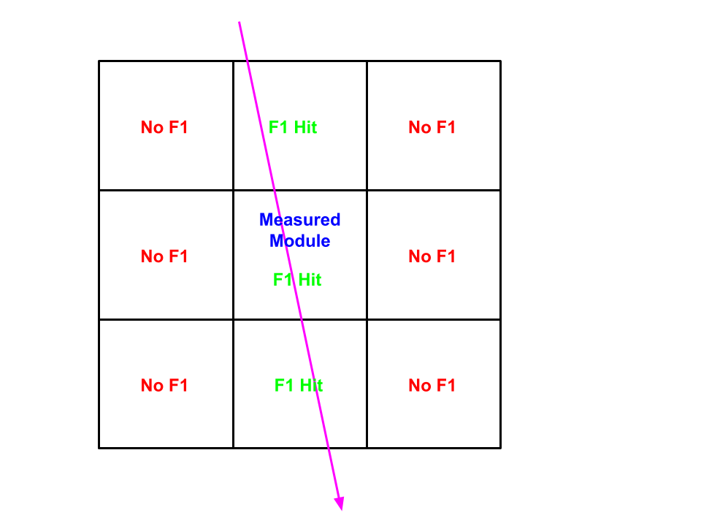
Individual PMT Timing Resolutions
Require vertical cosmics for best timing.
  Three F1s fire vertically in a row and surrounding six F1s don't fire.

Slide 8
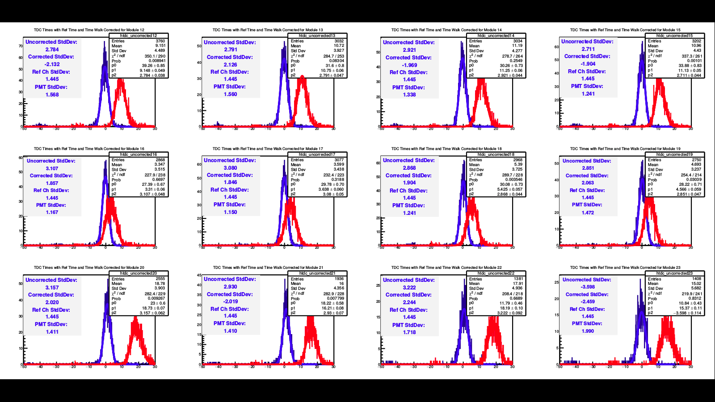
Time Walk Corrected Timing Resolutions
σ_{fADC T.O.T.} = (|σ²_{corrected} _{time} - σ²_{ref time}|)^{1/2}. (Gaus)

Slide 9

Using histogram standard deviation.
  1.639 vs. 1.445 for Gaussian.

Slide 10
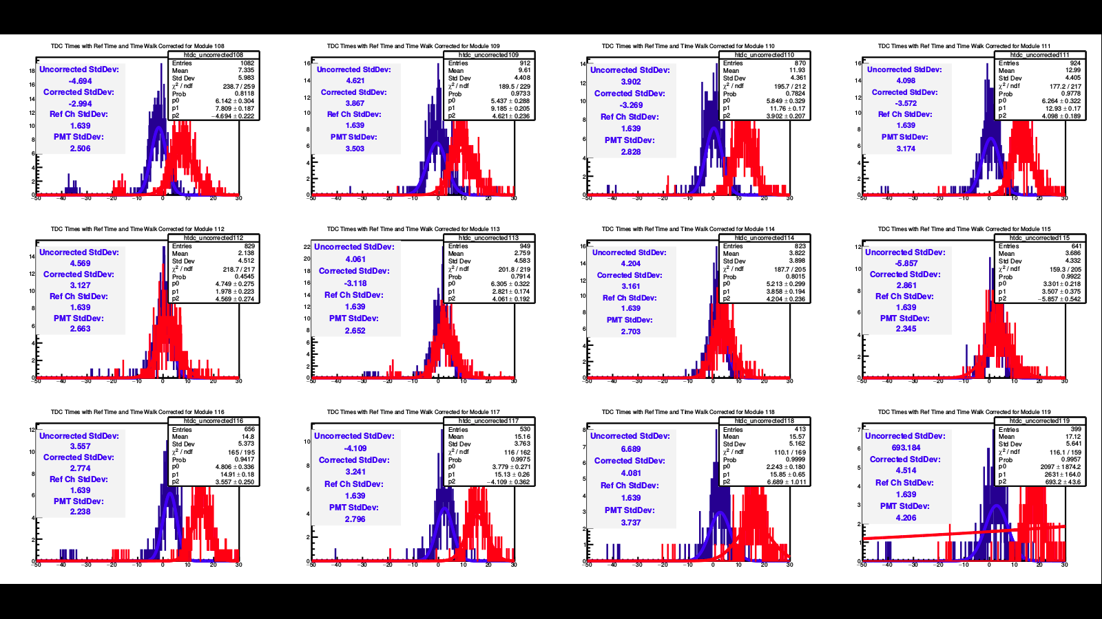
Timing resolution worse lower down in HCal.
  Probably just geometry. (histogram std. dev.)

