Slide 1

CHEBROLU ENGINEERING COLLEGE
Main Road, Chebrolu, Chebrolu, Guntur - 522212 (Near Power Station)
SURVEILLANCE SPY ROBOT USING ESP32 WITH IOT-BASED CONTROL
Team Members
Project Guide
Mr. ANKA SIVA PRASAD KATURU _{MTech}
Shaik Basheer 21HU1A0437
Gonisipudi Sankar 22HU5A0405
Valluru Narendra 21HU1A0448
Korumalli Teja 21HU1A0422

Slide 2
CONTENTS
ABSTRACT
INTRODUCTION
EXISTING SYSTEM
PROPOSED SYSTEM
HARDWARE COMPONENTS
ADVANTAGES
APPLICATIONS
FUTURE SCOPE
CONCLUSION

Slide 3
ABSTRACT
This project developed a cost-effective, remotely controlled Surveillance Spy Robot using ESP32 and ESP32-CAM. The robot enables real-time video surveillance and remote navigation via a IoT-enabled Android application. It offers a mobile and flexible alternative to traditional fixed surveillance systems for enhanced security and monitoring

Slide 4
INTRODUCTION
Security is important in defense, industry, and homes.
Regular surveillance systems are costly and need fixed setups.
This project presents a smart Spy Robot that can be controlled from a distance.
It helps monitor dangerous or hard-to-reach places in real-time.
The robot is operated using a Wi-Fi-based Android app.
It’s a low-cost and efficient option compared to traditional systems

Slide 5
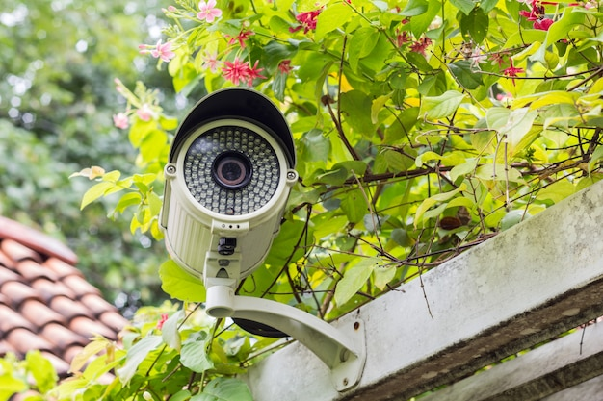
EXISTING SYSTEM
Conventional CCTV systems are fixed and need a lot of infrastructure. They can't move or adapt to changing situations. They’re not suitable for dangerous environments where human presence is risky.

Slide 6
PROPOSED SYSTEM
Development of a remotely controlled Surveillance Spy Robot
Equipped with a live video streaming system
Core Components:
ESP32 Microcontroller, Motor Driver Circuit, LM2596 Power Supply Module
Wi-Fi Based Android Application
Receives movement commands via Wi-Fi.
Transmits live video feed to the user's mobile device for remote visual monitoring.

Slide 7
HARDWARE COMPONENTS
ESP32 Microcontroller
LM2596 Power Supply Module
DC-DC Converter
L298N Motor Driver

Slide 8
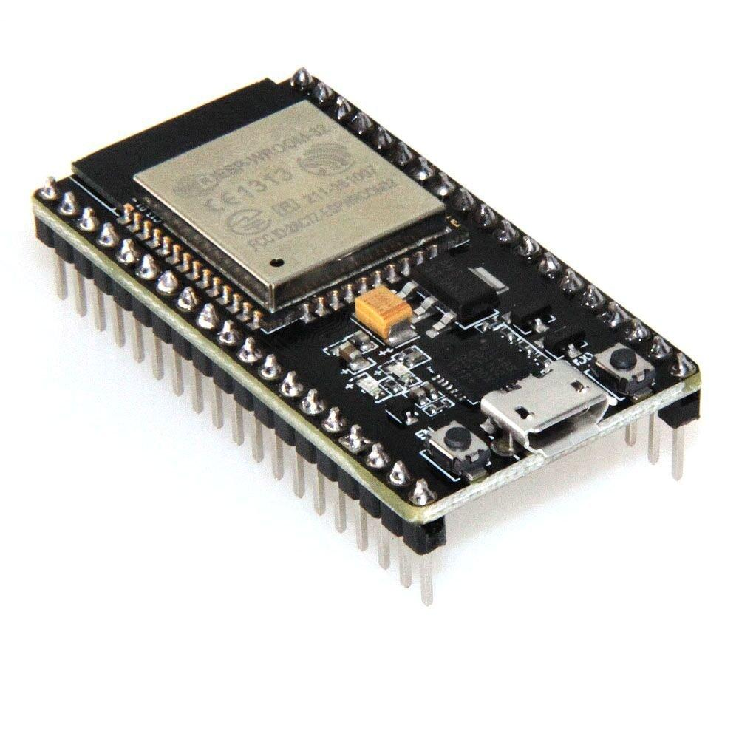
ESP32 Microcontroller
The ESP32 microcontroller is the core processing unit of the Surveillance Spy Robot project. It is a low-power, high-performance Wi-Fi and Bluetooth-enabled microcontroller designed for IoT and embedded system applications.
Dual-core processor (up to 240 MHz)
Wi-Fi and Bluetooth connectivity
Integrated peripherals for sensors, displays, etc.

Slide 9
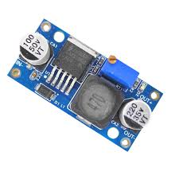
LM2596 Voltage Regulator
LM2596 A step-down voltage regulator to convert higher voltage to stable lower voltage.
Input Voltage Range: 4.5V to 40V
Output Voltage: 1.25V to 37V
Output Current: Up to 3A
Efficiency: Up to 92%

Slide 10
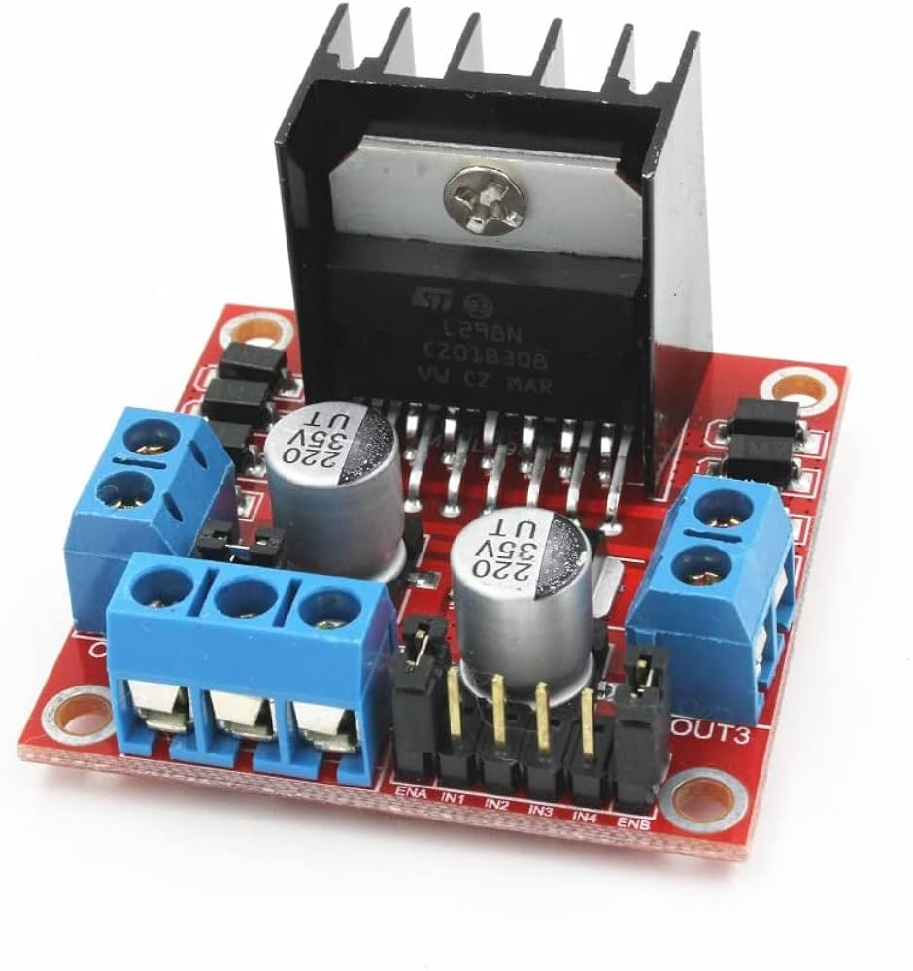
L298N Motor Driver
The L298N Motor Driver is used in the Surveillance Spy Robot project to control the direction and speed of the robot's motors, enabling its movement and navigation

Slide 11



SOFTWARE TOOLS
Arduino IDE – Used for coding and uploading the program to ESP32
Blynk IoT – We used Blynk IoT in our project to enable remote control of our robot over the internet
IP Web Cam App – IP Webcam for Android allows you to turn your phone into a network camera, streaming video and audio to various devices and platforms
Arduino IDE
Blynk IoT
IP Web Cam App

Slide 12
ADVANTAGES
Mobility and Flexibility: Can navigate various environments.
Remote Control: Operation from a safe distance.
Real-time Monitoring: Live video feed for immediate observation.
Cost-Effective: Utilizes readily available and affordable components.
Wireless Operation: Eliminates the need for extensive wiring.
Suitable for Hazardous Environments: Reduces the need for human presence in dangerous areas.
Portable and Autonomous Alternative: Compared to fixed CCTV systems.

Slide 13
Applications
Security: Home/business surveillance, intrusion detection.
Military: Reconnaissance, surveillance, battlefield assessment.
Industry: Hazardous area monitoring, remote site inspection.
Home: General monitoring of property, people, or pets.
Perimeter: Boundary security, intrusion alerts.

Slide 14
STATISTICS

Slide 15
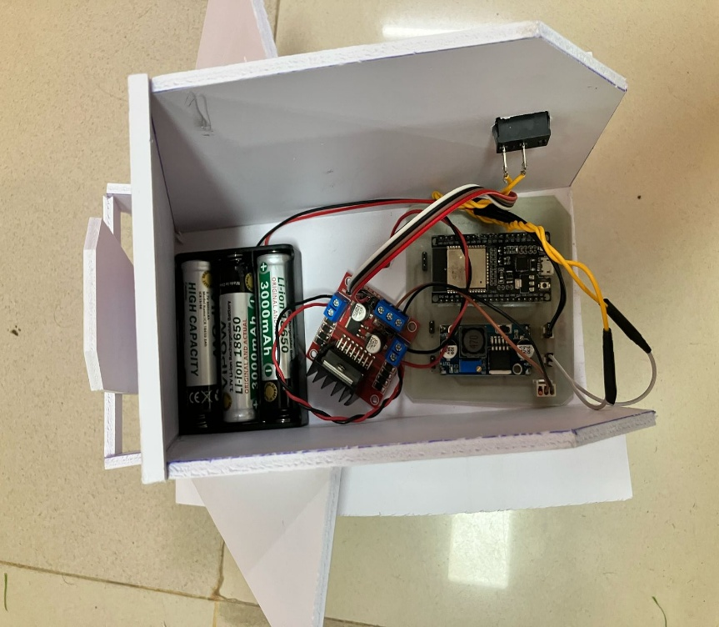
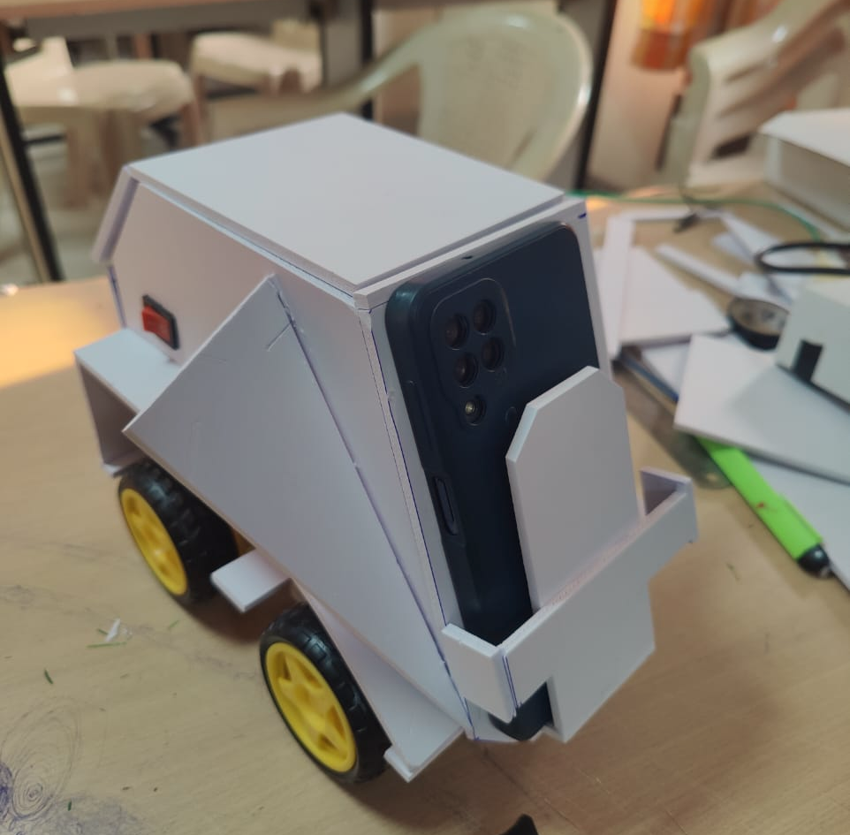
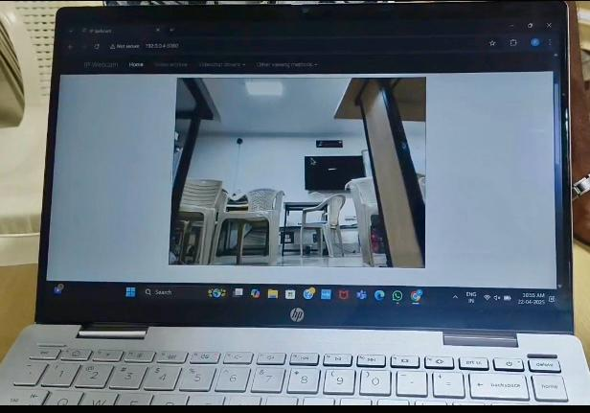
RESULTS

Slide 16
FUTURE SCOPE
Enhance Mobility with obstacle avoidance.
Improve Video Quality with higher resolution or compression.
Increase Range with alternative wireless protocols (LoRa).
Add Advanced Features like night vision, audio recording, object detection.
Explore AI Integration for intelligent surveillance
Optimize Power Consumption for longer operation.

Slide 17
CONCLUSION
Successfully designed and developed a cost-effective, remotely controlled Surveillance Spy Robot.
Demonstrated real-time video surveillance and remote navigation capabilities.
Offers a practical solution for overcoming the limitations of traditional surveillance systems.
Provides a mobile, flexible, and easily deployable system for various security and monitoring needs.

Slide 18
THANK YOU

