Slide 1



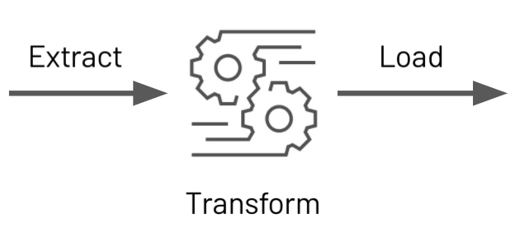




Trip Analysis
Trip Data
Visualization

Slide 2




Machine Learning Pipeline
Trip Data
Daily Weather Data
Demand Prediction
Operational Report (Monthly)
Visualization

