Slide 1

B.Tech Major Project · 2026
Sound for
Silence
A digital therapy companion for cochlear implant children
Abhishek Verma · Shekhar Chaurasiya · Sakshi Puria · Abhishek Rathore | Arya Institue of Engieering Technology and Managment, Jaipur

Slide 2
What Do These Children Go Through?
🧒
34 million children worldwide live with disabling hearing loss — cochlear implants help, but rehabilitation is a long, hard journey 🌍
Born into Silence
Missing the Critical Window
🔇
Children with profound hearing loss experience no sound from birth. Without early intervention, they never naturally develop speech or language.
🧠
The brain is most receptive to language between ages 0–3. Every month of delay causes lasting gaps in cognitive and speech development.
Therapy is Exhausting & Confusing
Isolated at School & Home
😰
Hours of repetitive exercises with no visual reward. Young children cannot understand why they must keep practicing — and give up.
🏫
Unable to communicate clearly, children face social isolation. They struggle to follow conversations, make friends, or keep up in class.

Slide 3
The Problem
📋
👁️
📊
Paper Records
No Parent Visibility
No Clinical Data
Therapy progress is tracked manually, making long-term monitoring error-prone.
Parents have no real-time insight into their child's daily therapy progress.
Therapists lack tools to record CAP/SIR scores and visualize trends over time.

Slide 4
Our Solution
Sound for Silence — Dual Interface Platform
📱 Android App
🌐 Web Dashboard
Patient & Parent Portal
Therapist Portal
Gamified therapy stages with sequential video unlocks
Post-video quizzes to test comprehension
Parent dashboard with streaks & progress %
Manage patients & view implant/assessment dates
Record CAP (0–7) & SIR (0–5) clinical scores
Interactive Chart.js progress charts (3/6/12 months)

Slide 5
Who Is It For?
🧒
👨‍👩‍👧
👩‍⚕️
Child
Parent
Therapist
Cochlear implant patient
Caregiver & monitor
Clinician & analyst
Watches therapy videos, takes quizzes, earns streaks in a fun game-like experience
Tracks child's daily progress, stage completion, and quiz scores in real time
Records CAP/SIR scores, views long-term charts, and manages patient records

Slide 6
Architecture or App Flow
📱 Android App (Patient)
🌐 Web Dashboard (Therapist)
Child / Parent Login
Therapist Login
Browse Therapy Stages
View Patient List
🔥
Firebase
Watch Video (Unlocked)
Record CAP / SIR Score
Take Post-Video Quiz
View Progress Charts
Progress Saved to Firebase
Data Synced in Real Time

Slide 7
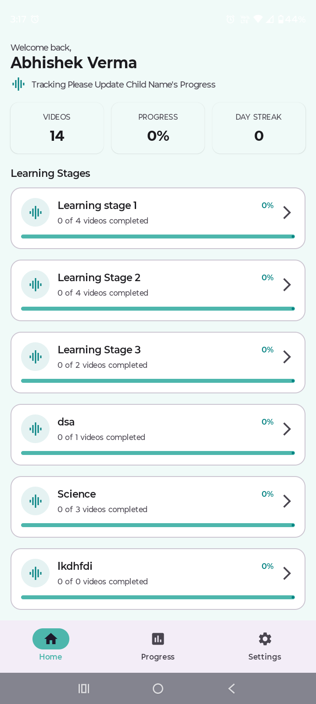
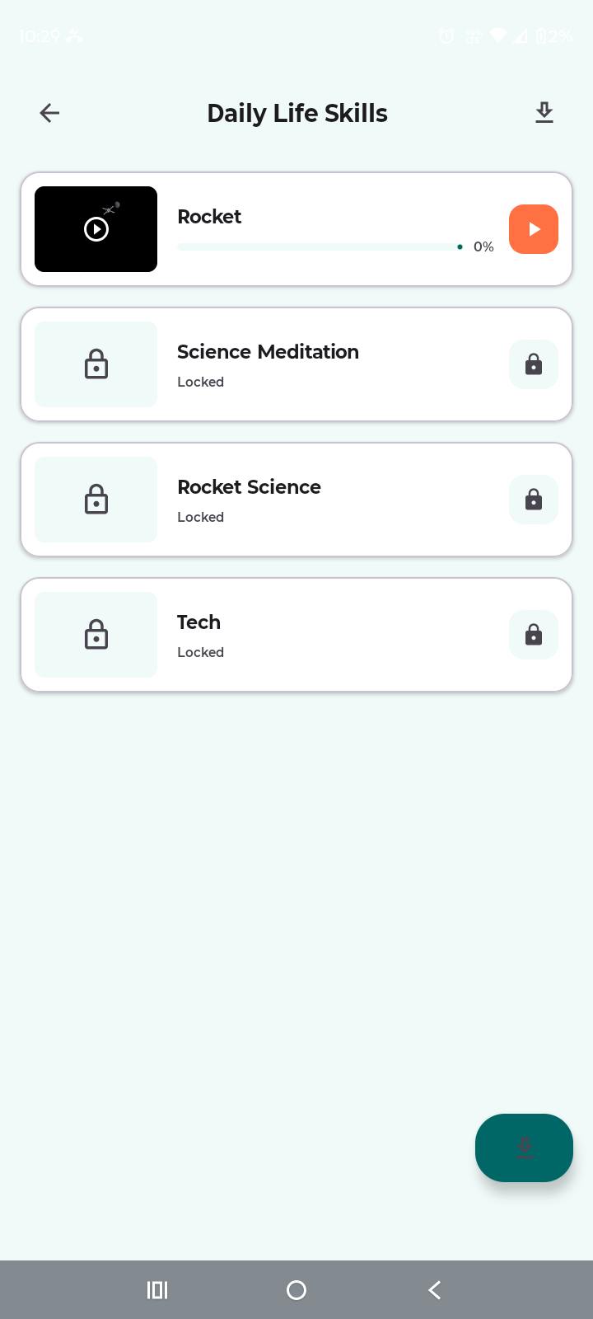
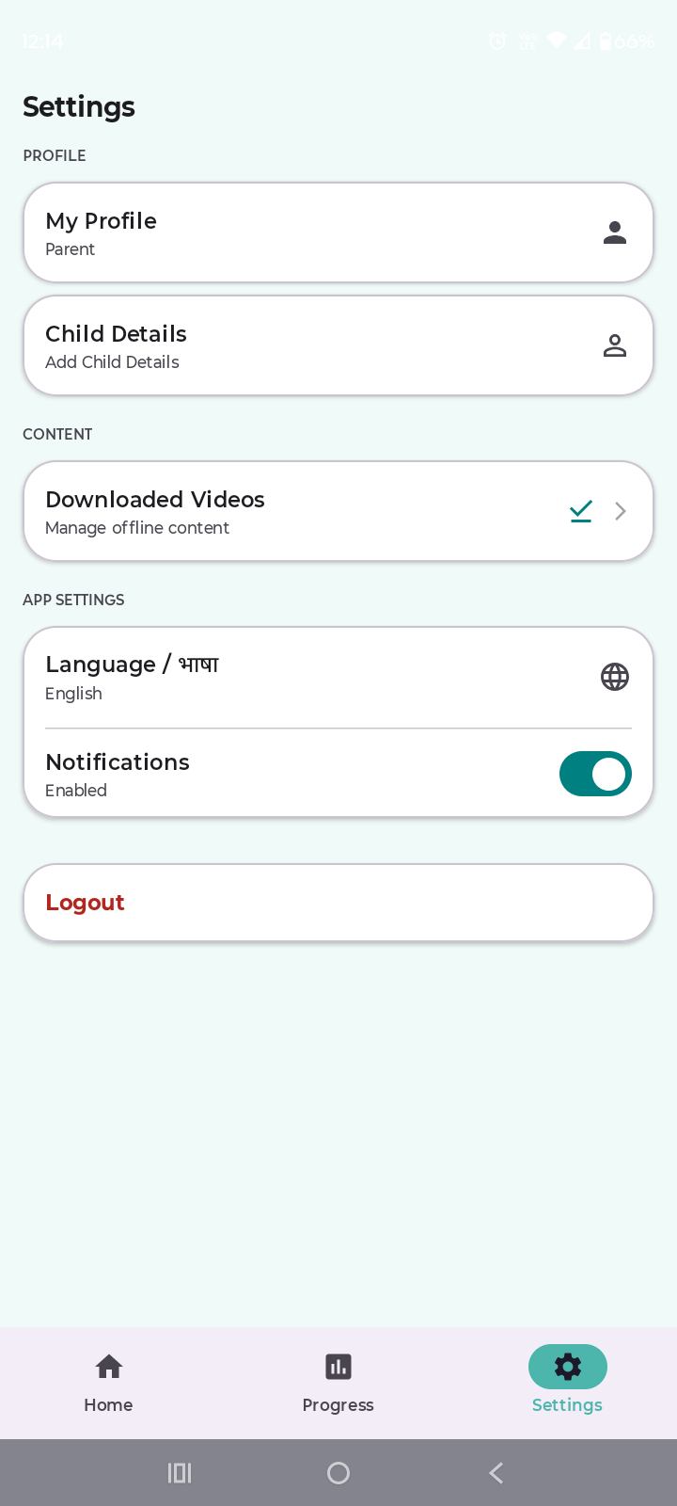
Android App — Patient & Parent Portal
Therapy Stages
Therapy Stages
Therapy Stages
Therapy Stages
Learning Stage
Settings Page

Slide 8
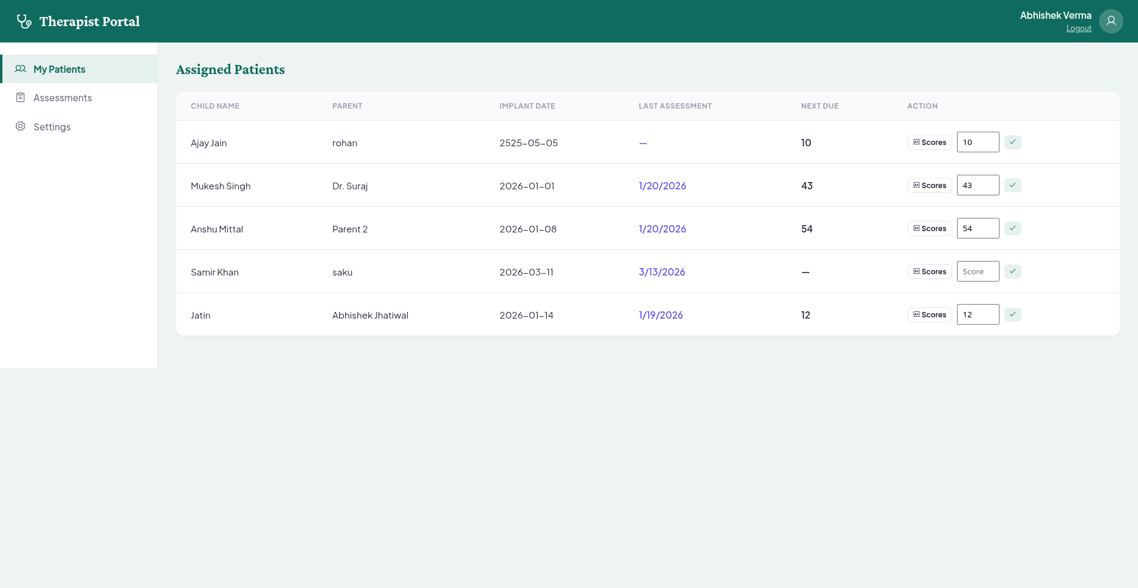
🌐 Web Dashboard — Therapist Portal
👤 Patient Management
📈 CAP / SIR Scoring
📊 Settings Page

Slide 9
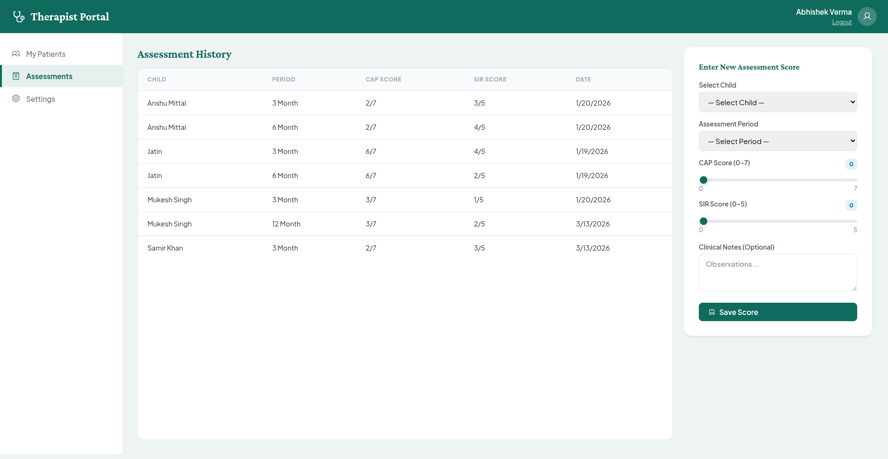
🌐 Web Dashboard — Therapist Portal
👤 Patient Management
📈 CAP / SIR Scoring
📊 Settings Page

Slide 10
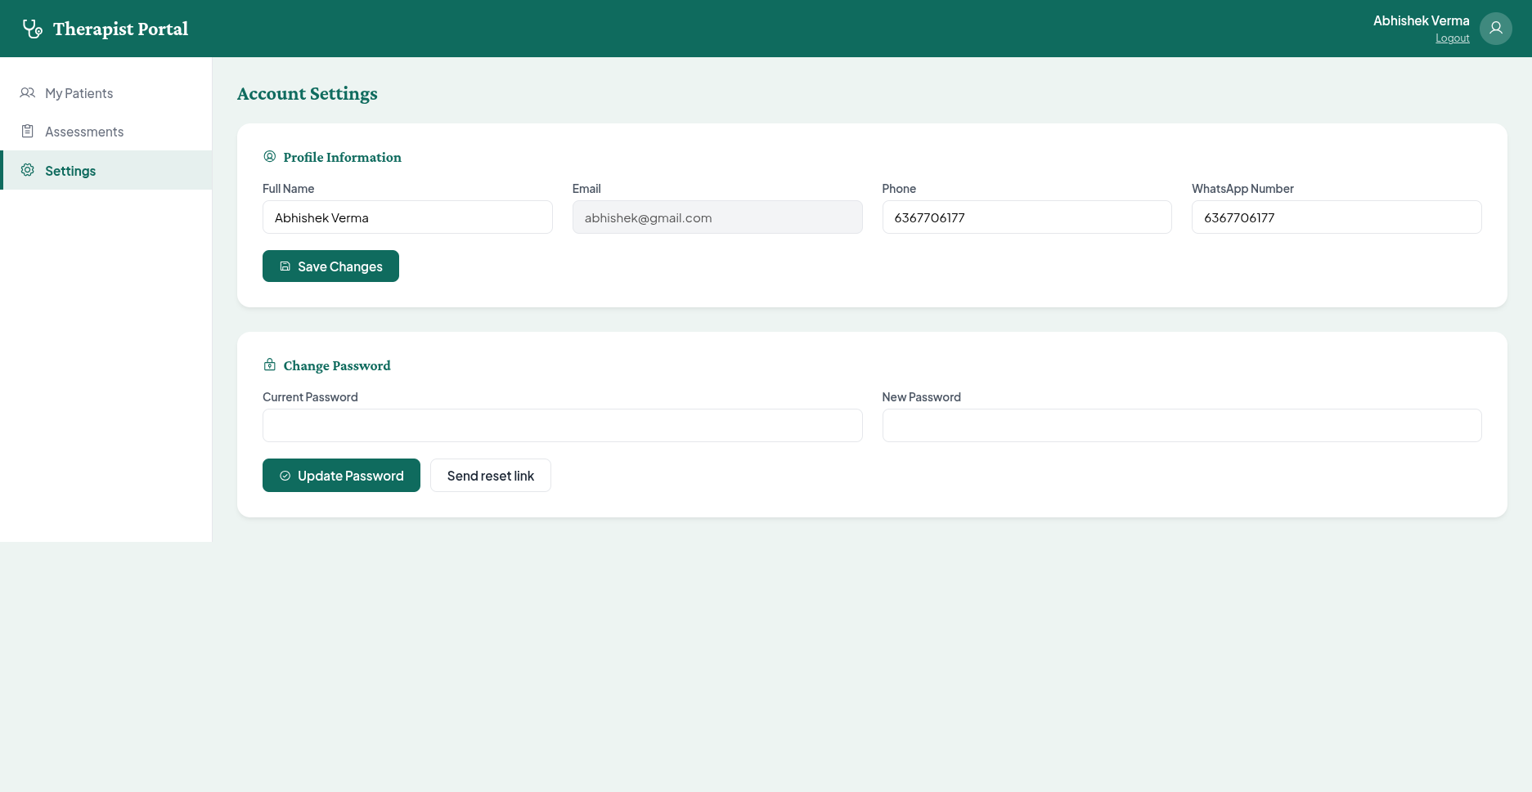
🌐 Web Dashboard — Therapist Portal
👤 Patient Management
📈 CAP / SIR Scoring
📊 Settings Page

Slide 11
⚙️ Tech Stack
🤖
▶️
🔥
Kotlin +
Jetpack Compose
Jetpack
Media3
Firebase
Firestore
Android App UI & Logic
Video Playback
Real-time Database
🔐
📊
🌐
Firebase
Auth
Firebase
Storage
HTML · CSS
· JavaScript
Role-based Login
Video and data storage
Web Dashboard

Slide 12
Expected Outcomes
Gamified therapy path keeps children engaged and following the correct learning order
🎮
Parents see live progress — streaks, stage completion & quiz scores — no manual input needed
📱
Therapists record CAP/SIR scores and view interactive charts across 3, 6 & 12 months
📈
Firebase syncs all data in real time — zero paper records, zero admin overhead
☁️

Slide 13
Thank You! 🎉
Sound for Silence
A digital therapy companion for cochlear implant children
Arya Institue of Engieering Technology and Managment, Jaipur
B.Tech CSE · May 2026
Firebase + Kotlin + Web
Abhishek Verma · Shekhar Chaurasiya · Sakshi Puria · Abhishek Rathore

