Slide 1
Streamlit, pip, venv
최선경

Slide 2
Streamlit
https://streamlit.io/
https://docs.streamlit.io/get-started

Slide 3
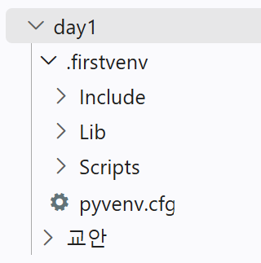
E:\agent26_DayByDay\day1>python –version
Python 3.12.0
E:\agent26_DayByDay\day1>dir
Volume in drive E is 새 볼륨
Volume Serial Number is 9A5B-7F56
Directory of E:\agent26_DayByDay\day1
2026-08-31 오후 01:40 <DIR> .
2026-08-31 오후 01:40 <DIR> ..
2026-08-31 오후 01:43 <DIR> 교안
0 File(s) 0 bytes
3 Dir(s) 958,162,755,584 bytes free
E:\agent26_DayByDay\day1>python -m venv .firstvenv

Slide 4
파이썬 가상환경 활성화와 비활성화
E:\agent26_DayByDay\day1>.firstvenv\Scripts\activate.bat
(.firstvenv) E:\agent26_DayByDay\day1>
개발하기 ~~~블라브라~~~
(.firstvenv) E:\agent26_DayByDay\day1>.firstvenv\Scripts\deactivate.bat
E:\agent26_DayByDay\day1>

Slide 5
가상환경 생성 및 stremlit 실행
E:\agent26_DayByDay\day1>.firstvenv\Scripts\activate.bat
(.firstvenv) E:\agent26_DayByDay\day1>
(.firstvenv) E:\agent26_DayByDay\day1>pip install streamlit
Collecting streamlit …

Slide 6
(.firstvenv) E:\agent26_DayByDay\day1>pip list
(.firstvenv) E:\agent26_DayByDay\day1>python -m streamlit run ex2_st.py
2026-09-02 00:16:35.256 Uvicorn server started on :::8501
You can now view your Streamlit app in your browser.
Local URL: http://localhost:8501
Network URL: http://192.168.0.115:8501
Help agents write better Streamlit apps?
Install the official Streamlit skills by running streamlit skills in your terminal.

Slide 7
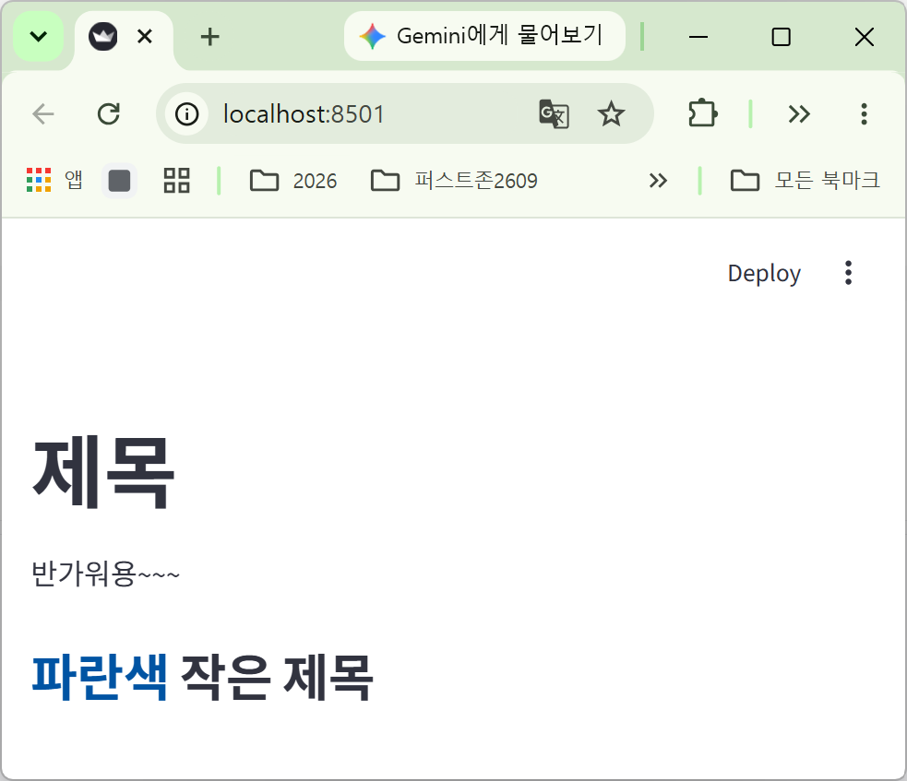
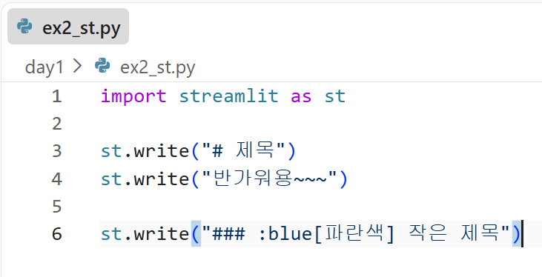
결과

