Slide 1
Streamlit, uv, venv
최선경

Slide 2
Streamlit
https://streamlit.io/
https://docs.streamlit.io/get-started

Slide 3
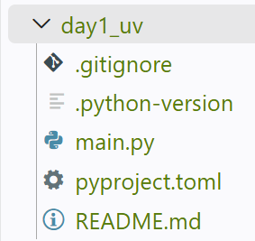
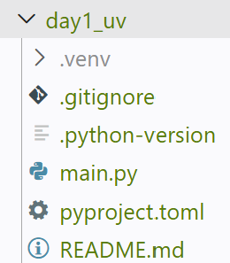
E:\agent26_DayByDay\day1_uv>python –version
Python 3.12.0
E:\agent26_DayByDay\day1_uv>uv init
Initialized project `day1-uv`
E:\agent26_DayByDay\day1_uv>uv venv
Using CPython 3.12.11
Creating virtual environment at: .venv
Activate with: .venv\Scripts\activate

Slide 4
가상환경 생성 및 stremlit 실행
E:\agent26_DayByDay\day1_uv>.venv\Scripts\activate.bat
(day1_uv) E:\agent26_DayByDay\day1_uv>
(day1_uv) E:\agent26_DayByDay\day1_uv>uv add streamlit
Resolved 39 packages in 510ms
Prepared 1 package in 417ms
░░░░░░░░░░░░░░░░░░░░ [0/38] Installing wheels...

Slide 5
(day1_uv) E:\agent26_DayByDay\day1_uv>uv tree
Resolved 39 packages in 3ms
day1-uv v0.1.0
└── streamlit v1.62.0
├── altair v6.2.2
│ ├── jinja2 v3.1.6
│ │ └── markupsafe v3.0.3
│ ├── jsonschema v4.26.0
│ │ ├── attrs v26.1.0
│ │ ├── jsonschema-specifications v2025.9.1
│ │ │ └── referencing v0.37.0
│ │ │ ├── attrs v26.1.0
│ │ │ ├── rpds-py v2026.6.3
│ │ │ └── typing-extensions v4.16.0
│ │ ├── referencing v0.37.0 (*)
│ │ └── rpds-py v2026.6.3
│ ├── narwhals v2.25.0
│ ├── packaging v26.3
│ └── typing-extensions v4.16.0
├── anyio v4.14.2
│ ├── idna v3.19
│ └── typing-extensions v4.16.0
├── blinker v1.9.0
├── click v8.5.0
├── httptools v0.8.0
├── itsdangerous v2.2.0
├── numpy v2.5.2
├── packaging v26.3
├── pandas v3.0.5
│ ├── numpy v2.5.2
│ ├── python-dateutil v2.9.0.post0
│ │ └── six v1.17.0
│ └── tzdata v2026.3
├── pillow v12.3.0
├── protobuf v7.36.1
├── pyarrow v25.0.1
├── pydeck v0.9.3
│ ├── jinja2 v3.1.6 (*)
│ └── numpy v2.5.2
├── python-multipart v0.0.32
├── requests v2.34.2
│ ├── certifi v2026.7.22
│ ├── charset-normalizer v3.5.1
│ ├── idna v3.19
│ └── urllib3 v2.7.0
├── starlette v1.6.0
│ ├── anyio v4.14.2 (*)
│ └── typing-extensions v4.16.0
├── toml v0.10.2
├── typing-extensions v4.16.0
├── uvicorn v0.52.4
│ ├── click v8.5.0
│ └── h11 v0.16.0
├── watchdog v6.0.0
└── websockets v16.1.1
(*) Package tree already displayed

Slide 6
(day1_uv) E:\agent26_DayByDay\day1_uv>uv run streamlit run test.py
2026-09-01 23:20:05.764 Uvicorn server started on :::8501
You can now view your Streamlit app in your browser.
Local URL: http://localhost:8501
Network URL: http://192.168.0.115:8501
Help agents write better Streamlit apps?
Install the official Streamlit skills by running streamlit skills in your terminal.

Slide 7
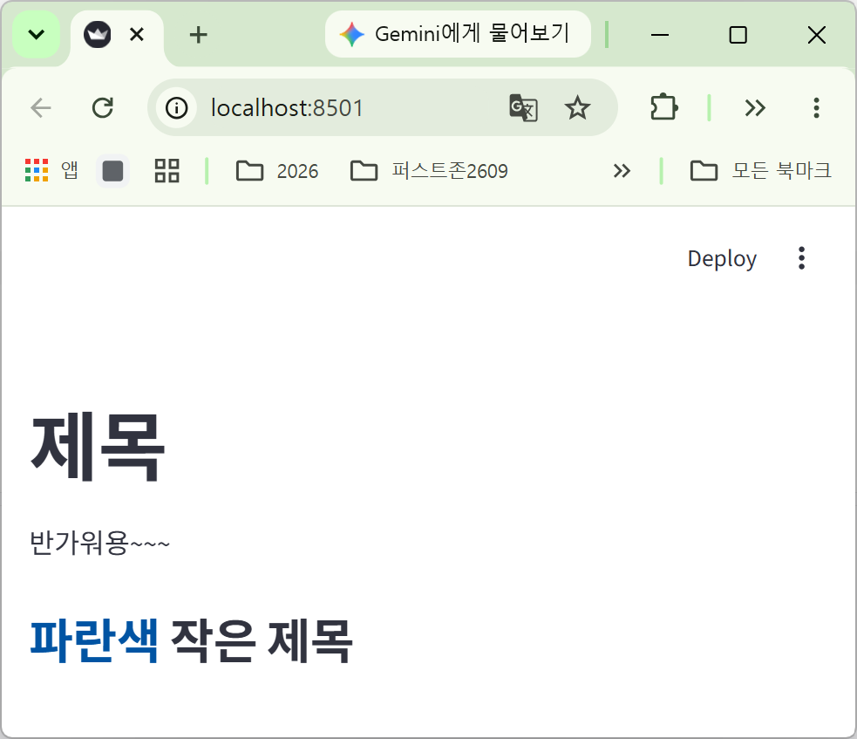
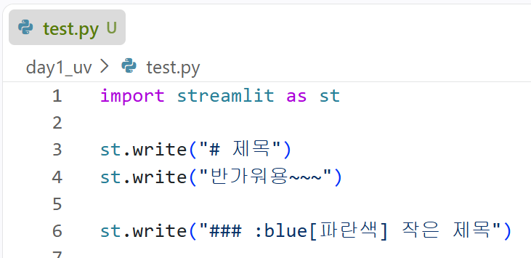
결과

