Slide 1
Dictionary Web Application
College Project Presentation
Aditya Raj

Slide 2
Introduction
A web-based dictionary application
Allows users to search English words
Displays meaning, part of speech, phonetics, and pronunciation
Designed for beginner-level understanding

Slide 3
Technologies Used
HTML – Structure of the application
CSS – Styling and responsive UI
JavaScript – Logic and API handling
VS Code – Code editor
GitHub – Version control and hosting

Slide 4
Project Features
Word search functionality
Meaning and part of speech display
Phonetic pronunciation
Audio pronunciation button
Error handling for invalid inputs

Slide 5
API Integration Details
API Name: Free Dictionary API
Base URL: https://api.dictionaryapi.dev/api/v2/entries/en/<word>
Data fetched using JavaScript fetch()
Handles successful and error responses

Slide 6
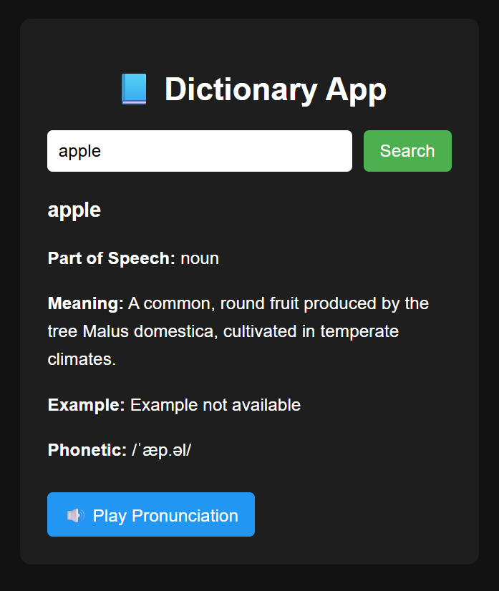
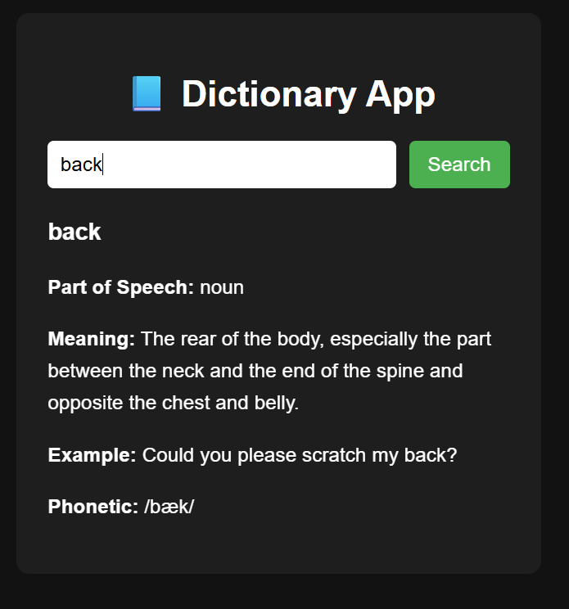
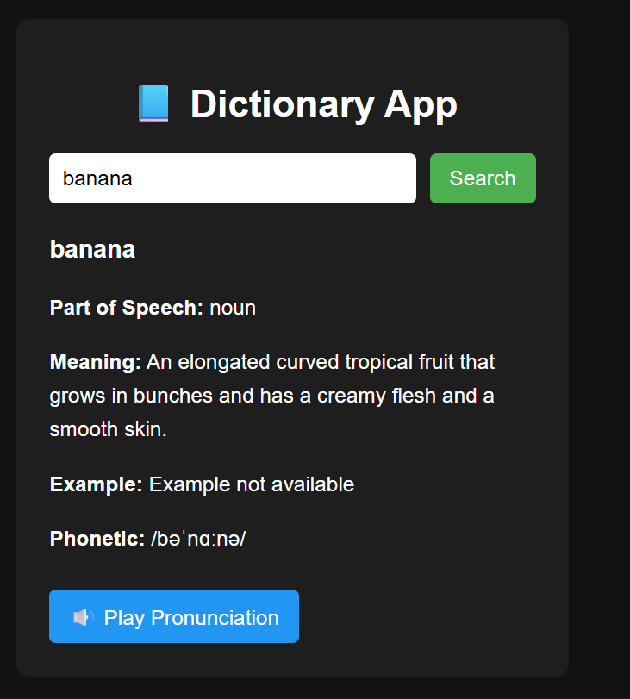
UI Screenshots

Slide 7
Deployment Details
Hosting Platform: GitHub Pages
Project developed using VS Code
Live Project URL: https://adityaraj-coder-creator.github.io/Dictionary-Website/
GitHub Repository URL: https://github.com/adityaraj-coder-creator/Dictionary-Website

Slide 8
Future Enhancements
Add synonym and antonym support
Support for multiple meanings
Improve UI with animations
Add dark/light mode toggle

