Slide 1

Dynamic Warp Formation and Scheduling for
Efficient GPU Control Flow
Wilson W. L. Fung
Ivan Sham
George Yuan
Tor M. Aamodt
Electrical and Computer Engineering
University of British Columbia
Micro-40 Dec 5, 2007

Slide 2

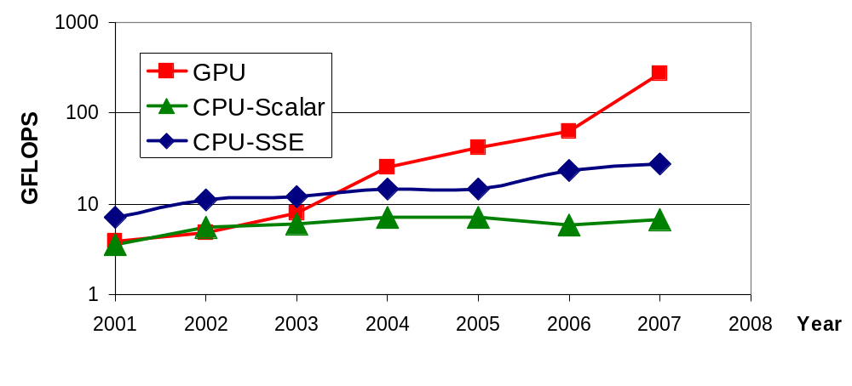
Motivation =
GPU: A massively parallel architecture
  SIMD pipeline: Most computation out of least silicon/energy
Goal: Apply GPU to non-graphics computing
  Many challenges
  This talk: Hardware Mechanism for Efficient Control Flow

Slide 3

Programming Model
Modern graphics pipeline
CUDA-like programming model
  Hide SIMD pipeline from programmer
  Single-Program-Multiple-Data (SPMD)
  Programmer expresses parallelism using threads
  ~Stream processing
OpenGL/
DirectX
Vertex
Shader
Pixel
Shader

Slide 4
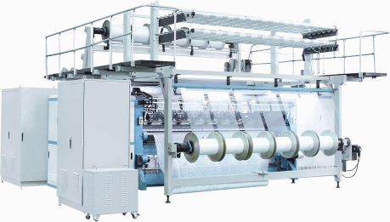
Programming Model
Warp = Threads grouped into a SIMD instruction
From Oxford Dictionary:
  Warp: In the textile industry, the term “warp” refers to “the threads stretched lengthwise in a loom to be crossed by the weft”.

Slide 5
The Problem: Control flow
GPU uses SIMD pipeline to save area on control logic.
  Group scalar threads into warps
Branch divergence occurs when threads inside warps branches to different execution paths.
Branch
Path B
Path A
Branch
Path A
Path B
50.5% performance loss with SIMD width = 16

Slide 6
Dynamic Warp Formation
Consider multiple warps
Opportunity?
Branch
Path B
Path A
Branch
Path A
20.7% Speedup with 4.7% Area Increase

Slide 7
Outline
Introduction
Baseline Architecture
Branch Divergence
Dynamic Warp Formation and Scheduling
Experimental Result
Related Work
Conclusion

Slide 8
Baseline Architecture
CPU
spawn
Shader
Shader
Shader
GPU
Core
Core
Core
done
Interconnection Network
CPU
Memory
Memory
Memory
CPU
spawn
Controller
Controller
Controller
GPU
GDDR3
GDDR3
GDDR3
Time

Slide 9
Baseline Architecture
CPU
spawn
Shader
Shader
Shader
GPU
Core
Core
Core
done
Interconnection Network
CPU
Memory
Memory
Memory
CPU
spawn
Controller
Controller
Controller
GPU
GDDR3
GDDR3
GDDR3
Time

Slide 10
SIMD Execution of Scalar Threads
All threads run the same kernel
Warp = Threads grouped into a SIMD instruction
Thread Warp 3
Thread Warp 8
Thread Warp
Common PC
Scalar
Scalar
Scalar
Scalar
Thread Warp 7
Thread
Thread
Thread
Thread
W
X
Y
Z
SIMD Pipeline

Slide 11
Latency Hiding via
Fine Grain Multithreading
Interleave warp execution to hide latencies
Register values of all threads stays in register file
Need 100~1000 threads
  Graphics has millions of pixels
Thread Warp 3
Threads available
Thread Warp 8
for scheduling
Thread Warp 7
SIMD Pipeline
I-Fetch
Decode
R
R
R
F
F
F
Threads accessing
A
A
A
memory hierarchy
L
L
L
U
U
U
Miss?
D-Cache
Thread Warp 1
All Hit?
Data
Thread Warp 2
Writeback
Thread Warp 6

Slide 12
SPMD Execution on SIMD Hardware:
The Branch Divergence Problem
C
E
B
Thread Warp
Common PC
G
D
A
Thread
1
Thread
2
Thread
3
Thread
4
F

Slide 13
Baseline: PDOM
Stack
A/1111
C
Reconv. PC
Next PC
Active Mask
TOS
TOS
TOS
TOS
-
-
-
-
-
-
-
G
E
A
E
B
E
E
1111
1111
1111
1111
1111
1111
1111
E
B
TOS
E
E
E
D
D
D
0110
0110
0110
B/1111
TOS
TOS
E
E
C
E
1001
1001
G
D
A
C/1001
D/0110
Thread Warp
Common PC
E/1111
F
Thread
1
Thread
2
Thread
3
Thread
4
G/1111
A
B
C
D
E
G
A
Time

Slide 14
Dynamic Warp Formation: Key Idea
Idea: Form new warp at divergence
  Enough threads branching to each path to create full new warps

Slide 15
Dynamic Warp Formation: Example
A
x/1111
y/1111
Legend
B
A
A
x/1110
y/0011
Execution of Warp x
Execution of Warp y
at Basic Block A
at Basic Block A
C
x/1000
D
x/0110
F
x/0001
y/0010
y/0001
y/1100
D
E
A new warp created from scalar threads of both Warp x and y executing at Basic Block D
x/1110
y/0011
G
x/1111
y/1111
A
A
B
B
C
C
D
D
E
E
F
F
G
G
A
A
Baseline
Time
Dynamic
Warp
Formation
A
A
B
B
C
D
E
E
F
G
G
A
A
Time

Slide 16
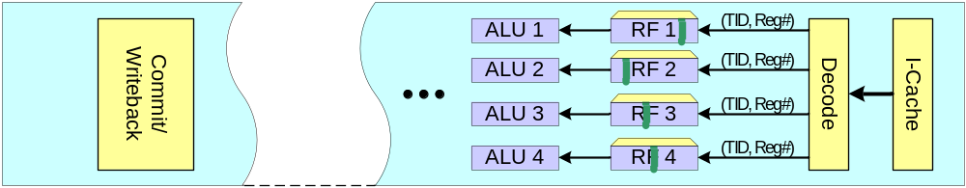
Dynamic Warp Formation:
Hardware Implementation
A: BEQ R2, B
C: …
Thread Scheduler
PC-Warp LUT
Warp Pool
I
Warp Update Register T
B
s
B
0110
0010
0
2
A
B
B
1
s
5
2
2
2
3
3
3
4
PC
OCC
IDX
PC
TID x N
8
Prio
u
TID x N
5
2
7
3
8
1011
0110
B
REQ
B
e
PC A
H
C
C
1001
1101
1
1
A
C
PC
OCC
IDX
C
PC
TID x N
Prio
5
1
6
6
7
8
4
L
Warp Update Register NT
B
o
PC
TID x N
Prio
7
g
1
6
4
0100
i
1001
C
TID x N
REQ
C
c
PC B
H
X
Warp Allocator
Y
X
Y
X
Y
Z
X
Y
Z
X
Y
Z
1
5
1
5
1
5
5
1
5
5
1
5
5
2
6
2
6
2
6
2
2
6
2
2
6
2
3
7
3
7
3
7
3
3
7
3
3
7
3
4
8
4
8
4
8
8
4
8
8
4
8
8
No Lane Conflict

Slide 17
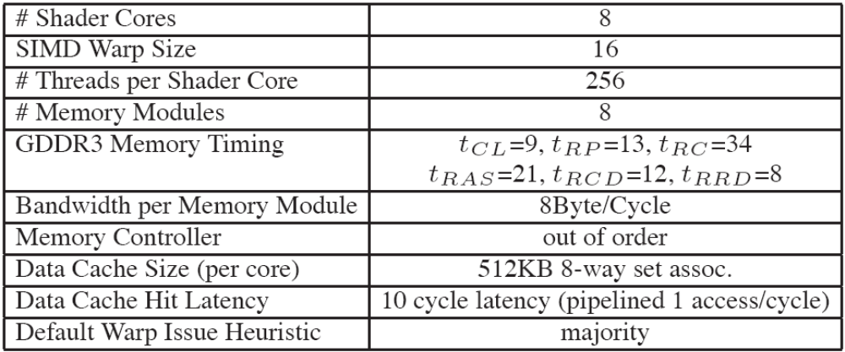
Methodology
Created new cycle-accurate simulator from SimpleScalar (version 3.0d)
Selected benchmarks from SPEC CPU2006, SPLASH2, CUDA Demo
  Manually parallelized
  Similar programming model to CUDA

Slide 18
Experimental Results
128
Baseline: PDOM
112
Dynamic Warp Formation
MIMD
96
80
IPC
64
48
32
16
0
hmmer
lbm
Black
Bitonic
FFT
LU
Matrix
HM

Slide 19
Dynamic Warp Scheduling
128
Baseline
112
DMaj
96
DMin
DTime
80
DPdPri
IPC
DPC
64
48
32
16
0
hmmer
lbm
Black
Bitonic
FFT
LU
Matrix
HM
Lane Conflict Ignored (~5% difference)

Slide 20
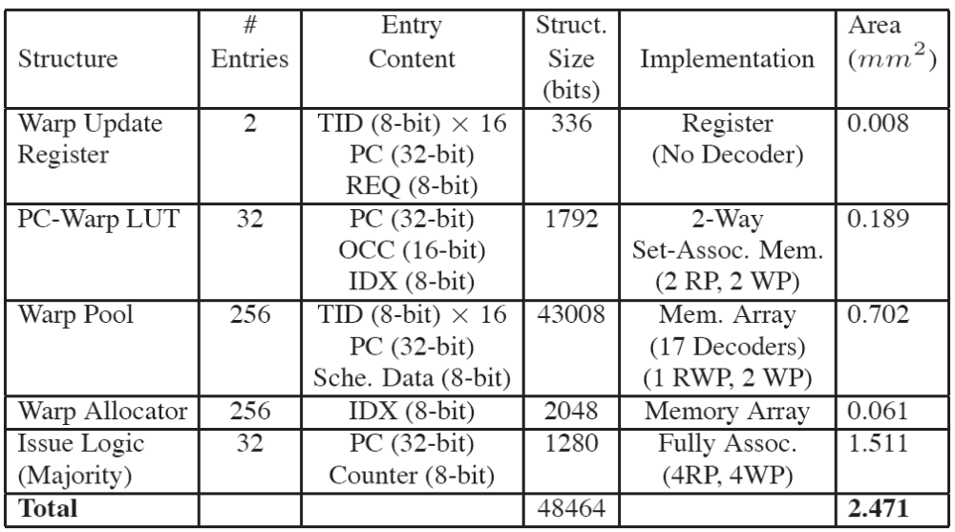
Area Estimation
CACTI 4.2 (90nm process)
Size of scheduler = 2.471mm²
8 x 2.471mm² + 2.628mm² = 22.39mm²
  4.7% of Geforce 8800GTX (~480mm²)

Slide 21
Related Works
Predication
  Convert control dependency into data dependency
Lorie and Strong
  JOIN and ELSE instruction at the beginning of divergence
Cervini
  Abstract/software proposal for “regrouping”
  SMT processor
Liquid SIMD (Clark et al.)
  Form SIMD instructions from scalar instructions
Conditional Routing (Kapasi)
  Code transform into multiple kernels to eliminate branches

Slide 22
Conclusion
Branch divergence can significantly degrade a GPU’s performance.
  50.5% performance loss with SIMD width = 16
Dynamic Warp Formation & Scheduling
  20.7% on average better than reconvergence
  4.7% area cost
Future Work
  Warp scheduling – Area and Performance Tradeoff

Slide 23
Thank You.
Questions?

Slide 24
Shared Memory
Banked local memory accessible by all threads within a shader core (a block)
Idea: Break Ld/St into 2 micro-code:
  Address Calculation
  Memory Access
After address calculation, use bit vector to track bank access just like lane conflict in the scheduler

