Slide 1
Team: Cyber Calliphate
Saurabh Prasad (Team Leader)
Akanksha Raikwar .

Slide 2
Problem Statement
Create One Add-on that perform to hold any link comment box & click submit button so new tab open these link

Slide 3
Solution
We have created an add-on named “Magic Link Opener” which will provide a rich interface to the user to open any web links & also they can store unlimited links.
It is very simple, easy to use & has interactive interface.

Slide 4
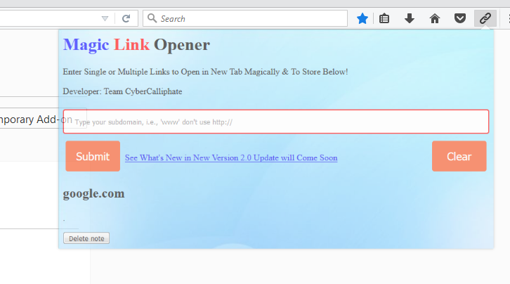
How to use our Add-on
Let Me Show the Live Demo…

Slide 5
Unique Features of Our Addon
Interactive & Elegant Interface
Easy to Use
Fast & Reliable
Additional Features Like Permanent Saving / Removing Link Anytime.

Slide 6
Future Implementation
WHAT'S NEW IN VERSION MAGIC LINK OPENER 2.0
Auto Suggestion on typing
Multiple Link Support at Once
Few Bug Fixes
Surprising Features

Slide 7
Thank You

