Slide 1
Inventory Management System User’s Guide
1.0 Introduction
2.0 Setup
3.0 Sign In
4.0 Dashboard
5.0 Inventory
6.0 Transactions
7.0 Tables
8.0 Audit Log

Slide 2

1.0 Introduction
The Inventory Management System is consisting of the following modules:
a. Dashboard
The main screen to show the summary of the items overviews statistics and also
also show the items below minimum level.
Inventory
The inventory module allows add / edit / delete of item. It also keep track of :
* item details
* item history record including in , out and adjust transactions.
* item onorder history
* item expiry lot details
Transactions
The transaction modules consist of :
* Purchase
- record all purchases and returns.
* Sales
- record all sales and returns
* Adjustment
- record all stock adjustment transactions
Reports
List of reports such as item listing, item onhand , etc.
Tables
The tables show the maintenance of group tables, user tables.
Under all data tables, the following functions are available as follows:
To add new record
To edit existing record
To delete existing record.
To export to text file.
To export to PDF file.
To export to Excel file.

Slide 3


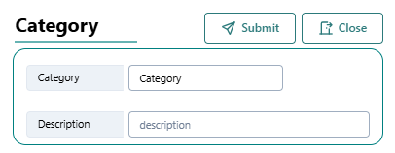
At the right-hand upper corner of all data tables, you will see these functions in below:
To search for any string found in all fields inside the table.
To show / hide filters for each fields
To show / hide columns inside the table
To toggle density of the table
To toggle full screen
Inside the form, , the search icon beside the field will allow the user to select a particular record from the pop-up search table. The selected record will automatically show in the respective fields.
Inside the form, if there is selection field, the beside the selection field will allow the user to enter new selection as below:
The new selection will show in the drop-down box.

Slide 4
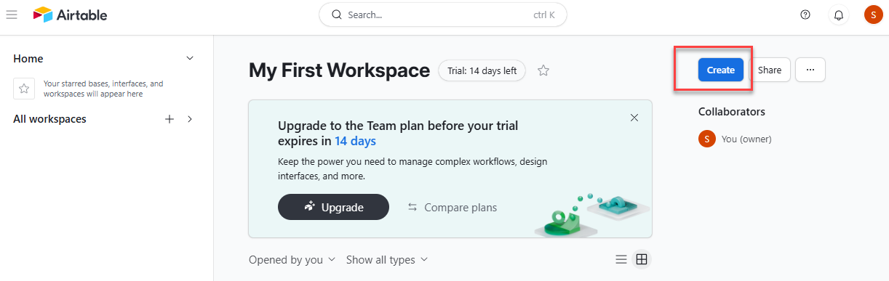
2.0 Setup
Copy and unzip the imssource.zip to your local folder called ims.
Make sure you have Node.js v18 installed. If not, please goto Nodejs download and install. To check your current version, just type node –v at your command prompt.
Goto command prompt. Change to ims folder and type npm install to install the respective libraries.
Before you could run the inventory management system, you need to sign up with Netlify and Airtable. Please refer to the below sections on how to sign up with them. Once you have the airtable id key and base id key, you will need to update .env file
Once done, you can run from your local folder by typing npm run netlify,
2.1 Airtable
Once you have signed up with Airtable, you will need to create a new base and just name your base such as imsdata.

Slide 5
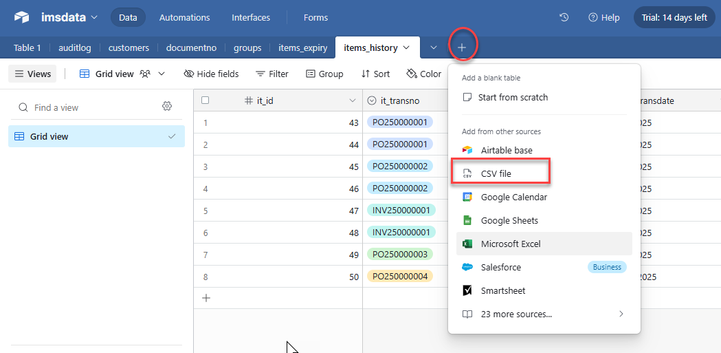
Unzip the data.zip file in your download attachment. The zip file is consisting of the following tables:
No | CSV files | Table Name
1 | auditlog-Grid view.csv | auditlog
2 | customers-Grid view.csv | customers
3 | documentno-Grid view.csv | documentno
4 | groups-Grid view.csv | groups
5 | items_expiry-Grid view.csv | items_expiry
6 | items_history-Grid view.csv | items_history
7 | items-Grid view.csv | items
8 | setup-Grid view.csv | setup
9 | stocktake-Grid view.csv | stocktake
10 | suppliers-Grid view.csv | suppliers
11 | tranadjdetls-Grid view.csv | tranadjdetls
12 | tranadj-Grid view.csv | tranadj
13 | trans-Grid view.csv | trans
14 | transitems-Grid view.csv | transitems
15 | translots-Grid view.csv | translots
16 | users-Grid view.csv | users
Click on the + sign and select CSV file.

Slide 6
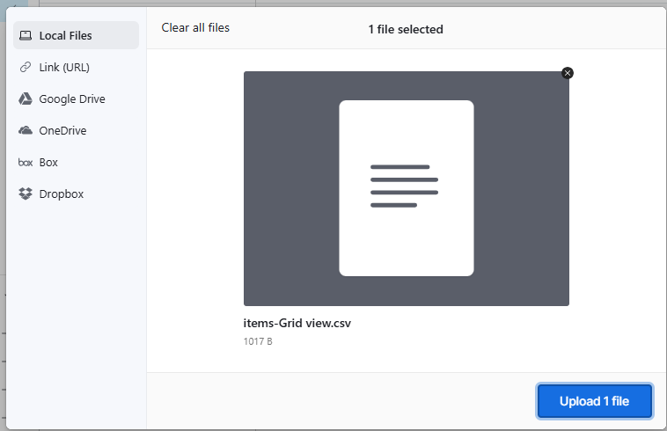
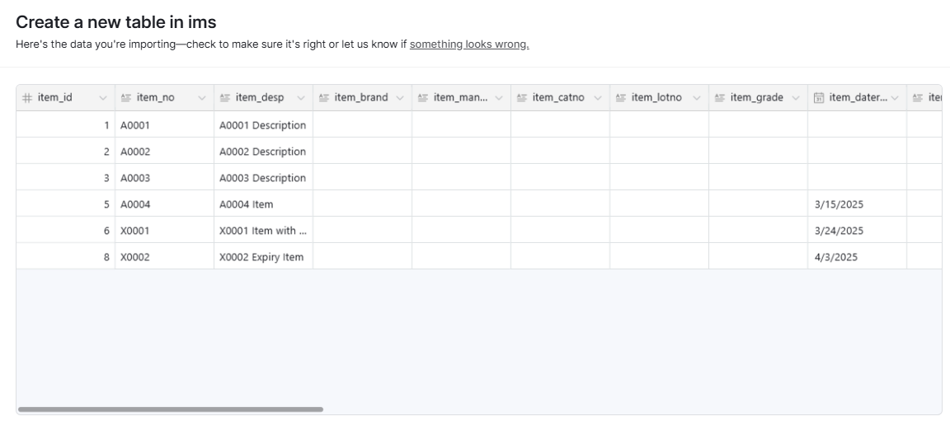
Click on Upload 1 file button to upload and select “+ Create a new table” and click Next button. Then click on Import button to import data.
Please refer to the Table Structure.xlsx file to check and update the fields type accordingly.
Once imported, change the imported table name by double click and change to the respective table name as shown in the table. Example for items-Grid view.csv, the table name is items.
Import all the CSV files and name the table accordingly.

Slide 7
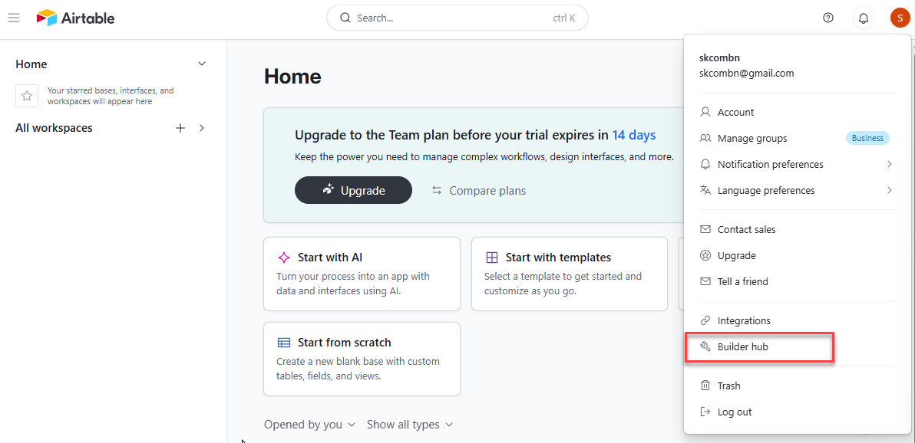
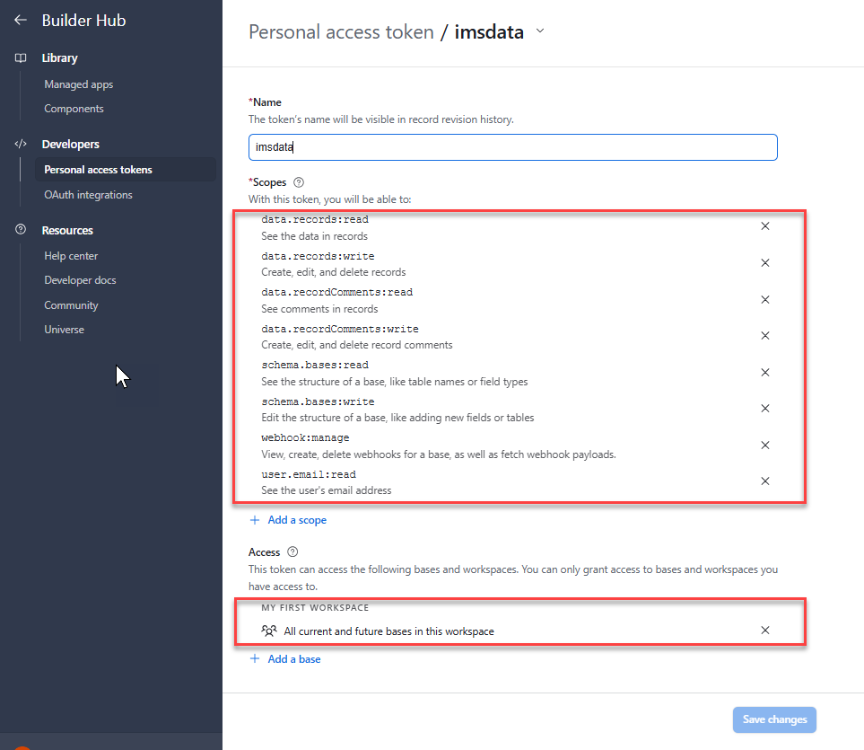
2.1.1 Airtable – Personal Access Token
In order to inregrate Airtable into React application, you will need to create a personal access token.
With Airtable open, click on your account in the uppder right corner of the screen. From the dropdown menu, click on Builder hub.
Under API key, click on Create Token button. Make sure you have included all the scopes as listed in below under Scope settings. Add your base under the Access section.

Slide 8
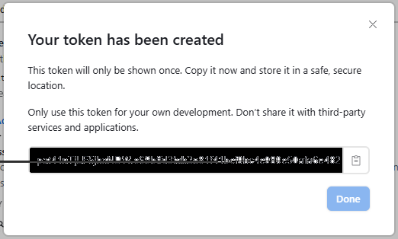
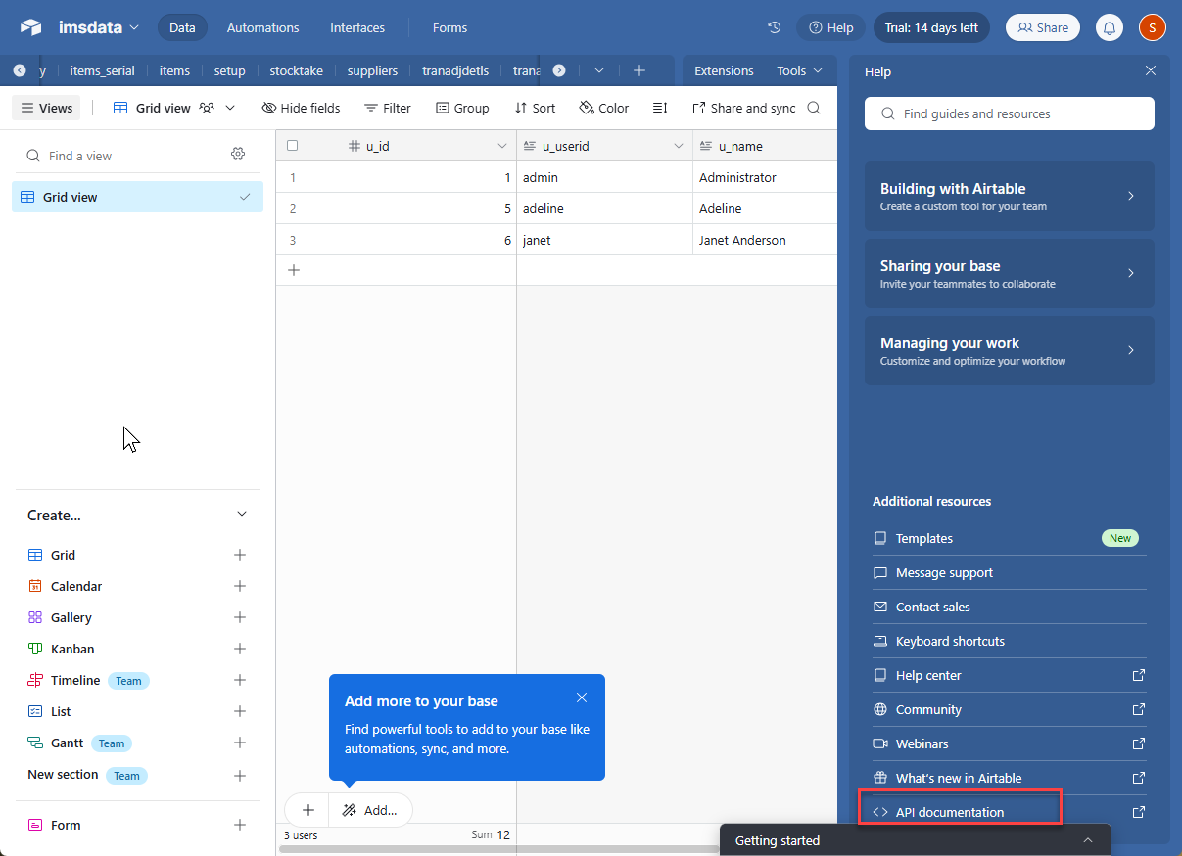
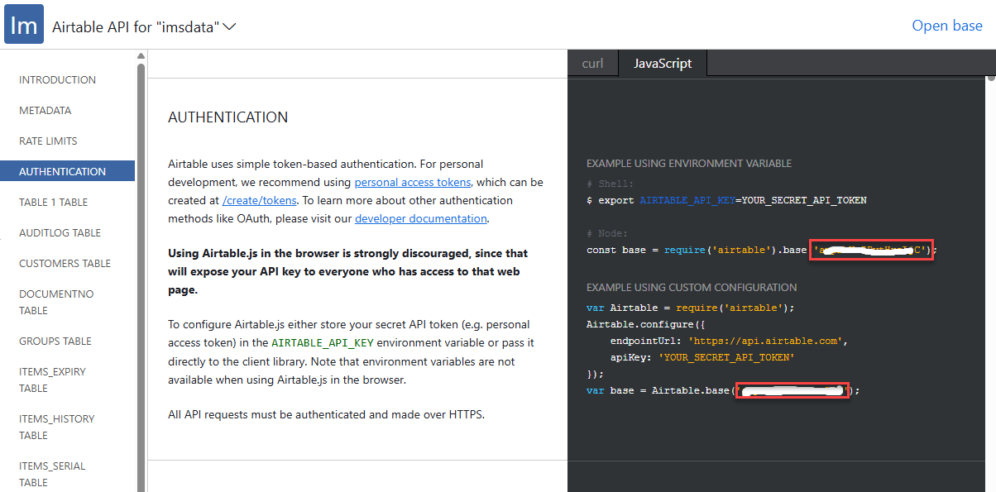
Select the respective selection under Scopes and Access and then click on Create Token button. Copy and save your personal access token which will need to be used in your React application.
2.1.1 Airtable – Base Id key
Open your base for example imsdata in Airtable. Goto Help and select API documentation from the dropdown menu.
Copy and save your base id key highlighted inside the box in below. You will need this base id key in your React application.

Slide 9
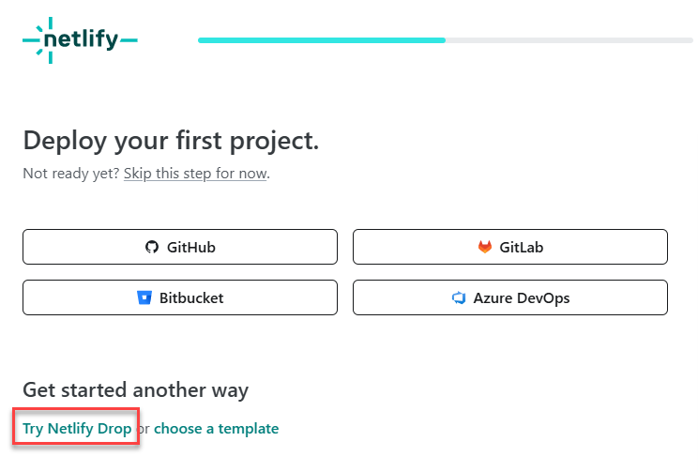
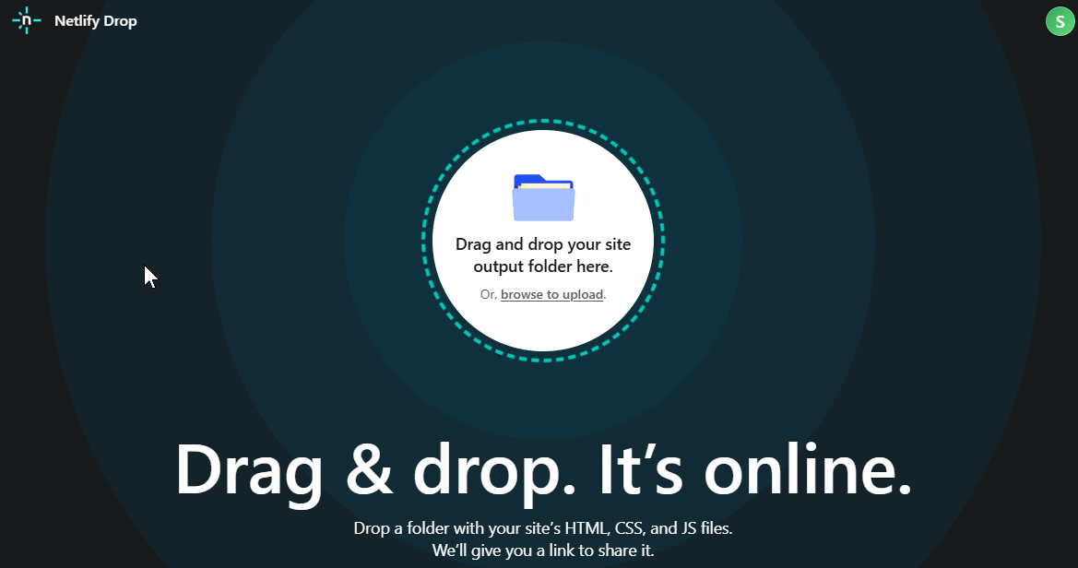
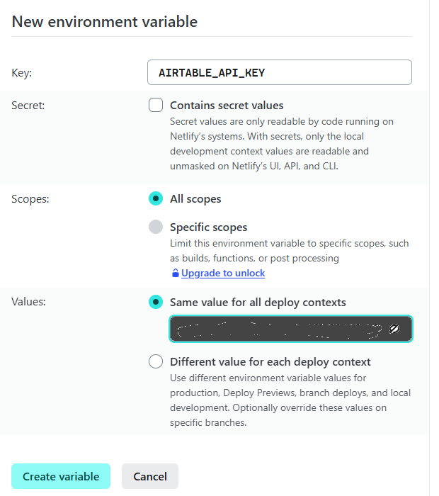
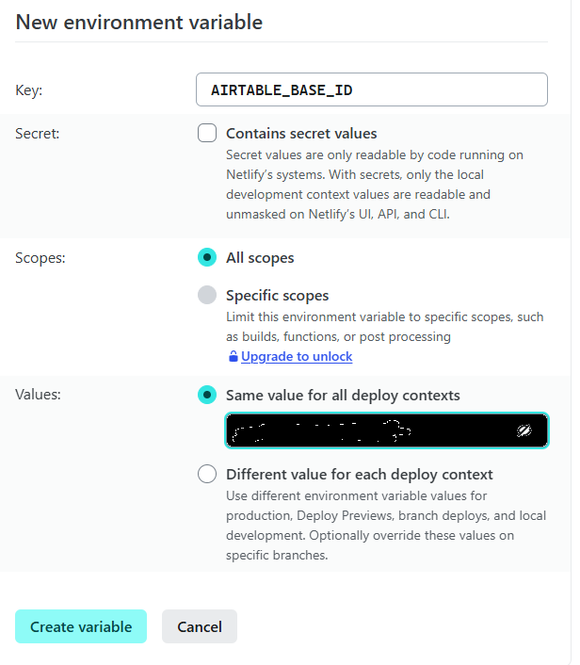
2.2 Deploy to Netlify
Sign up a new Netlify account under www.Netlify.com. To create your first project, choose Try Netlify Drop method.
Drop your Build folder from your React application into here. Netlify will automatically assign an Netlify.app which you can change the name by clicking on Site Configuration and then goto Change site name to change to your own name.
You will need to add on your environment variables for Airtable integration. Just click on Deploy settings and select Environment variables. Click on Add a variable button to enter the following variables with your own Airtable Api key and Base Id key:
Make sure your Airtable Api Key and Base Id Key are the same as your .env file inside your React application before running Npm Run Build. Then you can access to your Netlify app on your Google Chrome browser.

Slide 10
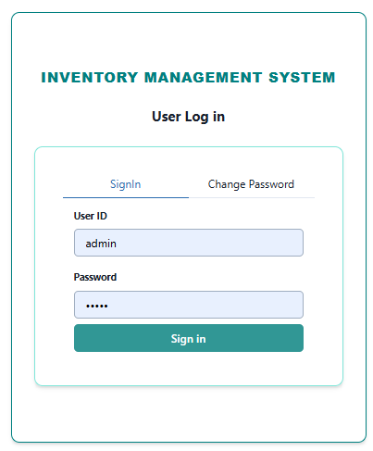
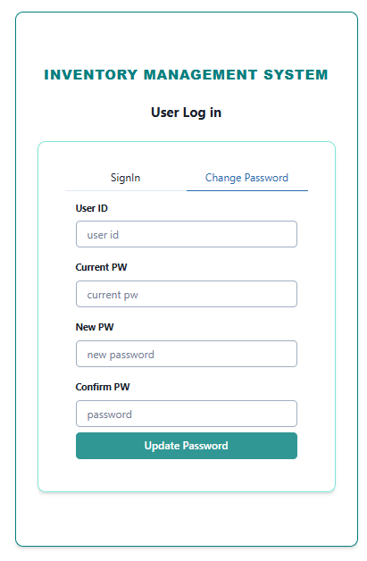
3.0 Sign In
Enter your login id and password given by your administrator and click “Sign In” button to login.
Change Password will allow user to change their current password.

Slide 11
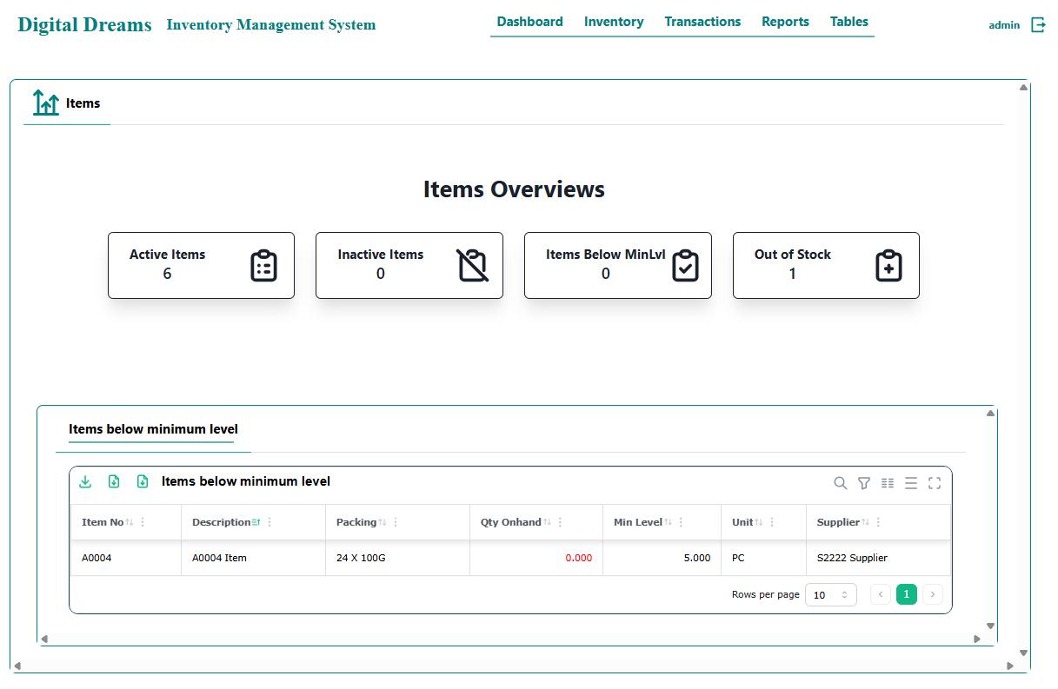
4.0 Dashboard
Dashboard will show the summary of all items including active items, inactive items, items below minimum level and out of stock items.
It also shows those items below minimum level in table form.

Slide 12
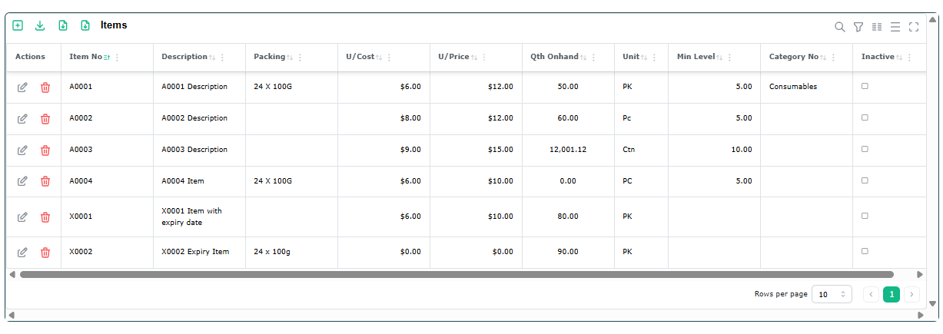
5.0 Inventory
To add new record, click on to add new record.
To edit an existing record, click on respective to edit an existing record.
To delete an existing record, click on respective to delete an existing record.
To export the data table to PDF file, click on to export.
To export the data table to Excel file, click on to export.
To export the data table to Text file, click on to export.
To filter the records inside the table, click on at right-hand corner and enter the search string.

Slide 13
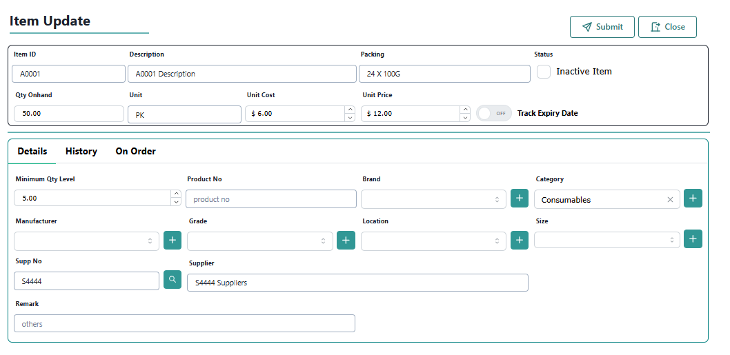
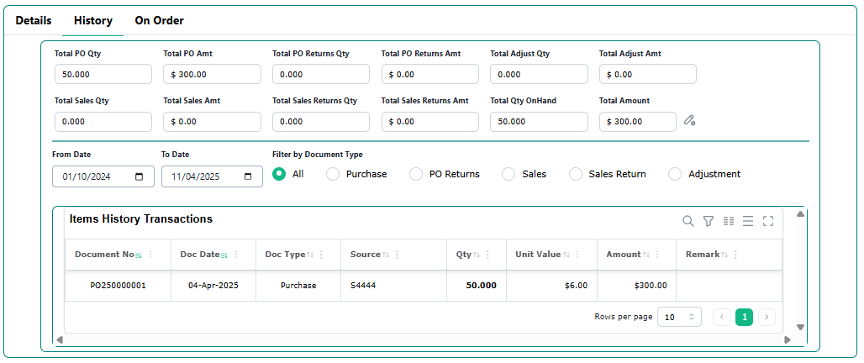
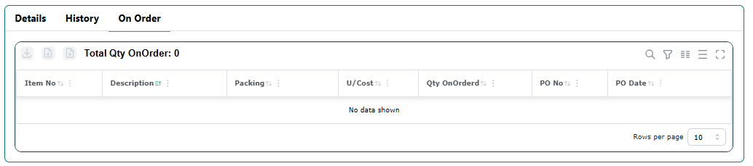
5.1 Item Details
5.2 Item History
5.3 Item On Order

Slide 14
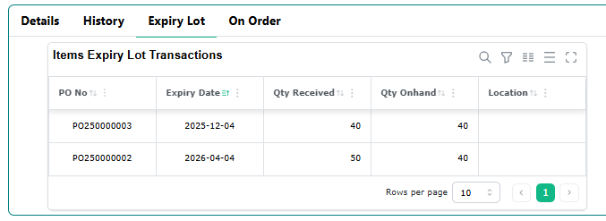

5.4 Item Expiry Lot Table
The Item Expiry Lot Table will only be shown when the selected item is enabled on Track Expiry Date field in Item form as follows

Slide 15
6.0 Transactions
Under Transaction module, there are three selection as follows:
Purchases
In purchases, the user will be able to issue the purchase order and purchase returns.
Sales
In sales, the user will be able to issue sales invoices and sales returns.
Adjustments
In adjustments, the user will be able to create and enter physical stock count
and adjustments to the existing stock on-hand quantity for individual items.

Slide 16
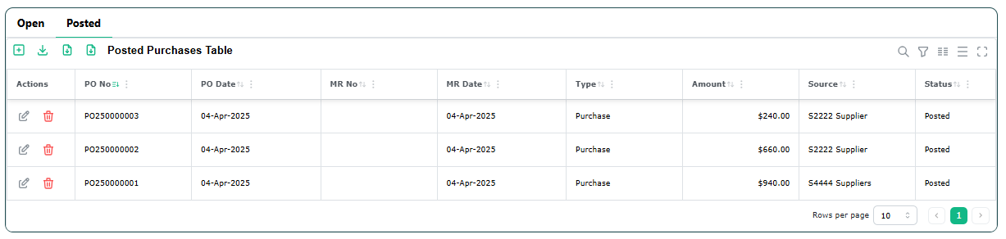


6.1 Purchases
The purchases have been classified into ‘Open’ and ‘Posted’ section.
The ‘Open’ section will show all the unposted purchase transactions. The purchase details will be shown as quantity on-order in individual item history table.
The ‘Posted’ section will show all the posted purchase transactions which mean these purchases have been posted and updated to item history table and item onhand quantity.
To add new record, click on to add new record.
To edit an existing record, click on respective to edit an existing record.
To delete an existing record, click on respective to delete an existing record.
To export the data table to PDF file, click on to export.
To export the data table to Excel file, click on to export.
To export the data table to Text file, click on to export.
To filter the records inside the table, click on at right-hand corner and enter the search string.
At the right-hand top corner of the form, click on :
Click on ‘Submit’ to save and exist the form.
Click on ‘Print’ to print the current form.
Click on ‘Post’ to post the transaction to item history table.
Once posted, the transaction will not be able to edit.
An icon will be shown on the top to indicate this transaction has been posted.
Click on ‘Close’ to exit without saving the form.

Slide 17
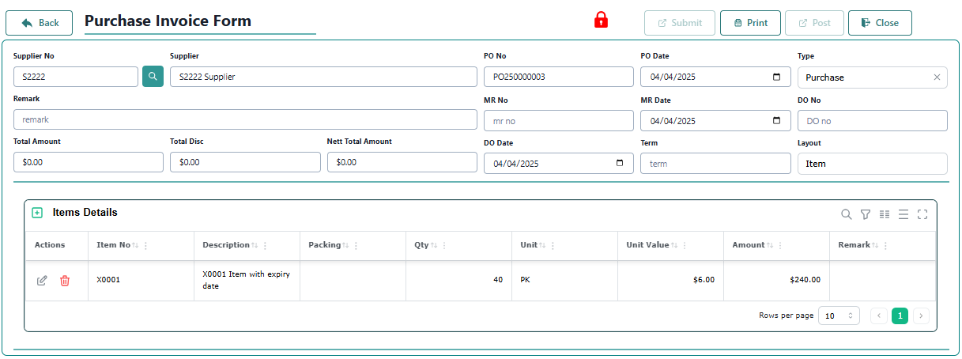
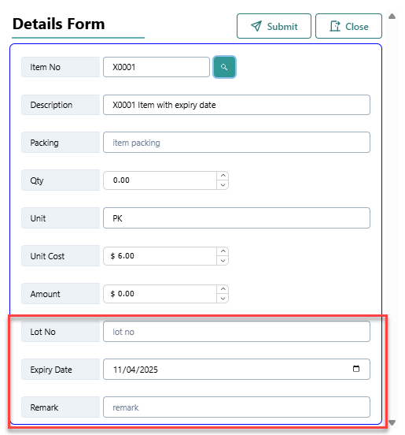
6.1.1 Purchase Form
To add new item in the details form, click on icon to add new details.
To Lot No and Expiry Date will only be shown if the selected item is enabled to track the expiry date.

Slide 18
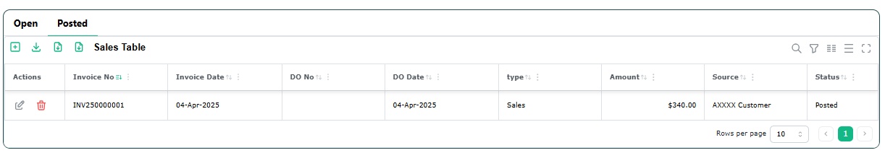
6.2 Sales
The sales have been classified into ‘Open’ and ‘Posted’ section.
The ‘Open’ section will show all the unposted sales transactions.
The ‘Posted’ section will show all the posted sales transactions which mean these sales have been posted and updated to item history table and item on-hand quantity.
To add new record, click on to add new record.
To edit an existing record, click on respective to edit an existing record.
To delete an existing record, click on respective to delete an existing record.
To export the data table to PDF file, click on to export.
To export the data table to Excel file, click on to export.
To export the data table to Text file, click on to export.
To filter the records inside the table, click on at right-hand corner and enter the search string.
At the right-hand top corner of the form, click on :
Click on ‘Submit’ to save and exist the form.
Click on ‘Print’ to print the current form.
Click on ‘Post’ to post the transaction to item history table.
Once posted, the transaction will not be able to edit.
An icon will be shown on the top to indicate this transaction has been posted.
Click on ‘Close’ to exit without saving the form.

Slide 19
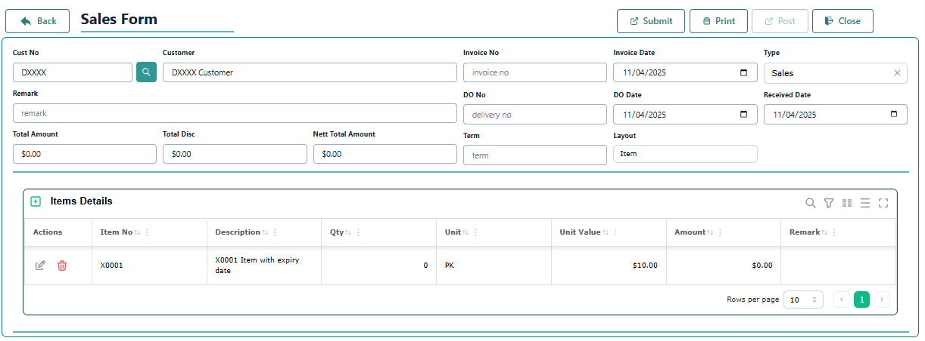
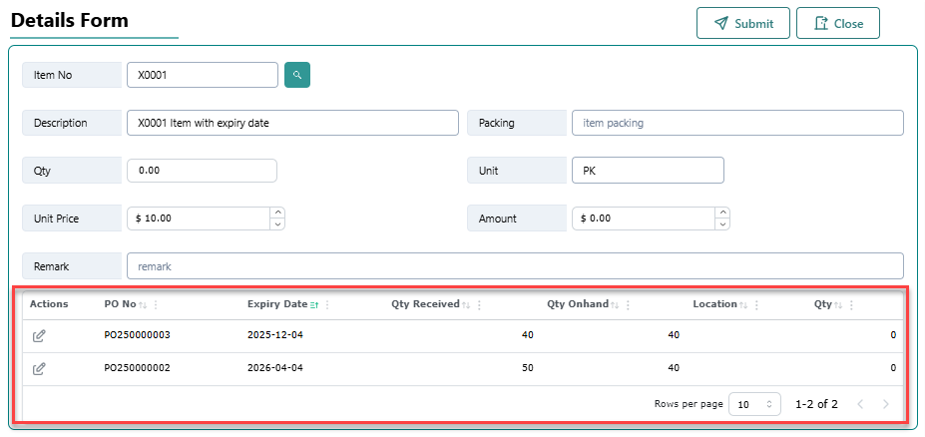
6.2.1 Sales Form
To add new item in the details form, click on icon to add new details.
The Lot Expiry Table will only be shown when the selected item is enabled to track expiry date.
Just click on the icon to enter the sales quantity and click on icon to save the changes.

Slide 20
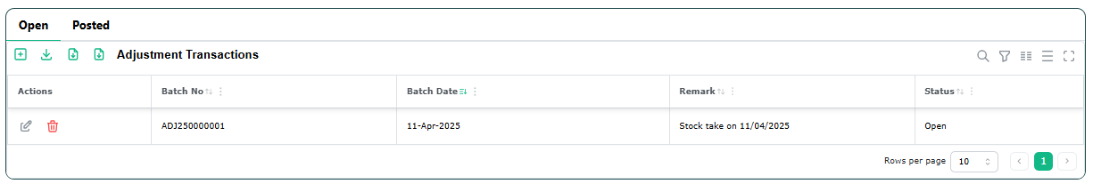
6.3 Adjustments
The adjustments have been classified into ‘Open’ and ‘Posted’ section.
The ‘Open’ section will show all the unposted adjustment transactions.
The ‘Posted’ section will show all the posted adjustment transactions which mean these sales have been posted and updated to item history table and item on-hand quantity.
To add new record, click on to add new record.
To edit an existing record, click on respective to edit an existing record.
To delete an existing record, click on respective to delete an existing record.
To export the data table to PDF file, click on to export.
To export the data table to Excel file, click on to export.
To export the data table to Text file, click on to export.
To filter the records inside the table, click on at right-hand corner and enter the search string.
At the right-hand top corner of the form, click on :
Click on ‘Submit’ to save and exist the form.
Click on ‘Print’ to print the current form.
Click on ‘Post’ to post the transaction to item history table.
Once posted, the transaction will not be able to edit.
An icon will be shown on the top to indicate this transaction has been posted.
Click on ‘Close’ to exit without saving the form.

Slide 21
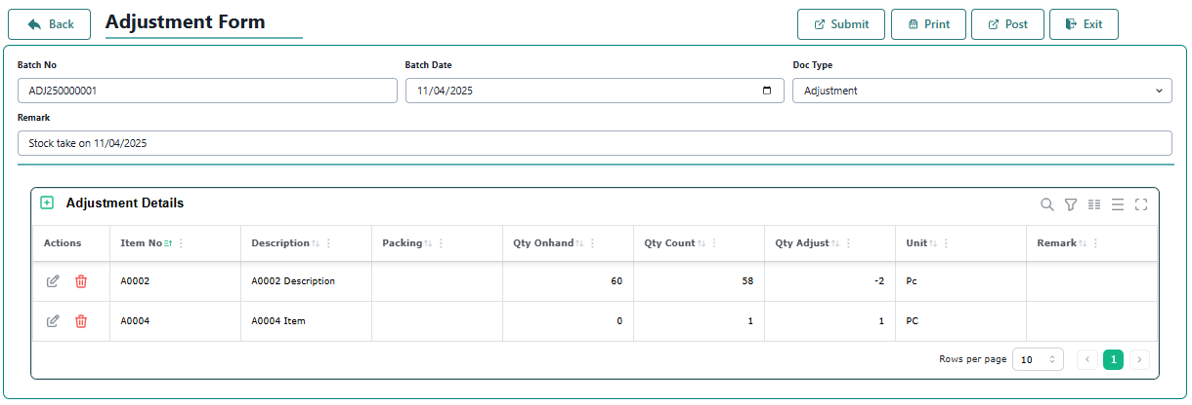
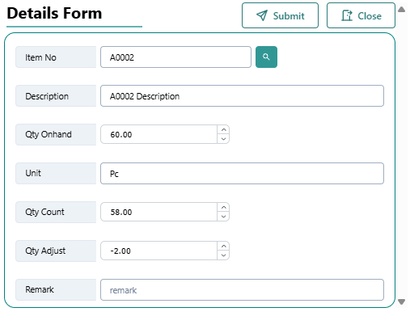
6.3.1 Adjustment Form
To add new item in the details form, click on icon to add new details.

Slide 22
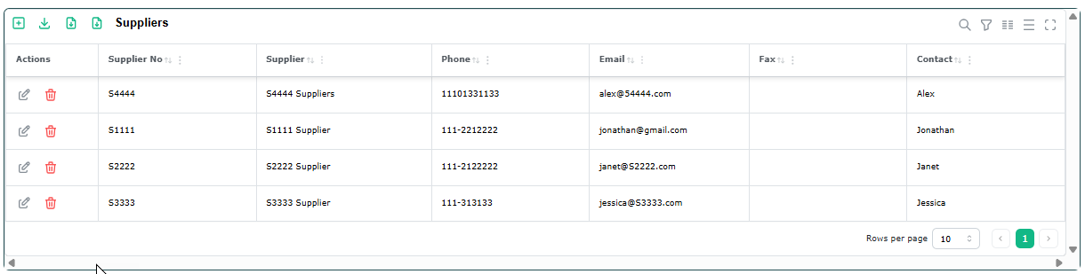
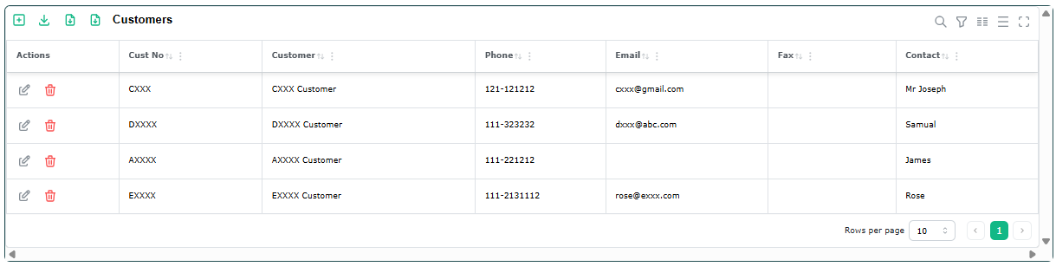
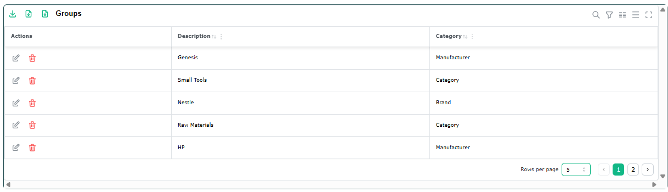
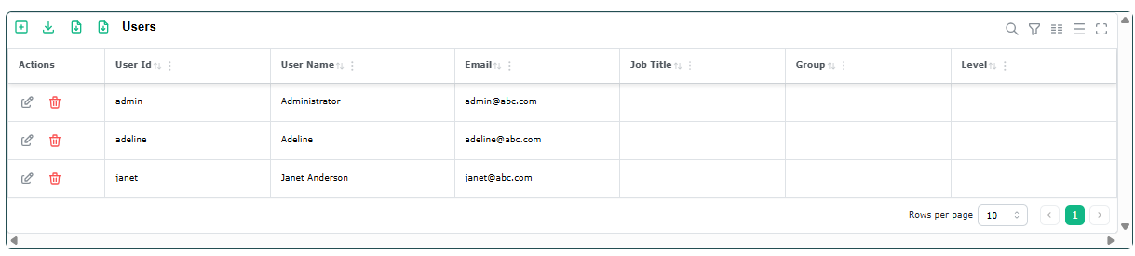
7.0 Tables
Under Tables, the user will be able to maintain and update the following tables.
Suppliers Tables
Customers Table
Group Tables
d. Users Table

Slide 23
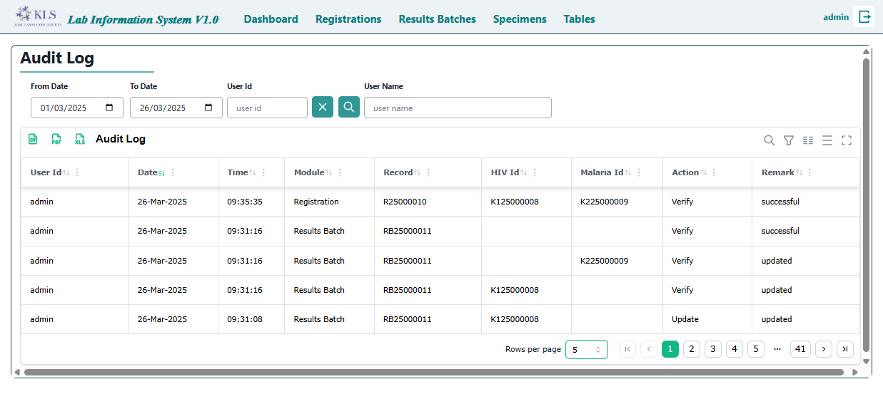
8.0 Audit Log
Audit log will keep track of all the activities recorded in the system. User will be able to filter and search by date range and user id.

