Slide 1

Team Details
Team name: SKavengers
Team leader: Sumit Kumar Das
Challenge: AI-Powered Product Intelligence for Industrial Commerce

Slide 2

Brief about your solution
GlassBox
Six columns in, 252 out — and every one of them can show you its evidence.
A self-bootstrapping enrichment engine for industrial catalogues. It induces its own brand and attribute vocabularies from the corpus it is given, records the exact characters behind every value it emits, and refuses to invent the ones it cannot derive.
Runs with no API key, no network and no model download — so it cannot fail on the evaluation dataset.
100%
Invoice ≤ 40 chars
100%
Vocabulary compliance
9/9
Gold channels exact
214/s
Rows per second

Slide 3
1. How does it enrich minimal product information?
One real row of the supplied dataset, start to finish. Every value below is read from the generated delivery sheet.
INPUT - 6 COLUMNS
Mfg_Part_Num 49-94-1940
Part_Desc 49-94-1940 Milw 14"x1/8"x1" Masonr
y Cut Off Disc
E1_Brand -- Unbranded --
Unilog_Brand -- No Unilog Brand --
DIB_Brand -- No DIB Brand --
Part_Manuf Milwaukee Accessory (4031)
3 of the 6 columns are placeholders meaning “empty”. 799 of the 1000 rows carry one; all 1000 carry another.
OUTPUT - 252 COLUMNS (extract)
BRAND_NAME
Milwaukee®
MANUFACTURER_NAME
Milwaukee Electric Tool Corporation
Classpath
Tools & Equipment > Power Tool Accessories > Cut-Off Wheels
Attributes
Diameter 14 in · Thickness 1/8 in · Arbor Size 1 in · Size 14 in x 1/8 in x 1 in
INVOICE_DESC
CUTOFF WHEEL 14IN 1/8IN 1IN MASONRY
MOBILE_DESC
Milwaukee, Cut Off Wheel, 49-94-1940, 14 in Diameter, 1/8 in Thickness
Every value is traced to its source characters. The run 14"x1/8"x1" is read positionally - diameter, thickness, arbor - because on a cut-off wheel that order is fixed, and swapping them would silently corrupt the record.

Slide 4
2. How does it ensure accuracy and trust?
Five mechanisms, all measured. Nothing below is estimated.
9/9
Gold channels reproduced exactly
100%
Values inside the controlled vocabulary
100%
Char-limit compliance
0
Unit-format violations
100%
252-header schema conformance
Provenance, not self-report Every cell carries its mechanism, rule, confidence and source span. Confidence is computed from that distribution, so fluent invented values cannot score well.
Controlled generation Attribute values are constrained to a per-category vocabulary. A value outside it is rejected and reported, never emitted.
Verified against the published ground truth All five description channels of both fully-worked rows reproduce character-for-character, including a 390-character long description. Run tests/test_gold_channels.py.
Human-in-the-loop triage 618 rows auto-publishable, 297 flagged with a specific reason, 85 blocked. A reviewer clears an item in seconds.
It refuses to invent Part numbers, prices, UPC and country of origin are left blank with a recorded reason naming the system of record. Both gold rows leave the same fields blank.

Slide 5
3. What makes it scalable for enterprise catalogues?
214
rows/sec, single threaded CPU
5s
for the full 1,000-row file
0
API keys or network calls required
51
brands learned with no dictionary given
Large catalogues Linear, single-pass, no per-row network call. 1,000 rows in 5 seconds on one core; the work parallelises per row, so a 2M-SKU catalogue is an overnight batch, not a budget line.
New manufacturers The vocabulary is induced from whatever corpus is loaded, so a new distributor needs no dictionary work. This is the whole point: a pipeline that depends on a hand-curated 27,000-row brand list can only process catalogues someone already curated.
Different formats The delivery schema is read from the organisers' own sheet at runtime, and input is accepted as CSV or XLSX in any column order. A changed header list is absorbed, not a code change.
Continuous updates Deterministic and idempotent: the same row always produces the same record, so re-runs are diffable and only genuinely changed rows need re-review.
Cost The core path uses no paid inference at all. The optional hosted layer is capped, cached, and only ever invoked for rows that need it.

Slide 6
Opportunities — how this differs, and its USP
The expected submission is: pandas → fuzzy match → one large LLM prompt → before/after view. Four things separate ours.
1
It learns its own vocabulary
The challenge is built on seven reference workbooks — a 27,000-row brand list, a 161,000-row list of values — and none of them are published on the portal. Teams following the guide literally will hardcode a few brands, and the brief warns that submissions must process an unseen evaluation set. We induce the lexicon from the corpus, so an uncurated catalogue works on day one.
2
Every cell is auditable
The challenge asks for traceable, explainable outputs. We take that literally: each of the 252 cells records the mechanism, the rule, the confidence and the exact source characters. A wrong value is traceable to the rule that produced it — the difference between a demo and something a content team can adopt.
3
It refuses to fabricate
Non-derivable fields are emitted blank with a reason naming the system of record. The Solution Guide states that a fluent description of invented values scores zero, and that reporting gaps is a strength.
4
It runs anywhere, deterministically
No key, no network, no model download; 240 rows/sec on a laptop. The optional AI layers attach on top and are never required, so the prototype cannot fail on the judges' machine.

Slide 7
List of features offered by the solution
ENRICHMENT
• Brand and manufacturer resolution via a 6-rung evidence ladder
• Dual taxonomy — Classpath plus Dept/Class/Fine, guaranteed consistent
• 17 per-category attribute contracts, 313 controlled values
• Trade-aware extraction: fractions, UOM, nominal sizes, wire codes
GENERATION
• Five description channels, each to its own house contract
• Two-sided constraint solver for the 60–80 char mobile window
• Hard 40-char all-caps invoice line with greedy-with-skip packing
• Deterministic digital-asset filenames and manufacturer URLs
TRUST
• Per-cell provenance with source character spans
• Confidence scored from provenance, not model self-report
• Triaged review queue with specific, actionable reasons
• Explicit refusal to populate non-derivable fields
OPERATIONS
• Zero-config: no key, no network, no model download
• Runtime schema binding — 252 headers read from the client sheet
• XLSX + CSV delivery, JSONL provenance sidecar, compliance report
• Vocabulary induction report and human-approval queue

Slide 8
Process flow
Two passes. The first learns the catalogue's vocabulary; the second enriches each row against it.
PASS 1 · LEARN
• Group by distributor account
• Score token distinctiveness (group TF-IDF)
• Link aliases to attested brands
• Induce series, product types, unit spellings
• Fit taxonomy + brand priors
Output: 51 brands, 181 held for review
PASS 2 · ENRICH EACH ROW
1. Clean — drop placeholders, expand shorthand
2. Resolve entity — 6-rung brand ladder
3. Classify — 87 leaves, both hierarchies
4. Fill contract — extract with source spans
5. Normalise units — fractions, approved UOM
6. Render 5 channels — constraint-solved lengths
7. Score + triage — confidence from provenance
DELIVERABLES
enriched.xlsx
252 columns, review rows tinted
provenance.jsonl
every cell's evidence
review_queue.csv
worst rows first, with reasons
report.md
compliance + evaluation
Optional layers attach at step 4 and are never required for a complete run.

Slide 9
Architecture
Deterministic core, optional AI on top. The core is complete on its own — which is why it cannot fail on an unseen dataset.
OPTIONAL · AI ACCELERATION
NVIDIA NIM proposals — validated against the vocabulary, labelled, always routed to review
Distilled local models — classifier + span tagger, CPU inference, zero marginal cost
CORE ENGINE · DETERMINISTIC, OFFLINE
induce · entity · taxonomy · attributes · extract · units · render · confidence
Vocabulary induction → evidence ladder → contract fill → constraint-solved generation
FOUNDATION
schema — 252 headers bound from the client sheet at runtime
provenance — every cell carries mechanism, rule, confidence, source span
Data flow: 6-column CSV/XLSX → learn → enrich → 252-column delivery sheet + provenance sidecar + review queue + compliance report

Slide 10
Technologies used in the solution
Core Python 3.12 · pandas · RapidFuzz · XlsxWriter · openpyxl
13 purpose-built modules, no ML framework in the critical path
NLP / IE Rule-based information extraction · group-conditional TF-IDF induction · fuzzy entity resolution · BIO span labelling
Constraint satisfaction for the length-bounded channels
Generative AI (optional) NVIDIA NIM — OpenAI-compatible endpoint, Llama 3.3 70B
Schema-constrained proposals, validated and cached; never on the critical path
ML (optional) PyTorch · Hugging Face Transformers · DistilBERT
Rule-engine distillation: 77-class classifier + 38-type span tagger
Interface Streamlit · custom CSS
Five views: enrich, compliance, review queue, vocabulary, export
Engineering pytest · git · deterministic seeds
Gold-row exact-match tests; every published metric reproducible from the CLI

Slide 11
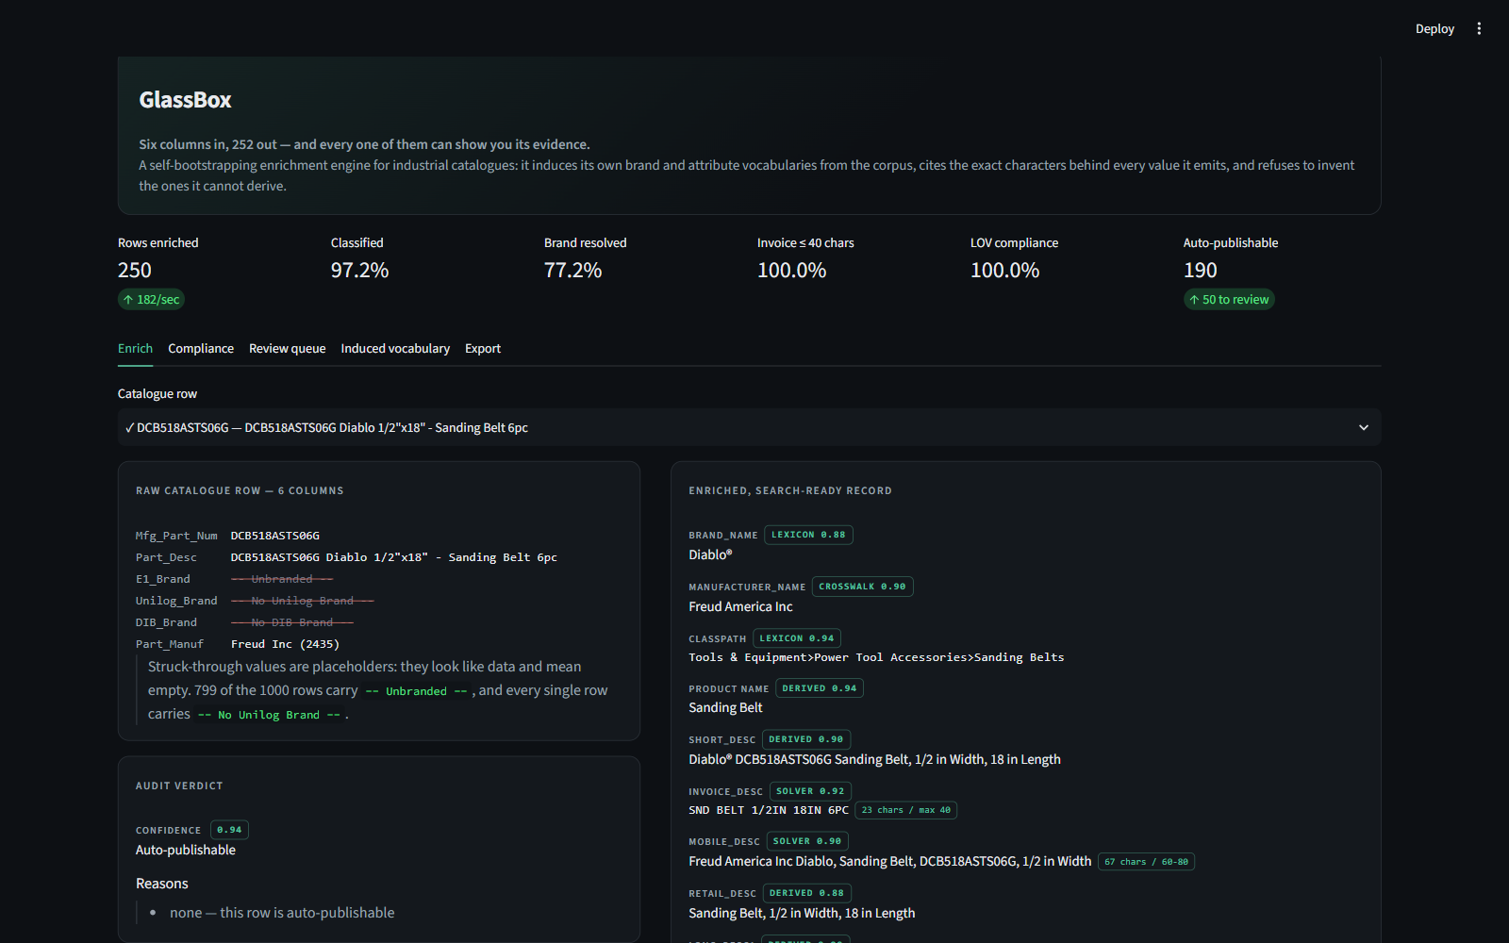
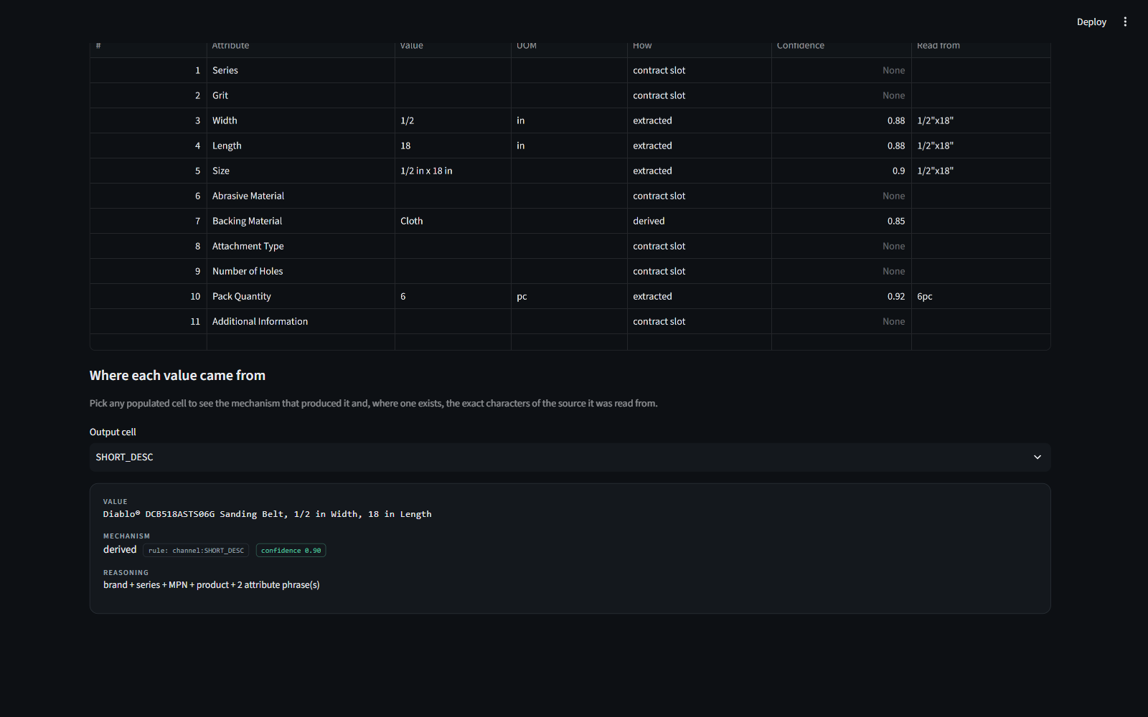
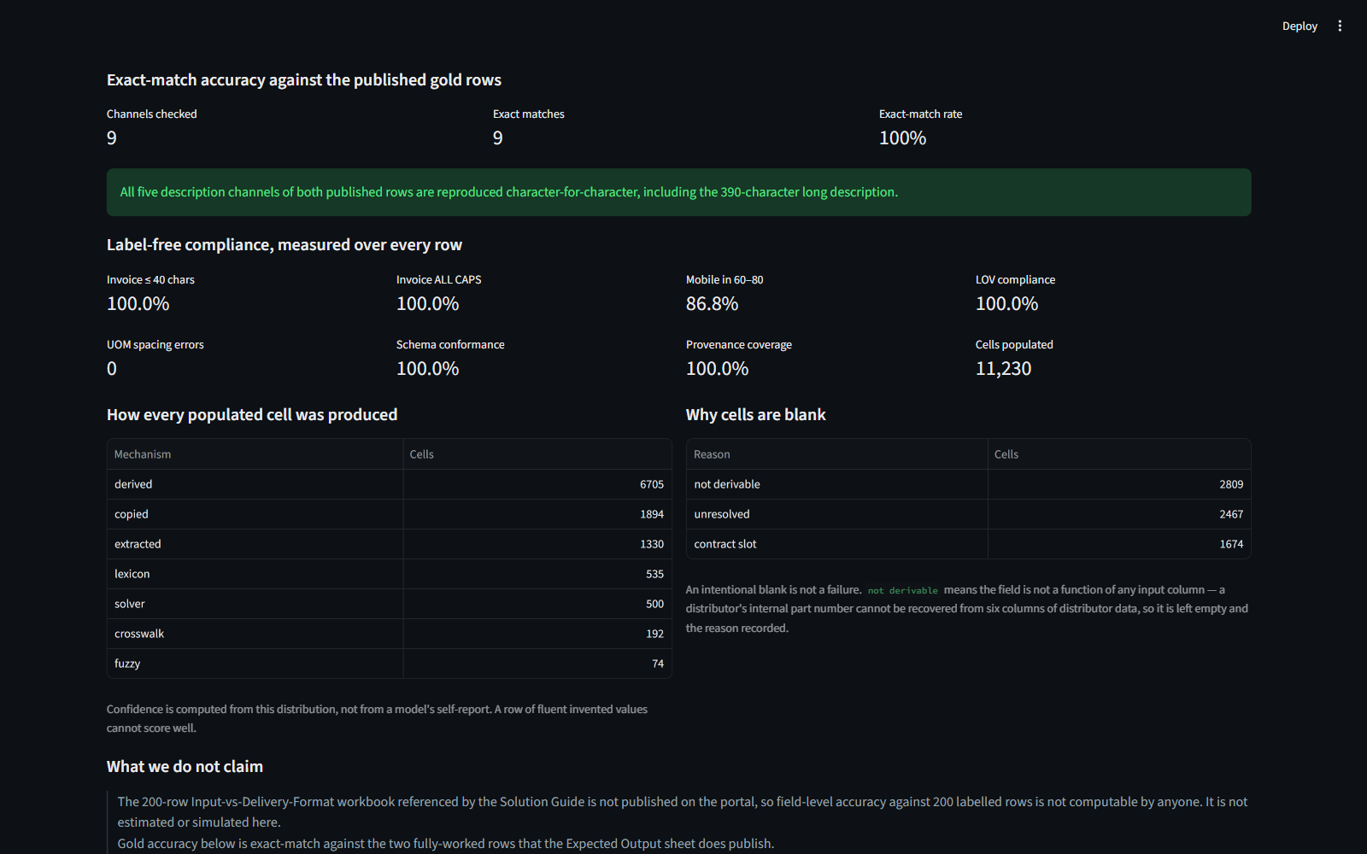
Snapshots of the MVP
Live application — not mockups. Every figure on screen is computed at load time.
Before / after with per-cell provenance
Attribute block: every value shows the characters it was read from
Self-measured compliance and gold-row accuracy
The middle panel is the differentiator. The “Read from” column shows, for every extracted attribute, the exact substring of the raw description it came from — alongside the mechanism that produced it and its confidence. Blank cells state why they are blank.

Slide 12
Current status and next steps
SHIPPED AND VERIFIED
• End-to-end engine — 1,000 rows in 5s, 79% classified, 76% brand resolved
• 9/9 gold description channels exact · 100% vocabulary compliance · 100% schema conformance · 0 unit-format errors
• Provenance sidecar, triaged review queue, compliance report, Streamlit application
BUILT, PENDING A TRAINING RUN
The distillation package is complete and validated — 3,591 classifier examples over 77 classes and 636 span examples, generated from the rule engine, with the label-alignment and metric logic unit-tested (21 checks, including a pass over all 560 real span rows). The fine-tuning run itself is not yet executed, so no trained-model accuracy is claimed anywhere in this deck.
ROADMAP
• Manufacturer-source retrieval, honouring the guide's sourcing hierarchy, to close the attribute gap the input genuinely cannot supply
• Active learning — accepted review decisions feed straight back into the induced vocabulary
• Per-customer vocabulary packs, so an induced lexicon becomes a reusable asset per distributor

Slide 13
Links
GITHUB PUBLIC REPOSITORY
https://github.com/skdas20/UniHack
WORKING PROTOTYPE
https://glassbox-unihack.streamlit.app/
DEMO VIDEO (3 MINUTES)
Submitted alongside this deck on the Hack2skill portal
Run it yourself: git clone · pip install -r requirements.txt · python run.py — no API key, no network, ~5 seconds for 1,000 rows.

Slide 14


