Slide 1
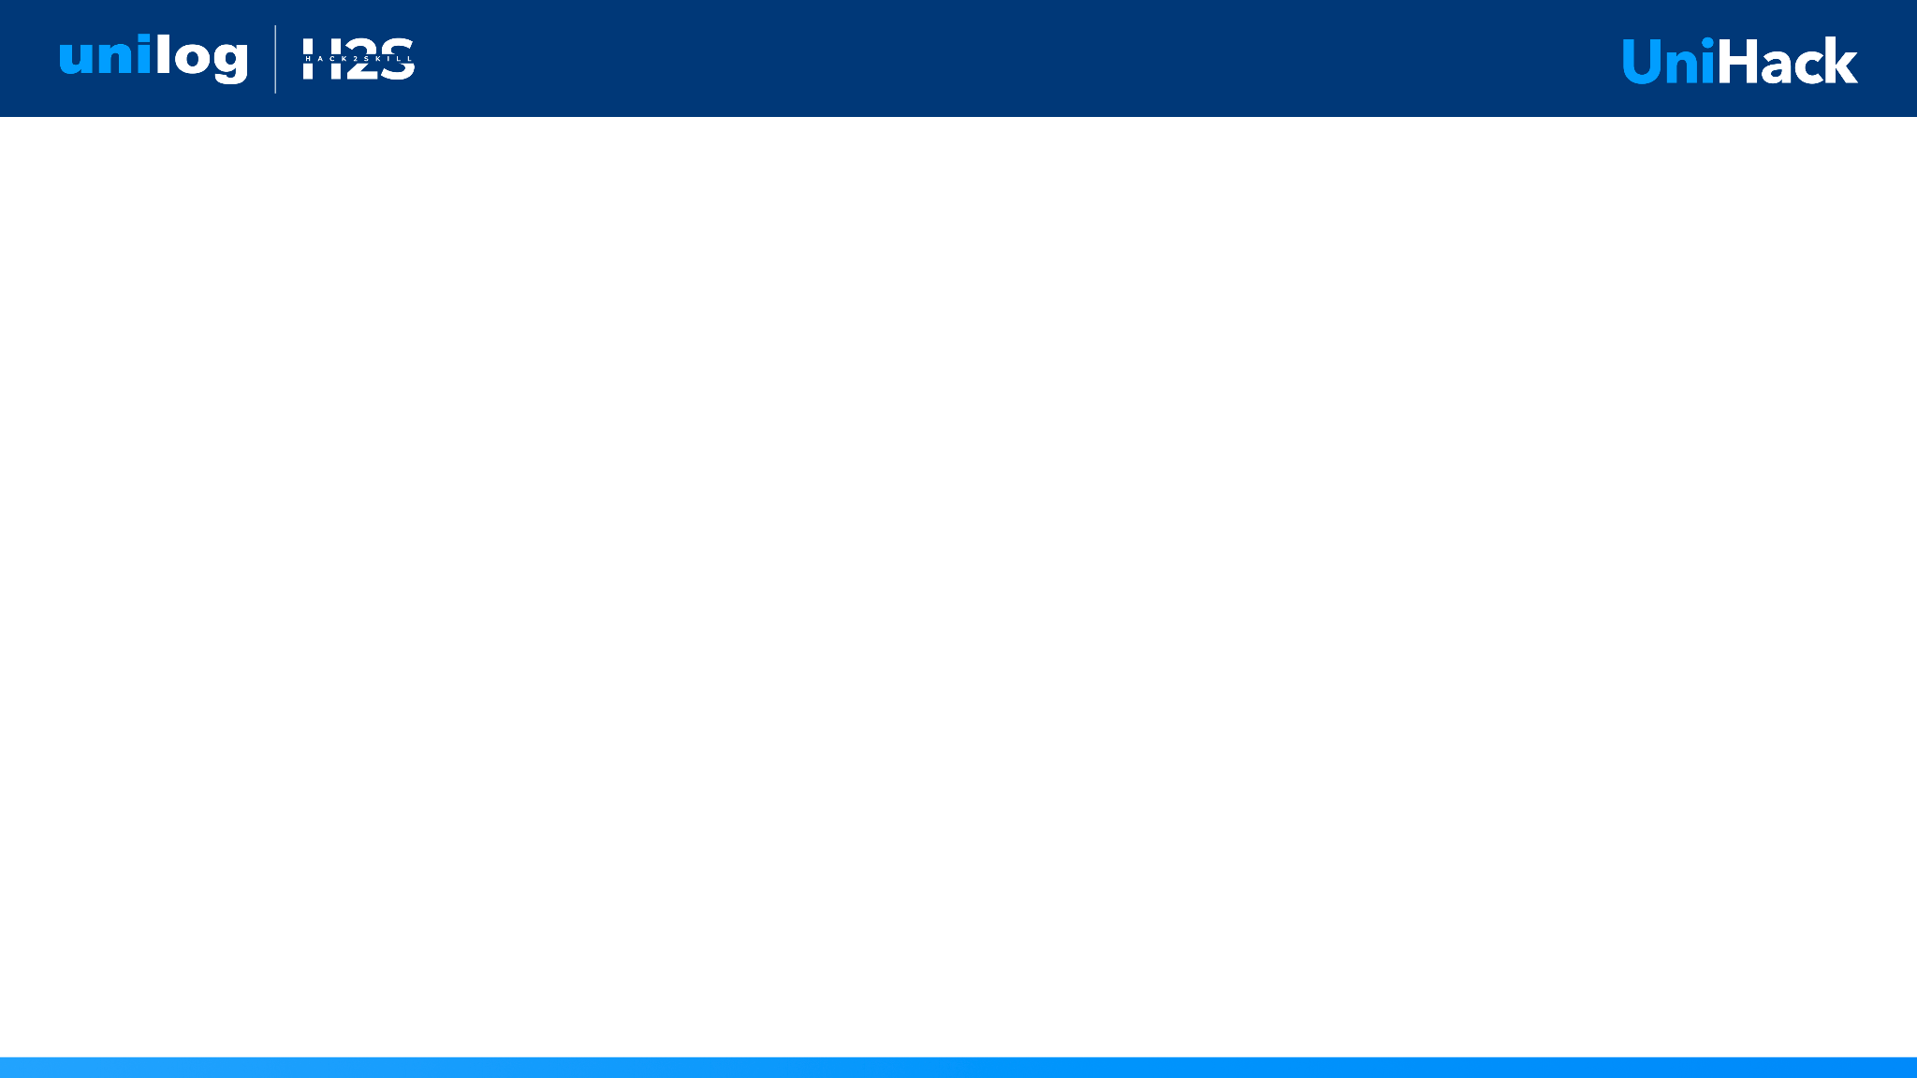
Guidelines
Kindly use the given template for submitting your prototype(Make a copy of the template)
One team is only required to submit one project.
Follow this template while preparing your presentation.
You are welcome to add as many POCs and design concepts to support your project.
The project should be feasible and the team members should be capable enough, to come up with the fully functioning prototype of the same idea, if required.

Slide 2

Team Details
Team name:
Team leader name:

Slide 3
Brief about your solution

Slide 4
1. How does your solution enrich minimal product information?
Briefly explain how your solution transforms limited inputs (e.g., Part Number, Brand, Short Description) into rich product intelligence.
2. How does your solution ensure accuracy and trust in the generated product data?
Describe your validation strategy. This may include:
(Confidence scoring, Multi-source verification, Human review, Rule-based validation, AI validation, Other approaches)
3. What makes your solution scalable for enterprise product catalogs?
Describe how your solution would handle: Large product catalogs, New manufacturers, Different document formats, Continuous product updates

Slide 5
Opportunities
How different is it from any of the other existing ideas?
How will it be able to solve the problem statement given?
USP of the proposed solution

Slide 6
List of features offered by the solution

Slide 7
Process flow diagram or Use-case diagram

Slide 8
Wireframes/Mock diagrams of the proposed solution (optional)

Slide 9
Architecture diagram of the proposed solution

Slide 10
Technologies used in the solution

Slide 11
Estimated implementation cost (optional)

Slide 12
Snapshots of the MVP

Slide 13
Additional Details/Future Development (if any)

Slide 14
Provide links to your:
GitHub Public Repository
Demo Video Link (3 Minutes)
Working Prototype Link

Slide 15


