Slide 1

EP1001 Further Digital Fabrication & Prototyping
Embedded Programming

Slide 2
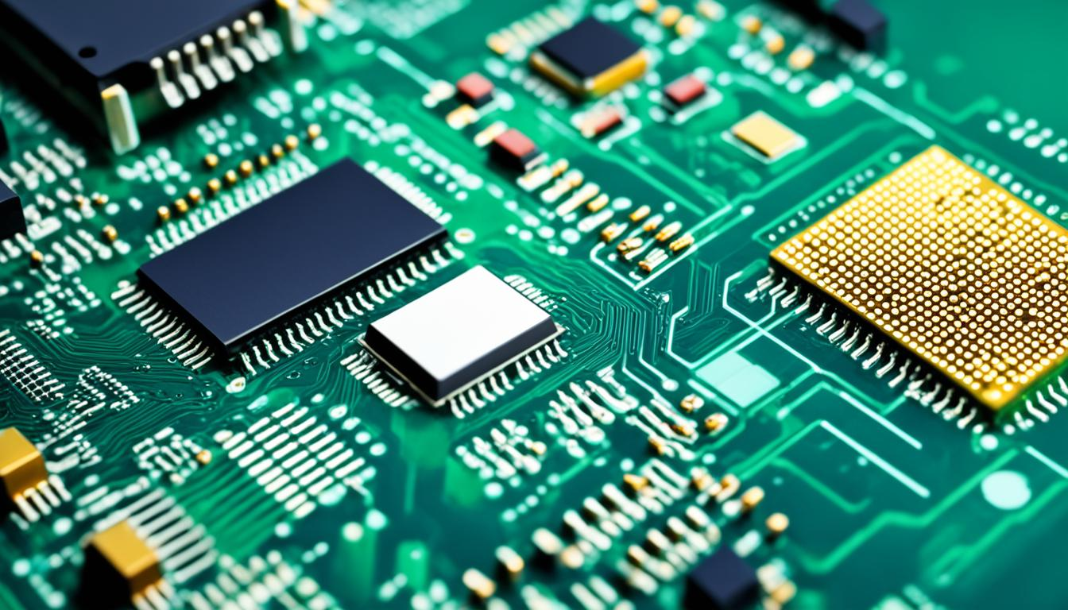
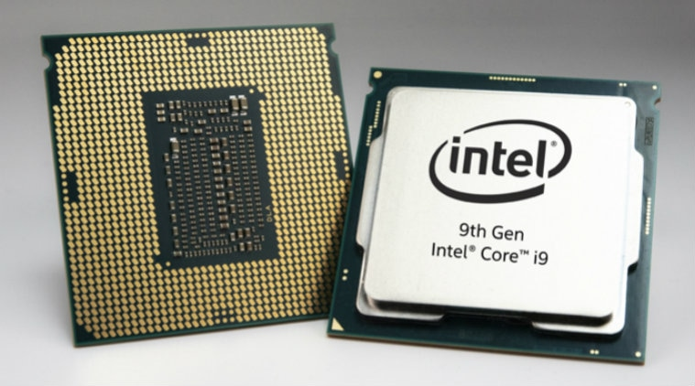
Computer architectures
Computers follow 2 basic memory architectures
  Von Neumann: shared instruction & data space
  Harvard: separate instruction & data space
CPU architectures can be
  CISC: complex, multi-cycle instructions
  RISC: simple, single cycle instructions
Specialized CPUs include
  GPU: graphics processing unit
  TPU: tensor processing unit (for AI tasks)
Hardware implementation
  CPUs: general purpose, slower
  FPGAs: field (end-user) programmable, custom circuits
  ASICs: application specific, highly customised at IC manufacturer level

Slide 3
Microprocessors vs microcontrollers vs soc
Microprocessors
general purpose processors
require external hardware (memory, peripherals)
Microcontrollers
integrate CPU, memory, peripherals within a single chip
limited memory
CPU not as fast as microprocessors
System on a Chip (SoC)
Single IC that combines most or all components of a computer on a single chip
Includes CPU, GPU, memory, I/O ports, peripherals, wireless connectivity and display units

Slide 4
Types of memory
Registers (within CPU)
Non-volatile memory
PROM
EPROM
EEPROM
Flash memory
NVRAM
Volatile memory
SRAM
DRAM
Fuse (for configuration settings)

Slide 5
Typical microcontroller Peripherals
Input/Output ports
Analog-to-Digital converters
Analog comparators
Digital-to-analog converters
Timer/Counter units
PWM waveform generators
UART (Serial Communications)
USB interface

Slide 6
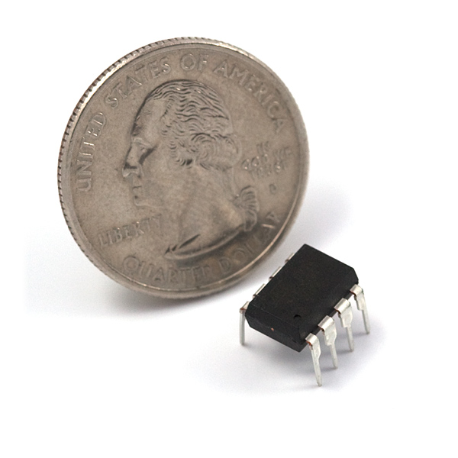
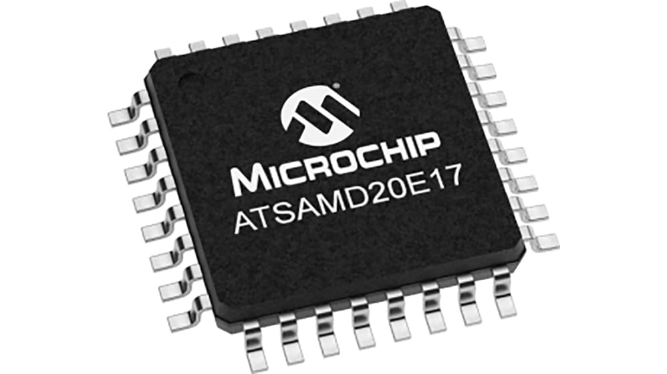
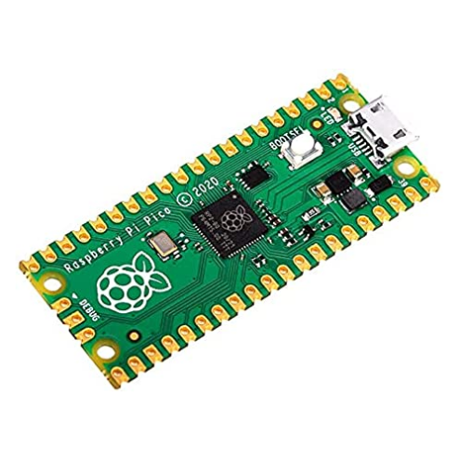
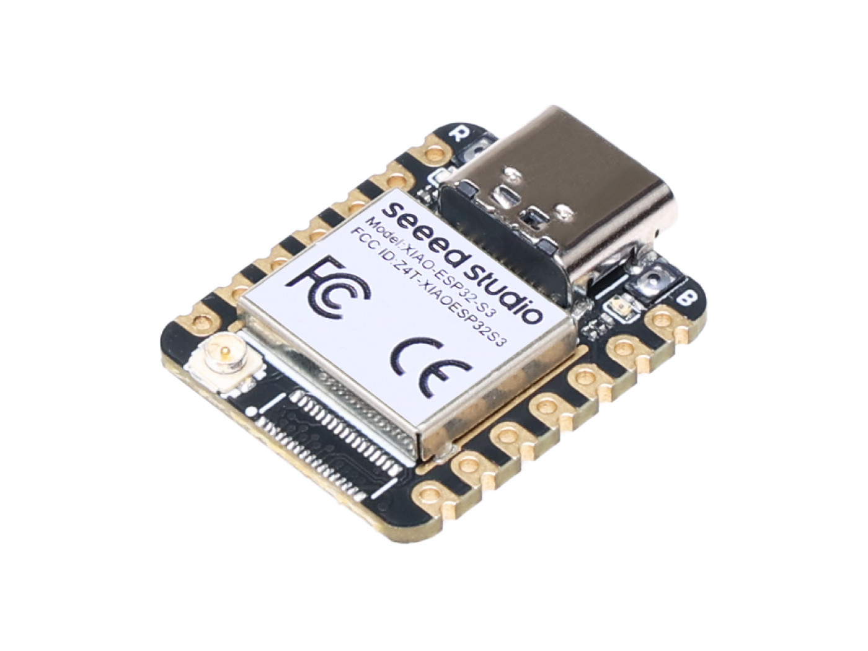
Processor families
8051
PIC
AVR
  ATmega328
  ATtiny412, ATtiny1614, ATtiny3216
ARM
  ATSAMD11, ATSAMD21
  STM32
Raspberry Pi
  RP2040
  RP2350
Xtensa
  ESP8266
  ESP32
RISC-V
  ESP32-C3, ESP32-C6, ESP32-S3

Slide 7
Microcontroller Programming languages
Assembly language
C/C++
MicroPython/CircuitPython
JavaScript
Basic
Forth
Lua

Slide 8

Development environments
Arduino IDE: C/C++, Arduino sketch
Visual Studio Code / Platform IO: multiple languages
Eclipse: multiple languages
Microchip Studio: C/C++
GCC: C/C++
Thonny IDE: MicroPython, CircuitPython

Slide 9
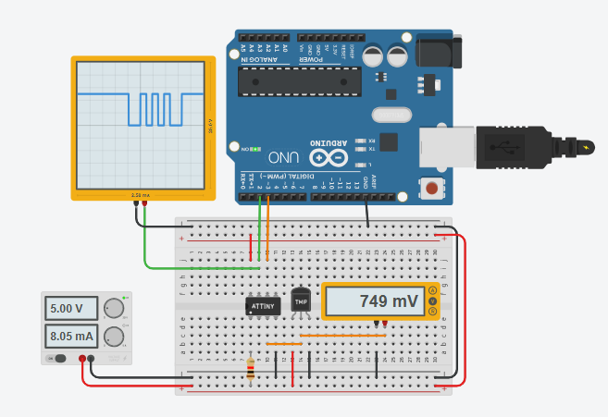
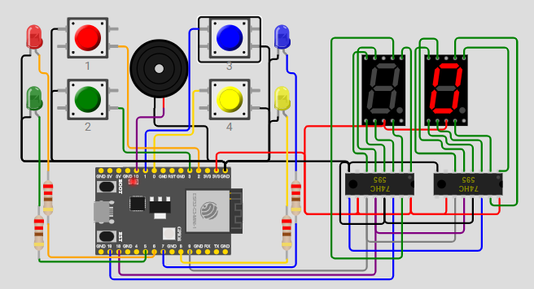
Simulators
Tinkercad Circuits
  Basic electronics
  Arduino Uno
  ATtiny85
  Micro:bit
Wokwi
  Arduino Uno, Mega
  ATtiny85
  ESP32
  STM32
  Raspberry Pi Pico

Slide 10
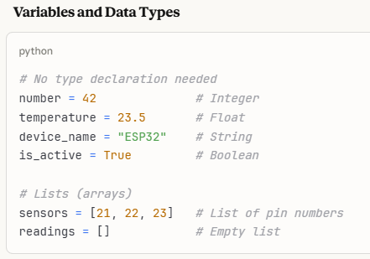
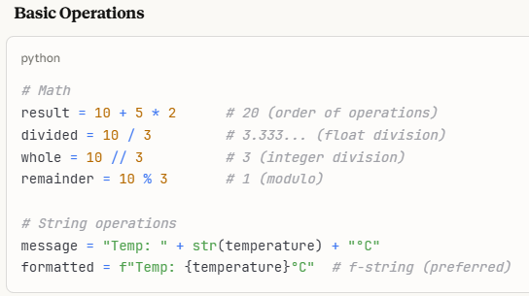
Micropython basics
MicroPython Getting Started Guide
ESP32
Raspberry Pi Pico

Slide 11
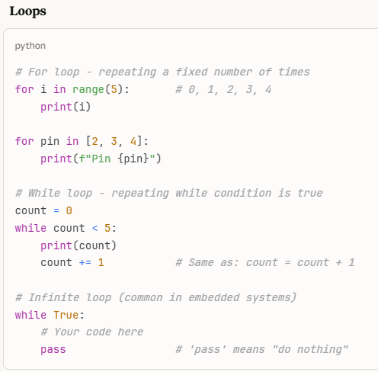
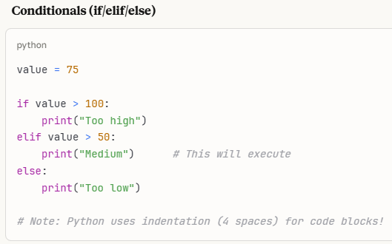
Micropython basics

Slide 12
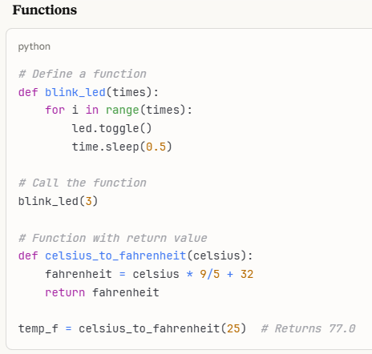
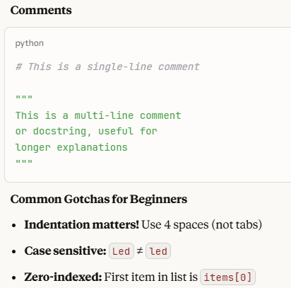
Micropython basics

Slide 13
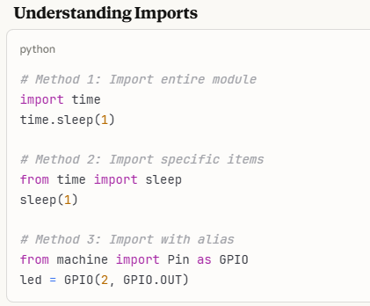
Micropython basics
Importing libraries
Import vs from … import

Slide 14
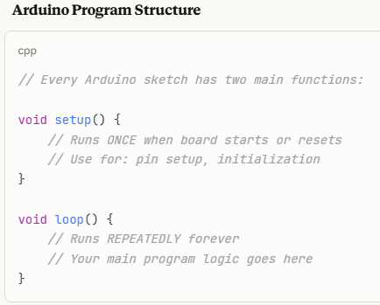
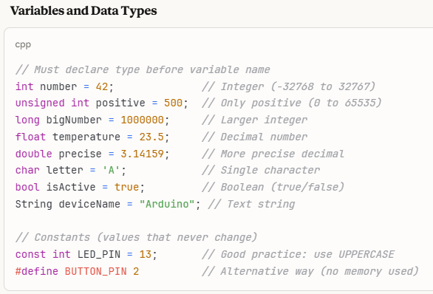
Arduino (c/c++) basics
Getting Started with the ESP32C3 Supermini
Arduino-Pico ReadTheDocs

Slide 15
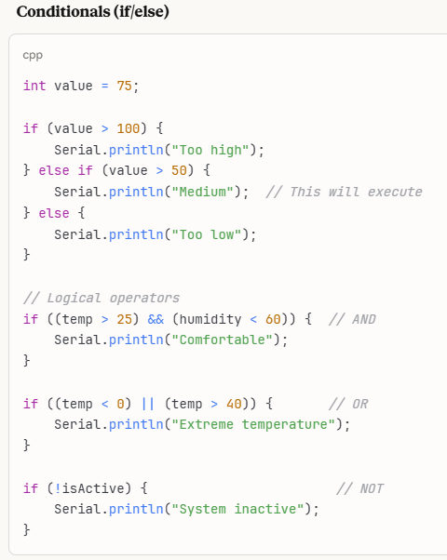
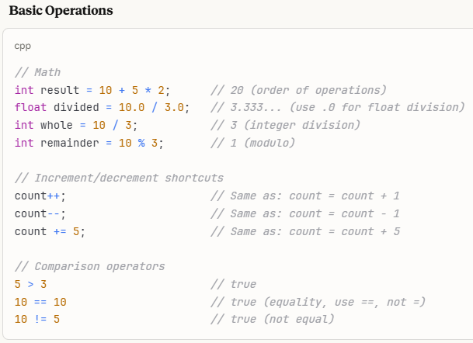
Arduino (c/c++) basics

Slide 16
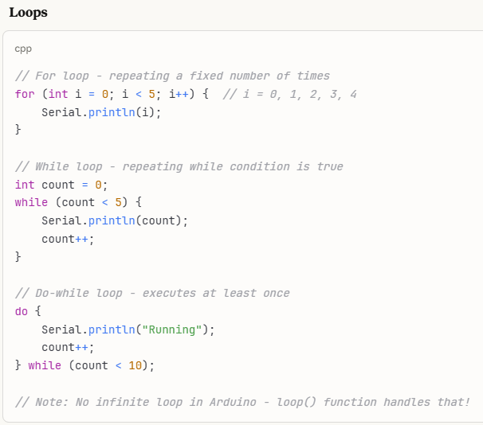
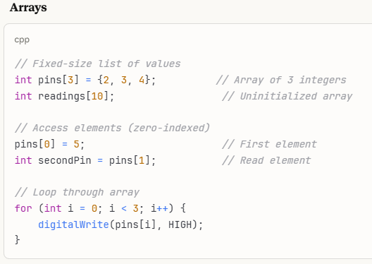
Arduino (c/c++) basics

Slide 17
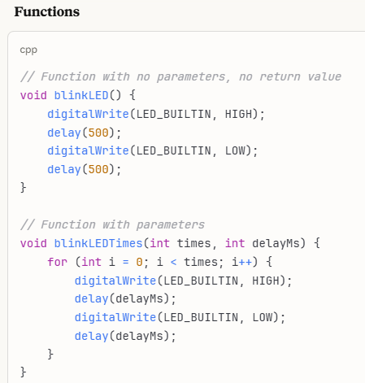
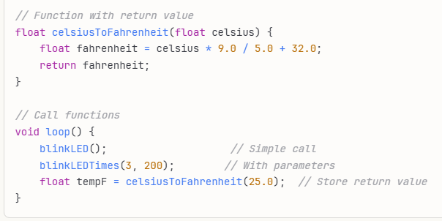
Arduino (c/c++) basics

Slide 18
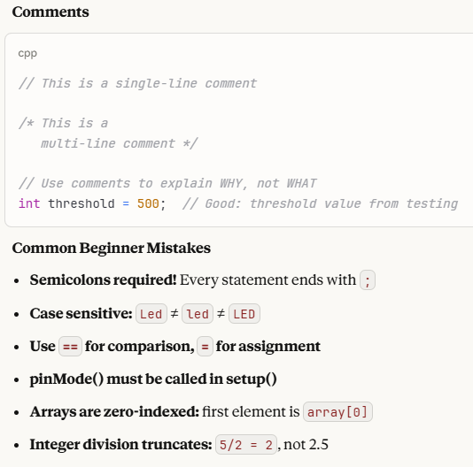
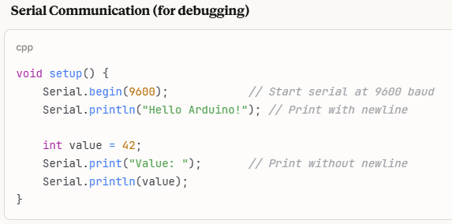
Arduino (c/c++) basics

Slide 19
Hands-on exercises

Slide 20
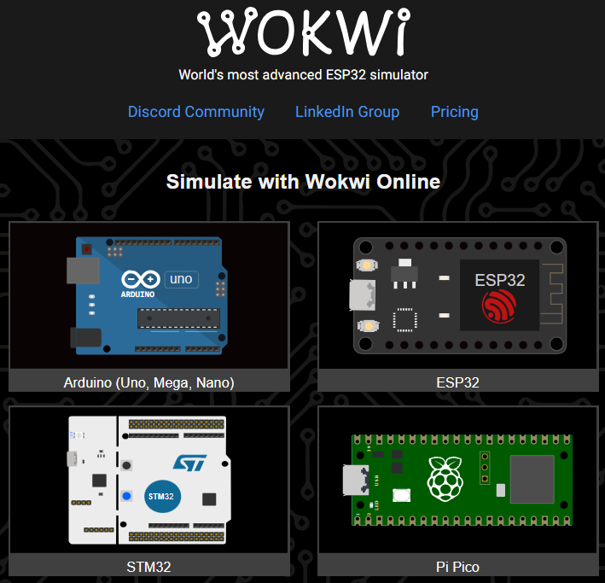
Introduction to Wokwi
online electronics simulator
Supports multiple microcontroller families:
  Arduino
  ESP32
  Raspberry Pi Pico
  STM32
Supports C/C++ and MicroPython, Rust
Extensive component library
Advanced features
  Wifi simulation
  Virtual logic analyzer
  VS Code integration
Website: https://wokwi.com/
Makerpro Wokwi Tutorial

Slide 21
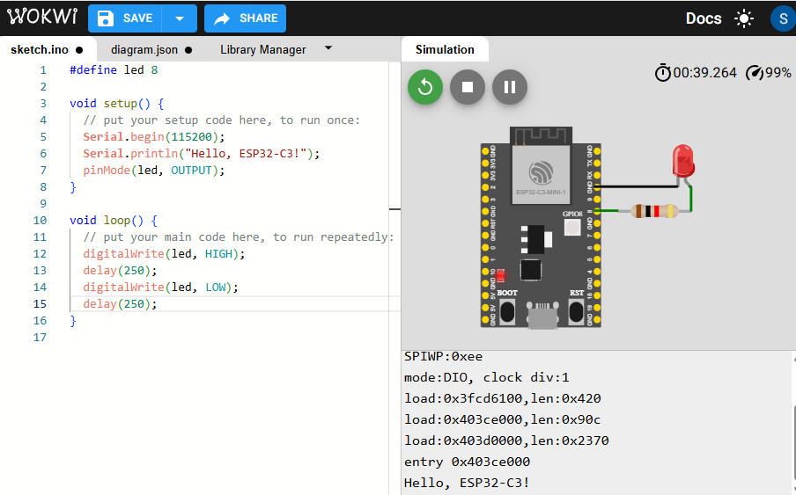
Exercise 1: ESP32-c3 Hello world (C/C++)
Go to the Wokwi website: https://wokwi.com
Select ESP32 simulation, then ESP32-C3 starter template
Add an LED and a resistor as shown in the diagram
Wire the components:
  LED cathode to GND, anode to resistor to GPIO8
  Set resistor value to 200 ohms
Enter the code on the left panel.
Start the simulation
Try changing the delay interval and run the simulation again

Slide 22
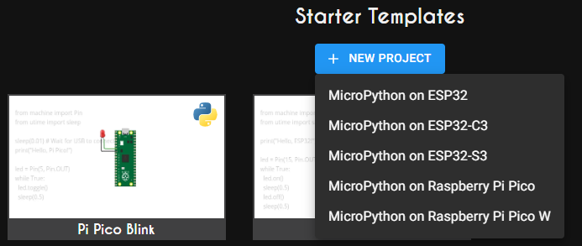
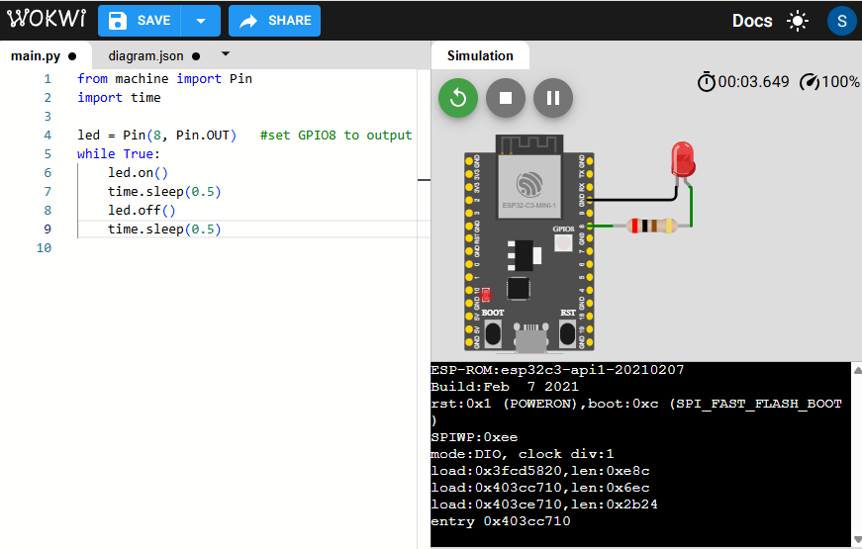
Exercise 2: ESP32-C3 Hello world (mpy)
Start a new MicroPython project
Scroll down to Starter Project, select MicroPython on ESP32-C3
Add an LED and a resistor
Wire the components as shown
  LED: cathod to GND, anode to resistor to GPIO8
  Set resistor value to 200 ohms
Enter the MicroPython code as shown
Run the simulation
Modify the program:
  Use led.toggle( ) instead of led.on( ) / led.off( )
  Change delay interval to 250 ms

Slide 23
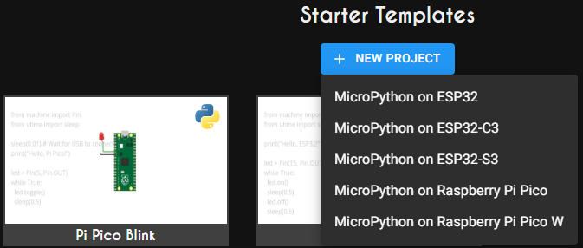
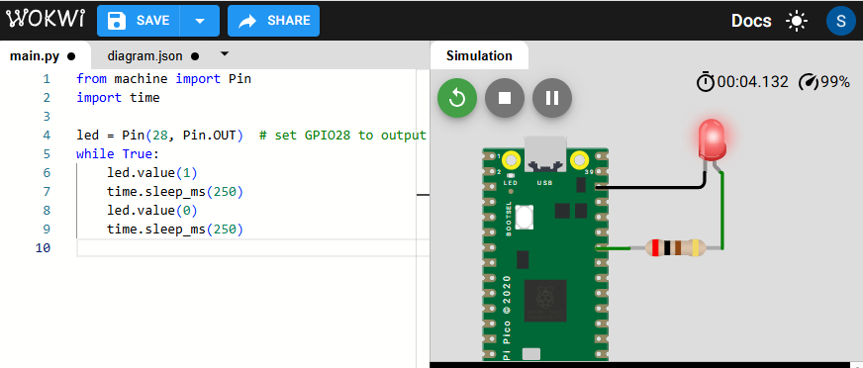
Exercise 3: RP2040 HELLO (Micropython)
Start a new MicroPython project
Scroll down to Starter Project, select MicroPython on Raspberry Pi Pico
Add an LED and a resistor
Wire the components as shown
  LED: cathode to GND, anode to resistor to GPIO8
  Set resistor value to 200 ohms
Enter the MicroPython code as shown
Run the simulation
Modify the program:
  Use led.toggle( ) instead of led.value(1 ) / led.value(0 )
  Change delay interval to 1 s

Slide 24
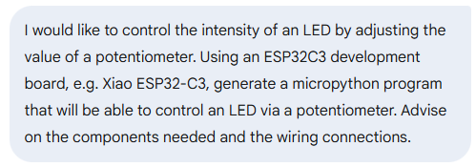
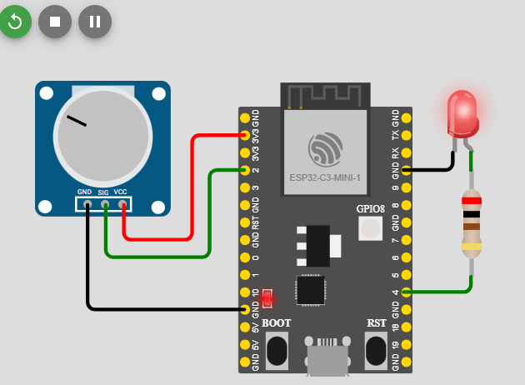
Exercise 4: esp32c3 controlling led w/pwm
Start a GenAI chat (deepseek, gemini)
Write a prompt, asking GenAI for advice on writing a micropython program for the ESP32C3 to read input values from a potentiometer and use it to control the intensity of an LED.
Start a Wokwi ESP32C3 micropython project. Examine the GenAI code, add components and wire the circuit.
Copy the code to Wokwi and run the simulation.
Did the simulation work?
Determine the problem (if any) and ask GenAI to generate an updated program.
Repeat the process until you get a working program.

Slide 25
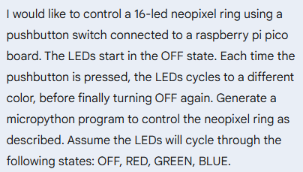
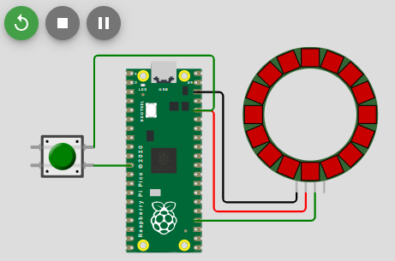
Exercise 5: Pi pico neopixel control
Start a GenAI chat (deepseek, gemini)
Write a prompt, asking GenAI for advice on writing a micropython program to control a neopixel ring display using a pushbutton connected to a Pi Pico board. The LEDs start in the OFF state. Each time the pushbutton is pressed, the LEDs will cycle through different colors, e.g. red, green, blue, then OFF.
Start a Wokwi Raspberry Pi Pico micropython project. Examine the GenAI code, add components and wire the circuit.
Copy the code to Wokwi and run the simulation.
Did the simulation work?
Determine the problem (if any) and ask GenAI to generate an updated program.
Repeat the process until you get a working program.

Slide 26
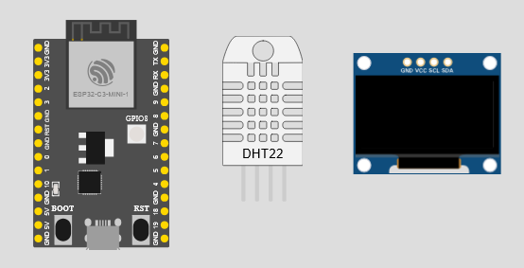
Challenge Exercise 1
You have been tasked to develop a portable environmental monitoring device, comprising of an ESP32-C3 board with 128x64 OLED screen which will sample and display the ambient temperature and humidity
With the aid of GenAI:
  Document the components and wiring diagram for the system
  Write a micropython program to perform the required actions
  Document the GenAI prompts and outputs, including the debugging/troubleshooting steps used to develop your solution

Slide 27
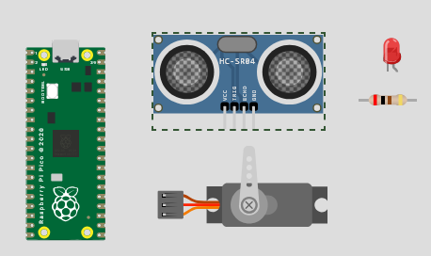
Challenge Exercise 2
To help maintain hygiene in hospital wards, you have been tasked to develop an automated sanitizer dispensing unit which comprises of a Pi Pico board, an ultrasonic sensor, a servo motor and an LED indicator.
When the user places his hand(s) at a distance of < 3 cm from the ultrasonic sensor, the servo motor will be activated to dispense the sanitizer lotion. The LED will light up at the same time to indicate that sanitizer lotion is being dispensed.
With the aid of GenAI:
  Document the components and wiring diagram for the system
  Write a micropython program to perform the required actions
  Document the GenAI prompts and outputs, including the debugging/troubleshooting steps used to develop your solution

Slide 28
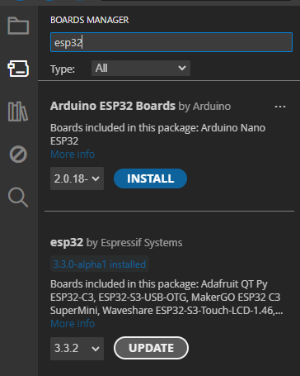
Installing ESP32 support for Arduino IDE
Ref: Xiao ESP32-C3 Wiko: Getting Started
Download and install the latest version of the Arduino IDE
Launch the Arduino application
Click the BOARDS MANAGER icon and type “esp32” in the search bar
Select “esp32 by Espressif Systems” and click install
Follow the same procedure to install support for the RP2040 MCU

Slide 29
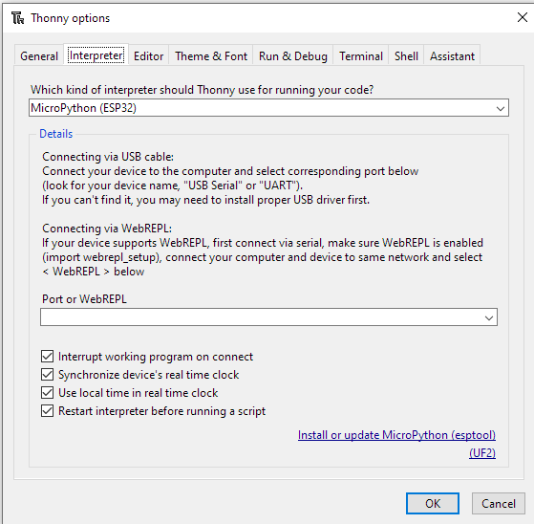
Installing thonny ide for micropython
Ref: Getting Started with Thonny MicroPython
Go to https://thonny.org, download Thonny IDE
Run the installer
After Thonny IDE is installed, to program the microcontroller board, you need to flash the MicroPython firmware to the MCU board
Connect your ESP32-C3 board, then press “Boot” + “Reset”, release “Reset”, followed by “Boot” to place the board in the bootloader mode
Run Thonny IDE. Click Tools > Options > Interpreter

Slide 30
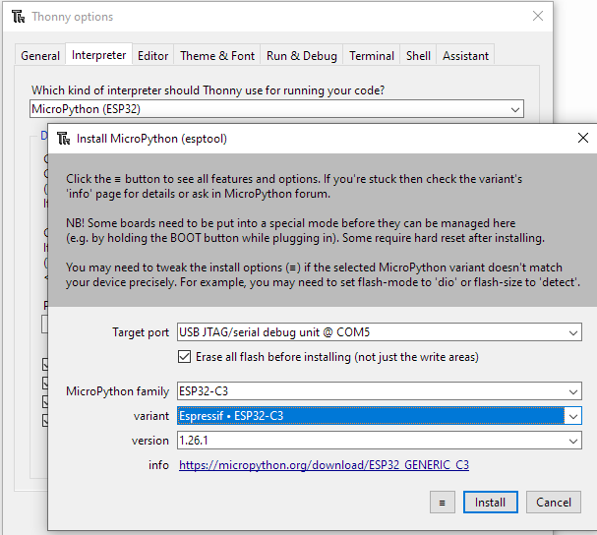
Flashing micropython firmware
Click “Install or update MicroPython”
Select the target port “USB JTAG/serial debug unit @COMx”
Select MicroPython Family, variant, version
Click “Install” to flash the firmware to the ESP32-C3 board
Once the firmware has been uploaded, click the “Close” button, followed by OK to return to Thonny IDE

Slide 31
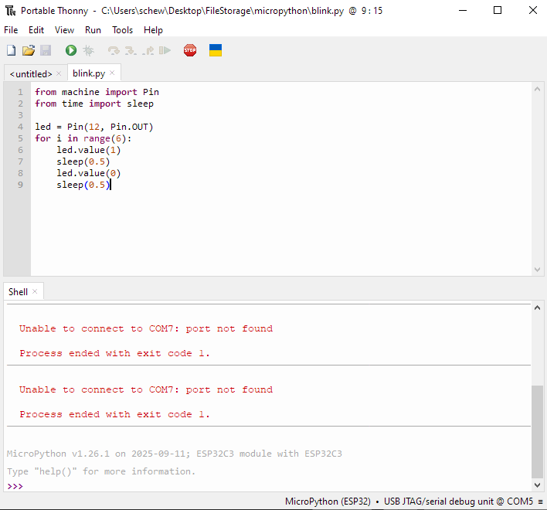
Verifying MICROPYTHON FIRMWARE
Once you return to Thonny IDE, verify that MicroPython has been correctly installed on the ESP32-C3 board
You should see the MicroPython REPL prompt (>>>)
If you do not see the REPL prompt, you may need to press “Reset” on the ESP320C3 board, “STOP” icon on Thonny IDE or check Tools > Options > Interpreter to verify that the correct COMport has been selected

