Slide 1
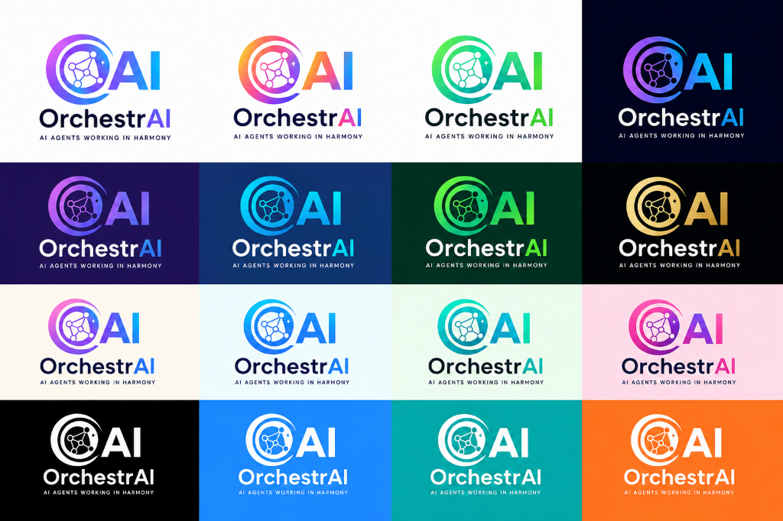
AI AGENTS WORKING IN HARMONY
The Complete AI-Native
Enterprise Operating Model
OrchestrAI
Two Frameworks. One Continuous Cycle. Infinite Enterprise Value.
Enterprise Suite
OMG
OrchestrAI Model Governance
Govern AI. Control Risk. Ensure Compliance.
Govern AI with Confidence.
Build AI with Speed.
Deliver Value with Assurance.
ODF
OrchestrAI Delivery Framework
Build Faster. Validate Continuously. Deliver Value.
Sithanandham Radhakrishnan
Founder, OrchestrAI | Chief AI Architect
OGE
Quality & Governance Engine
vThink Global Technologies Pvt Ltd
Observability. Guardrails. Evaluation.
From Ideas to Impact
From Tools to Ownership
From Months to Days
"Human Orchestrates. AI Builds. Value Delivers."
Human Orchestrates | AI Builds | Value Delivers
OrchestrAI Enterprise Suite - vThink Global Technologies Pvt Ltd

Slide 2
THE ENTERPRISE AI CHALLENGE
02 / 15
Every Enterprise Has AI Tools. Almost None Have an AI Operating Model.
The gap between AI investment and measurable delivery is the problem ODF solves.
Without ODF — The Status Quo
With OrchestrAI ODF
x AI tools exist — delivery is still months-long
v Complete AI-Native Enterprise Operating Model
x AI generates code — humans cannot govern or audit it
v Human Orchestrated. AI Powered. Value Focused.
VS
x No repeatable process — every project reinvented
v Built-in governance, risk control & quality from Day 1
x Compliance & risk exposure without human oversight
v Delivery in days — not months
x Billions invested. Limited measurable outcomes.
v Every output owned, audited and approved by a human
"OrchestrAI is not a tool. It is your new way of working."
Human Orchestrates | AI Builds | Value Delivers
OrchestrAI Enterprise Suite - vThink Global Technologies Pvt Ltd

Slide 3
THE ORCHESTRAI ENTERPRISE SUITE
03 / 15
The Complete AI-Native Enterprise Operating Model
Two Frameworks. One Continuous Cycle. | Governed. Built. Delivered. Together.
OMG
TWO FRAMEWORKS.
ODF
OrchestrAI Model Governance
ONE CONTINUOUS CYCLE.
OrchestrAI Delivery Framework
Govern AI. Control Risk. Ensure Compliance.
Build Faster. Validate Continuously. Deliver Value.
AI Inventory & Registry
AI
Intent & Outcome Definition
Ownership & RACI Roles
HARMONY
Requirements & Context
Risk Classification
AI-Assisted Design
Approval Workflow
AI-Generated Development
Human Override & Kill Switch
Governed.
Built. Delivered.
Together.
Testing & Quality Assurance
Audit & Compliance
Deployment & Improvement
RBI-Aligned AI Governance
AI-Powered Speed
Risk Control & Compliance
Human Oversight Always
Measurable Business Outcomes
Human Orchestrates | AI Builds | Value Delivers
OrchestrAI Enterprise Suite - vThink Global Technologies Pvt Ltd

Slide 4
THE ORCHESTRAI NEXT-GEN PHILOSOPHY
04 / 15
Balancing Human Wisdom with AI Intelligence
The world's first AI-orchestrated delivery framework — purpose-built for the AI era.
HUMAN
HUMAN
HUMAN
HUMAN
Human
Wisdom
Human
Judgement
Human
Creativity
Human
Accountability
< - >
< - >
< - >
< - >
AI
AI
AI
AI
AI
Intelligence
AI Speed &
Analysis
AI
Generation
AI
Automation
OrchestrAI elevates the human to their highest value: decisions, judgement and accountability — while AI executes at machine speed.
Human Orchestrates
AI Builds
Value Delivers
Human Orchestrates | AI Builds | Value Delivers
OrchestrAI Enterprise Suite - vThink Global Technologies Pvt Ltd

Slide 5
ODF — ORCHESTRAI DELIVERY FRAMEWORK
05 / 15
The 6-Stage AI-Orchestrated Delivery Loop
A continuous operating rhythm — from business intent to production, and back again. Stage 06 feeds back into Stage 01.
01
02
03
04
05
06
Human
Orchestrated
Human + AI
Context
AI Design
Engine
AI Code
Engine
AI + Human
QA
Continuous
Evolution
Intent &
Outcome
Definition
Requirements
& Context
AI-Assisted
Design
AI-Generated
Development
Testing &
Quality
Assurance
Deployment
& Improvement
->
->
->
->
->
Define goals, success metrics,
stakeholders & guardrails
before any AI is prompted.
Capture functional, non-functional
needs, actors, rules &
edge cases in plain English.
AI generates architecture &
solution design. Human
reviews, selects & locks.
AI accelerates coding, APIs,
schemas & integrations.
Human validates each component.
AI + Human testing for
quality, security & compliance.
No component ships unvalidated.
Rapid delivery, business feedback
& continuous iteration.
Loops back into Stage 01.
BUILD FAST . DELIVER SMART . IMPROVE CONTINUOUSLY . LOOP BACK TO INTENT
Human Orchestrates | AI Builds | Value Delivers
OrchestrAI Enterprise Suite - vThink Global Technologies Pvt Ltd

Slide 6
ODF CEREMONIES — YOUR NEW ENTERPRISE DELIVERY RHYTHM
06 / 15
The 5 OrchestrAI Ceremonies
OrchestrAI replaces Scrum ceremonies with AI-native equivalents that deliver in days, not weeks.
INTENT
WORKSHOP
MICRO
SPRINT
DAILY
AI REVIEW
DAILY DEMO
REVIEW
CONTINUOUS
EVOLUTION
Replaces:
Sprint Planning
Replaces:
2-4 Week Sprint
Replaces:
Daily Standup
Replaces:
Sprint Review
Replaces:
Retrospective
Define outcome, workflows,
actors, rules & guardrails
in plain English.
AI builds the delivery plan.
Duration: 1-2 hours
AI builds a focused component
in 1-2 days. Each sprint delivers
something demonstrable
& testable by the business.
Duration: 1-2 days
What did AI generate?
What was validated?
What is next?
Blockers are re-prompted,
not escalated. 15-30 min
Continuous demos,
immediate stakeholder feedback
& iteration. No waiting for
end-of-sprint.
Duration: 30-60 min daily
Daily: improve process
& adapt in real time.
Every cycle makes the
next delivery faster
& smarter. 30 min
INTENT -> BUILD -> REVIEW -> DEMO -> EVOLVE -> LOOP
Human Orchestrates | AI Builds | Value Delivers
OrchestrAI Enterprise Suite - vThink Global Technologies Pvt Ltd

Slide 7
SCRUM vs ORCHESTRAI
07 / 15
Which Development Model Delivers Enterprise Applications Faster?
DIMENSION
TRADITIONAL SCRUM
ORCHESTRAI ODF
THE
ADVANTAGE
Sprint Duration
1-2 Week Sprint
->
1-2 Day Micro Sprint
v Days Not Months
v Daily Progress
Sprint Planning
Estimate, prioritise, plan
->
Intent Workshop — AI builds the delivery plan
v AI Code & Tests
Daily Standup
Team sync on tasks & blockers
Daily AI Review — What generated? What's next?
v Continuous UAT
->
v Faster Adaptation
Sprint Review
Demo at end of sprint
->
Daily Demo Review — Continuous, immediate feedback
v Human Oversight
v Proved In Practice
Retrospective
Improve in next sprint (weeks)
->
Continuous Evolution — Daily, real-time improvement
Who Builds
Human develops & tests manually
->
AI Generates, Humans Validate & Own
10X
Faster Delivery
1-2 DAY
Micro Sprints
DAILY
Business Feedback
70-80%
MVP Rapidly
Human Orchestrates | AI Builds | Value Delivers
OrchestrAI Enterprise Suite - vThink Global Technologies Pvt Ltd

Slide 8
ODF — THE 6 CORE PRINCIPLES
08 / 15
Not Optional. Not Situational. Always.
Every OrchestrAI ODF delivery — regardless of domain, complexity or team size — runs on these 6 principles.
01 AI as Primary Builder
02 Human as Orchestrator
03 Plain-English Driven
The AI engine writes all code, schemas & tests.
The Lead orchestrates — never codes manually.
Humans make all decisions, set all constraints
& own all approvals. AI never decides alone.
Conversational, precise specifications —
not dry architecture docs or user stories.
04 Continuous Delivery
05 Instant Iteration
06 Quality by Design
Sprints replaced by constant feature deployments.
Every day produces something demonstrable.
Gaps identified are re-prompted & resolved
in hours — not scheduled into next sprint.
Security, logging & governance are Day 1
constraints — never retrofitted afterward.
Human Orchestrates | AI Builds | Value Delivers
OrchestrAI Enterprise Suite - vThink Global Technologies Pvt Ltd

Slide 9
OGE — THE ORCHESTRAI QUALITY & GOVERNANCE ENGINE
09 / 15
Built Into Every Stage of ODF. Not an Add-On. A Mandate.
Quality . Governance . Security . Privacy . Data Protection — Not a Feature. A Mandate in OrchestrAI.
OBSERVABILITY
GUARDRAILS
EVALUATION
See. Understand. Act.
Safe. Aligned. Controlled.
Measure. Validate. Improve.
Continuous monitoring of AI-generated outputs,
drift detection, alerts & anomaly reporting.
Human always knows exactly what AI is
doing and can intervene at any point.
Constraints, boundaries & controls baked into
every AI prompt and every delivery stage.
AI cannot operate outside of defined
guardrails — ever.
Outcome scoring, quality benchmarks &
continuous improvement signals.
Every cycle measured against
the original business intent.
OGE governs every stage of the ODF loop — ensuring AI delivery is trustworthy, auditable, and enterprise-grade.
Human Orchestrates | AI Builds | Value Delivers
OrchestrAI Enterprise Suite - vThink Global Technologies Pvt Ltd

Slide 10
OMG — ORCHESTRAI MODEL GOVERNANCE
10 / 15
10 Pillars of Enterprise AI Governance
Trusted. Transparent. Governed. | RBI-Aligned | Risk-First. Human-Led. Enterprise-Ready.
01
AI Inventory & Registry
02
Ownership & Roles
Define and register all AI assets enterprise-wide
RACI-based accountability — every AI has a human owner
03
Risk Classification
04
Approval Workflow
Classify by business impact and RBI risk tiers
Structured approvals before any AI model is deployed
05
Validation & Testing
06
Human Override & Kill Switch
Independent validation with documented evidence
Control, pause or stop any AI — at any time
07
Monitoring & Observability
08
Audit & Reporting
Continuous monitoring, alerts and drift detection
End-to-end regulatory audit trails and RBI-ready exports
09
Lifecycle Management
10
Ethics & Responsibility
Manage AI from creation through retirement and archive
Fairness, transparency and responsible AI at every level
RBI-Aligned AI Governance | Risk-First | Human-Led | Enterprise-Ready
Human Orchestrates | AI Builds | Value Delivers
OrchestrAI Enterprise Suite - vThink Global Technologies Pvt Ltd

Slide 11
ODF BUSINESS OUTCOMES
11 / 15
What Enterprises Actually Get
Not slideware. Measurable delivery outcomes — governed end to end.
10X
1-2 Days
Same Day
Faster Delivery
Micro Sprints
Faster Feedback
Outcomes shipped in a fraction of traditional cycle time.
Short, focused delivery cycles instead of multi-week sprints.
Feedback re-enters delivery immediately, not next iteration.
Built In
Always
Every Cycle
Enterprise Governance
Human Ownership
Continuous Improvement
Controlled, auditable & measurable delivery at every stage.
People stay accountable for decisions, quality & outcomes.
Every cycle makes the next delivery measurably better.
Human Orchestrates | AI Builds | Value Delivers
OrchestrAI Enterprise Suite - vThink Global Technologies Pvt Ltd

Slide 12
PROVED IN PRACTICE (PIP) — REAL APPS. REAL SPEED. REAL ODF.
12 / 15
Not Just AI. Your Competitive Advantage.
Production-ready enterprise systems built entirely through ODF — live and explorable right now.
OrchestrAI Lead
Certification & Career Portal
Timesheet
Management Portal
Project
Issue Tracker
HRIMS . HR Resource Planner
Finance Resource Planner
Built in 10 Days
Built in 7 Days
Built in 5 Days
Built in 20 Days
Full learning management platform
7 training modules . Quiz engine
Capstone submission & AI review
Certification generation
Firebase backend . Gamification
27 APIs . Multi-role RBAC
Timesheet validation grids
Multi-project tracking
Approval workflows
Fully operational
Multi-tenant sprint tracking
Sub-items & custom categories
Prompt audit history
Full workflow state engine
16-transition status matrix
18 of 24 complex modules built
Leave & expense management
Payroll integration
HR & Finance resource planning
UAT-ready
vthinkorchestrai-academy.web.app
timesheet.vthinkdeveloper.com
projectissuetracker.vthinkdeveloper.com
Demo available on request
Login: Free access — no login required
Login: Guest01 / Guest@123
Login: Guest01 / Guest@123
Login: Contact us to schedule
This OrchestrAI Academy portal — a complex multi-role enterprise LMS — was built in 10 days using ODF. Everything you see IS ODF output.
Human Orchestrates | AI Builds | Value Delivers
OrchestrAI Enterprise Suite - vThink Global Technologies Pvt Ltd

Slide 13
ORCHESTRAI IS FOR EVERY DELIVERY ROLE
13 / 15
Not a Developer-Only Method. Every Role Has a Seat.
Every person in an enterprise delivery team has a clear job to do inside the OrchestrAI operating model.
Developers
Architects
Subject Matter Experts
Build enterprise software faster using AI-assisted delivery
Define architecture, standards, governance & guardrails
Convert deep business knowledge into enterprise solutions
QA Engineers
Testers
IT Engineers
Validate AI-generated applications & outcomes with evidence
Prove quality against real business intent, not just tickets
Accelerate deployment, automation & operational readiness
Product Owners
Engineering Managers
CTOs / CIOs / Tech Leaders
Focus on business outcomes & delivery priorities
Improve speed, predictability & delivery governance
Drive ODF adoption safely, strategically & at scale
Human Orchestrates | AI Builds | Value Delivers
OrchestrAI Enterprise Suite - vThink Global Technologies Pvt Ltd

Slide 14
ABOUT THE FOUNDER
14 / 15
Built by a Practitioner. Proved in Production.
24+ Years of Industry Experience
SR
Banking . Insurance . Telecom . Capital Markets
Elite Client Portfolio
Barclays . Verizon . ING Group . Merrill Lynch
OrchestrAI Framework Creator
Sithanandham
Radhakrishnan
Conceived, designed & built ODF from the ground up
Founder, OrchestrAI
ODF in Action — Proved in Practice
Chief AI Architect
vThink Global Technologies Pvt Ltd
Built the OrchestrAI Academy LMS in 10 days using ODF.
The platform you are seeing IS the proof of the method.
"Human Orchestrates. AI Builds. Value Delivers."
IP Ownership
All OrchestrAI methodology & products are proprietary IP
of vThink Global Technologies Pvt Ltd.
Strategic Advisor
OrchestrAI Architect
AI Delivery Pioneer
Enterprise Practitioner
Human Orchestrates | AI Builds | Value Delivers
OrchestrAI Enterprise Suite - vThink Global Technologies Pvt Ltd

Slide 15
15 / 15
Experience ODF.
The Future of AI-Governed Enterprise Delivery — Available Now.
EXPLORE LIVE NOW
REQUEST A LIVE DEMO
SCHEDULE A STRATEGY CALL
OrchestrAI Lead Certification & Career Portal
vthinkorchestrai-academy.web.app
Free access — no login required
Timesheet Management Portal
timesheet.vthinkdeveloper.com
Login: Guest01 / Guest@123
Project Issue Tracker
projectissuetracker.vthinkdeveloper.com
Login: Guest01 / Guest@123
Bring your use case.
We build a working ODF prototype
in 7 days — you experience
the framework firsthand.
HRIMS . HR Resource Planner
Finance Resource Planner
Available on request.
60-minute ODF Adoption
Strategy Session — tailored
to your organisation's
AI readiness level.
CTO / CIO / Technology Leader
alignment session included.
Contact: vthinkorchestrai@gmail.com
Email: vthinkorchestrai@gmail.com | Web: vthinkorchestrai-academy.web.app | vThink Global Technologies Pvt Ltd
"Human Orchestrates. AI Builds. Value Delivers." - Sithanandham Radhakrishnan, Founder OrchestrAI

